Slide 1

Deep Dive into Xamarin.Forms Shell
ALEJANDRO RUIZ
Microsoft MVP
Software Engineer @ ArcTouch

Slide 2
Xamarin.Forms Shell
Is a container for applications, that provides fundamental UI features that most applications require, leaving you to focus on the application's core workload.
Shell applications are provided with the following functionality:
A single place to describe the visual hierarchy of an application.
A common navigation user experience.
A URI-based navigation scheme that permits navigation to any page in the application.
An integrated search handler.

Slide 3
Xamarin.Forms Shell - Structure
Top Level of Navigation:
Flyout
Bottom Tab Bar
Top Tab Bar

Slide 4
Adding Forms Shell to Your Project
Set your shell into your Application’s MainPage property:
MainPage = new YourShell();

Slide 5
Xamarin.Forms Shell Hierarchy
FlyoutItem
Contains the main definition of a set of tabs that can be displayed on the flyout menu.
Tab
Hold the definition of one or more ShellContent(pages) elements.
ShellContent
Represent the minimun shell items content holder it can be a view or a template

Slide 6
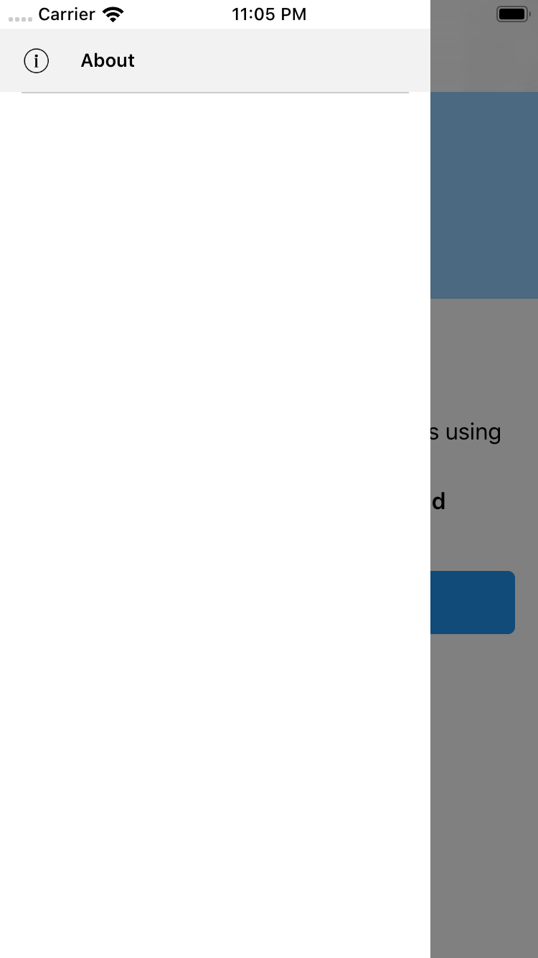
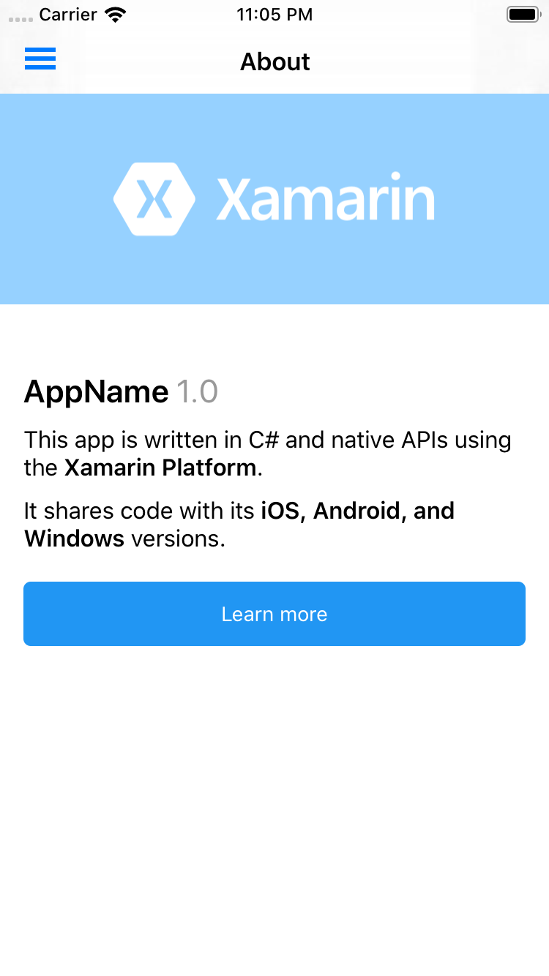
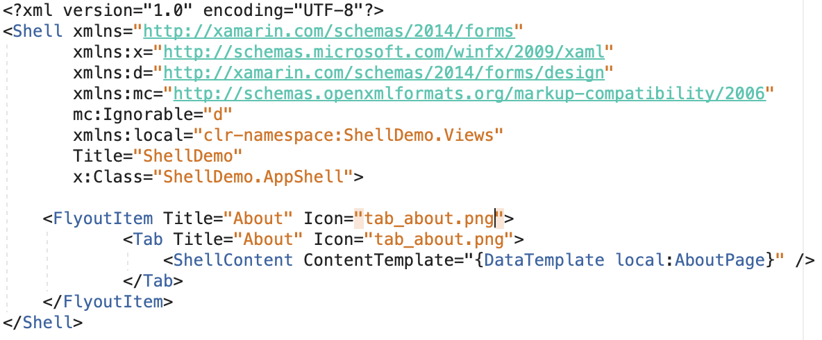

Slide 7
Flyout
The flyout is the root menu for a Shell application, and is accessible through an icon or by swiping from the side of the screen. The flyout consists of an optional header, flyout items, and optional menu items.

Slide 8
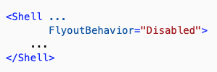
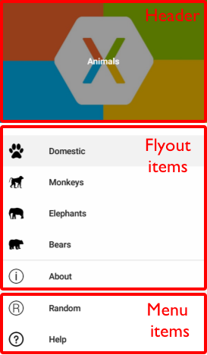


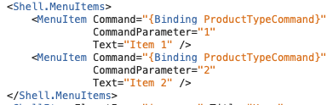
Flyout - Structure
Behavior
Header & HeaderTemplate
Menu items

Slide 9
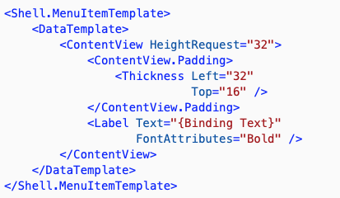
FlyoutHeaderBehavior
CollapseOnScroll
Fixed
Scroll
Custom Menu items Template

Slide 10
Tabs
When the navigation pattern for an application includes a flyout, the next level of navigation in the application is the bottom tab bar. In addition, when the flyout is closed the bottom tab bar can be considered to be the top level of navigation.

Slide 11
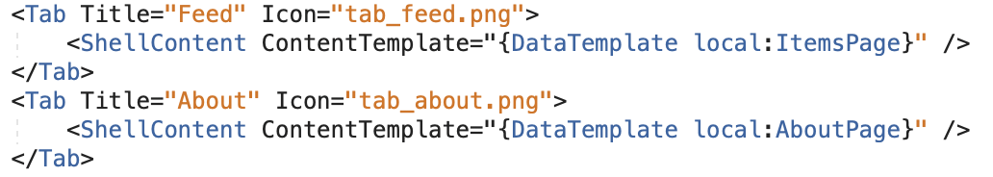
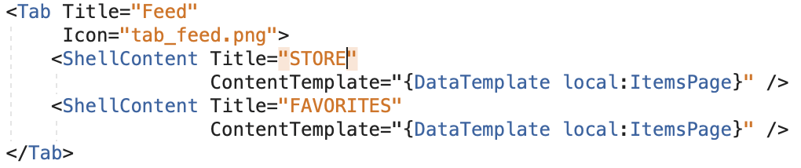


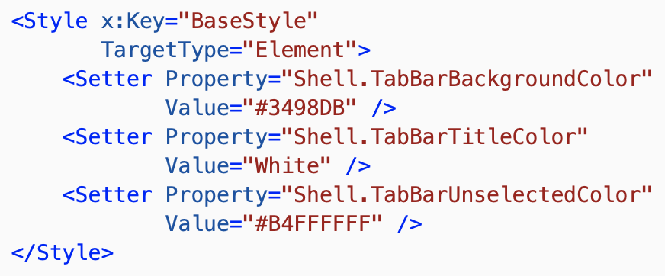
Tabs - Structure
Style

Slide 12
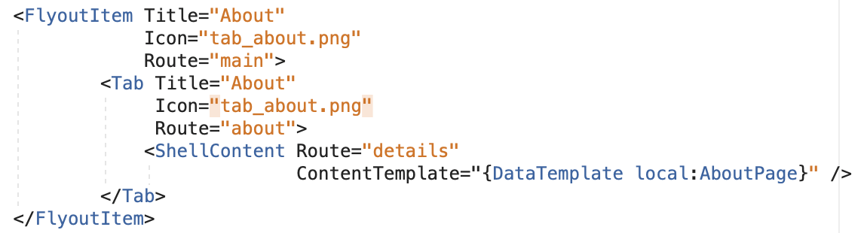
Adding Navigation
1) URI Based Navigation
2) Register your pages:
Routing.RegisterRoute("myawesomepage", typeof(HomePage));
3) Navigate to page and query string params:
Shell.Current.GoToAsync("//main/about/details", true);

Slide 13
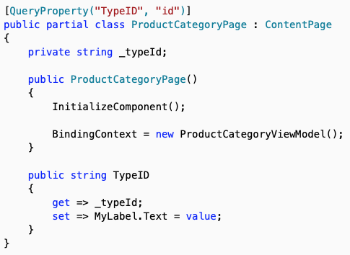
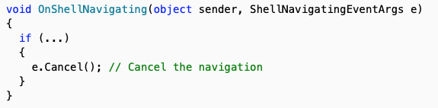

Adding Navigation
4) Intercept Params
5) Handle Navigation Actions:

Slide 14
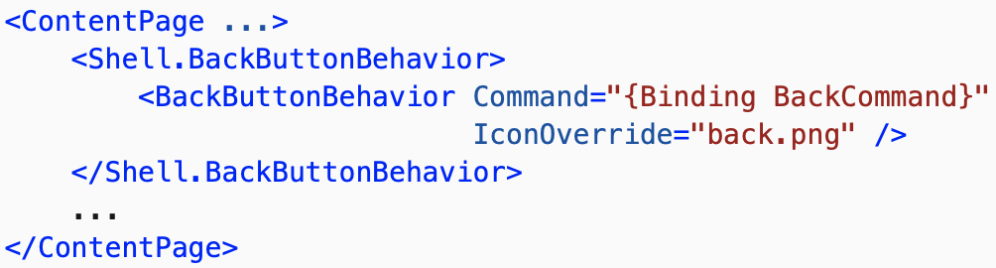
Adding Navigation
6) Back button behavior

Slide 15
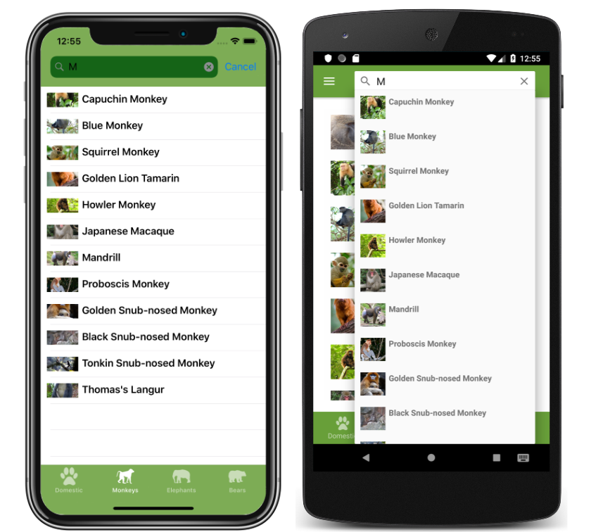
Search Handler
Xamarin.Forms Shell includes integrated search functionality that's provided by the SearchHandler class. Search capability can be added to a page by setting the Shell.SearchHandler attached property to a sub-classed SearchHandler object.

Slide 16
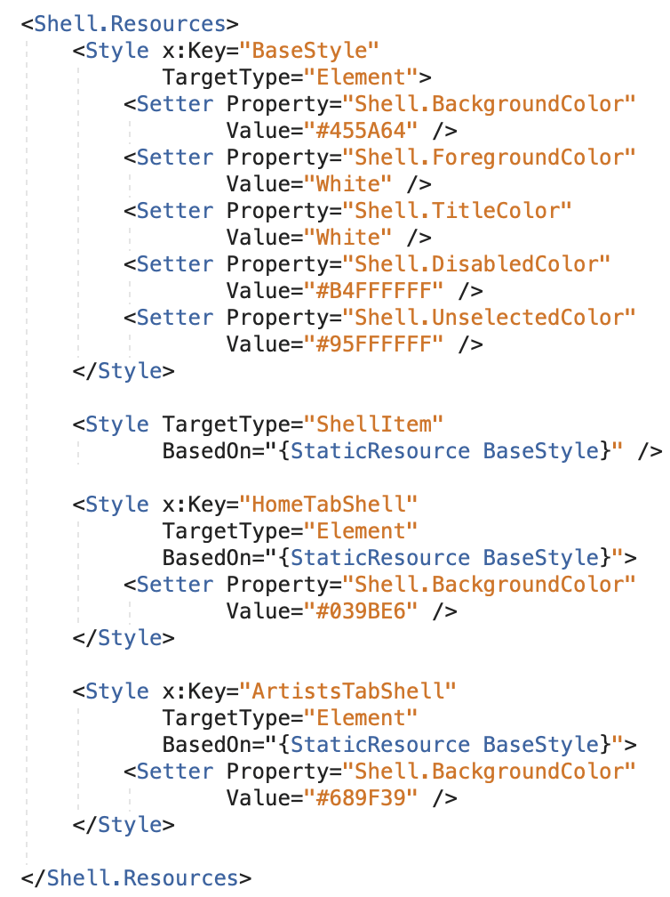
Styling and customization
Using an standard definition shell allows you to use styles across his elements setting up the behavior on the root shell root, flyout item, tab or shellContent level

Slide 17
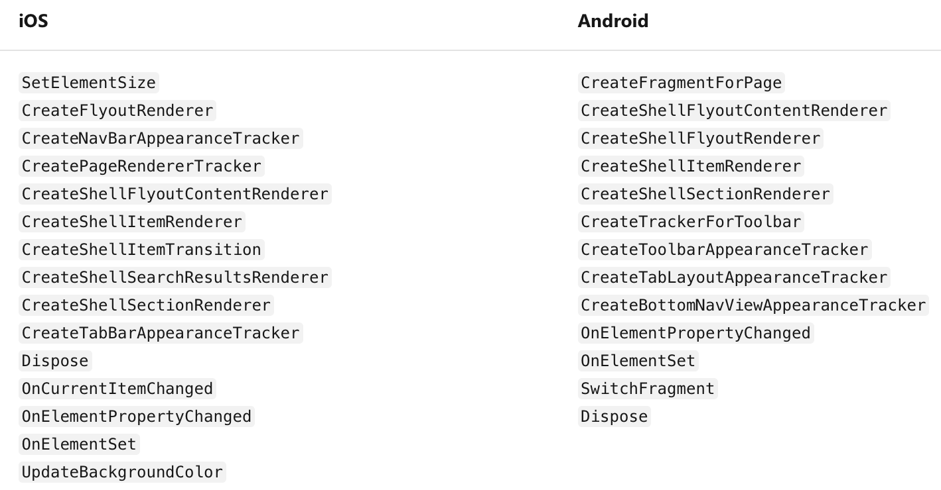
Custom Renderers
In case that you need to extended your shell definition you can create a custom renderer to override or implemented new feature to your shell by using the ShellRenderer class.

Slide 18
Resources
https://devblogs.microsoft.com/xamarin/shell-xamarin-forms-4-0-getting-started/
https://docs.microsoft.com/en-us/xamarin/xamarin-forms/app-fundamentals/shell/

Slide 19
OBRIGADO!
Questions?
Alejandro Ruiz
Microsoft MVP: Developer Technologies
Deep Dive into Xamarin.Forms Shell
DEMO: https://github.com/AlejandroRuiz/XamarinSummitBrasil
https://alejandroruizvarela.blogspot.mx
@alejandroruizva

