Slide 1
Hospital Optimisation Using Emulation
MLMI Group 2

Slide 2
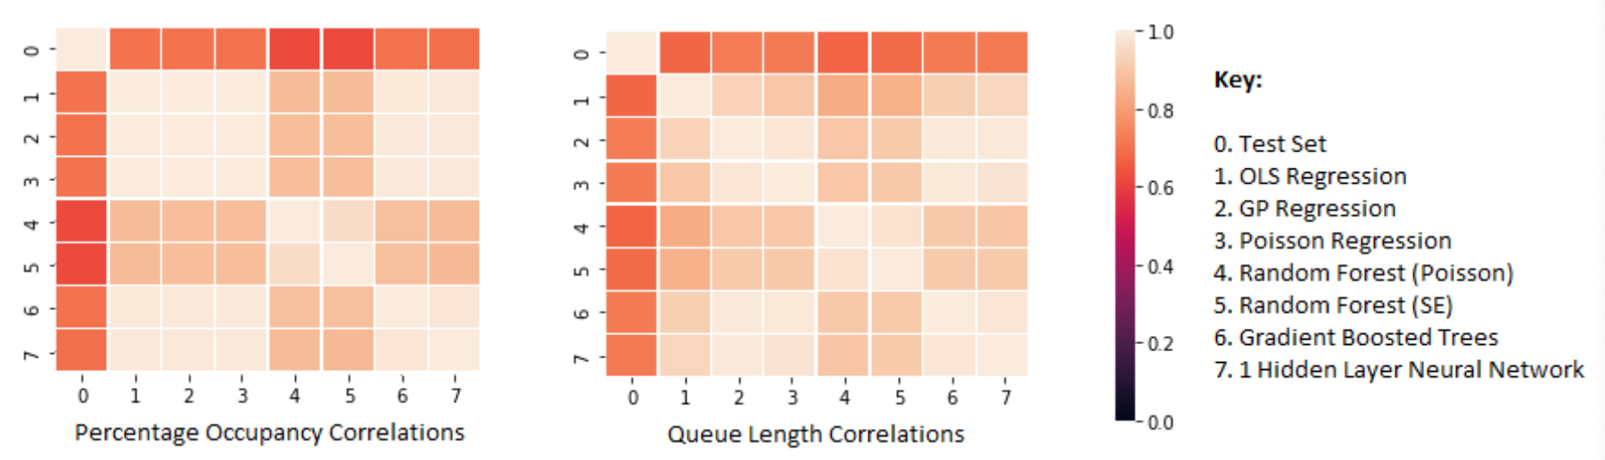
Assessing Performance of Different Models
Ensemble model automatically weighted based on correlations
Condorcet’s Theorem
Occupancy showed a linear trend
Queue Length demonstrated exponential decay

Slide 3
Optimisation
Optimal inputs:
14 beds, 1 resources, and 1 staff
Average daily queue length of 0.874
Average daily percentage occupancy of 52%
Cost with this configuration is $5, 900 per day

Slide 4
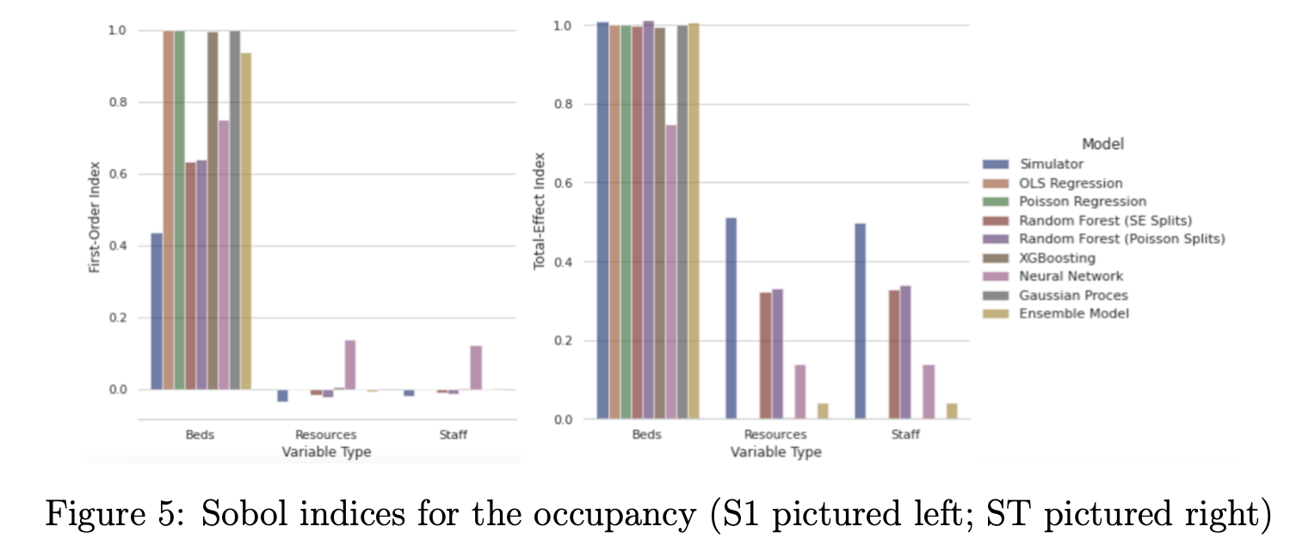
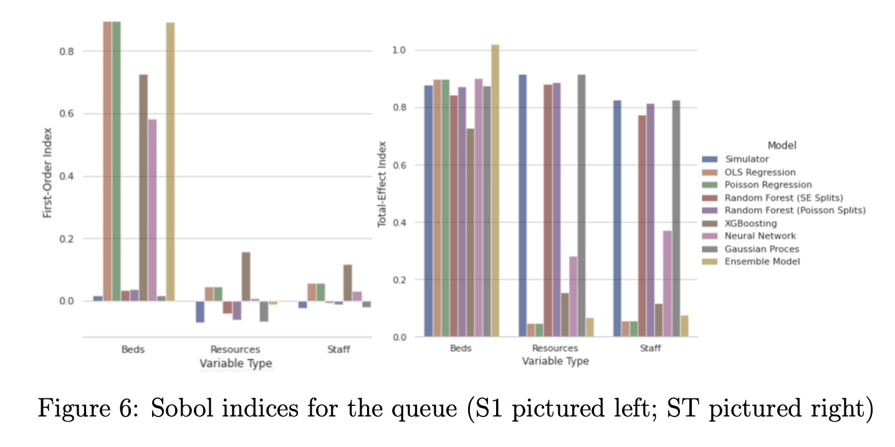
Sensitivity Analysis

