Slide 1
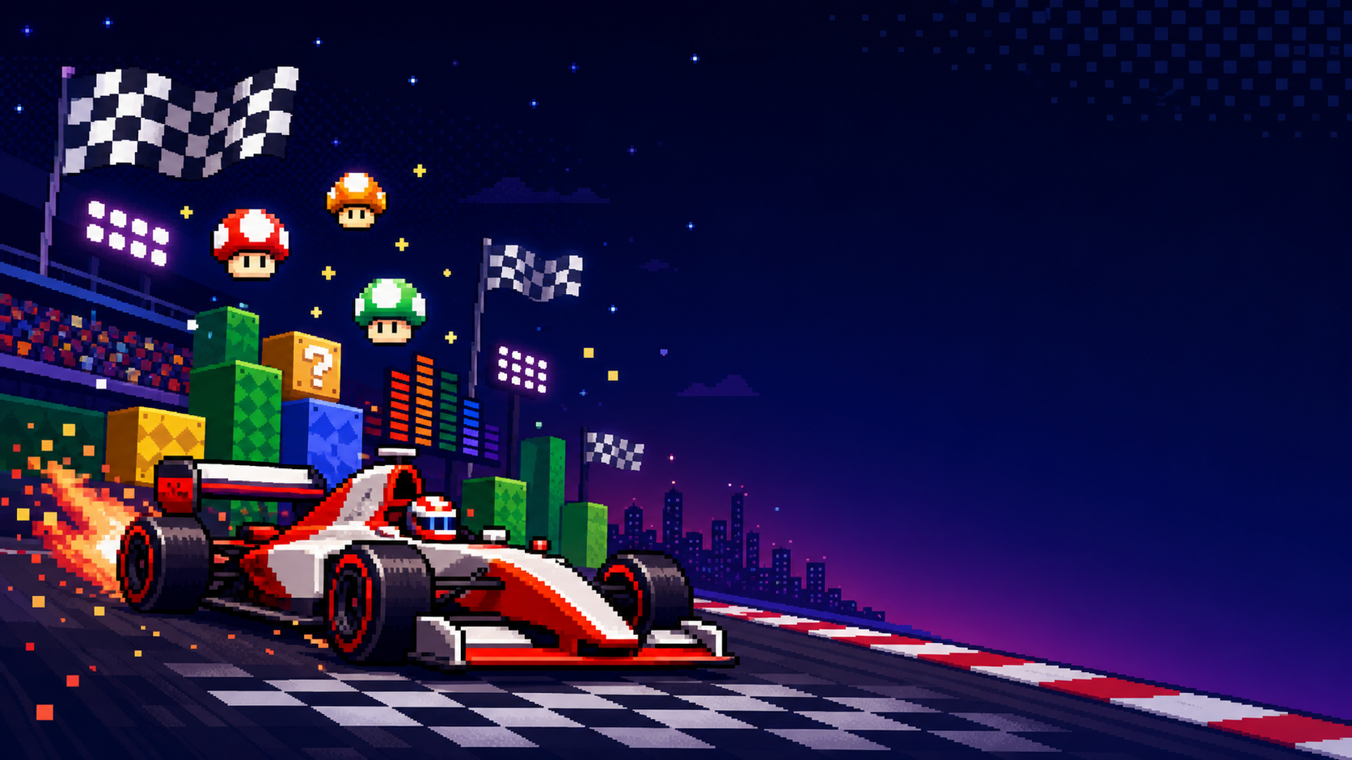
FINAL PROJECT PRESENTATION
FROM DRS TO
MARIO MUSHROOMS
A Formula 1 data visualization story about pace, passing pressure, and race disruption across 2025 and 2026.
Alejandro Gonzalez

Slide 2
Project Goal
LAP 02/11
What the site is trying to answer
Compare Formula 1's opening 2025 and 2026 races to see whether the 2026 regulation era is already visible in the data.
DRS = an F1 speed-boost zone.
The mushroom metaphor helped frame technical race data as a set of power-ups, penalties, and level-by-level comparisons.
Pace and top-speed patterns
Lap-by-lap race movement
Final scope update: Miami was added after the 2026 Miami GP.
Incidents, DNFs, safety cars, and VSCs
Circuit differences across Australia, China, Japan, and Miami

Slide 3
Project Objectives
LAP 03/11
Pulled from the proposal, updated for the final site
OBJ 1
OBJ 2
Measure pace and top-speed change
Evaluate race dynamics
Compare same-circuit 2025 vs 2026 lap-time and speed-trap summaries.
Use lap-by-lap positions and position-change proxy as passing-pressure evidence.
OBJ 3
OBJ 4
Compare race disruption
Show circuit variation
Track DNFs, incidents, safety cars, and virtual safety cars by race lap.
Prevent one-race overgeneralization with a circuit-level scorecard.

Slide 4
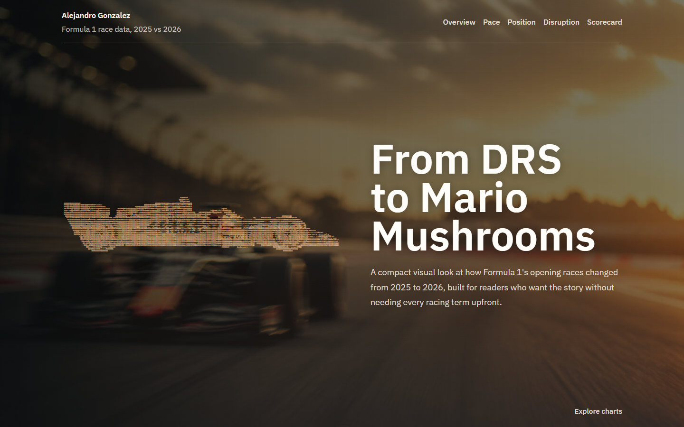
Demo Link
LAP 04/11
What to share on EdStem before presenting
Website
https://alejandrospot2.github.io/F1/
Post this link before the live walkthrough.
Use the live site for interaction, hover tooltips, and chart transitions.
Slides explain why each chart exists.
Final site hero and navigation.

Slide 5
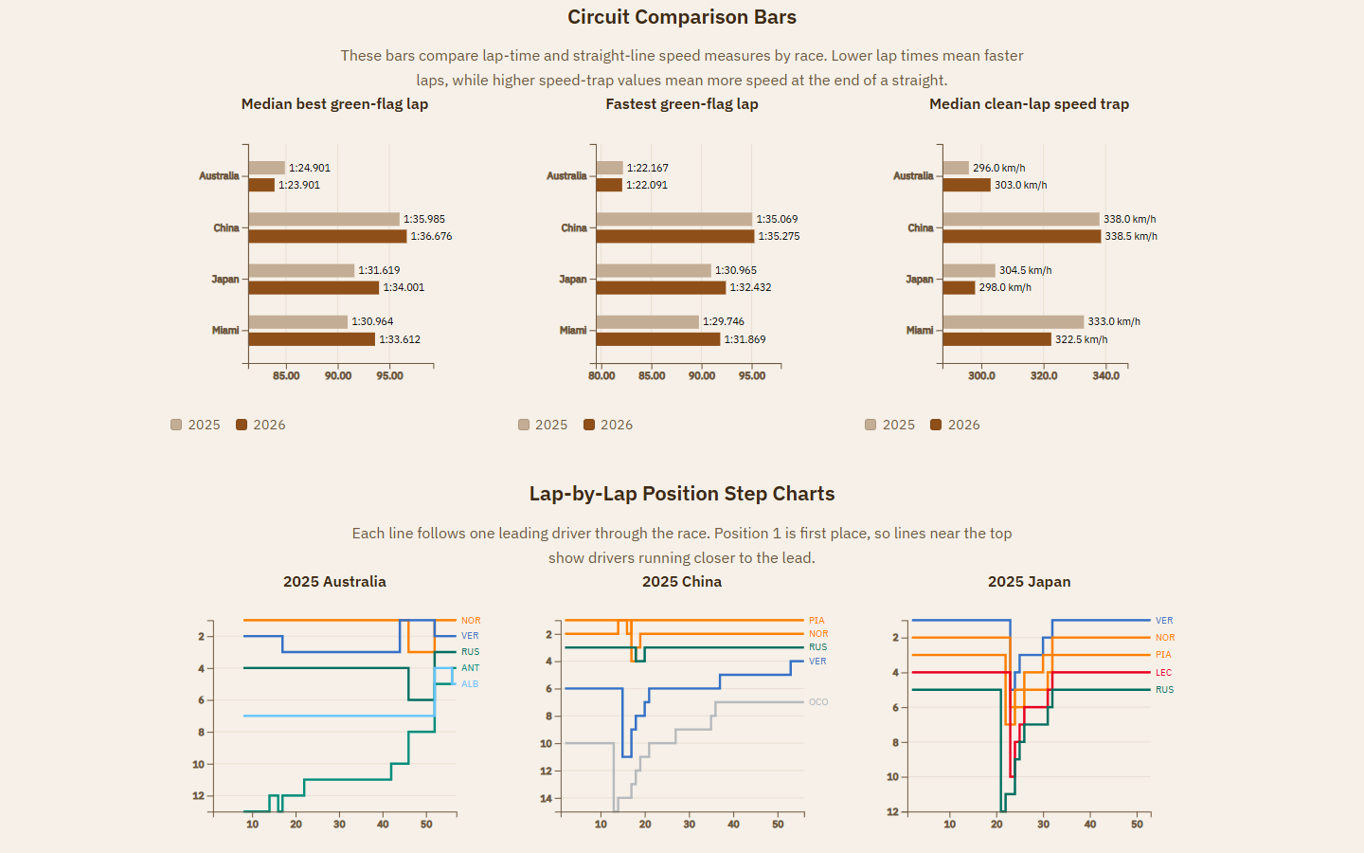
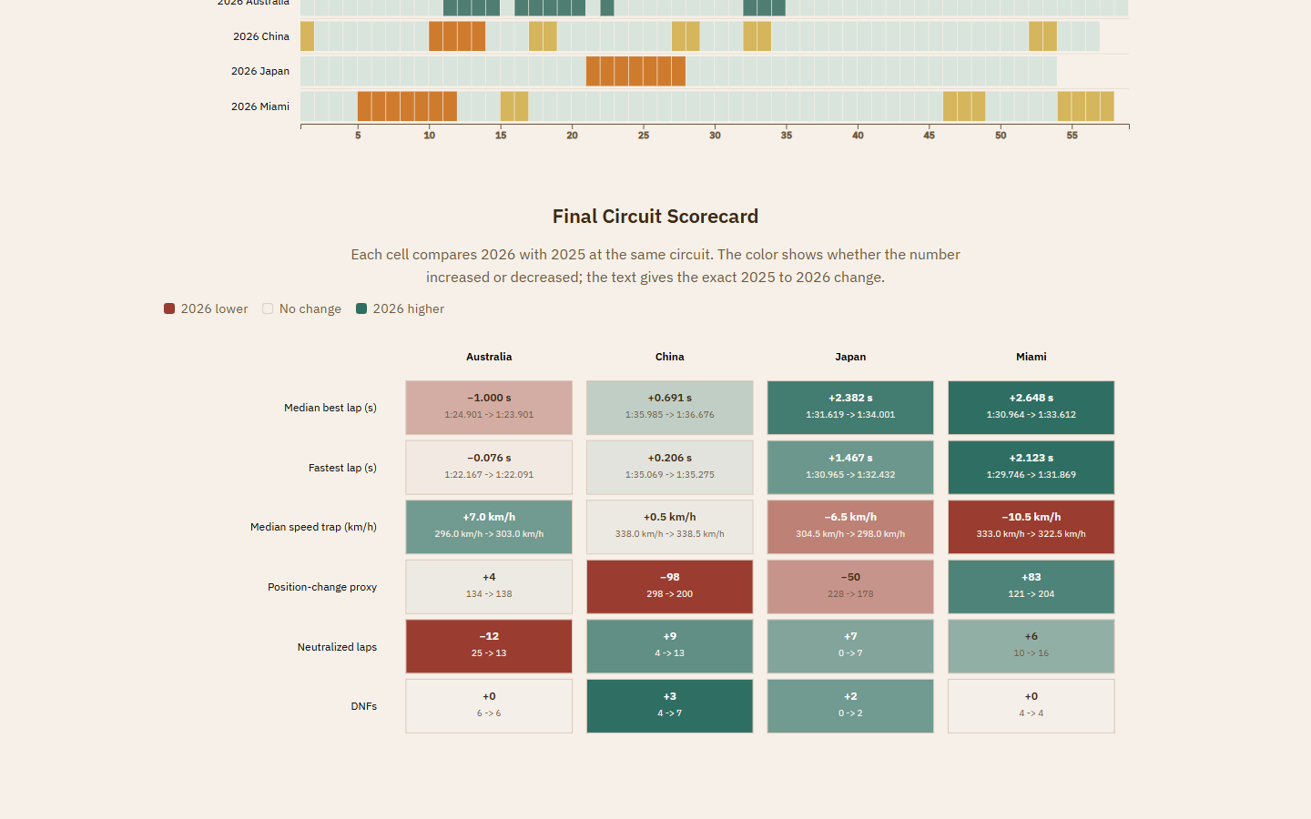
Demo and Results
LAP 05/11
How each visualization maps back to an objective
VISUALIZATION
OBJECTIVE
RESULT ROLE
Circuit comparison bars
Objective 1
Pace and speed deltas
Lap-by-lap position charts
Objective 2
Race order changes over time
Position-change slope graph
Objective 2
Movement proxy for overtaking intensity
Horizontal comparison bars plus first position charts.
Incident timeline heatmap
Objective 3
DNFs, safety cars, VSCs, yellow flags
Final circuit scorecard
Objective 4
Cross-circuit synthesis
Final scorecard with color legend.

Slide 6
Measuring Success
LAP 06/11
The score was objective completion, not a single vanity metric
DATA
CHARTS
READABILITY
STABILITY
8 race payloads
5 must-have views
Lower F1 barrier
Verified demo path
2025 and 2026 Australia, China, Japan, and Miami from FastF1-derived files.
Every required visualization has a clear objective mapping.
Short chart descriptions, legends, tooltips, labels, and d3 number formatting.
Browser checks and a public GitHub Pages target for the live walkthrough.

Slide 7
New Updates Since Beta
LAP 07/11
Feedback incorporated into the final release
Added simple color legends and hover tooltips across the visualizations.
Fixed incident and neutralization status colors so everything is not a yellow flag.
Changed the first comparison bars to horizontal bars for easier scanning.
Added the final chart color legend.
Used d3 formatting to reduce distracting decimals.
Replaced the position-change bar chart with a slope graph.
Added newcomer-friendly descriptions before each chart, plus 2025/2026 Miami data.
Fixed low-contrast Mercedes line colors.

Slide 8
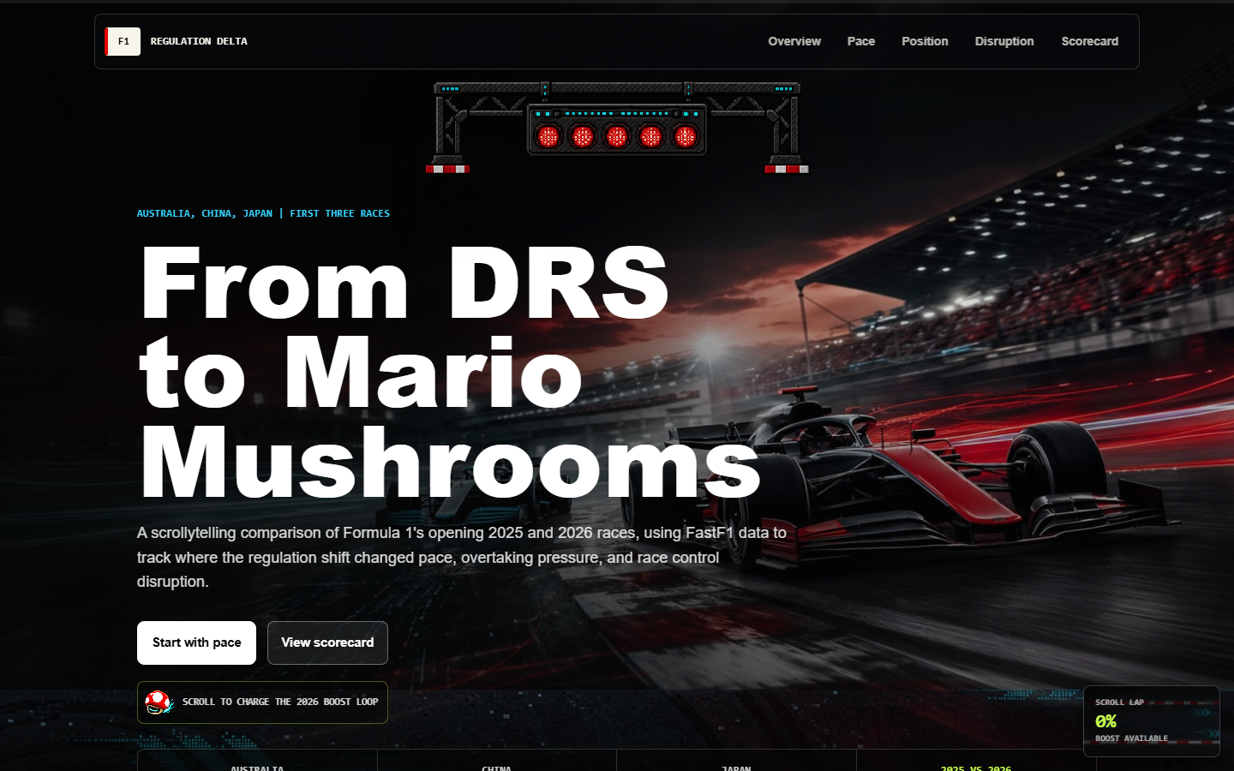
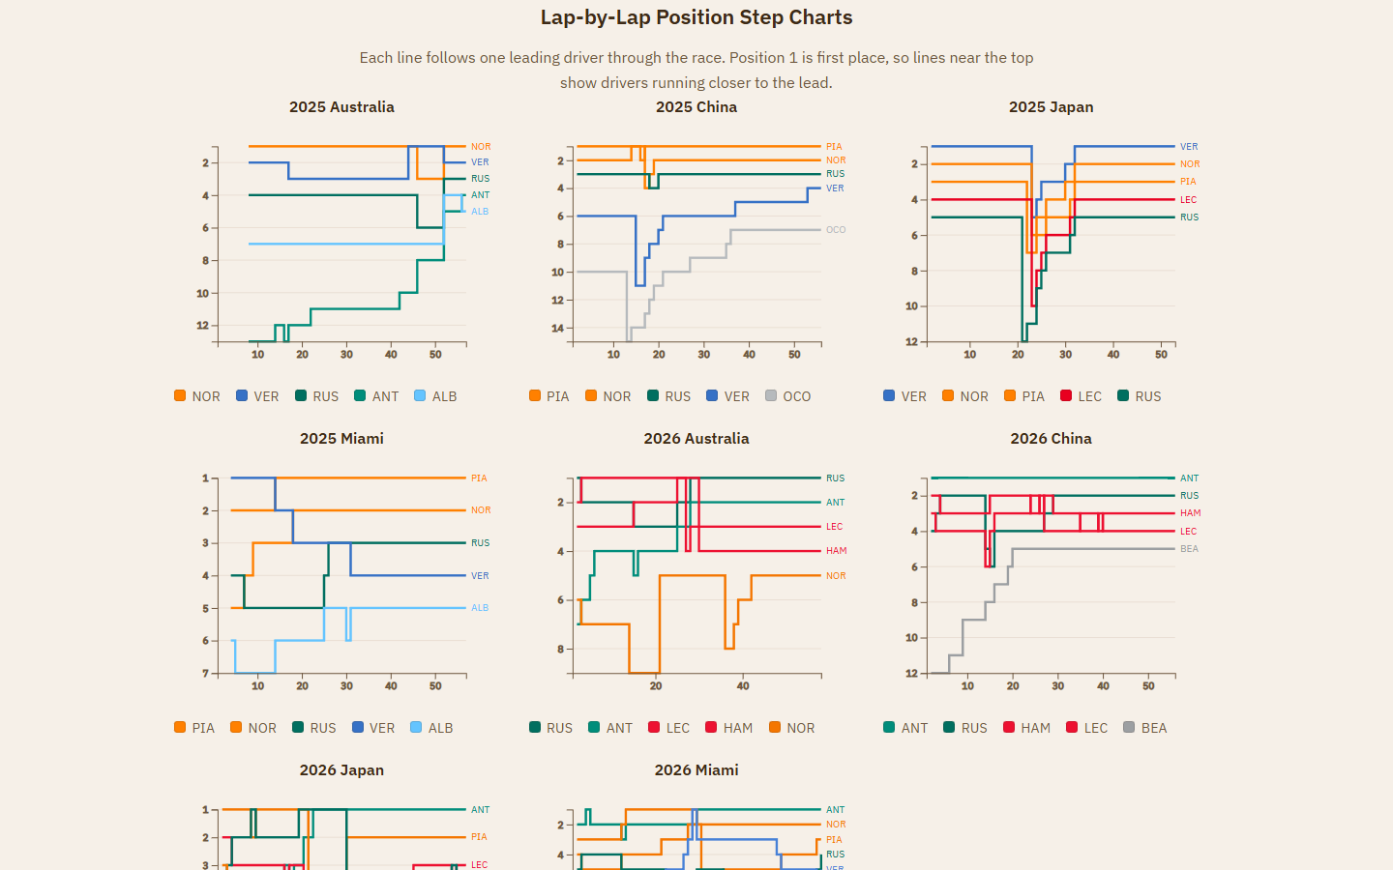
Approaches Tried
LAP 08/11
What worked, and what created too much complexity
Animation-heavy arcade/scrollytelling experiment.
Final guided D3 layout: less flashy, more dependable.
The arcade branch had stronger motion and personality, but it added a new layer of frontend complexity. For a data visualization class, the final version keeps the style while protecting chart readability and demo stability.

Slide 9
Discussion
LAP 09/11
Is the approach promising?
Yes. A guided comparison is promising because the question is not just 'who won?' but 'what changed?'
Better variant later:
A more scrollytelling-transition-focused version could work once the data pipeline and charts are fully stable.
Same circuits make the season comparison fairer.
Data clarity
9/10
Multiple chart types separate pace, movement, and disruption.
The final scorecard prevents overclaiming from one race.
Arcade motion
5/10
Future scrollytelling potential
8/10

Slide 10
Problems and Reflection
LAP 10/11
What I would do differently starting again
Problems I ran into
Starting again, I would
FastF1 and race-control data needed extra validation.
Collect visual inspiration earlier to guide the layout.
Track-status colors initially collapsed too many incidents into yellow flags.
Lock the visual language before polishing every chart.
Build validation checks for incidents, statuses, and missing race data sooner.
F1-specific terms made the site harder for non-fans.
The animation-heavy version broke too much for the payoff.
Prototype motion separately before integrating it into the main site.

Slide 11
Future Work
LAP 11/11
Features I would add with more time
Scrollytelling transitions that move one chart through the race story.
More F1 and retro-game visual references without hiding the data.
Lap replay controls for position changes and neutralization periods.
Driver and team filters for deeper exploration.
More races, more seasons, and qualifying/sprint context.
Mobile polish and accessibility checks for all tooltips and legends.
Next version:
A race-story mode where the viewer scrolls from lights out to checkered flag.
https://alejandrospot2.github.io/F1/

