Slide 1
c₁
c₂
c₀

Slide 2

$$V_{∞}$$
s/2

Slide 3
Wing box skin
y
x
z
Lattice ligament
Lattice node

Slide 4
Wing box skin
y
ϑ
x
z
Lattice ligament
Lattice node

Slide 5
Wing box skin
y
u
ϑ
x
z
Lattice ligament
Lattice node

Slide 6
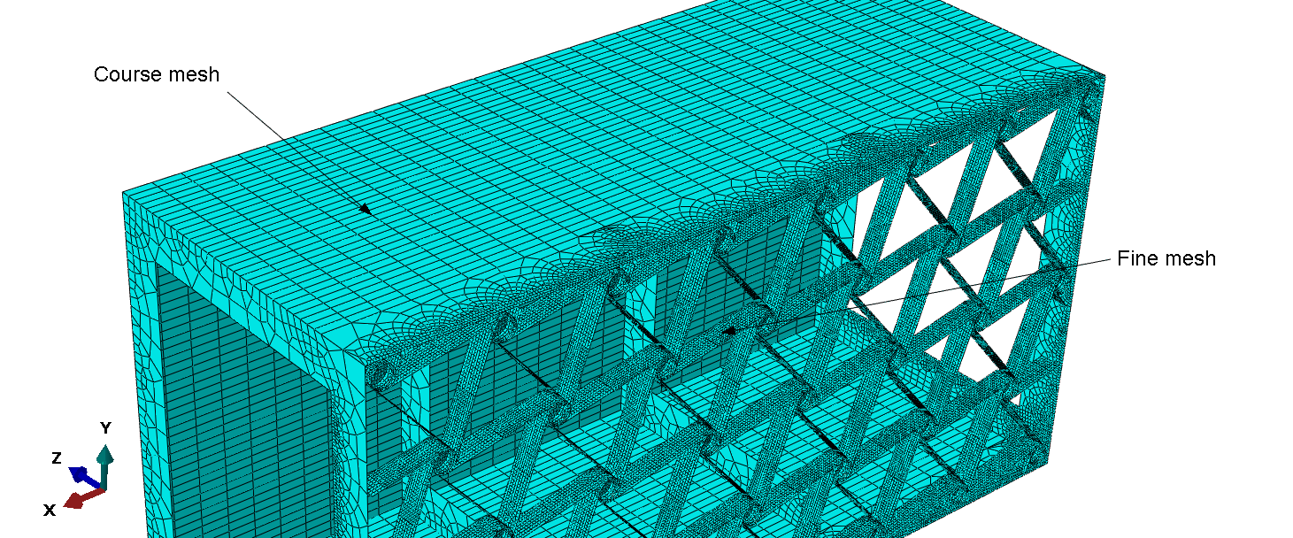
Course mesh
Fine mesh

Slide 7
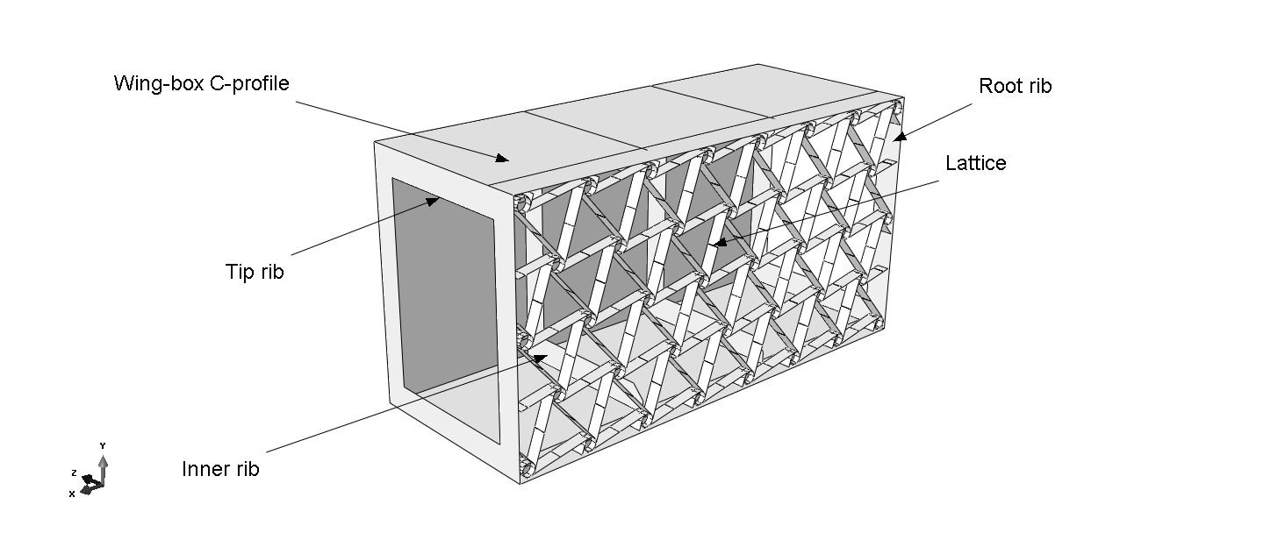
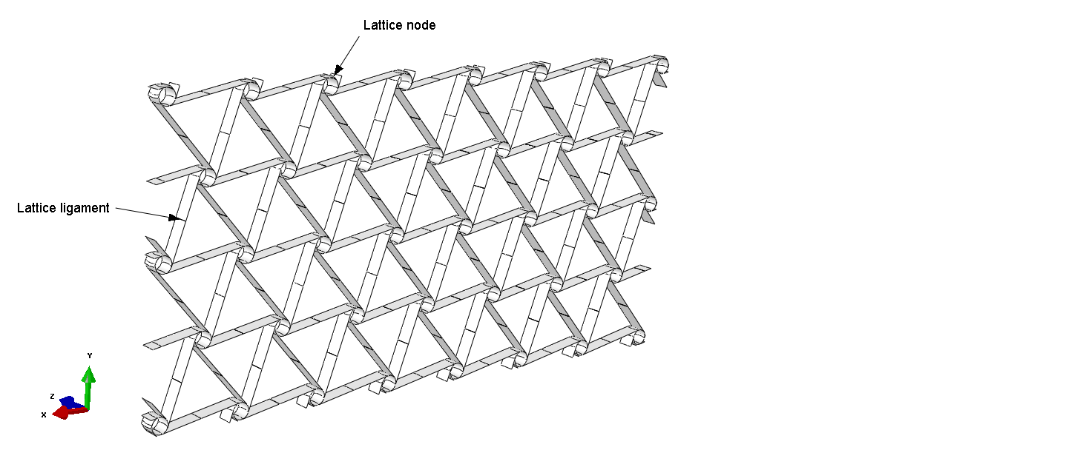
Wing-box C-profile
Root rib
Lattice
Tip rib
Inner rib

Slide 8
Lattice node
M
Lattice ligament
N

Slide 9
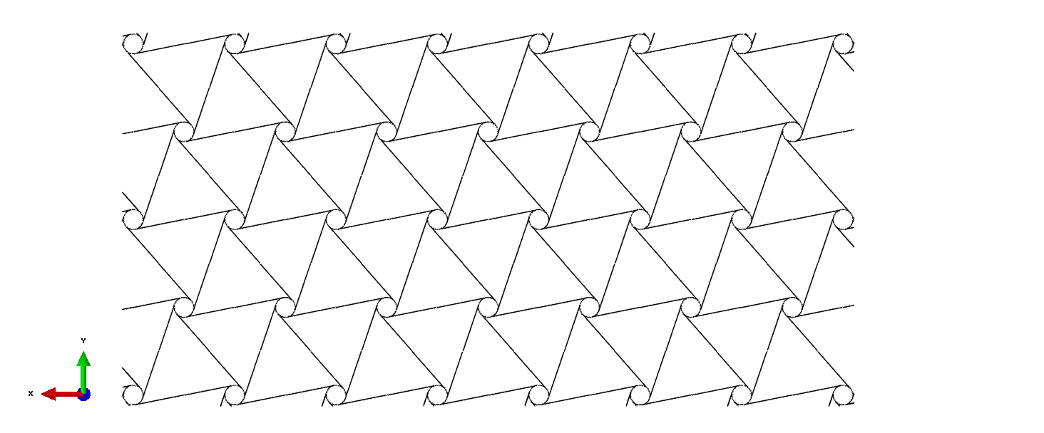

Slide 10
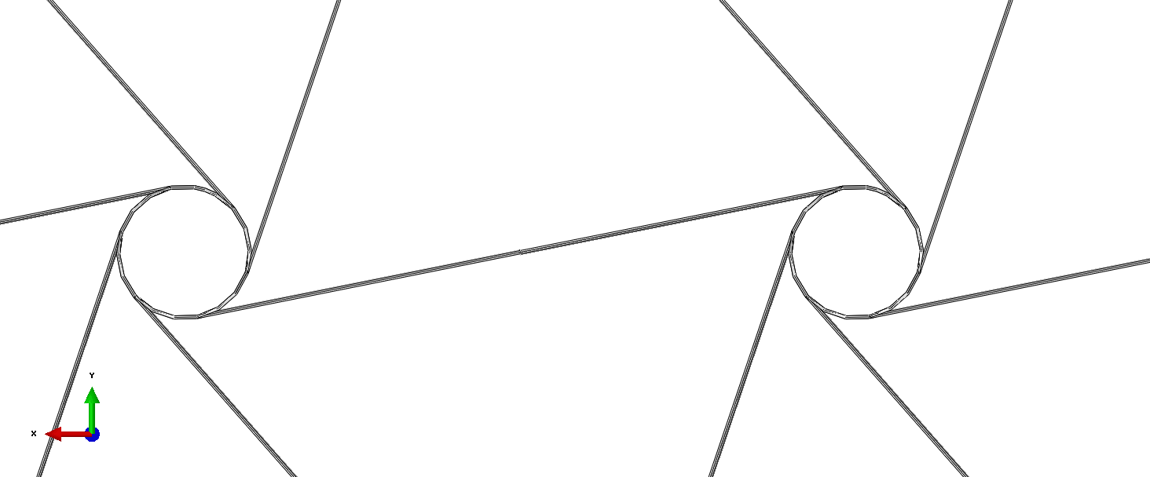
A
r
B
A
B
L
e
t
R
Cut view B-B
B
Cut view A-A

Slide 11
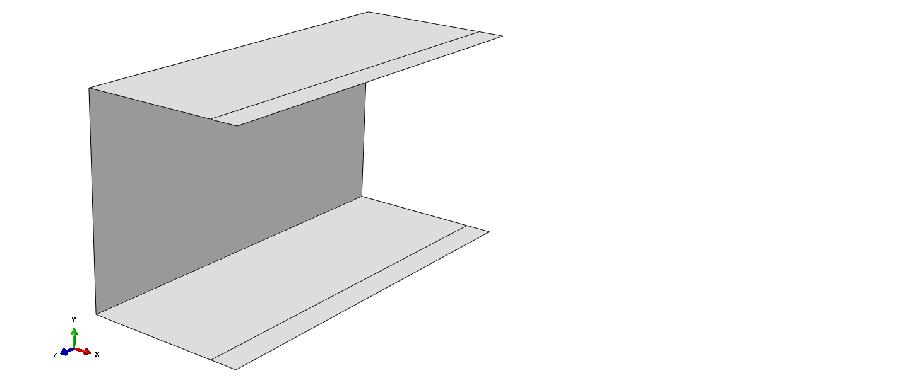

Slide 12
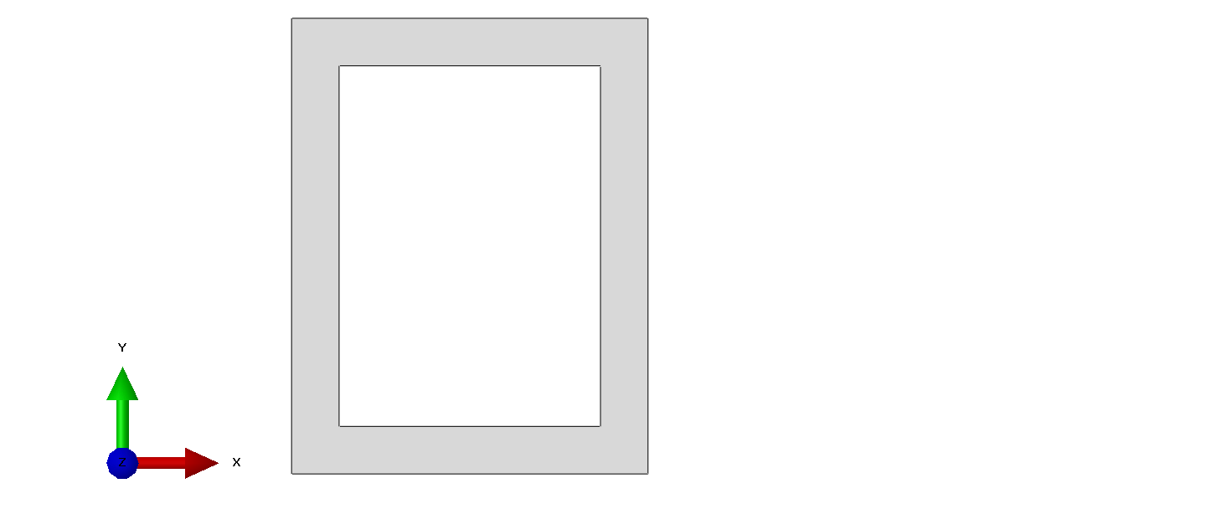
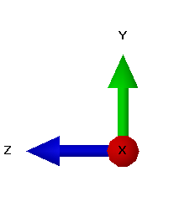
H
t
W
L

Slide 13
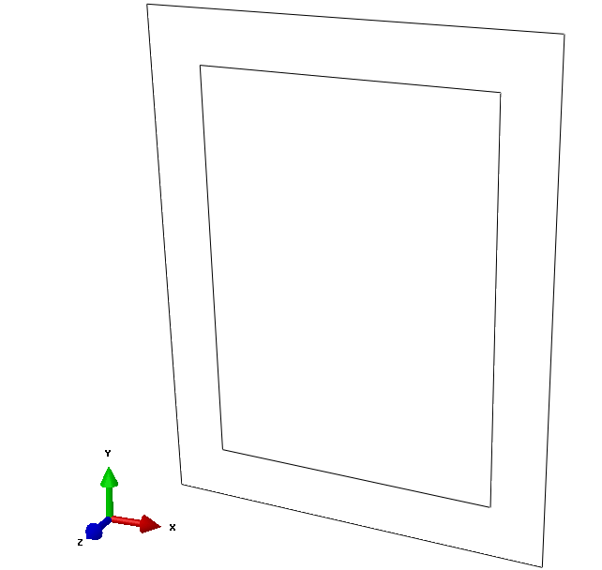

Slide 14
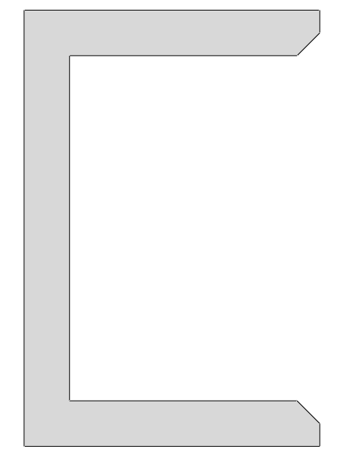
A
A
A/2
45°
H
H
W_{closed}
W_{open}

Slide 15
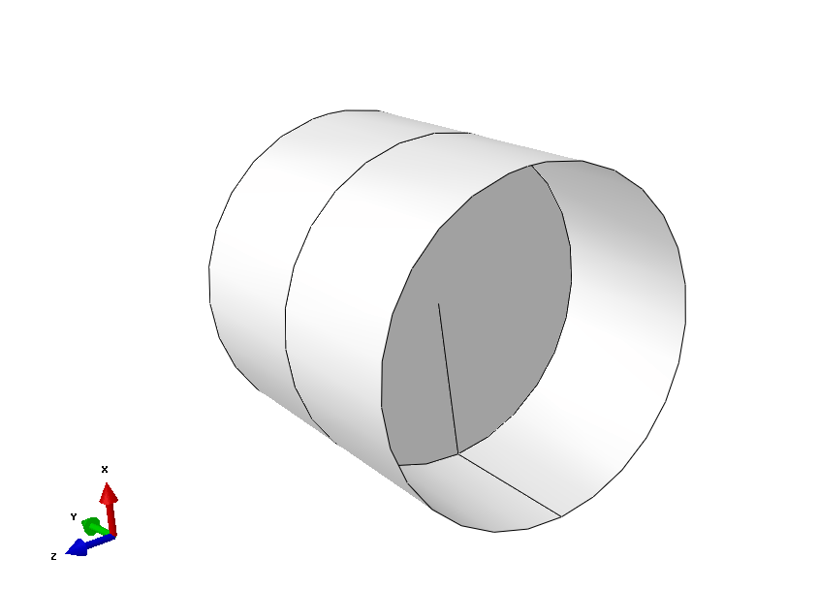

Slide 16
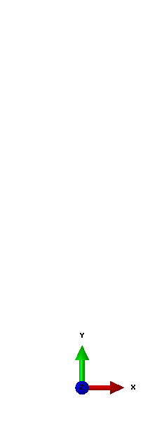
t
B
Ø r

Slide 17
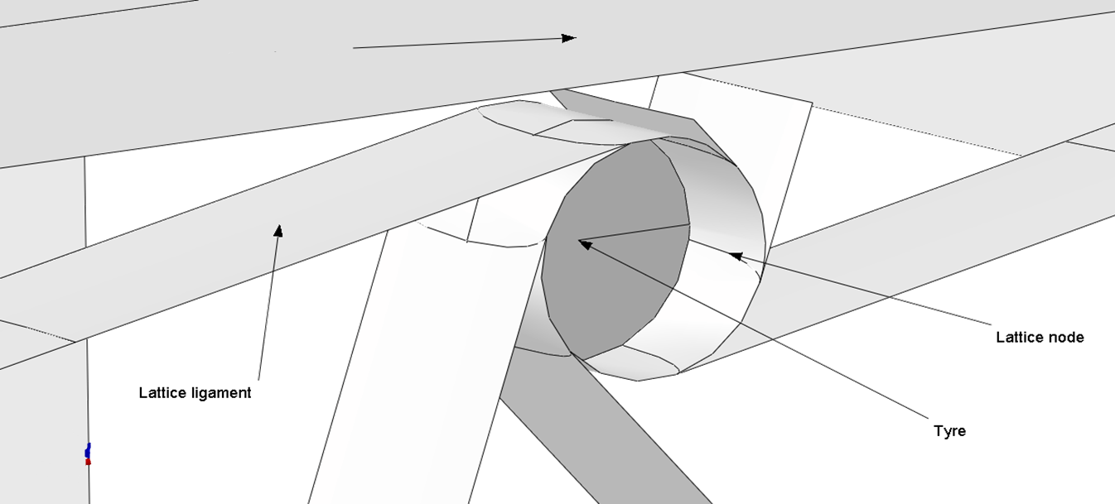
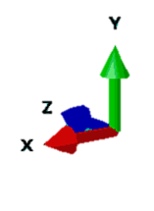
Wing-box C-profile
Lattice node
Lattice ligament
Tyre

Slide 18
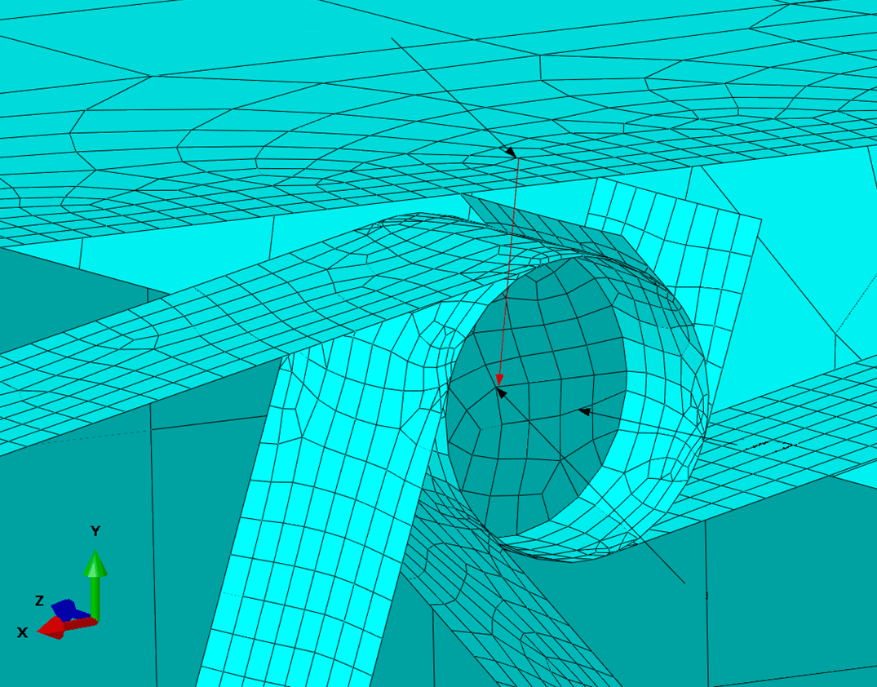
Master node on wing-box skin
Tyre part
Slave node on tyre

Slide 19
Wing box skin
r
θ
y
z
x
z
Lattice ligament
Lattice node

Slide 20
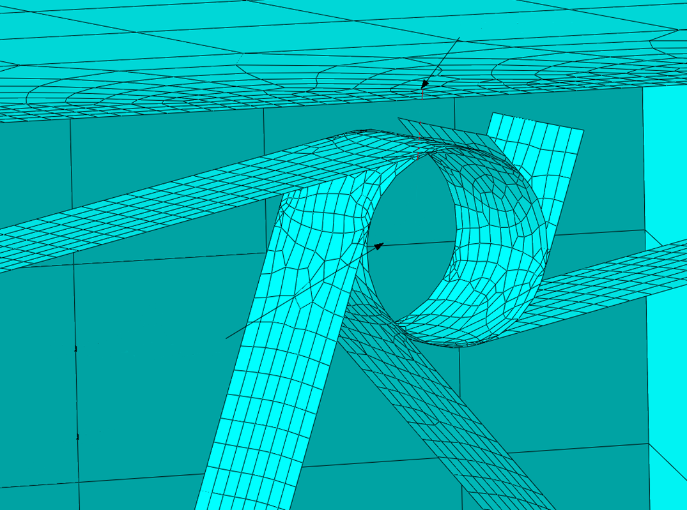
Master node on wing-box skin
θ
z
r
Local cylindrical reference system

Slide 21
Parametric study python main script
-> mainAbaqusParametricStudy.py
Abaqus execution python script
-> mainBuildAndExecuteWingBox.py
Start
Read parameters ranges
Start
Write parametric study definition to .txt file
Read model parameters from .txt file
for all cases
Build model
If mesh problems -> Modify mesh
Write Abaqus input to .txt file
Submit job
If convergency problems -> Modify damping
Execute nonlinear Abaqus simulation
Simulation converged?
Evaluate problems
No
Move input to postProc folder
Execute nonlinear Abaqus simulation
Yes
Run post-processing
Move input to postProc folder
Move output files to postProc folder
Write output files
End

