Slide 1
Wing box skin
y
UR₃
x
z
Lattice ligament
Lattice node

Slide 2
Wing box skin
y
U₁
UR₃
x
z
Lattice ligament
Lattice node

Slide 3
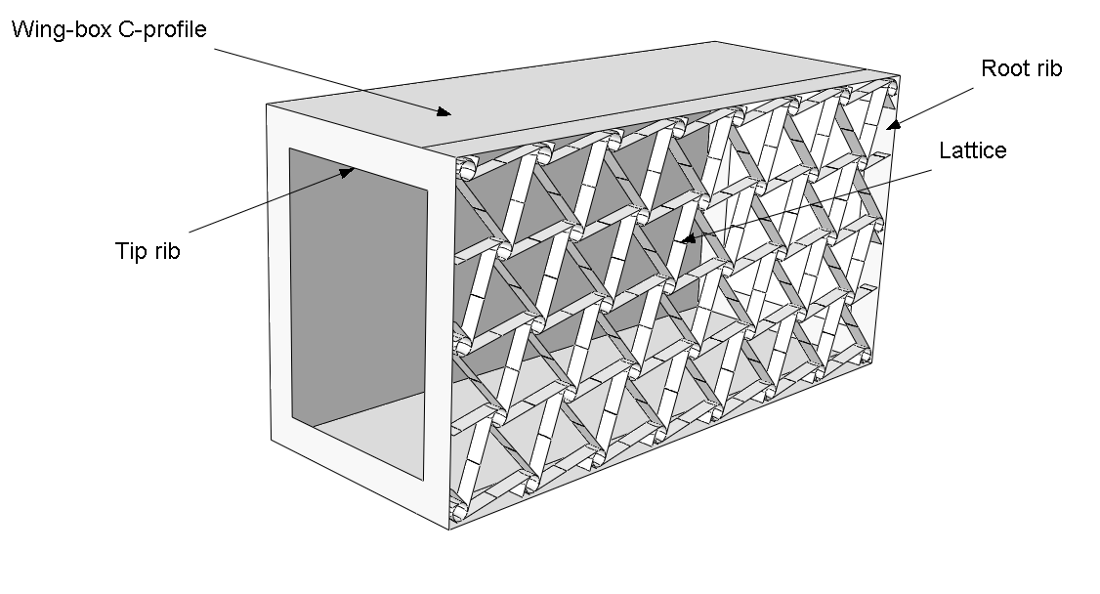
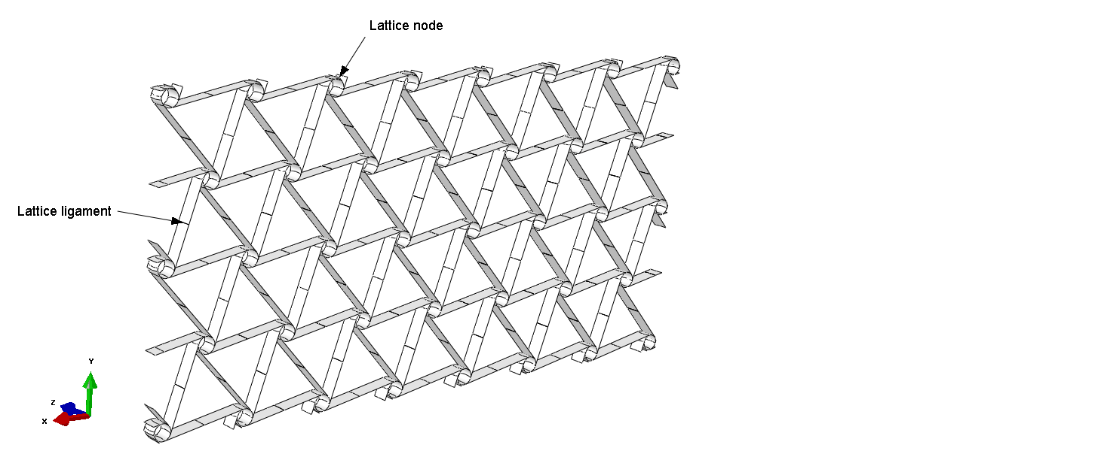

Slide 4
M
N

Slide 5
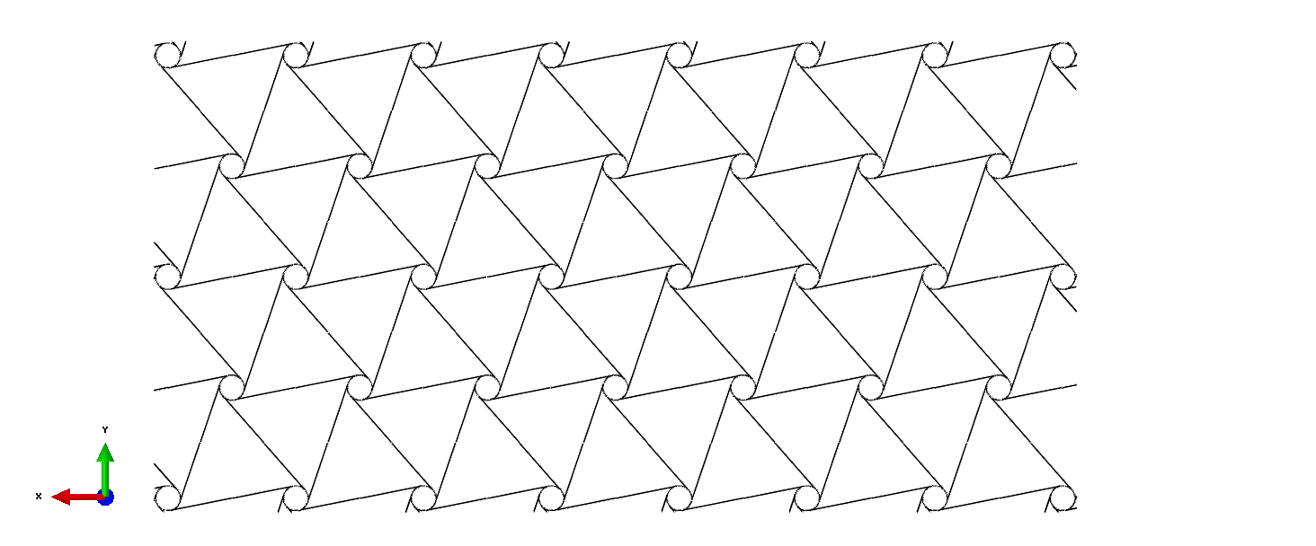

Slide 6
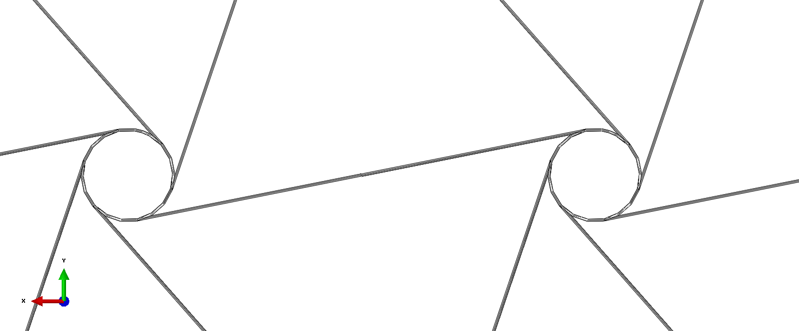
A
r
A
L
e
t
B
Cut view A-A

Slide 7
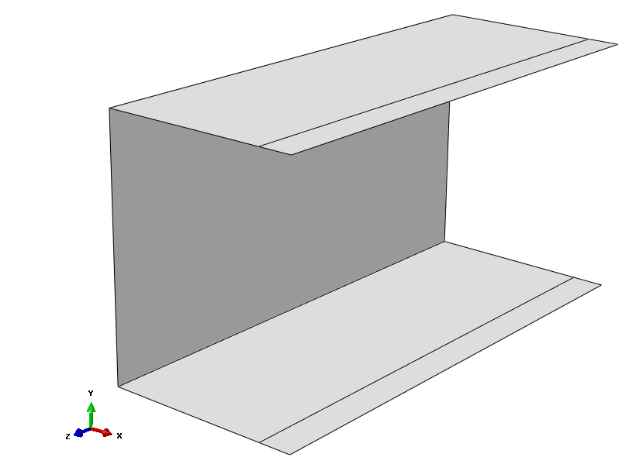

Slide 8
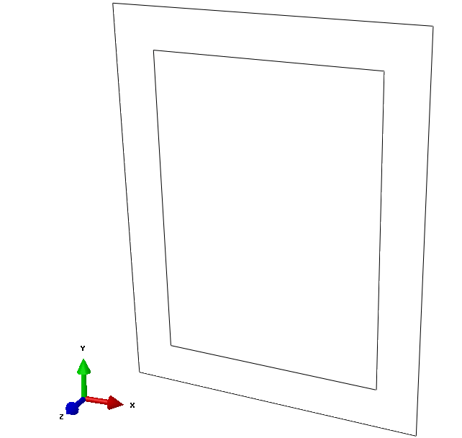

Slide 9
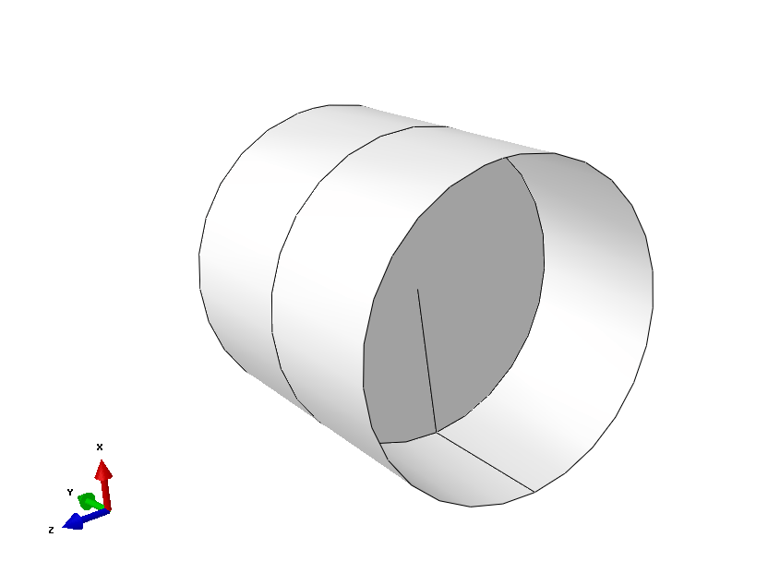

Slide 10
