Slide 1
Wing box skin
y
x
z
Lattice ligament
Lattice node

Slide 2
Wing box skin
y
UR₃
x
z
Lattice ligament
Lattice node

Slide 3
Wing box skin
y
U₁
UR₃
x
z
Lattice ligament
Lattice node

Slide 4
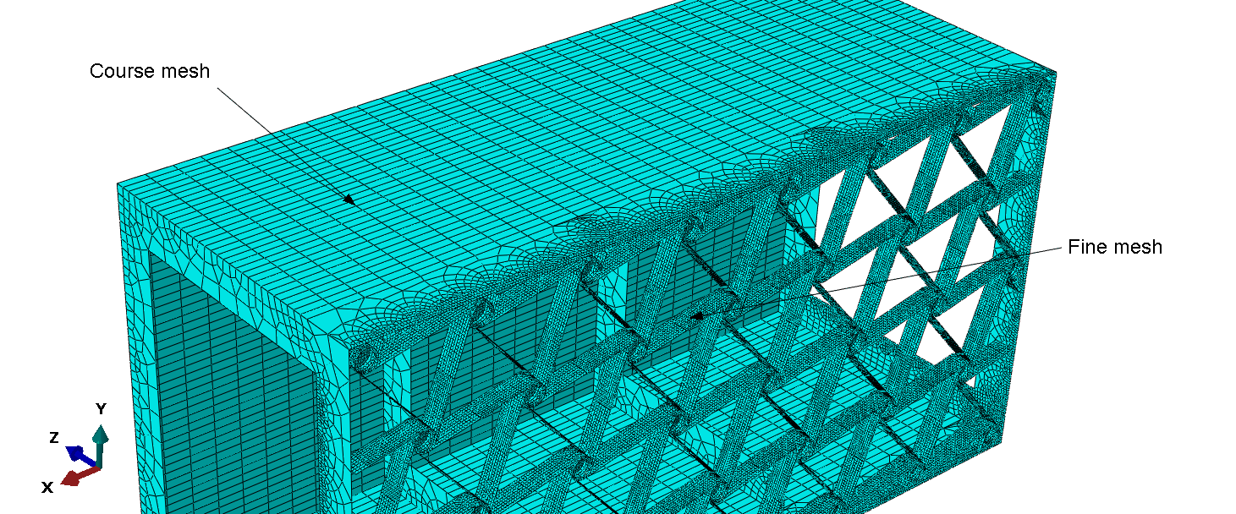

Slide 5
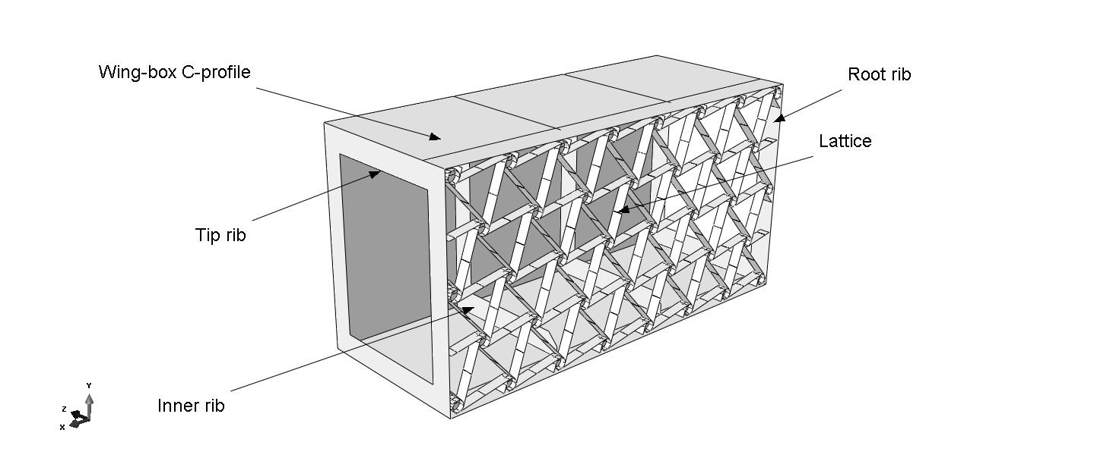
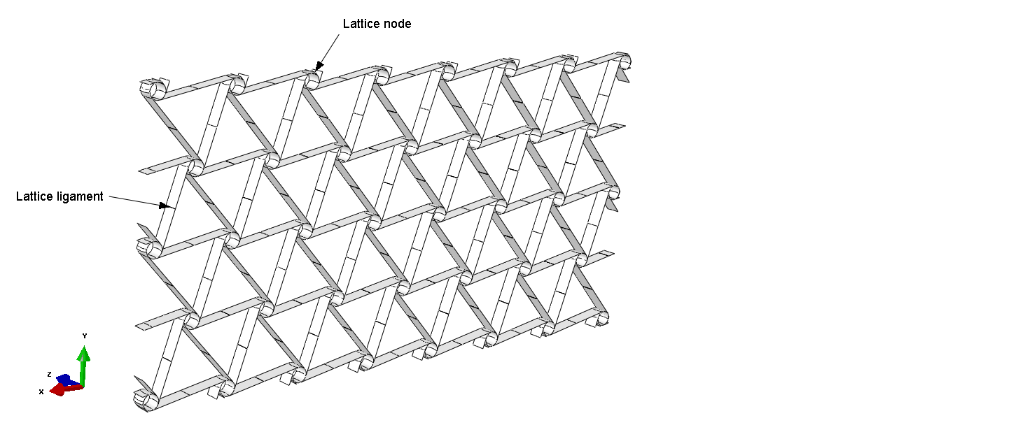

Slide 6
M
N

Slide 7
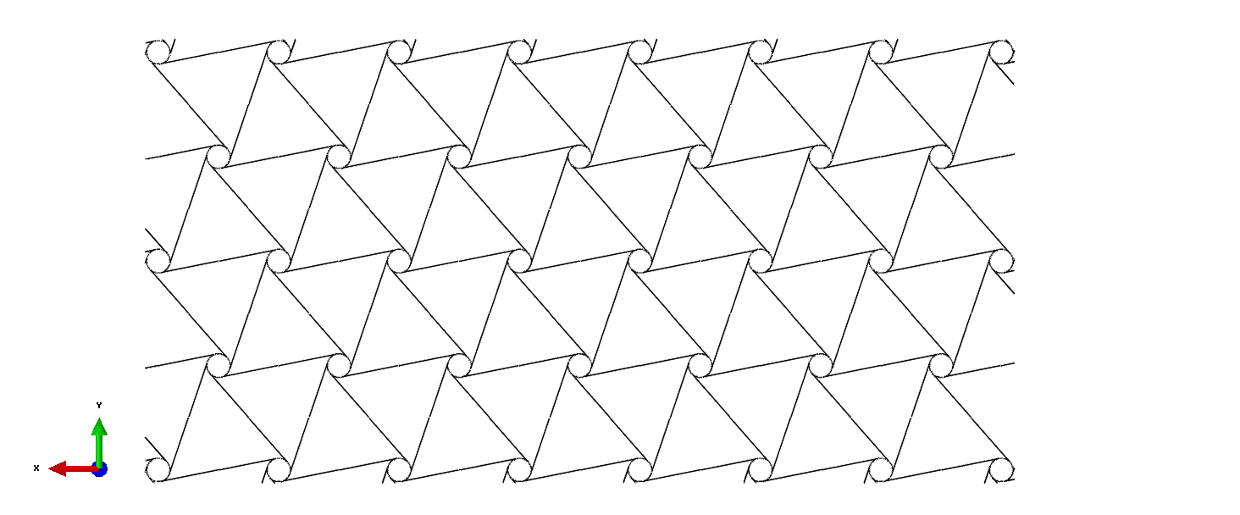

Slide 8
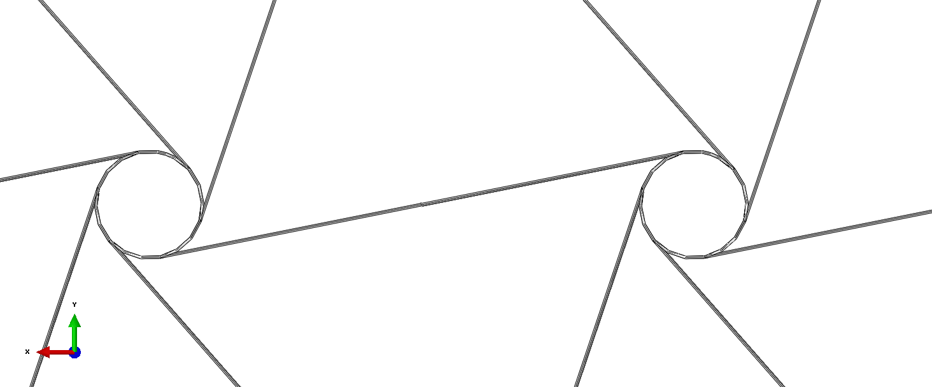
A
r
B
A
B
L
e
t
R
Cut view B-B
B
Cut view A-A

Slide 9
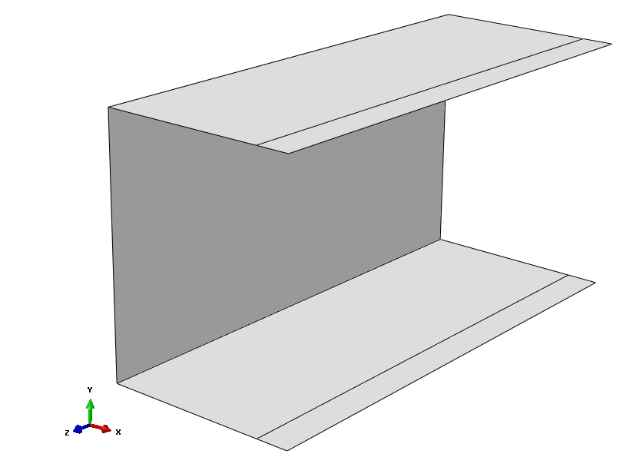

Slide 10
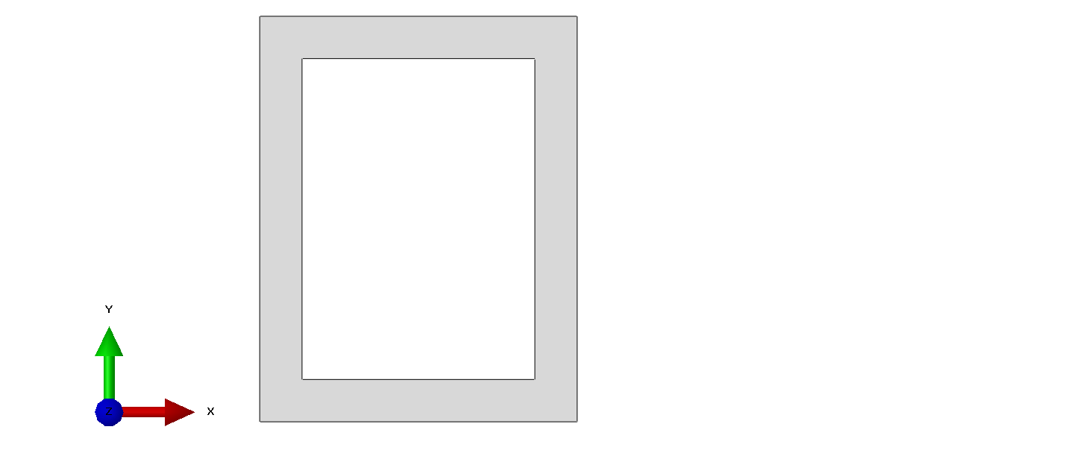
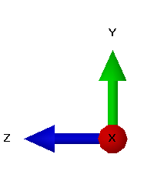
H
t
W
L

Slide 11
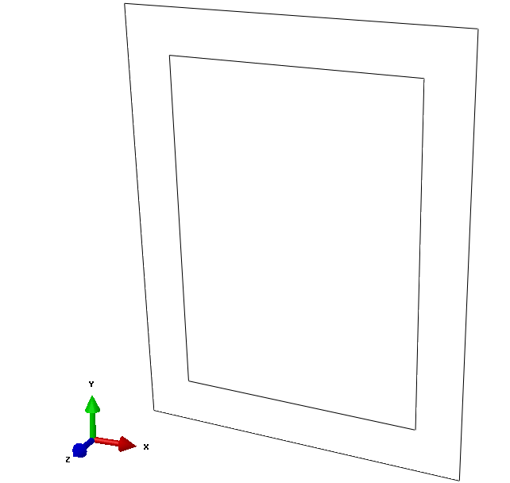

Slide 12
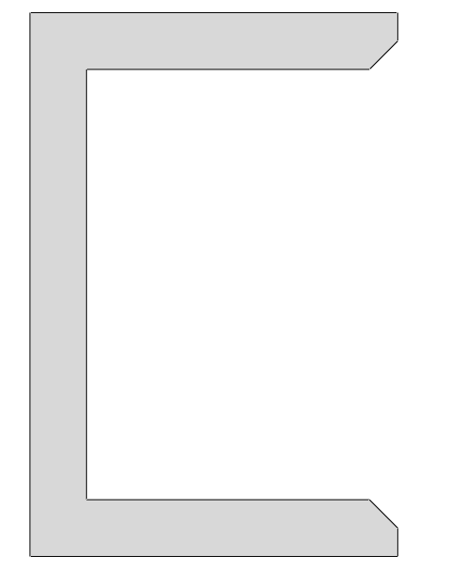
A
A
45°
H
H
W_{closed}
W_{open}

Slide 13
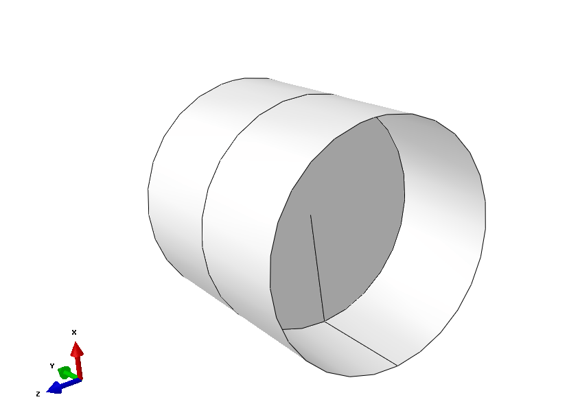

Slide 14
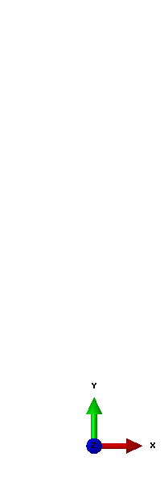
t
B
Ø r

Slide 15
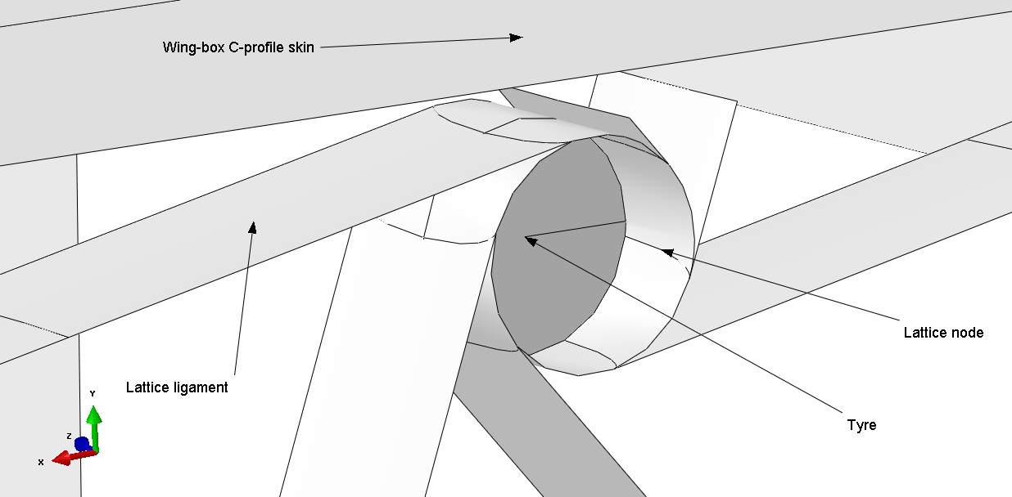

Slide 16
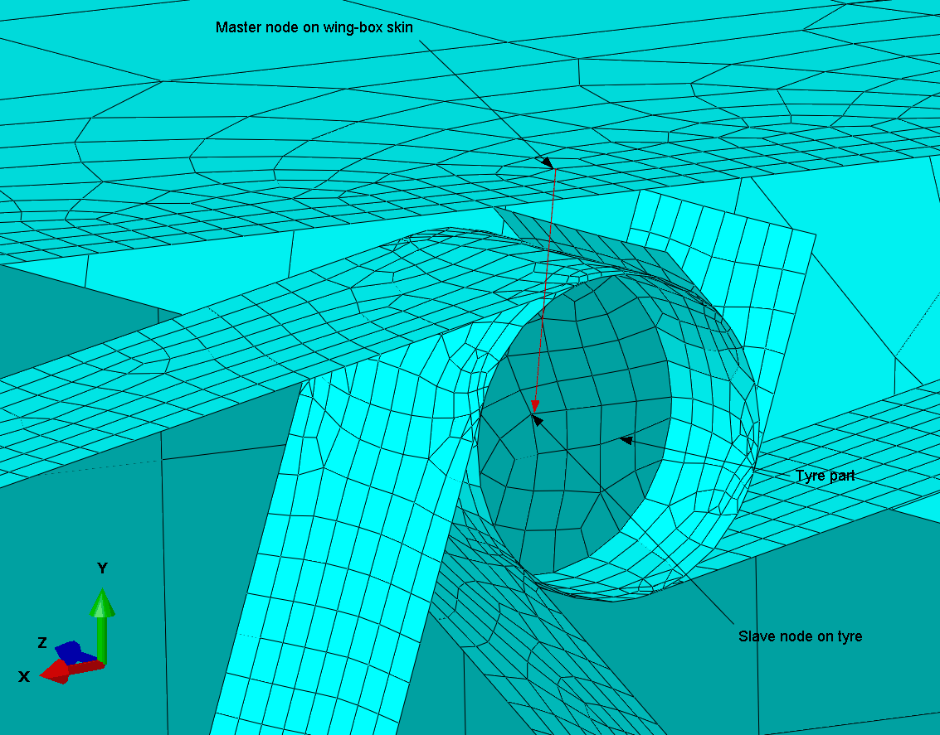

Slide 17
Wing box skin
r
θ
y
z
x
z
Lattice ligament
Lattice node

Slide 18
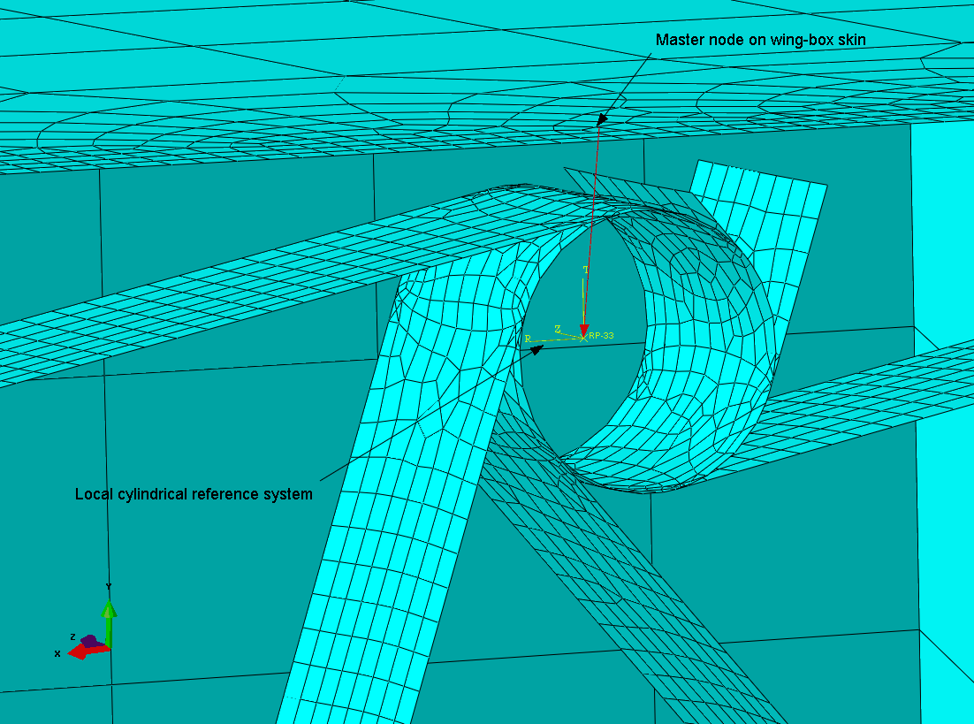

Slide 19
Parametric study python main script
-> mainAbaqusParametricStudy.py
Abaqus python script
-> mainBuildAndExecuteWingBox.py
Start
Read parameters ranges
Start
Write parametric study definition to .txt file
Read model parameters from .txt file
for all cases
Write Abaqus input to .txt file
Build model
Submit job
Execute nonlinear Abaqus simulation
Simulation converged?
No
Move input to postProc folder
Yes
Terminate execution
Execute nonlinear Abaqus simulation
Run post-processing
Move input to postProc folder
Move output files to postProc folder
Write output files
End

