Slide 1
Master Thesis Project: Bending-Twist Shape Adaptation of Wings by Compliant Chiral Spar Design
Alejandro Valverde López, Cranfield University
Advisors: Runkel, Falk; Keidel, Dominic; Urban Fasel

Slide 2
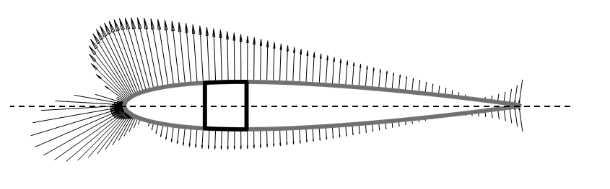
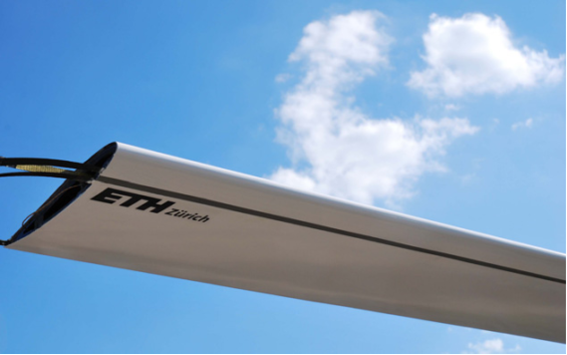
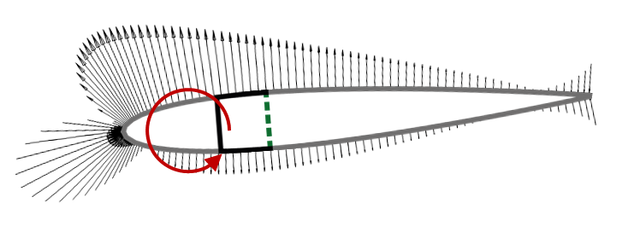
Analytical model
Gust alleviation
Wing demonstrator
Raither(2013)

