Slide 1
Master Thesis Project: Bending-Twist Shape Adaptation of Wings by Compliant Chiral Spar Design
Alejandro Valverde López, Cranfield University
Advisors: Runkel, Falk; Keidel, Dominic; Urban Fasel

Slide 2
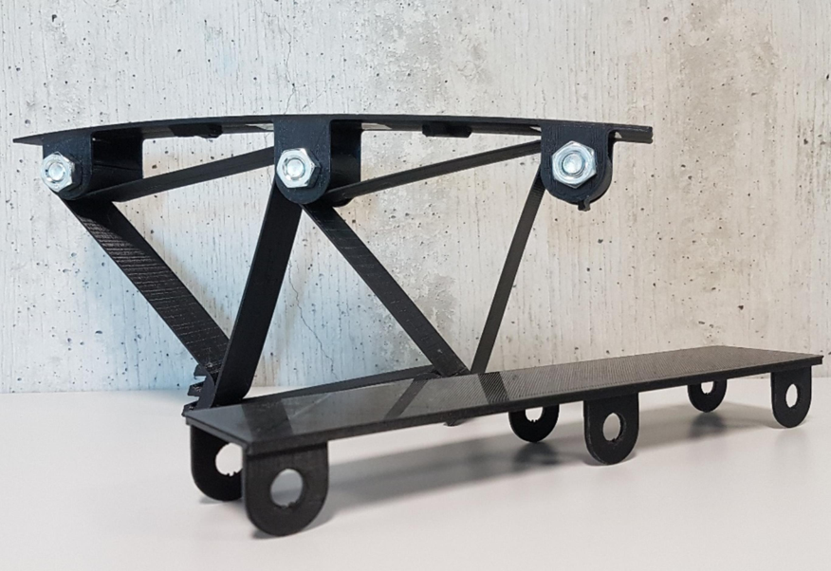
Chiral lattice – wing box skin connection modelling
Real model

Slide 3
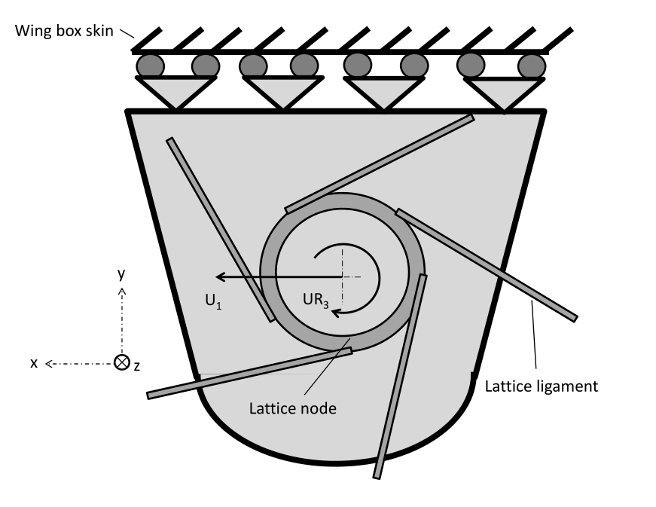
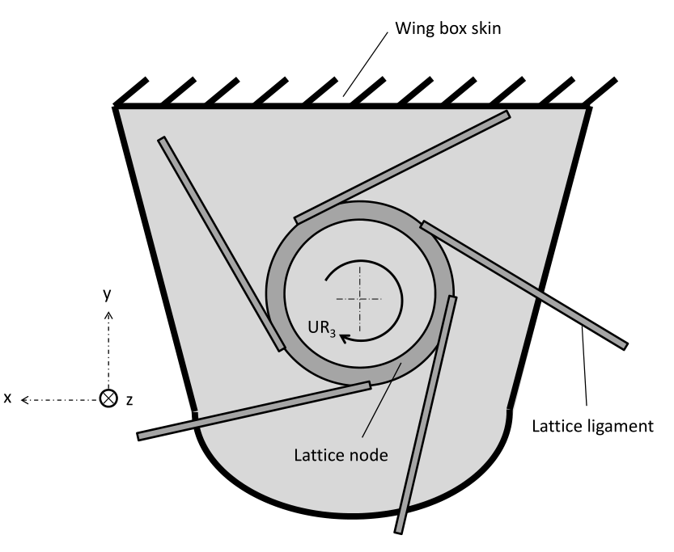
Chiral lattice – wing box skin connection modelling
Different configurations

Slide 4
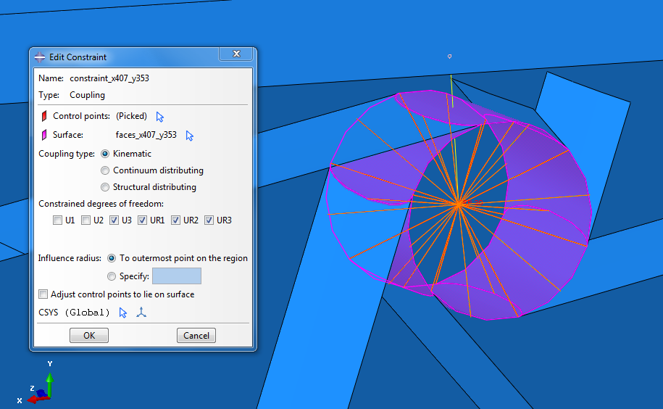
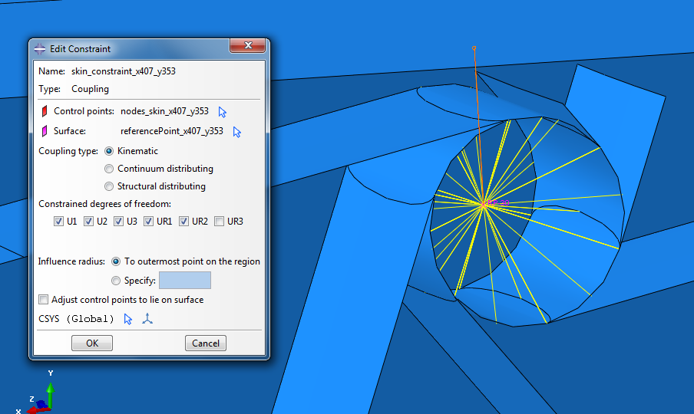
Chiral lattice – wing box skin connection modelling
Different approach

Slide 5
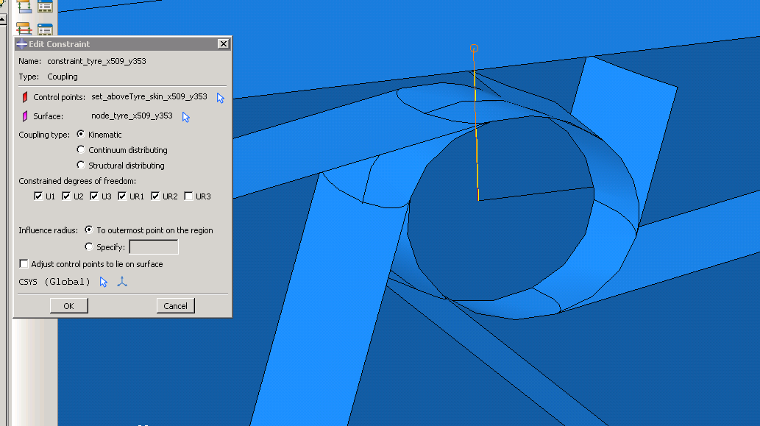
Chiral lattice – wing box skin connection modelling
Different approach – coupling through center node in tyre

Slide 6
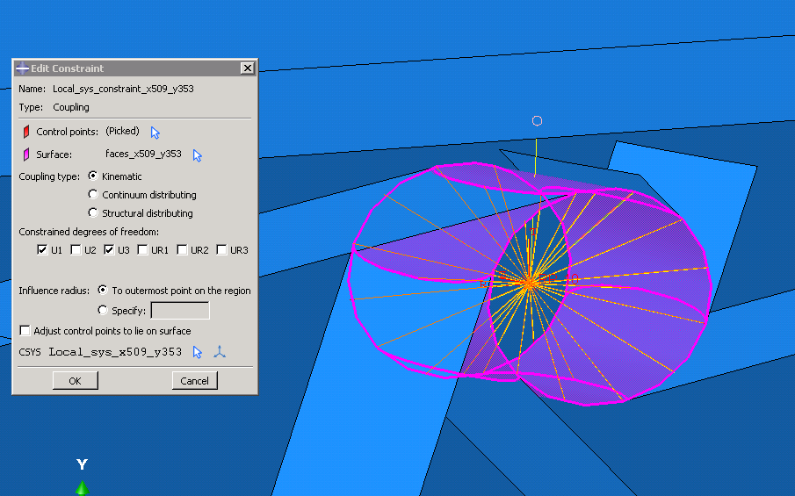
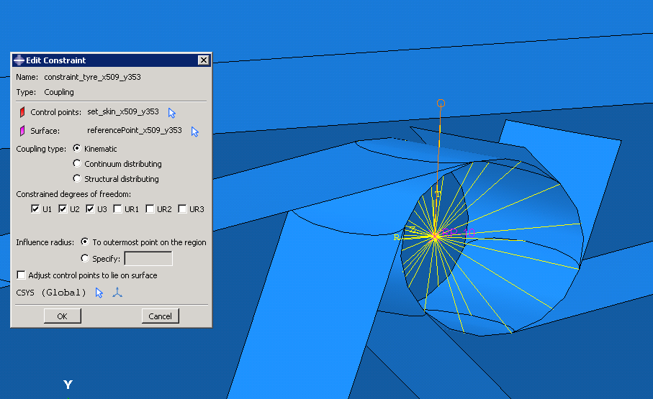
Chiral lattice – wing box skin connection modelling
Different approach – coupling using local SYS

