Slide 1
Master Thesis Project: Bending-Twist Shape Adaptation of Wings by Compliant Chiral Spar Design
Alejandro Valverde López, Cranfield University
Advisors: Runkel, Falk; Keidel, Dominic; Urban Fasel

Slide 2
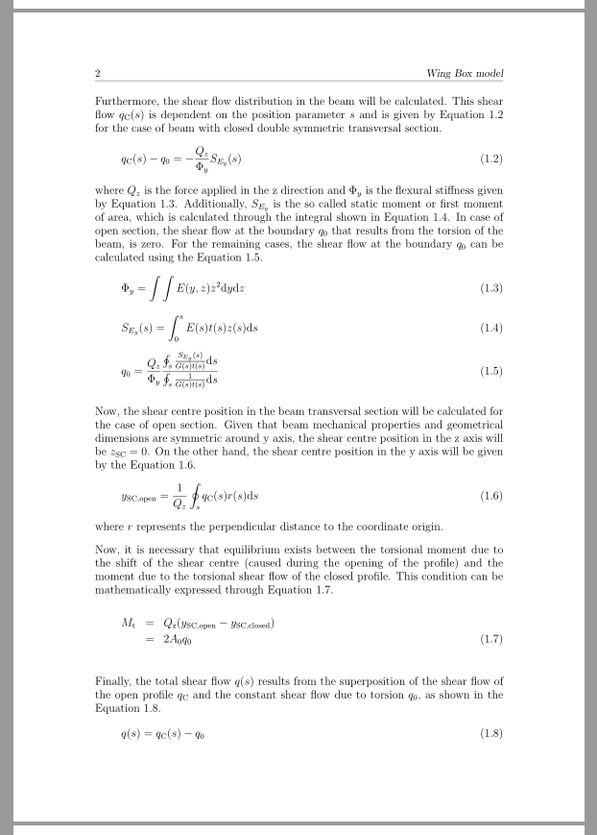
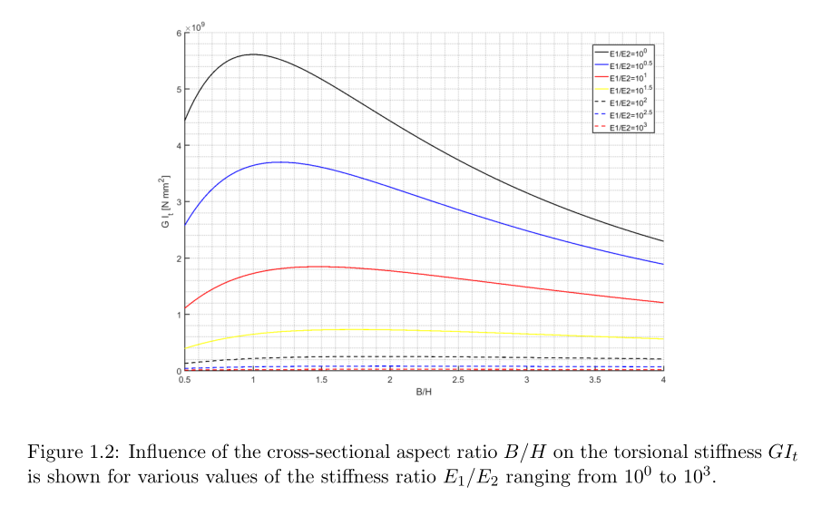
Analytical model
Parametric study based on analytical model

Slide 3
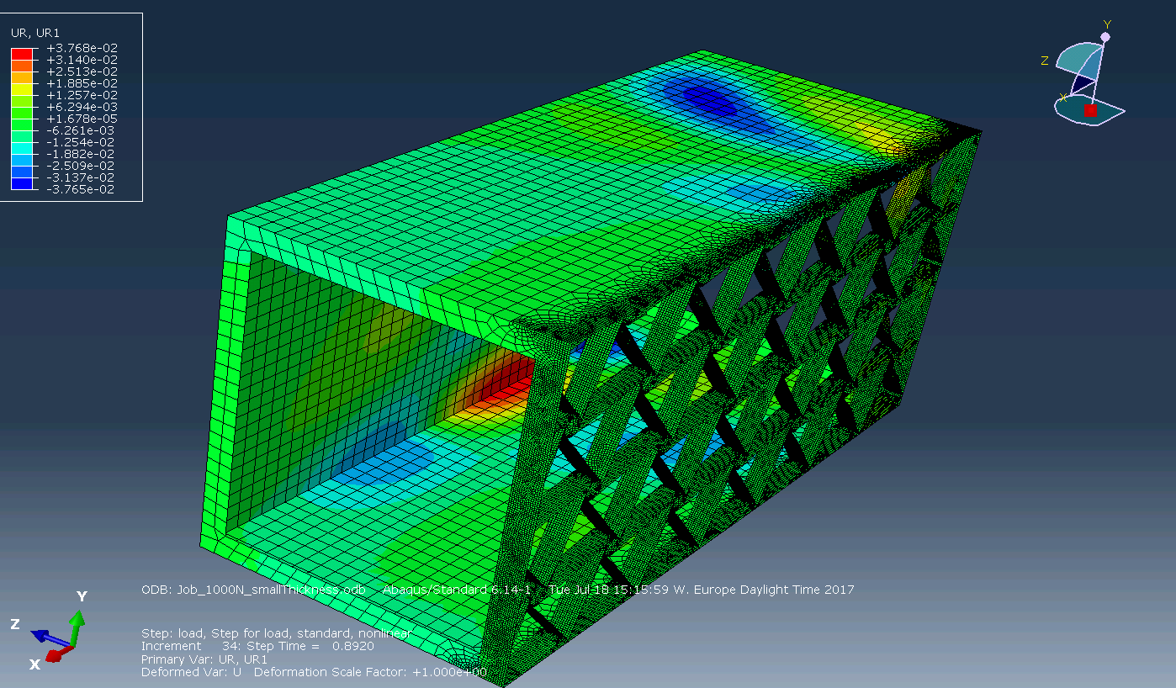
Abaqus model
Set of parameters:
Length spanwise: 815mm
Length transversal: 529mm
Length chordwise: 300mm
Thickness box: 0.8mm
Thickness chiral lattice: 0.5mm
BC’s and force
Limited to 1000N
Clamped at root
Results
Twist: 0.5<φ<1 deg
Vertical displacement at tip: 1<U2<2.5 mm

Slide 4
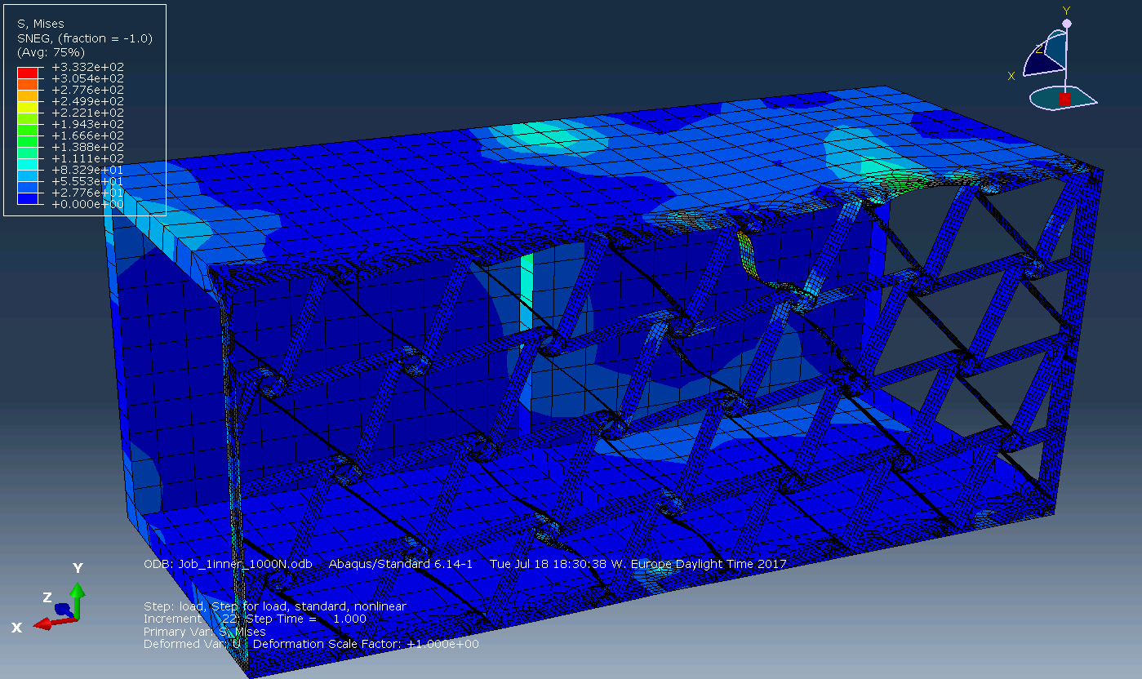
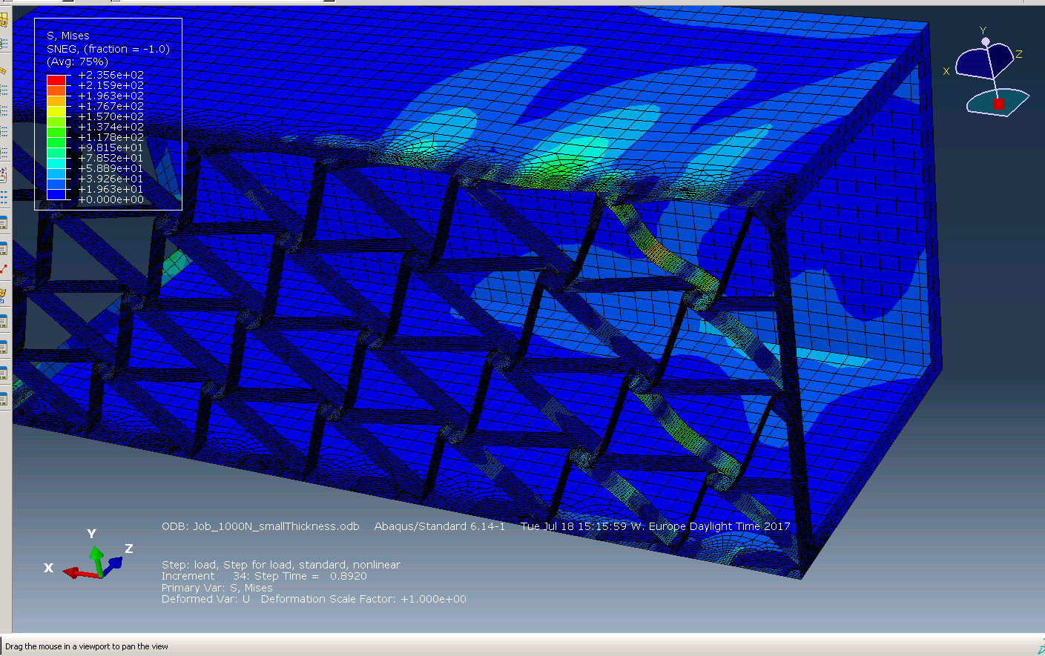
Abaqus model – Buckling characteristics
Charactistics:
At root
It’s the main cause of lack of convergence
Inner rib
No inner ribs

Slide 5
Abaqus model – Buckling characteristics
Charactistics:
At root
It’s the main cause of lack of convergence
Inner rib
No inner ribs

Slide 6
Next steps
Anaytical model:
Finish writing the first part
Complete FEM vs Analytical verification with Gilles
Nonlinear simulations
Linear vs nonlinear verification
Parametric study
Chiral thickness, N cells, M cells
How to deal with lack of convergence?
Wing model
Embed wing and box
Run simulations

