Slide 1
Master Thesis Project Bending-Twist Shape Adaptation of Wings by Compliant Chiral Spar Design
Alejandro Valverde López
Cranfield University
ETH Zürich
07.07.2017 Ostfalia University

Slide 2
Overview
Working principle
Analytical model
Wing box FEM model
Full wing FEM model
Results from the nonlinear simulations
Project status

Slide 3
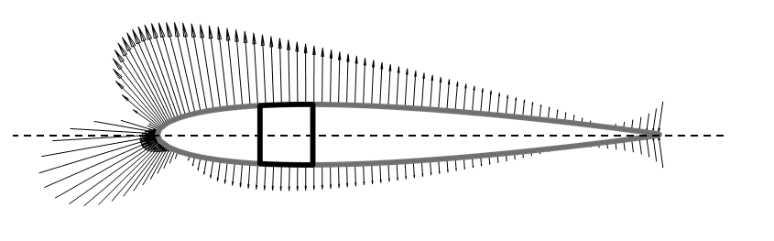

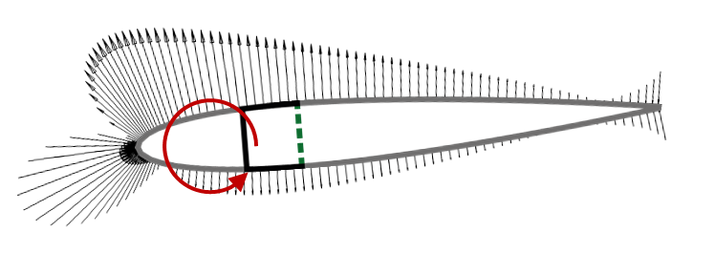
Motivation
Gust alleviation
Wing demonstrator

Slide 4
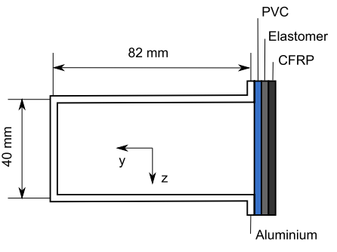
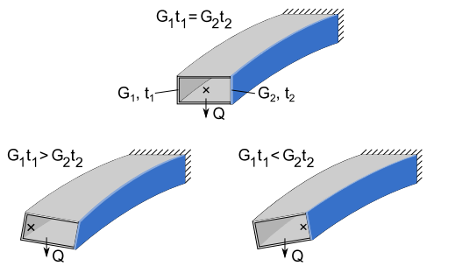
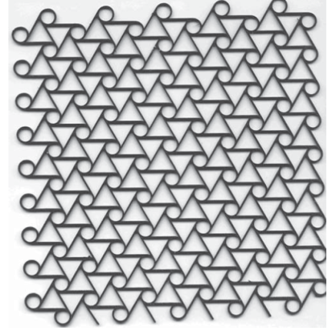
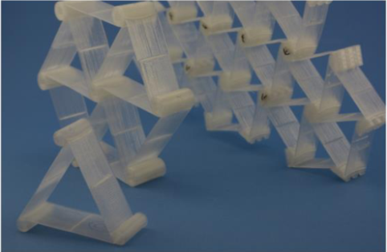
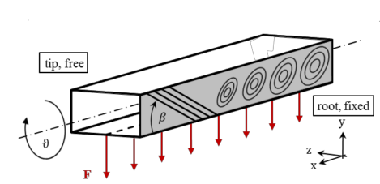
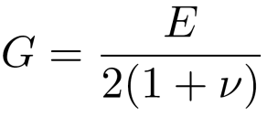
Different approaches
ΔT → G₂ t₂
Working principle, publicated on: Raither(2013)
Current project: Buckling-induced shear modulus variation
Runkel (2015): Δβ → material anisotropy
Notes:
Working principle
The variable shear stiffness G2t2 that is required for the activation of the adaptive web can in principle be achieved by changing either the web’s shear modulus or its thickness. The change in shear stiffness of the adaptive web will lead to a shift of the shear center in horizontal direction and thus to a non-zero twist of the profile.
Case 1-Raither:
An implementation based on the variation of the elastic modulus of a polymer web due to changes in temperature is investigated.
Case 2-Runkel:
A particular material anisotropy by varying fibre orientation and thickness of the component is introduced.
Case 3-Chiral:
At a particular external load, the shear flow in the web exceeds the buckling limit, resulting in a drastic reduction of the effective shear modulus of this structural element

Slide 5
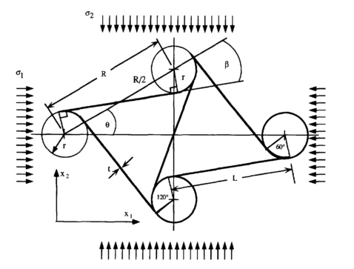
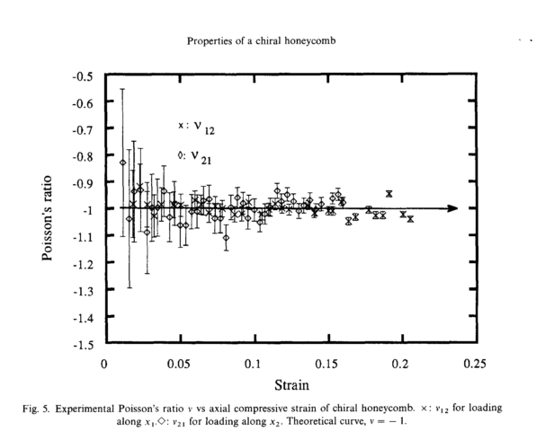
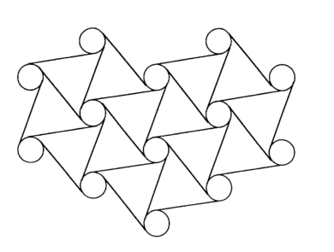
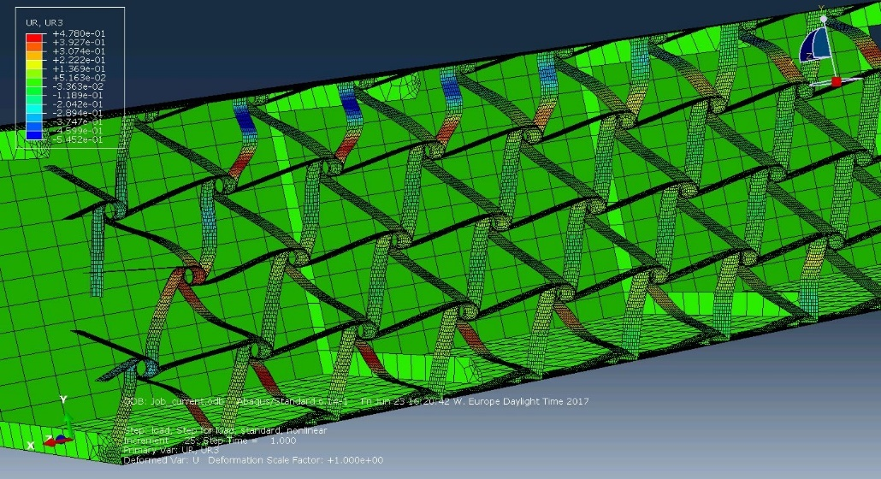
Chiral reticular structure
Constitutive elements
Prall (1997)

Slide 6
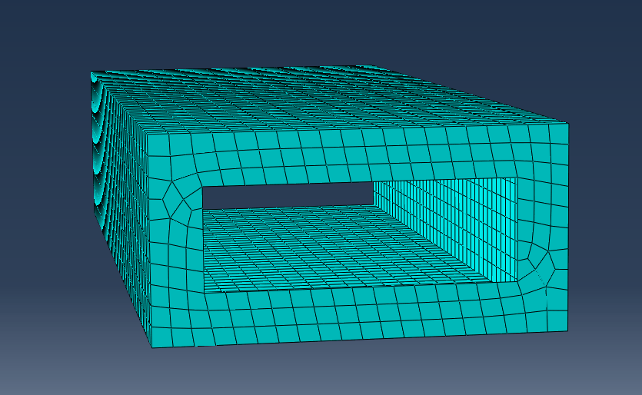


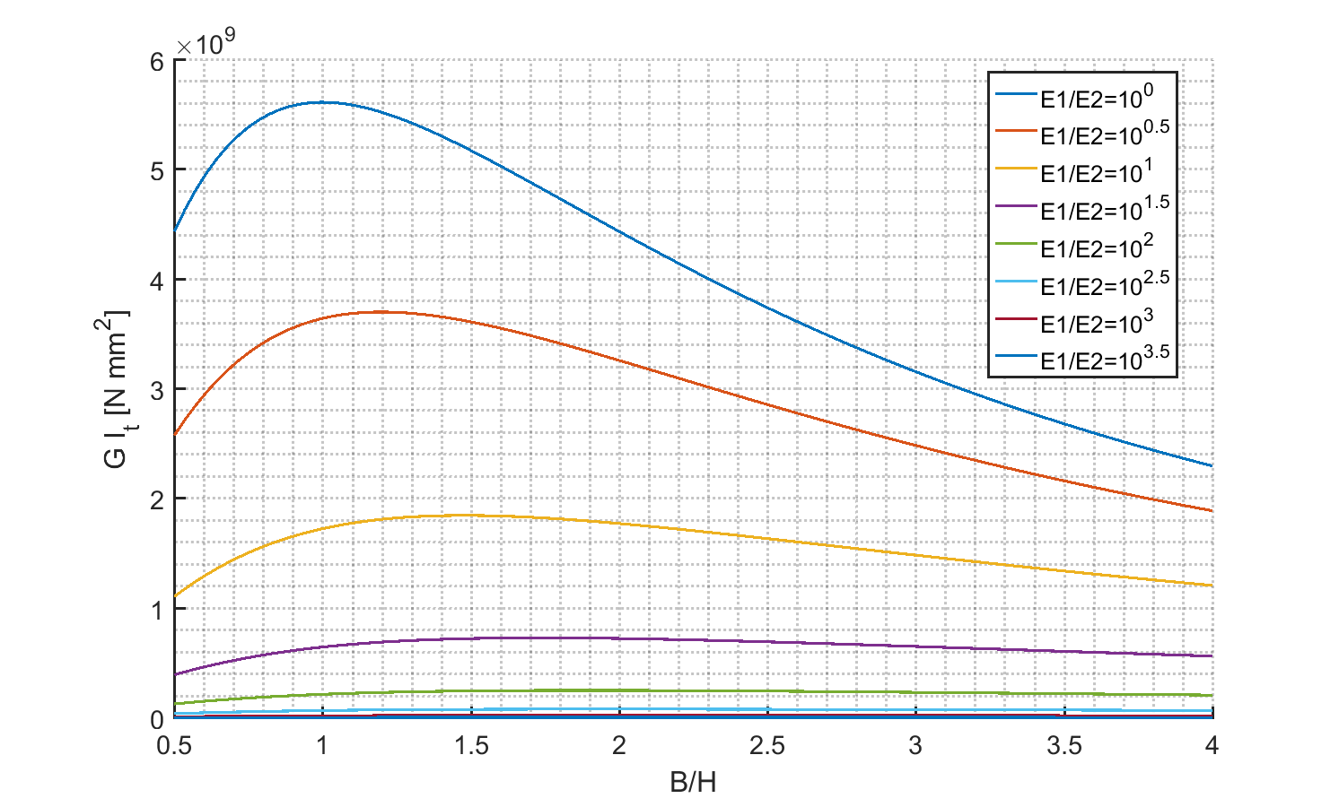
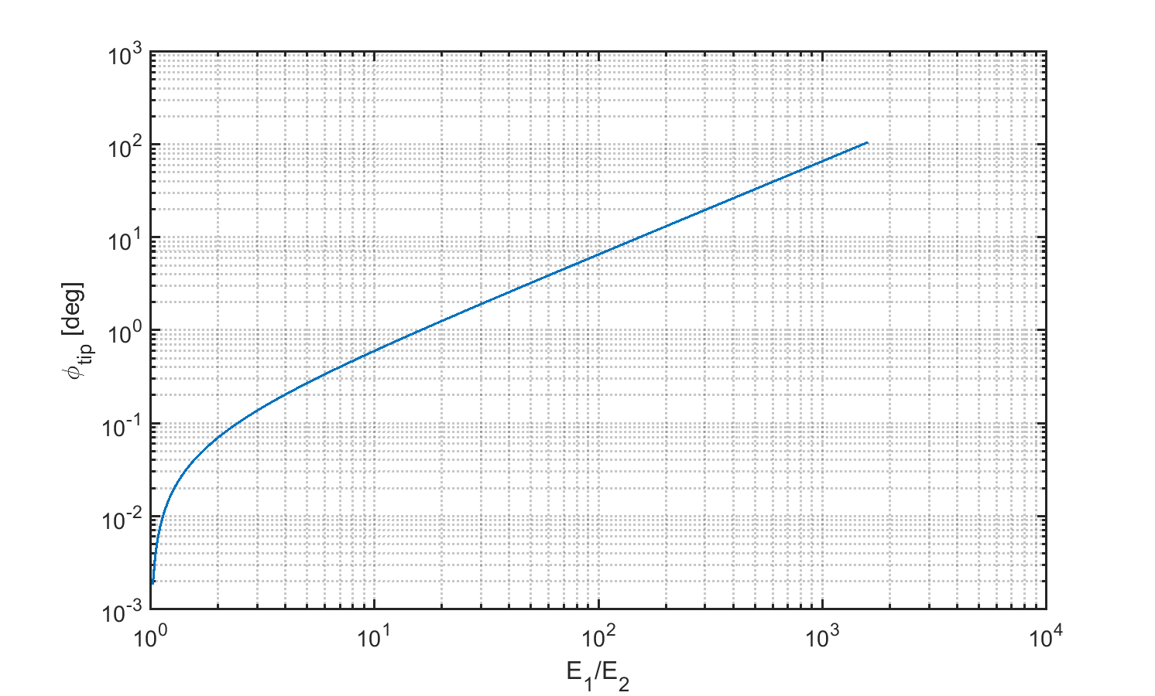
Analytical model
Bending:
St. Venant torsion:

Slide 7
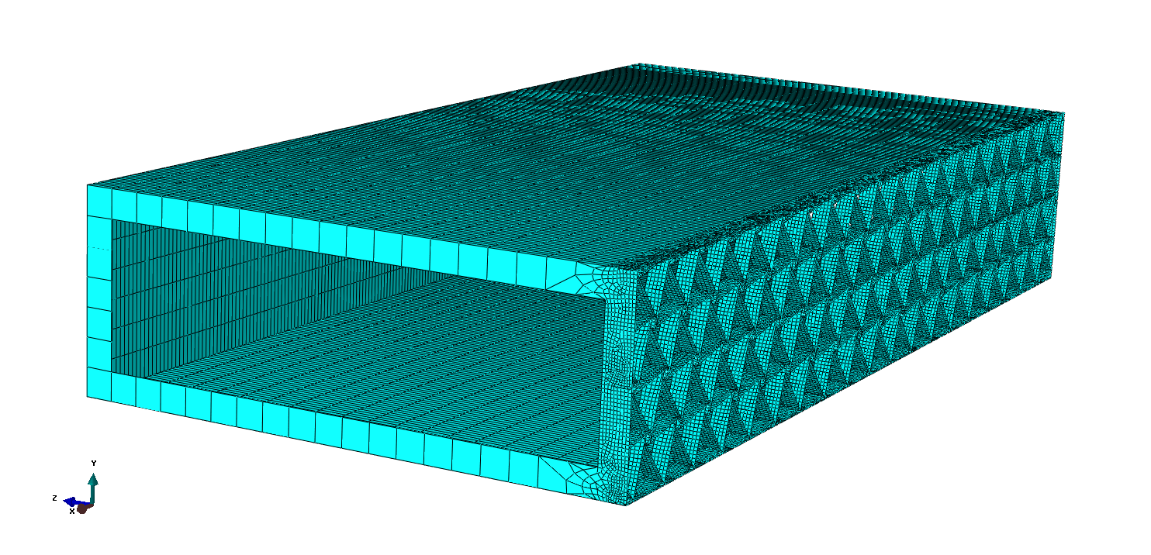
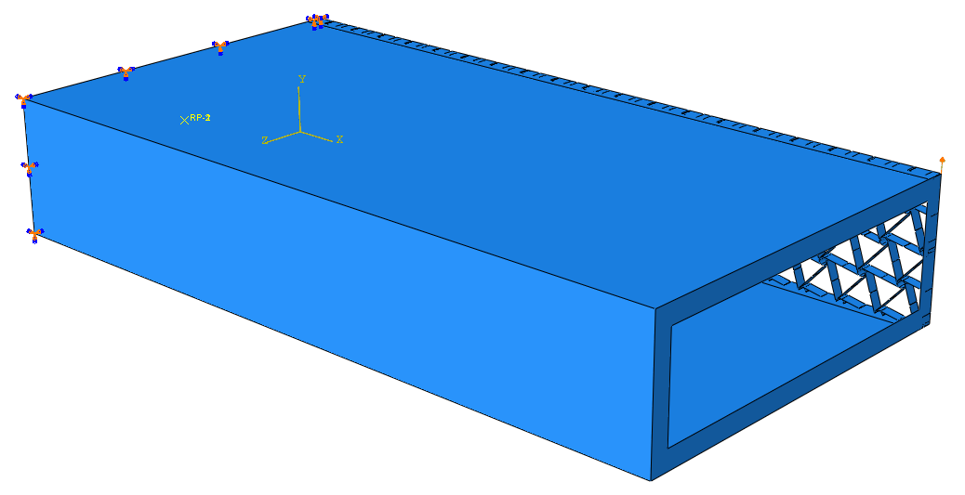
Wing box model overview
Abaqus model with mesh
Script developed in Python
Fully parameterized
Parameter study, with 5 variable parameters
C-box thickness
Rib thickness
Rib frame width
Chiral ligament eccentricity
Chiral section thickness
Length in the spanwise dimension: 1m
Fixed support at the wing root
Various load introduction strategies

Slide 8
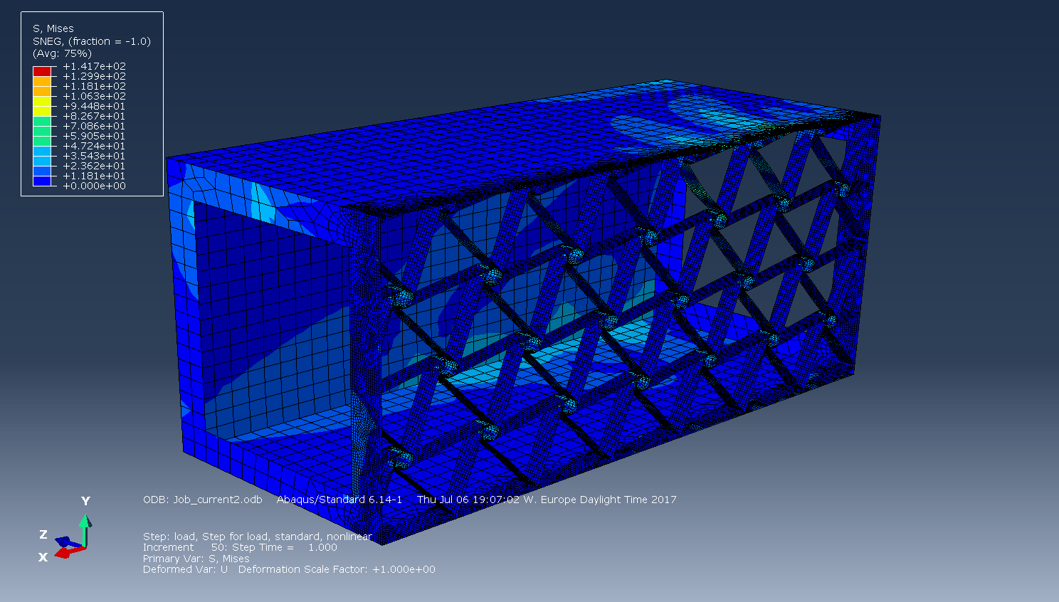
Wing box nonlinear simulations results
Single load introduction point on last rib

Slide 9
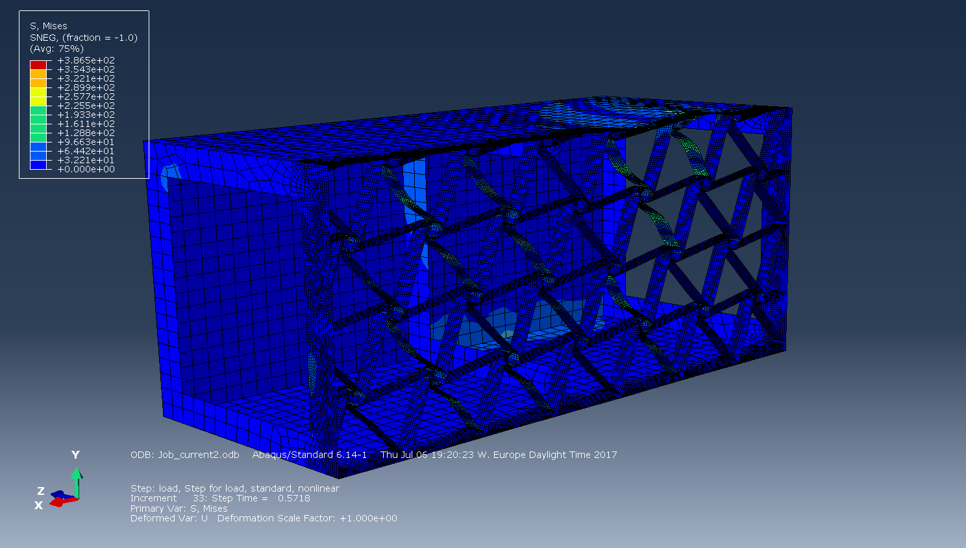
Wing box nonlinear simulations results
Multiple load introduction points on inner ribs

Slide 10
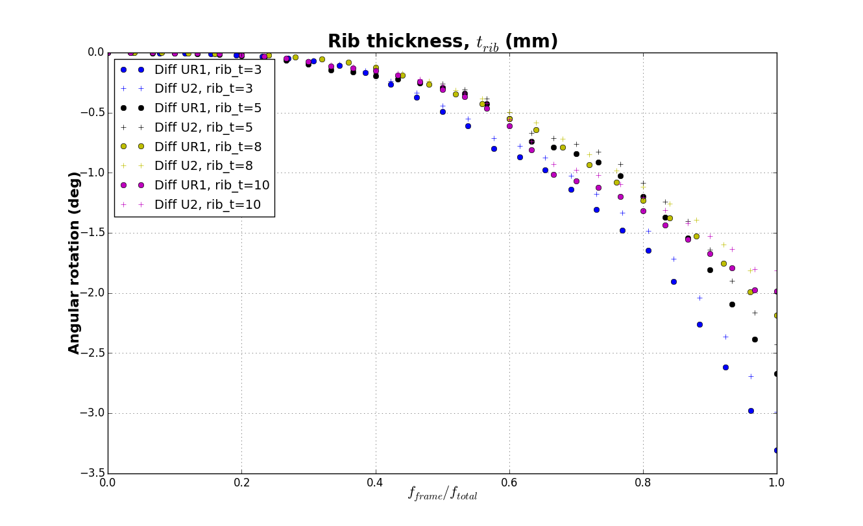
Wing box nonlinear simulations results
Beam twist evolution with the fraction of load applied

Slide 11
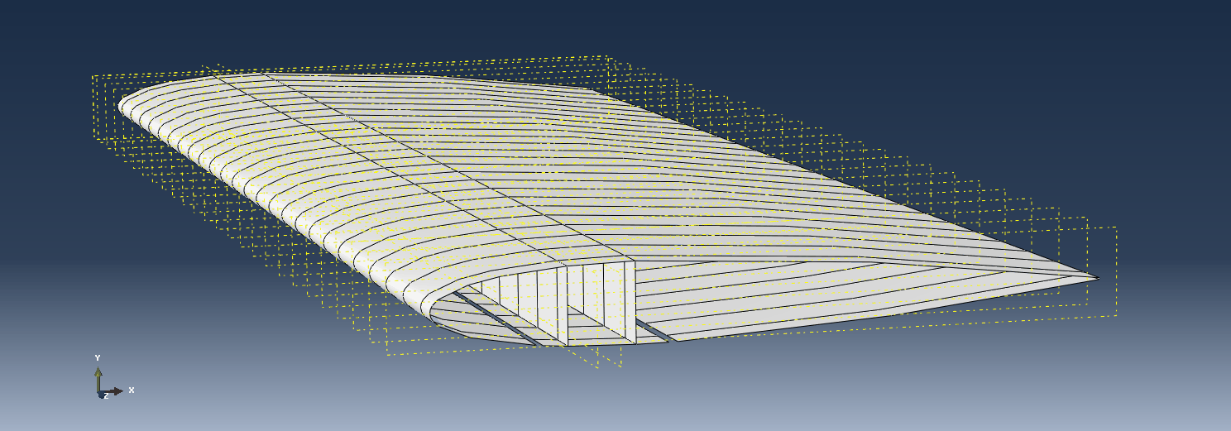
Whole wing model
Embeded wing box with chiral structure in one of the web
Aerodynamic loads calculated using XFOIL and lift line evalution
FEM + XFOIL interection within a loop until convergence is achieved

Slide 12
Project status
Done
Analytical model and parametric study
Python code to build the model on Abaqus, fully parameterized
Nonlinear simulation of the wing box model
To be completed
Nonlinear simulations on the full wing model
Parametric study

Slide 13
Thank you for your attention!
Bibliography:
W. Raither, M. Heymanns, A. Bergamini, and P. Ermanni, “Morphing wing structure with controllable twist based on adaptive bending twist coupling,” Smart Mater. Struct., vol. 22, no. 6, p. 065017, Jun. 2013.
F. Runkel, A. Arrieta, P. Ermanni, "Design of passive morphing wing structures using elastic instabilities", Proceedings of the 20th International Conference on Composite Materials, p. 1-12, Jul. 2015
D. Bornego, F. Scarpa, C. Remillat, "Evaluation of hexagonal chiral structure for morphing airfoil concept", Proceedings of the Institution of Mechanical Engineers, Part G: Journal of Aerospace Engineering, p. 185--192, vol. 219, no. 3, 2005

