Slide 1
UCF Dollar Menu
“The dollar store of fast food”

Slide 2
The team
Jason Dhillon
Brady Hill
Alejandro Zamora
Nav
Murali
Backend
Frontend
Frontend
Team leader, backend

Slide 3
About us
We are a team of talented computer science majors who are passionate about eating. We grew up on dollar menus as kids and live on them as adults. We Strive to make UCF proud as we embark on the challenge of redesigning lifestyles to revolve around the dollar menu.

Slide 4
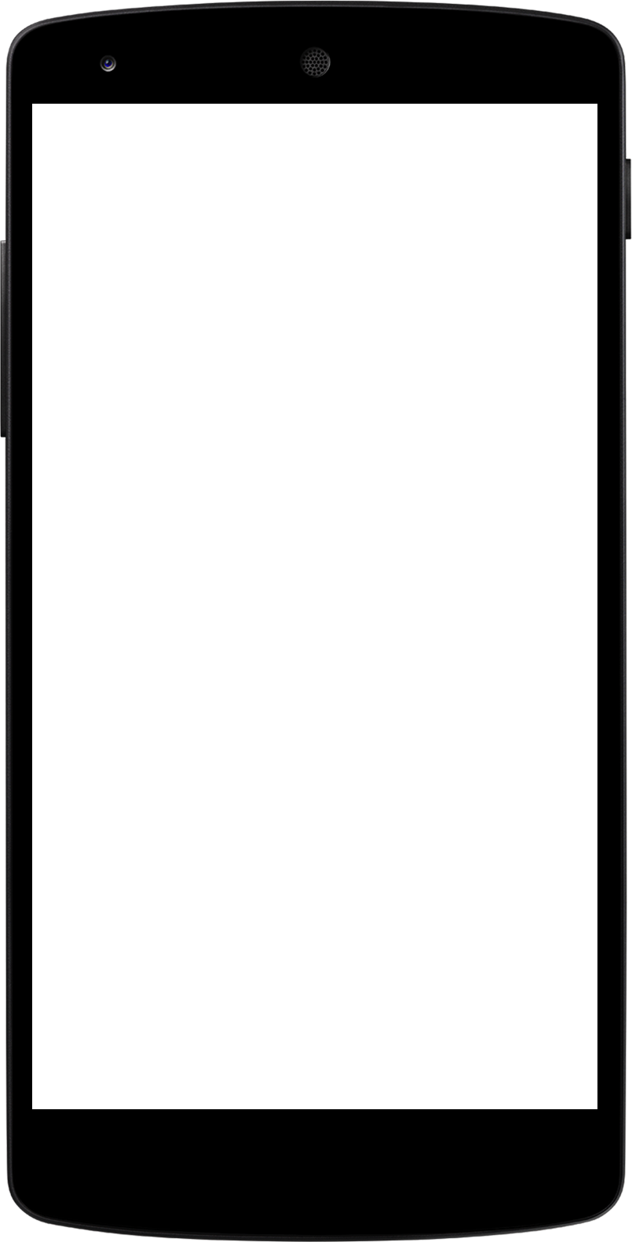
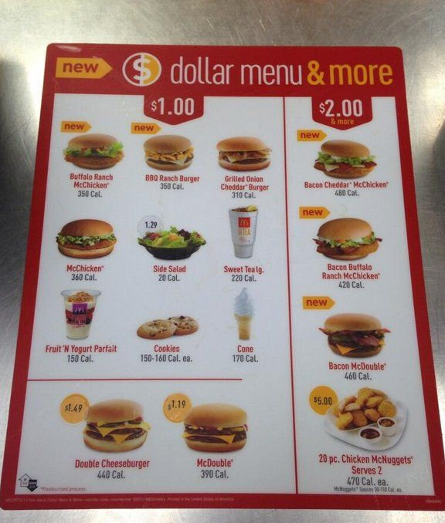
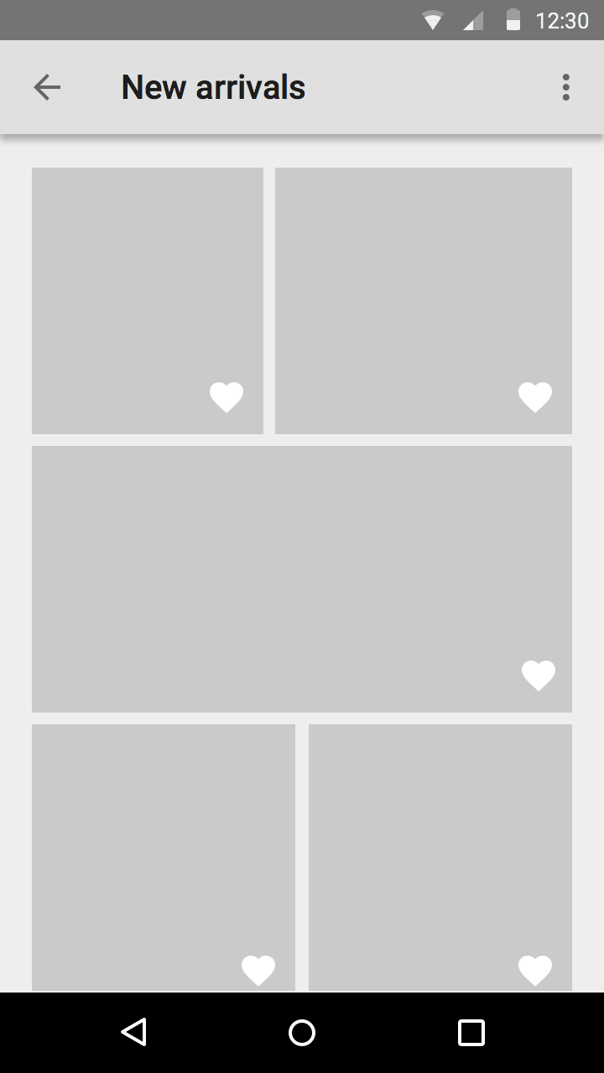
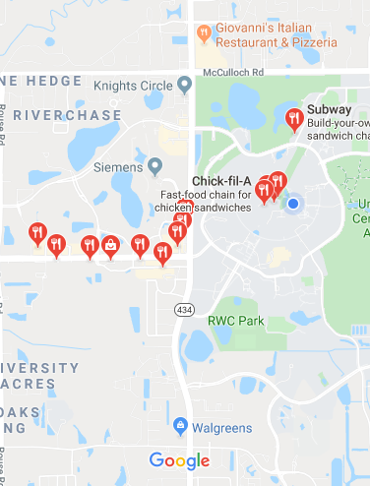
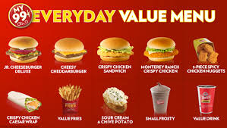
Prototype
Our app will display one menu that will contain all the dollar menus from every fast food chain within a 3 mile radius from ucf.
This way the average student can vary this unhealthy diet yet keep it affordable.

Slide 5
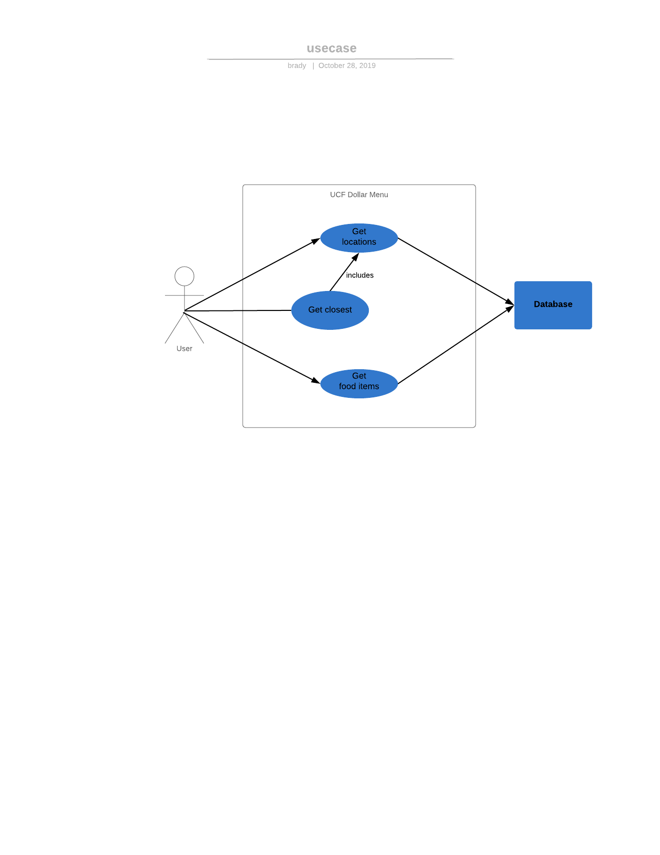
Use case

Slide 6
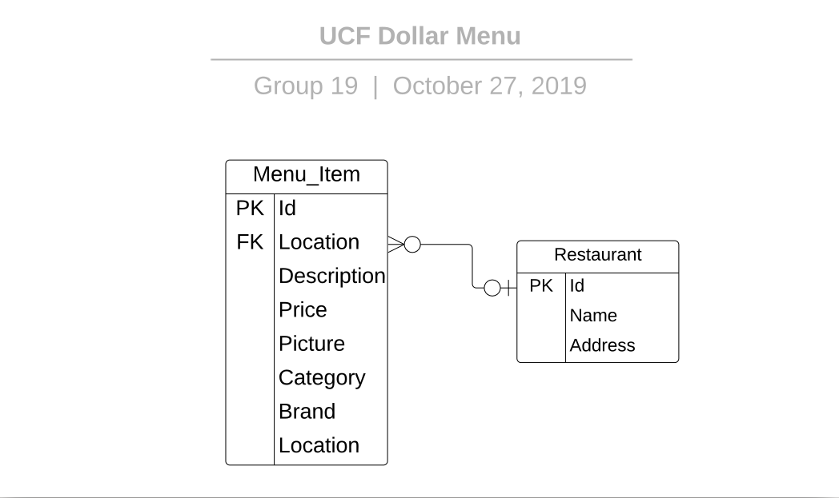
ERD

Slide 7
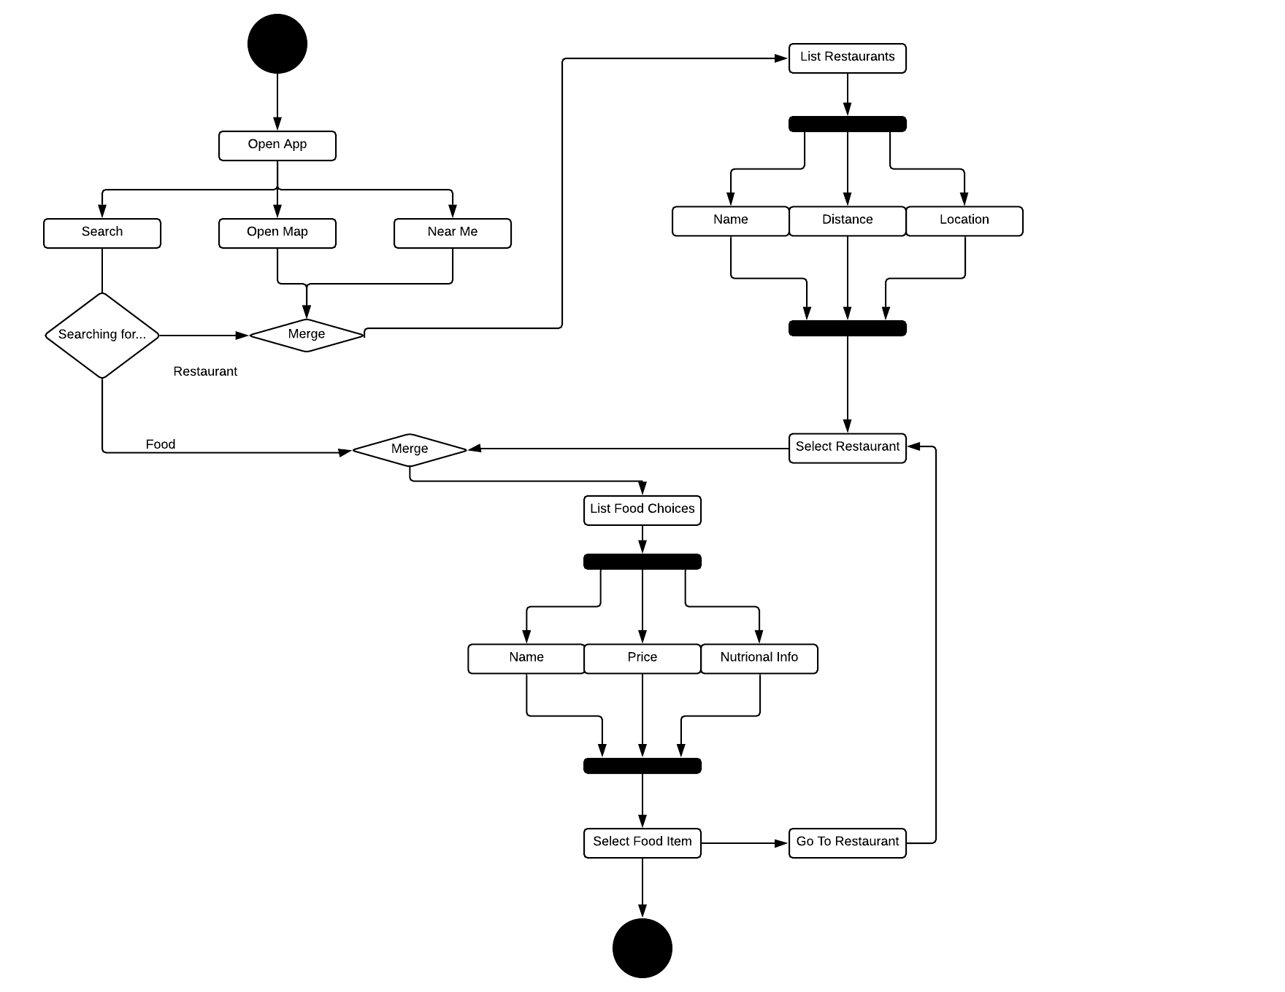
Activity Diagram

Slide 8
Project Tech
Mern Stack
Modern, Non-SQL, REACT components
Fast Food API
Provides menu, store locations, and images to create content
Trello
Keep project on schedule
Andriod Studio
Experience, powerful and diverse

Slide 9
Testing plan
Testing as we go
Verify functionality of
Google maps API
Location services
UI
Automated testing
Unit
Integration
End to end

Slide 10
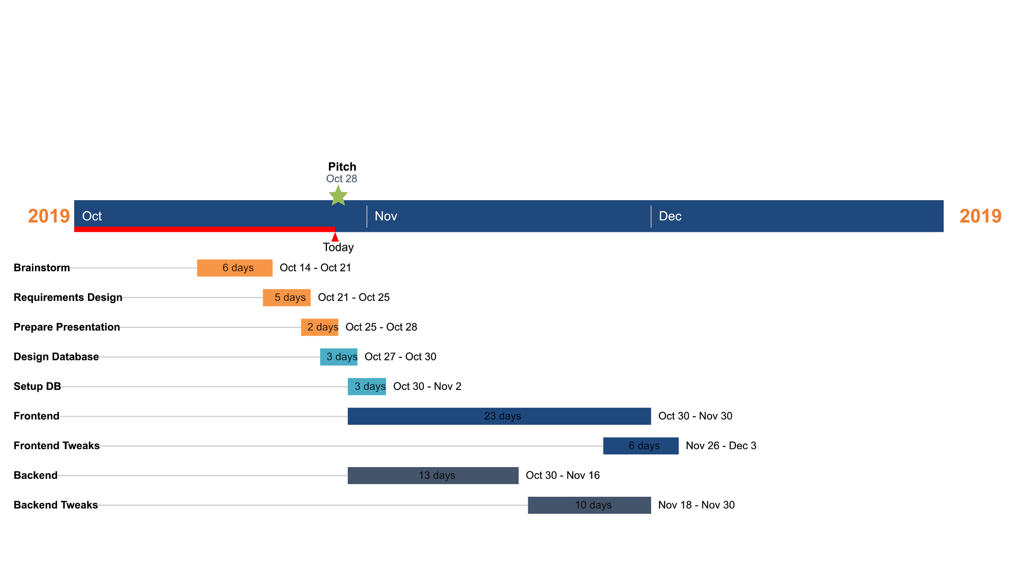
Gantt

Slide 11
But how do we profit?
Ads
Sponsors
You
Eventually all the nearby fast food restaurants

Slide 12
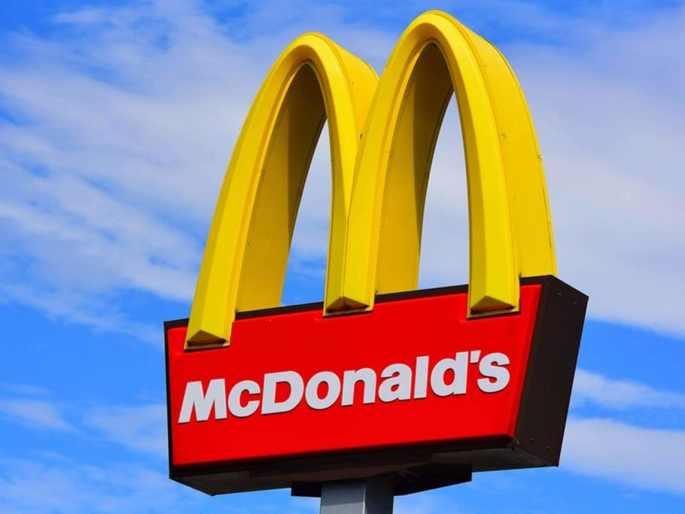
Questions?

