Slide 1
Drag Free control of GOCE spacecraft Group 27
de Miguel, Alejandro (918897)
Félix, Rafael (927690)
Salas, Carmen (935897)

Slide 2
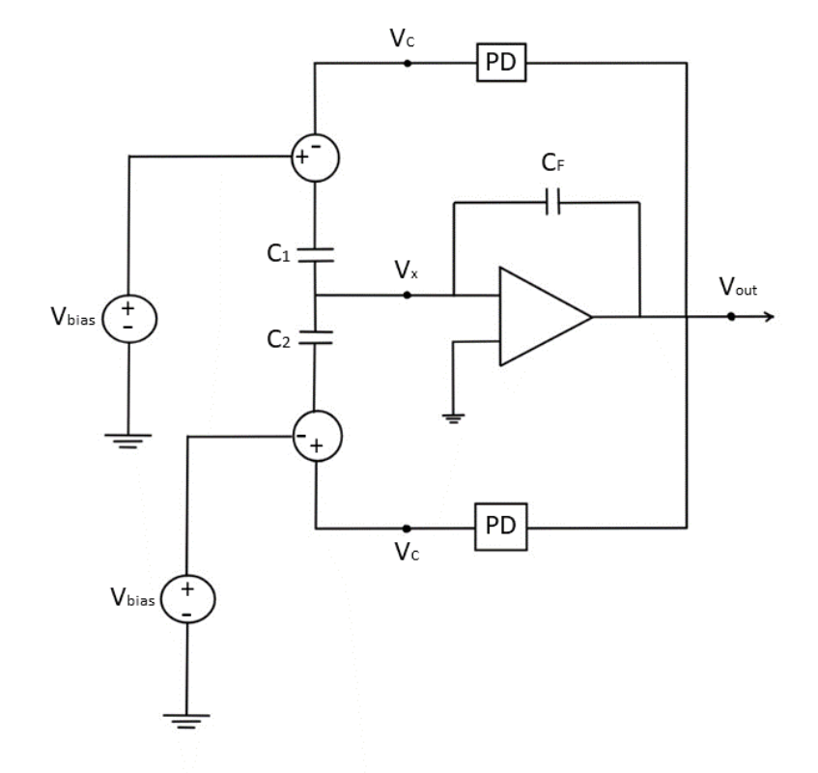
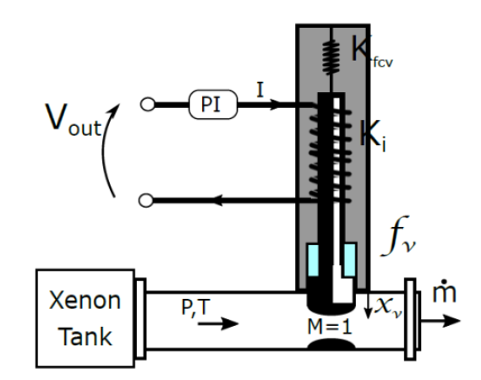
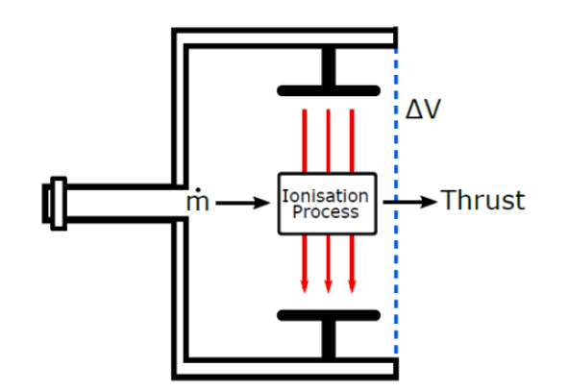
Physical model
Accelerometer
Valve
Thruster

Slide 3
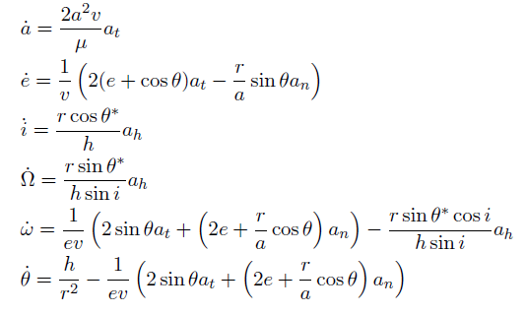
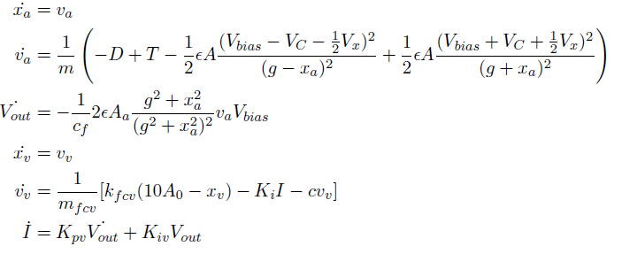
Mathematical model
Gauss planetary equations

Slide 4
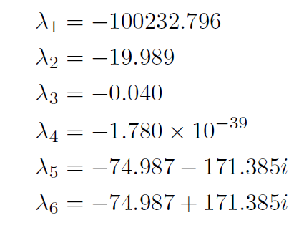
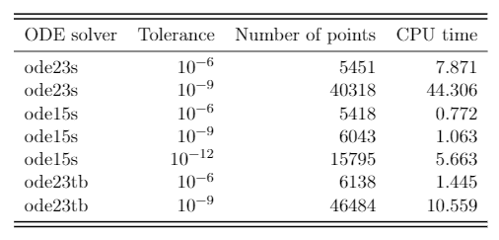
Stability Analysis
Eigenvalues of the system:
Stable problem
Stiff Problem

Slide 5
System response
Variables oscillate periodically with the orbit.
Thrust compensates effectively the air drag.
Modeling and Simulation of Aerospace Systems. Group 27

Slide 6
Failure modes: Engine failure
The engine stops working and is unable to produce thrust.
Failure condition → T = 0
Consequence → air drag acts completely onto the spacecraft, lowering the orbit and thus the altitude.
System response → valve keeps opening trying to generate more thrust.
System recovery → the engine gives back all the thrust lost during the failure, recovering the initial orbit and altitude.
Modeling and Simulation of Aerospace Systems. Group 27

Slide 7
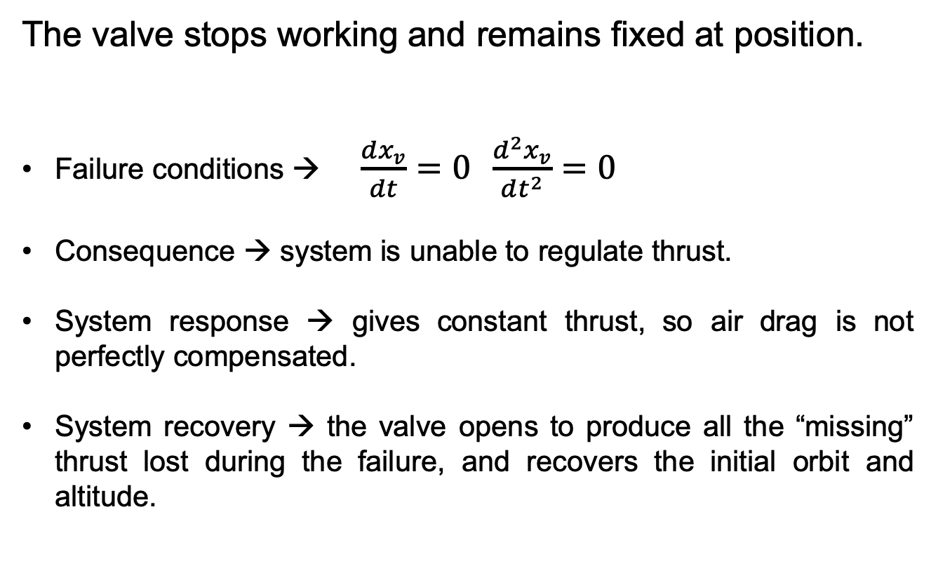
Failure modes: Valve failure
The valve stops working and remains fixed at position.
Failure conditions → $\frac{dx_{v}}{dt}=0 \frac{d^{2}x_{v}}{dt^{2}}=0$
Consequence → system is unable to regulate thrust.
System response → gives constant thrust, so air drag is not perfectly compensated.
System recovery → the valve opens to produce all the “missing” thrust lost during the failure, and recovers the initial orbit and altitude.
Modeling and Simulation of Aerospace Systems. Group 27

Slide 8
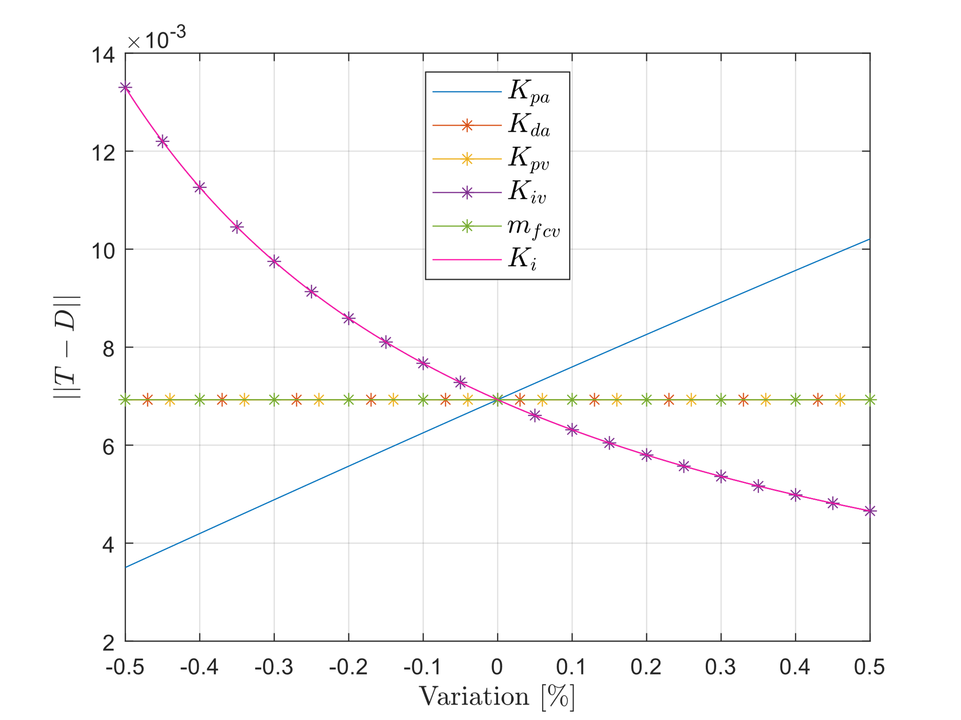
Sensitivity analysis
All six optimizable variables:
Variation of -50% to +50%
Error:
Only affect significantly the response
Variables to optimize

Slide 9
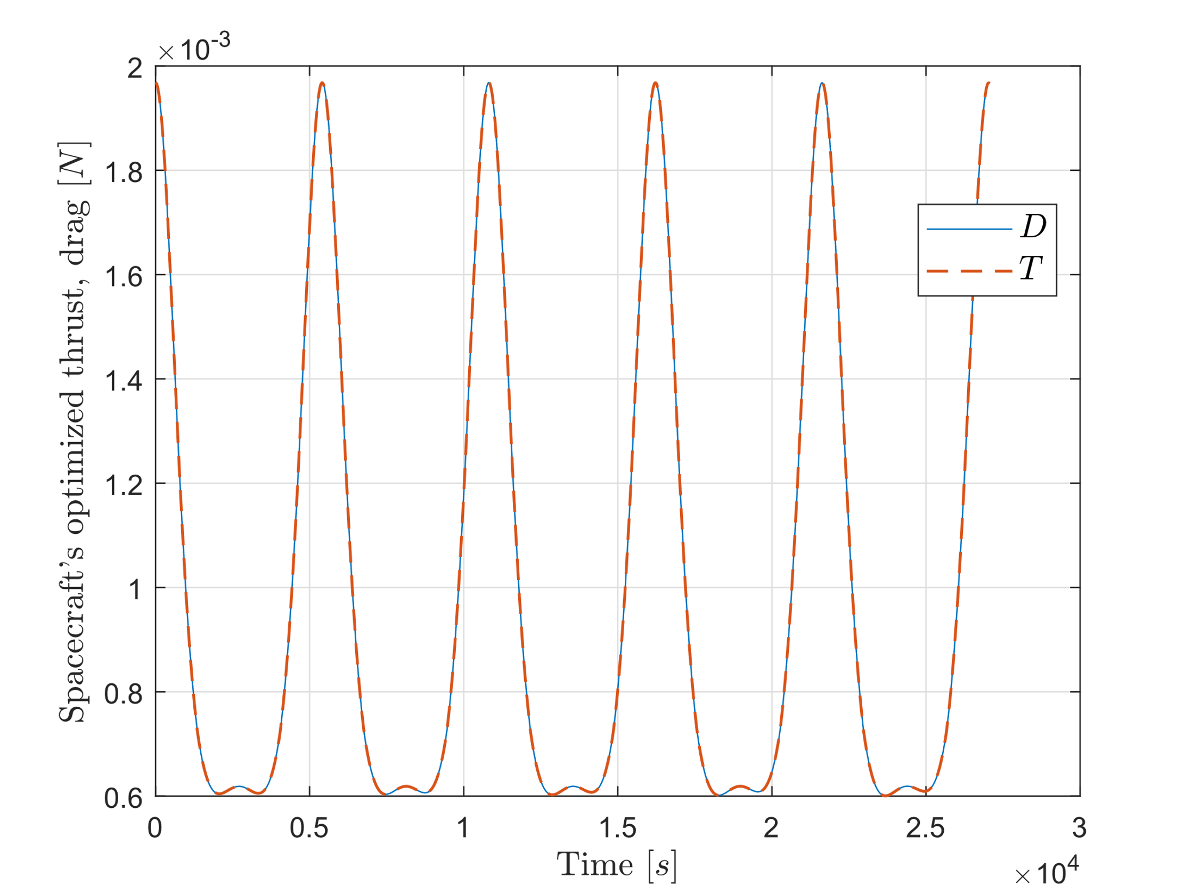
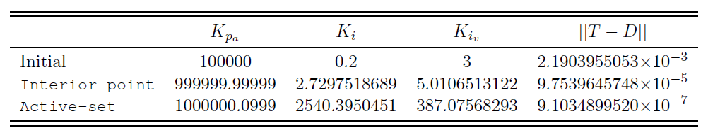
Optimization
Objective function:
First attempt:
fminsearch, fmincon
Errors during optimization → introduction of events
Second attempt:
fmincon, two algorithms: “interior-point”, “active-set”

