Slide 1
React.ts project template
01-17-2023

Slide 2
Objective
Define a react project architecture that can be used as a template in every react project

Slide 3
Summary
Programming Language
interfaces
Convention of the name of functions, pages, components etc
Convention of file names
Files Structure
State handler
Routes Structure
Environments
Forms handler
Using ENUMS
About the styles
Render a child component in a parent component
Structure of a component
Get HTML elements for iteration over a array
Names of the event handlers in the react component
Library to handle the keys in HTML generated from a iteration
Tool to make request

Slide 4

Programming language
Typescript is a strongly typed programming language, that's the reason why made the code more consistent.

Slide 5
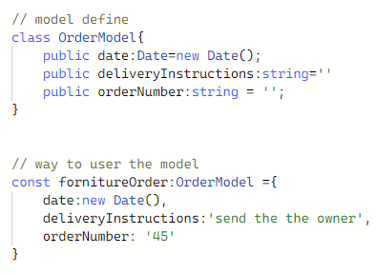
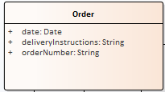
2. Interfaces

Slide 6
3. Convention of the name of functions, pages, components
convention: instanceName -> PascalCase
examples:
class 0rderModel
UserPage
BackdropComponent

Slide 7
3. Variable name convention - Instance
convention: name
examples:
const fornitureOrder: OrderModel = {}

Slide 8
4. Convention of the name of files
convention: name.Kind.format
All the letters has to be in lower case
name and kind has to be separate by a dot
users.page.tsx

Slide 9
4. Convention of the composed names
convention: name-complement.Kind.format
All letters has to be in lower case
name and kind has to be separate by a dot
users-client.page.tsx

Slide 10


5. Folder Structure
page:: Folder is store little piece of
UI like a card
models: It's all about data structures of the application
components: Folder is store little pieces of
UI like a card.
reducers: It’s all about actions and reducer, actions and selector of data slices(little pieces of data in the store)
enums: it´s named constants that can be invoked by other part of the application
sass:: It´s a general styles that can be used in all application
helpers: It's A functions with the business logic, the idea here is each subfolder for each entity, for example: user, conflicts
env: This folder contains all about each environment(develop, production and qa)
router: It's all the routes of the application and the guards
store: This file is a store to handle the states of the application
hooks.store: This file is a hooks to handle the selector and the dispatch of the store

Slide 11
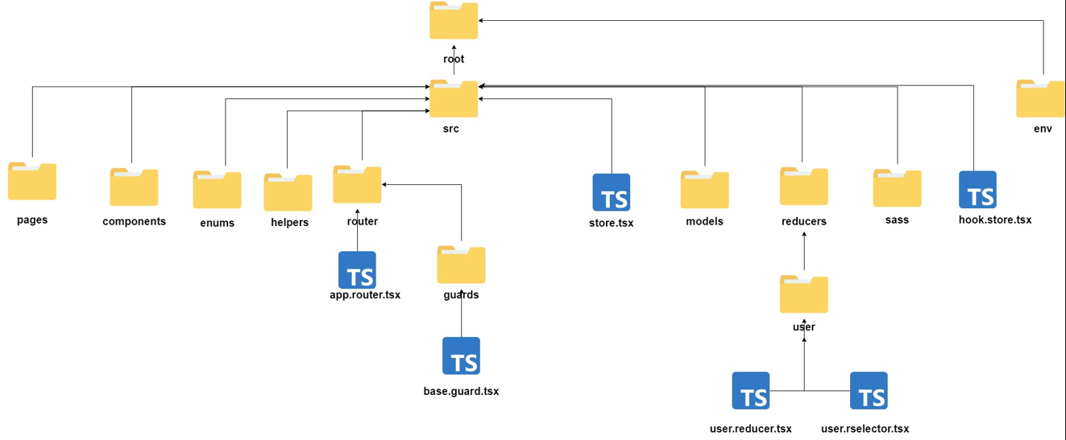
5. Folder Structure

Slide 12

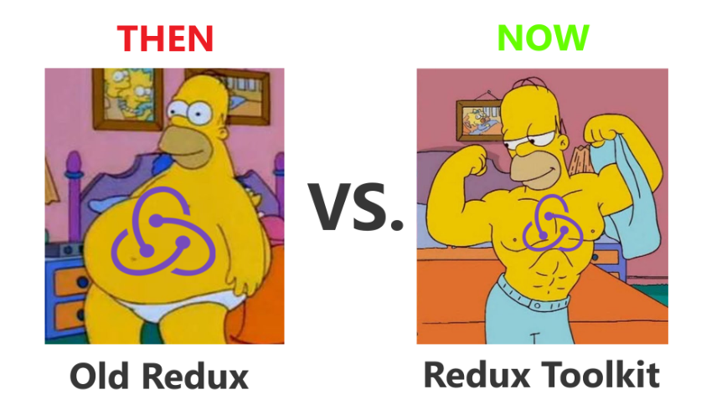
6. State handler

Slide 13
6. State handler
To handler the state was selected the library redux toolkit, now we here the steps to use redux toolkit:
1. Install the libraries
npm install @reduxjs/toolkit
npm i react-redux
2. Setup the store
const store = configureStore({
reducer:{
sliceName: reducer // here we will put the reducer of everything reducer
}
})

Slide 14
6. State handler
3. Attach the store the app in index.tsx
ReactDOM.render(
<React.StrictMode>
<Provider store={store}>
<AppRouter /> // in case that u r using react router DOM
</Provider>
</React.StrictMode>,
document.getElementById('root')
);
4. Create the reducer, actions with createSlice and don’t forget create a selector

Slide 15
6. State handler
When you are create the Thunk (actions) , you have to implement a way to catch all the responses of http request (pending, fulfilled and rejected). Then this concert will be solve at the moment of create the slice,
AsyncStatusEnum.completed -> return data
AsyncStatusEnum.rejected -> return null
AsyncStatusEnum.pending -> return undefined

Slide 16
6. State handler
5. Attach the reducer in the store.
6. Make a hook to can dispatch the normal action and the action which come from thunk (at the end of the day the thunk is a action) and to select a slice of a store
7. change the store. To change the store we have to get
useAppDispatch from hooks and the action to do it something like that:
dispatch(getFactsData({value:'',key:''}))
8.Consult the state. To consult a slice of the store we have to invoke the use selector from react.redux and invoke the selector of the slice
useSelector(factsSelector)

Slide 17

7. Routes React Router DOM V6
We will use the version number 6 of the react router DOM (RRD v6) library.
Here, the steps the set up the RRD v6 in our project:
Make the routes structure diagram.
Implement the routes in a file called:
app.router.ts
implements the guards for the views

Slide 18
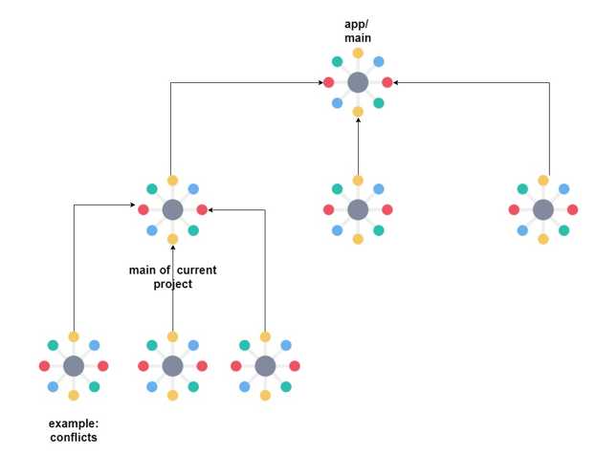
7. Routes React Router DOM V6
Make the routes structure diagram.

Slide 19
7. Routes React Router DOM V6
2. Implementation of the routes in a file called app.router.tsx
import { BrowserRouter, Route, Routes } from 'react-router-dom';
<BrowserRouter>
<Routes>
<Route element={<App />}>
<Route path="/" element={<HomePage />}/>
<Route path="/login" element={<LoginPage />} />
<Route path="/public-route" element={<PublicRouteComponent />}/>
<Route path="/private-route" element={<BaseGuard ><PrivateRoutePage /></BaseGuard>}>
<Route index element={<NestedIndexRouteComponent />}/>
<Route path="nested-route-one" element={<NestedRouteOneComponent />}/>
<Route path="nested-route-two" element={<NestedRouteTwoComponent />}/>
</Route>
<Route path="*" element={<Error404Page />} />
</Route>
</Routes>
</BrowserRouter>
** don’t forget that you have to import every component here

Slide 20
7. Routes React Router DOM V6
3. Implementation of guards for the view using High Order Component
const BaseGuard = ({ children }: IBaseGuardProps) => {
const logged=useAppSelector(userSelector)
const [ isLogged ] = useState<boolean>(logged);
return isLogged ? children : <Navigate to="/login" />;
}
export default BaseGuard;

Slide 21
8. Environments
install the library:
npm install env-cmd
Modify the object called stripts in the package.json file
"scripts": {
"start:dev": "env-cmd -f ./environments/.dev.env react-scripts start",
"build:dev": "env-cmd -f ./environments/.dev.env npm run-script build",
"start:qa": "env-cmd -f ./environments/.qa.env react-scripts start",
"build:qa": "env-cmd -f ./environments/.qa.env npm run-script build",
"start:prod": "env-cmd -f ./environments/.prod.env react-scripts start",
"build:prod": "env-cmd -f ./environments/.prod.env npm run-script build"
}

Slide 22
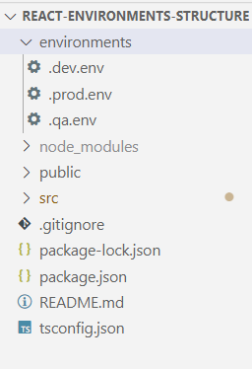
8. Environments
3. create the file in the root of the project
4. invoke the variables
<h1>{process.env.REACT_APP_VARIABLE}</h1>

Slide 23
8. Environments
4. run the project
npm run start:dev
npm run start:prod
npm run start:qa
5. invoke the variables
<h1>{process.env.REACT_APP_VARIABLE}</h1>

Slide 24
9. Forms handler
So, when you want to handle a forms, the most important things is:
Set up the fields
Make up the validation
Be aware when the user touch any field
Blur
Take up the values from the form
To do that we will use Formik npm i formik
Tutorial: Tutorial | Formik
Then, hands on:
Set up the fields
const formik = useFormik({
initialValues: {
firstName: '',
lastName: '',
email: '',
},
validate,
onSubmit: (values:UserModel) => {
dispatch(userIsLoggeed(values))
alert(JSON.stringify(values, null, 2));
},
}); ,

Slide 25
9. Forms handler
Make the validations:
To make the validations we will use the library yup
npm i yup
export class validatorFormHelper {
public static basicForm = yup.object({
firstName: yup.string()
.max(20, "el nombre debe ser maximo de 20 caracteres")
.min(2, "el nombre debe ser mínimo de 2 caracteres")
.required("el nombre es requerido")
.matches(/^(?=.{1,30}$)[a-zA-Z]+(?:[-' ][a-zA-Z]+)*$/gm, "el formato del nombre no es valido"),
email: yup.string()
.email("ingrese un email valido")
.max(50, "el email es demasiado largo")
.min(15, "el email es demasiado corto")
.required("el email es requerido"),
lastName: yup.string()
.max(20, "el nombre debe ser maximo de 20 caracteres")
.min(2, "el nombre debe ser mínimo de 2 caracteres")
.required("el nombre es requerido")
.matches(/^(?=.{1,30}$)[a-zA-Z]+(?:[-' ][a-zA-Z]+)*$/gm, "el formato del apellido no es valido"),
})
}

Slide 26
9. Forms handler
Make the validations:
And then we have to attach the schema to when we want to get a instance of a formik class
const formik = useFormik({
initialValues: {
firstName: '',
lastName: '',
email: '',
},
onSubmit: (values:UserModel, {setSubmitting, resetForm}) => {
dispatch(userIsLoggeed(values));
setSubmitting(false);
resetForm();
alert(JSON.stringify(values, null, 2));
formRef.current?.reset();
},
validationSchema: validatorFormHelper.basicForm
});

Slide 27
9. Forms handler
Be aware when the user touch any field :
The formik library has a API to be aware when the user touches any field in the form. Here the way to do that:
formikInstance.fieldName <<syntax>>
formik.touched.firstName <<example>>
This has to return true if the user touched the field
and return will be return false if the user didn’t touches the field
Blur
The formik library has a API that allow know when the focus over the form field lost, this is implemented with the property called blur. Here the way to implement this:
<input
type="text"
className="basic-form__input"
id="firstName"
name="firstName"
placeholder="Name"
onChange={formik.handleChange}
onBlur={formik.handleBlur}
/>

Slide 28
9. Forms handler
Take up the values from the form: When we are setting the instance of formik library, we have to declare what we want do within the values of the form in onSubmit function. Here, the way to do that:
const formik = useFormik({
initialValues: {
firstName: '',
lastName: '',
email: '',
},
onSubmit: (values:UserModel, {setSubmitting, resetForm}) => {
dispatch(userIsLoggeed(values));
setSubmitting(false);
resetForm();
alert(JSON.stringify(values, null, 2));
formRef.current?.reset();
},
validationSchema: validatorFormHelper.basicForm
});

Slide 29
10. Using ENUMS
Here, the ways to use ENUMS in the react project:
The idea is not “burn” strings values in the code, then we
will put the strings inside a ENUMS. One example of that
can be when we have handle the “IVA”, you know that this
value can change
The state of http request can be fulfilled, rejected or pending
this can be handled with a ENUM

Slide 30
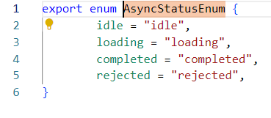
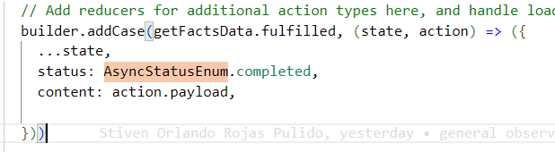
10. Using ENUMS
example in a thunk:

Slide 31
11. About the styles
Here, the recommendations about styles:
Is mandatory use Block Elment Modifier (BEM)
methodology
https://animaticss.com/articulo/que-es-bem-css/
Every component and page has to has its own scss file
The idea is not had .css file in the project to handle the
styles, instead only .scss (sass)

Slide 32
12. Render a child component in a parent component
Sometimes we need to implement a strategy to render a
child component inside a parent component according to
a logic condition. So here the best notation to implement
that:
{ logicCondition && <childComponent/> }
So, only when the value of the logicCondition be true, the
child component will be rendered.
example: { age>=18 && <childComponent/> }
note: The idea is not ose terniary expressions

Slide 33
13. Structure of a component
/*
<<imports zone>>
*/
const ComponentName = ()=>{//ComponentName in PascalCase
/*
<< Hooks zone >>
<< Event handler zone >>
Here we can not put any business logic ** important
Only we can have a SetState of useState
The bussiness logic have to be in the helpers
Inside of any hook we can not put business logic
The Business Logic has to be on the helpers
*/
return (
<div>
<p>Here is the html zone</p>
</div>
)
}

Slide 34
14. Get HTML elements from iteration over a array
When we have to create new HTML element from the
iteration over array, for example when we use a javascript
map operator; The idea is create this HTML elements in the
<<HTML Zone>>> .
Here the example:
{ facts.content && facts.content.map((fact:FactModel, index) => <ul key={index.toString()}>😃{fact.fact}</ul>)}

Slide 35
15. Names of the event handlers in the react component
Here is so important the name of the event handler because likely you have to
implement many handlers of a events over many html elements in a same react
component; This can be very confuse for the developer; To avoid that, the idea
is use the next names convention to the handlers:
handleElementEvent
Example:
const handleSearchButtonClick = () =>{
// here we can not put any business logic ** important
// only we can have a SetState of useState
// the bussiness logic have to be in the helpers
// Inside of any hook we can not put business logic
dispatch(getFactsData({value:'',key:''}))
}//ok

Slide 36
16. Library to handle the keys in HTML generated from a iteration
When you are generate html element using a iterator, for
example the .map; we have to make sure about not repeat
the key of the element; for that reason we will implement the
library:
uuid
https://www.npmjs.com/package/uuid
to use:
install -> npm i uuid
npm i @types/uuid
import import { v4 as uuidv4 } from 'uuid';
use: facts.content.map((fact:FactModel, index) => <ul key={uuidv4()}>😃{fact.fact}</ul>)

Slide 37
Thank You

