Slide 1
Predicting Electricity Price Spikes in Alberta
(2020-2025)
Data 607 machine learning project Comparing MLP, LSTM, CNN, and strong time-series baselines
Core question
Can public AESO market and generation data predict whether the Alberta pool price will exceed CAD 200/MWh two hours ahead?
Source: AESO data merged and modeled by the project team

Slide 2
Motivation And Research Question
Alberta’s deregulated electricity market experiences large hourly pool-price spikes that create financial and operational risk.
Short-horizon spike prediction matters for market participants because dispatch conditions can tighten very quickly.
This project treats spike forecasting as a classification problem instead of only describing past volatility.
Research question
Using publicly available AESO data, can we predict whether a spike occurs at t+2 and determine whether sequence models outperform simpler benchmarks?
Definition of a spike
spike_lead_2 = 1 when the pool price at time t+2 exceeds CAD 200/MWh.
Why the horizon matters
Using t+2 prevents trivial contemporaneous prediction and makes the exercise closer to a short-run operational warning system.
Presentation structure: motivation, data, EDA, methods, results, conclusions

Slide 3
Data Sources And Sample
Dataset 1
Merged sample
AESO Hourly Metered Volumes and Pool Price and AIL: Hourly pool price, system load, and import-export flows.
48,887 hourly observations 2020-01-02 00:00 to 2025-07-30 22:00 Mountain Prevailing Time alignment
Dataset 2
AESO Historical Generation Data (CSD): Hourly generation aggregated by fuel type, including gas, wind, solar, hydro, and coal.
Class imbalance
Overall spike_lead_2 rate = 9.94% Train = 12.37% Validation = 6.15% Test = 1.79%
Engineered features
Net load, reserve-style tightness ratios, fuel shares, lagged price terms, lagged spike indicators, and calendar controls.
Why time-based splits
Train: 2020-01-02 to 2023-11-05 Validation: 2023-11-06 to 2024-12-11 Test: 2024-12-12 to 2025-07-30
Source: AESO datasets merged at the hourly level

Slide 4
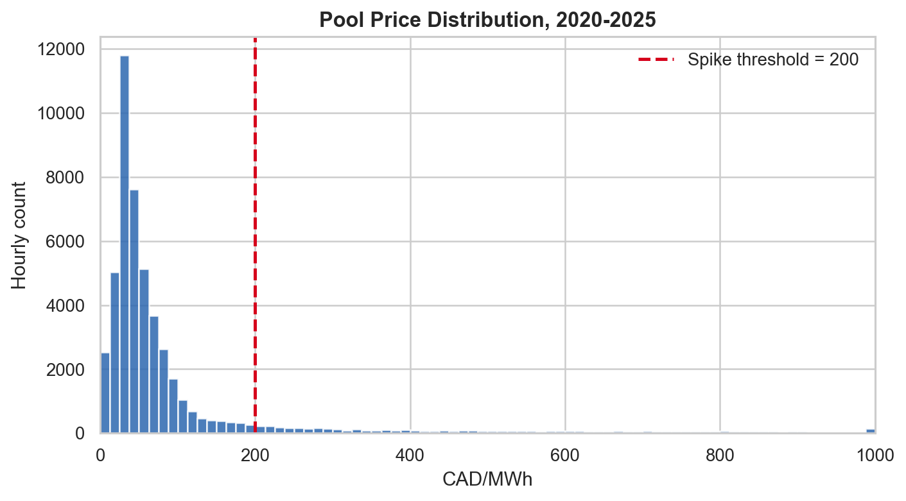
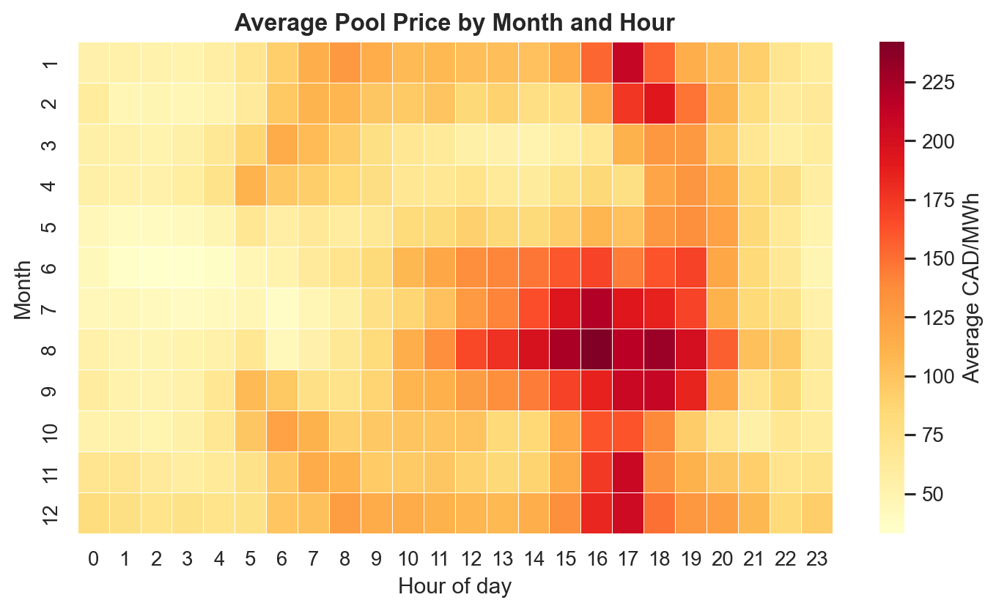
EDA: Price Distribution And Timing
Main EDA takeaways
Pool prices are highly right-skewed: median = CAD 45.34/MWh, 95th percentile = CAD 431.00/MWh, and maximum = CAD 999.99/MWh. Average prices peak in hours 17, 18, and 16; the highest-price months are 8, 12, and 9.
Left: histogram with spike threshold. Right: average price heatmap by month and hour.

Slide 5
EDA: System Conditions Before Spikes
Variable | Unit | No future spike | Future spike at t+2
Current pool price | CAD/MWh | 65.02 | 366.57
Current demand | MW | 9,798 | 10,283
Net load | MW | 8,518 | 9,599
Wind output | MW | 1,103 | 407
Renewables share | % | 13.0% | 6.7%
Reserve margin | ratio | 0.851 | 0.722
Interpretation
Hours followed by spikes are already tighter at time t: current prices and load are higher, while wind output, renewable share, and reserve margin are lower.
Additional signal
net_load_3h_change shifts from -28.26 MW in non-spike rows to 255.35 MW before future spikes.
Economic reading
The EDA is consistent with a scarcity narrative: tighter supply-demand conditions and weaker renewable output tend to precede short-run spikes.
Means are computed by future spike status using spike_lead_2

Slide 6
Prediction Task, Baselines, And Neural Models
Evaluation design
MLP
LSTM
CNN
Target: spike_lead_2 Primary metric: F1-score Thresholds tuned on validation only Untouched test period reserved for final evaluation
Simplest neural benchmark. Flat feature vector with contemporaneous market conditions plus lagged price and spike variables.
Sequential model designed to learn temporal dependence over recent hourly windows without manually expanding all lags.
1D convolutional network that detects local ramp and regime patterns in the recent sequence of market conditions.
Baselines
Naive persistence predicts that the current spike state persists. SARIMAX treats price as I(1), uses d = 1, Fourier seasonality, and walk-forward forecasting to avoid leakage.
Why compare all three on one slide
The modeling strategy intentionally moves from a simple MLP benchmark to richer temporal architectures. This makes it easier to judge whether added sequential structure actually improves spike detection.
Same split logic and validation-threshold tuning were used across models

Slide 7
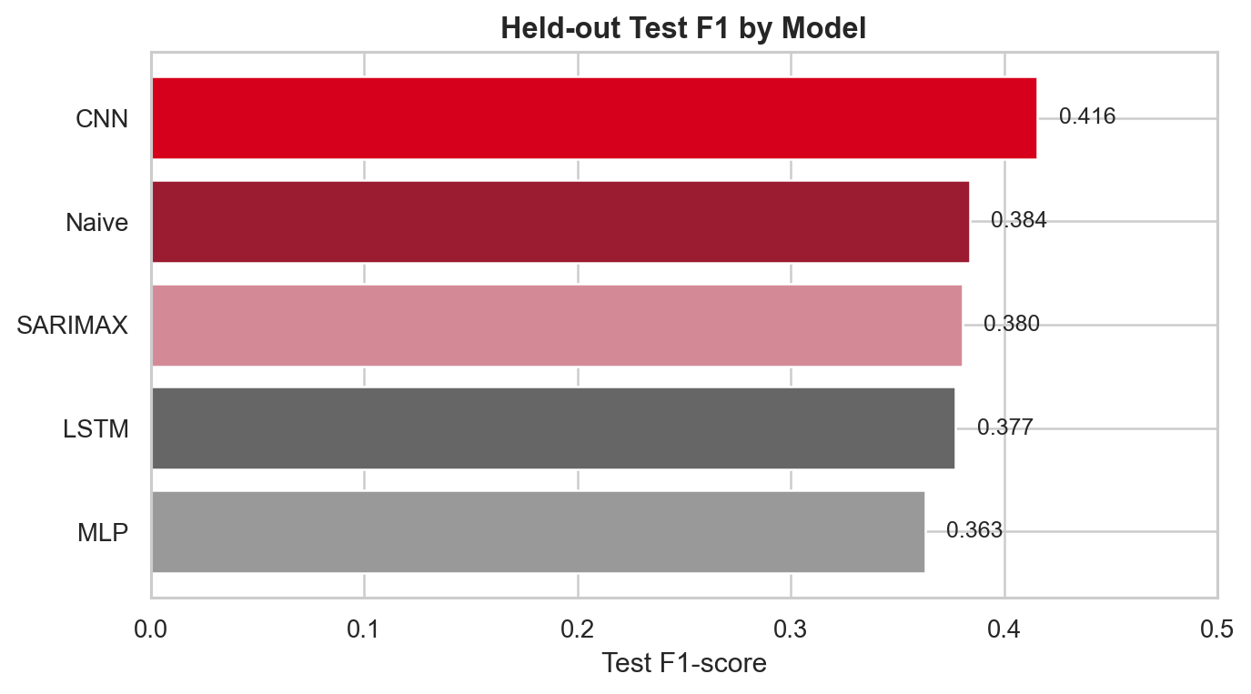
Results Comparison
Model | F1 | Precision | Recall
Naive | 0.384 | 0.384 | 0.384
SARIMAX | 0.380 | 0.412 | 0.354
MLP | 0.363 | 0.275 | 0.535
LSTM | 0.377 | 0.333 | 0.434
CNN | 0.416 | 0.340 | 0.535
Headline result
The CNN achieved the strongest held-out performance (test F1 = 0.416), while the naive baseline remained surprisingly competitive at 0.384.
All metrics are from the untouched test period

Slide 8
Interpretation
Finding 1
Finding 2
Finding 3
The CNN is the only neural model that clearly improved on the naive persistence baseline in held-out F1.
The LSTM and naive baseline were very close. This implies short-run persistence already captures a large share of the available predictive signal.
The MLP remained a useful benchmark because it showed how much can be learned from lagged variables alone before moving to sequence models.
Across the neural models, the same drivers repeatedly surfaced: ACTUAL_POOL_PRICE, wind_total, solar_total, and net_load_3h_change.
Those variables align with the EDA and support an economic interpretation based on system tightness and renewable variability.
The baseline comparison is substantively important: without it, the LSTM would appear stronger than it really is.
Interpretation combines model comparison, feature importance, and system-level economics

Slide 9
Conclusions And Future Work
Public AESO data contains meaningful signal for short-horizon Alberta electricity price spike prediction.
The CNN produced the strongest overall result, but strong simple baselines show the task is harder than raw neural scores alone suggest.
The main practical lesson is that richer temporal structure helps, but model gains remain modest in a changing and imbalanced market.
Future work
Add outage information, weather forecasts, probability calibration, and regime-specific models to improve robustness under changing system conditions.
Presentation takeaway
For this project, the CNN delivered the best balance of precision and recall, while the MLP provided a simple benchmark and the LSTM showed that sequential memory alone was not enough to dominate persistence.
End of presentation

