Slide 1
1
Predicting Alberta Electricity Price Spikes
A summary presentation of the EDA, modeling setup, and final results
Models summarized here: CNN = 0.416, LSTM = 0.394, MLP = 0.363
Target: predict whether the Alberta pool price exceeds CAD 200/MWh at t+2.
Project scope
Use public AESO hourly market and generation data to identify short-run spike risk and compare simple and sequential neural models.
Data 607 presentation summary

Slide 2
Why This Problem Matters
2
Alberta is an energy-only market, so tight supply-demand conditions can translate into sharp hourly price spikes.
Those spikes matter operationally and financially for retailers, generators, large consumers, and risk managers.
The goal is to predict spike risk two hours ahead using only information available at time t.
Modeling sample
48,168 modeled hourly rows 2020-01-03 to 2025-07-01 23:00 Overall spike rate: 10.1%
Main inputs
Pool price, load, imports/exports, generation by fuel type, renewable shares, reserve-style tightness indicators, and lagged features.
Two AESO sources
Hourly Metered Volumes / Pool Price / AIL + Historical Generation Data (CSD)
Source: AESO hourly market and generation datasets

Slide 3
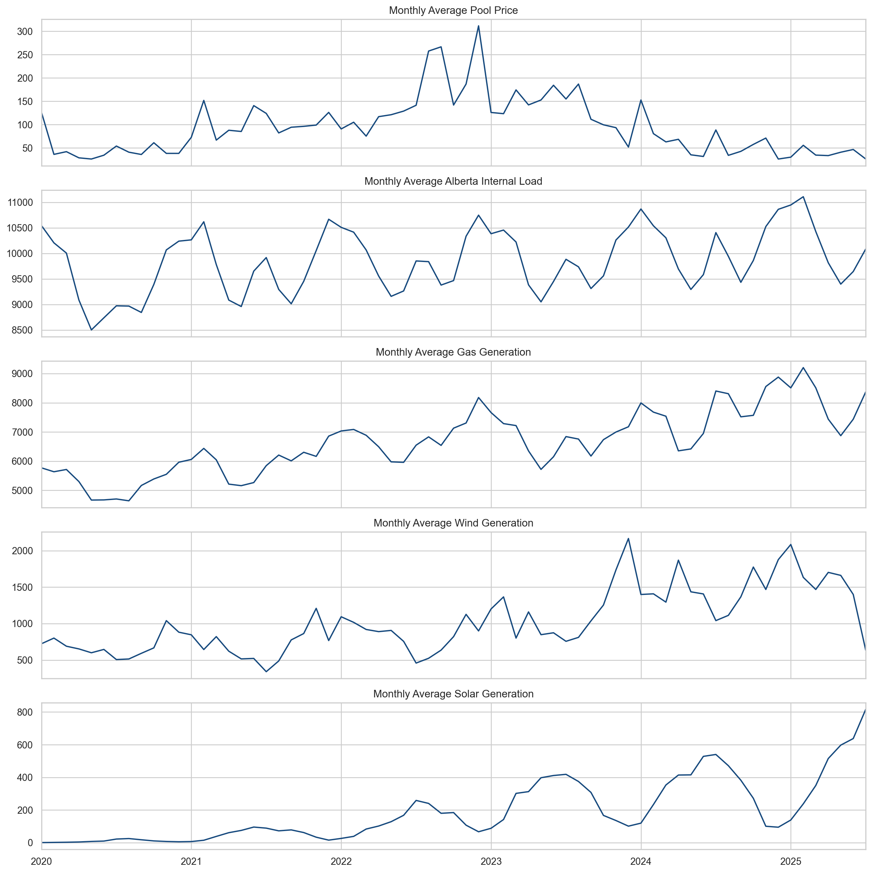
Time Series Overview
3
Price, load, and generation move together through changing system conditions.
Reading the chart
The series shows that Alberta prices are calm most of the time, but they jump sharply in stressed hours. Load and generation conditions provide the context for those jumps.
Project EDA figure: time series overview

Slide 4
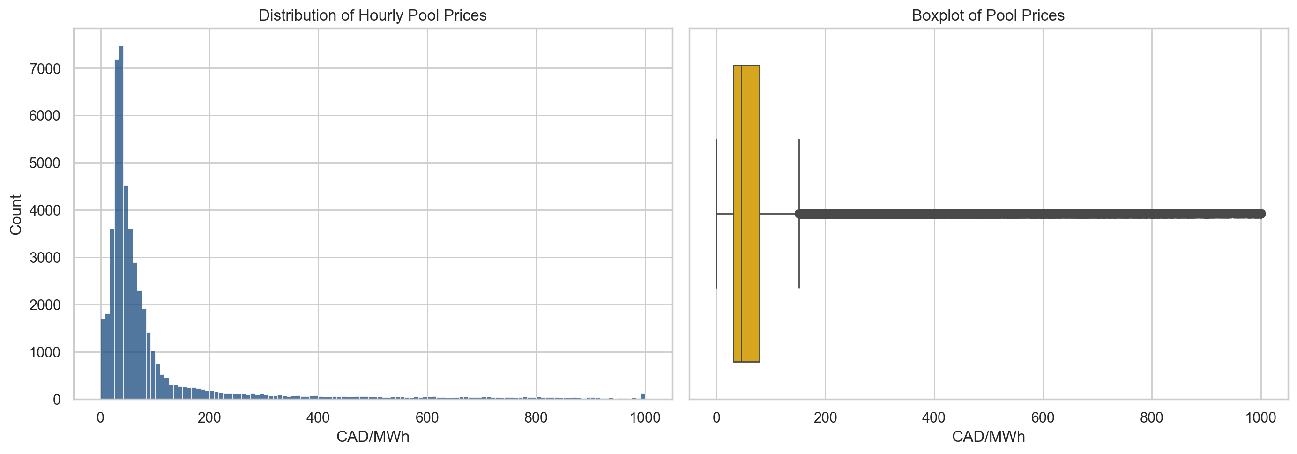
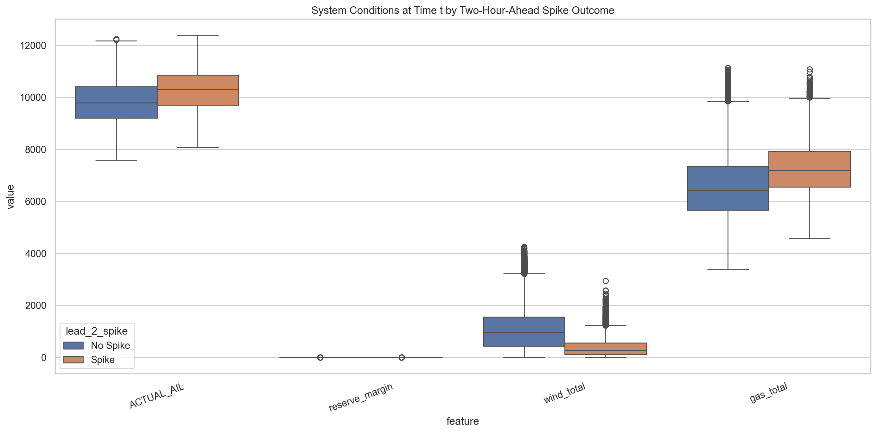
EDA: Heavy Tails And Pre-Spike Conditions
4
The price distribution is strongly right-skewed, which is why spike classification is more useful than plain average-price forecasting.
Rows followed by spikes already show higher stress: higher current prices and net load, but lower wind output and reserve margin.
Project EDA figures: price distribution and spike vs. non-spike comparison

Slide 5
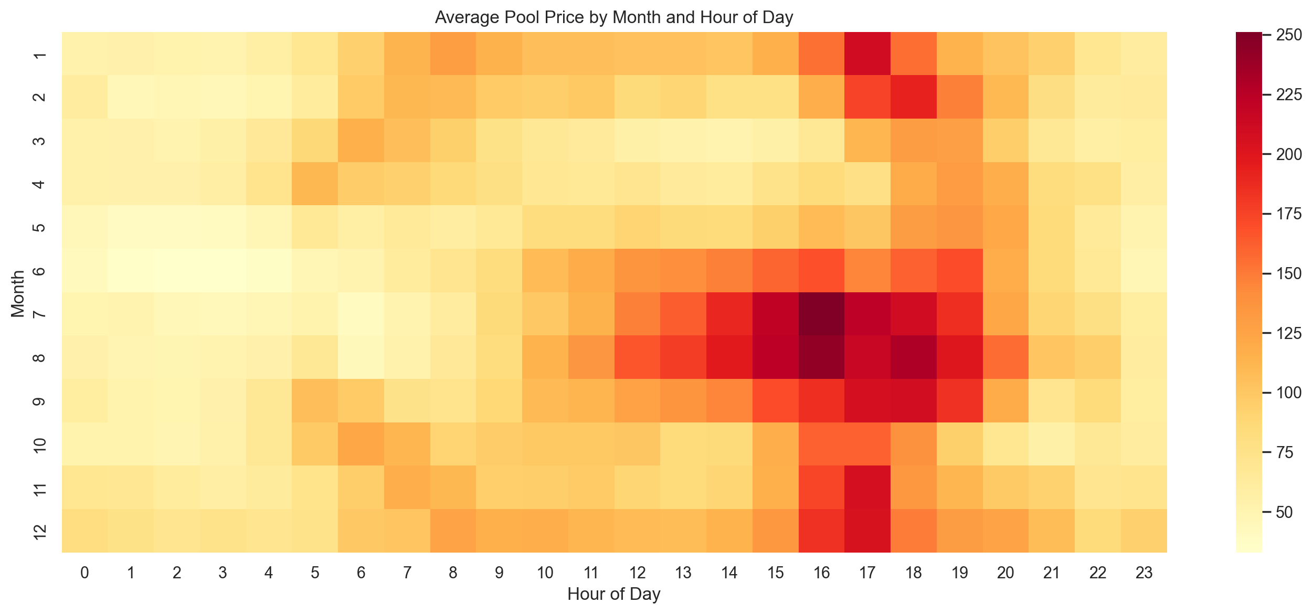
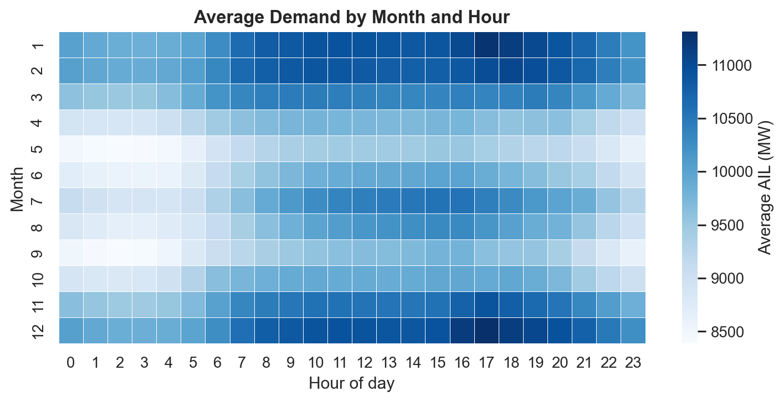
EDA: Patterns By Hour And Month
5
The price heatmap shows that high-price periods cluster in specific hours and months rather than appearing uniformly at random.
The demand heatmap shows predictable hourly and seasonal usage patterns, which helps explain why some periods are consistently more vulnerable to spikes.
Left: average price by month/hour. Right: average AIL by month/hour.

Slide 6
Modeling Setup
6
Target
Metric
Leakage control
Binary spike indicator at t+2 1 if pool price > CAD 200/MWh, else 0
F1-score is the main metric because spikes are rare and precision-recall balance matters more than accuracy.
Strict time-based splitting, training-only scaling, and untouched test data until final evaluation.
Train 33,672 rows 12.4% spikes
Validation 9,648 rows 6.1% spikes
Test 4,848 rows 1.8% spikes
Training and threshold selection were done before the final test period.
This makes the reported model comparison more credible as an out-of-sample summary.
Split summary taken from the project outputs

Slide 7
Three Models, Same Prediction Task
7
MLP
LSTM
CNN
Uses a flat feature vector with lagged price and spike indicators. Role in the project: simple neural baseline.
Uses sequential input windows so the model can learn temporal dependence directly. Role in the project: recurrent benchmark.
Uses temporal filters to detect local ramp and regime patterns in recent observations. Role in the project: strongest final model.
The design intentionally moves from a simple baseline to richer temporal architectures.
That makes it easier to judge whether extra temporal structure actually improves performance.
What changed across models
The target, split, and evaluation logic stayed fixed. Only the architecture changed.
Model summary slide for presentation use

Slide 8
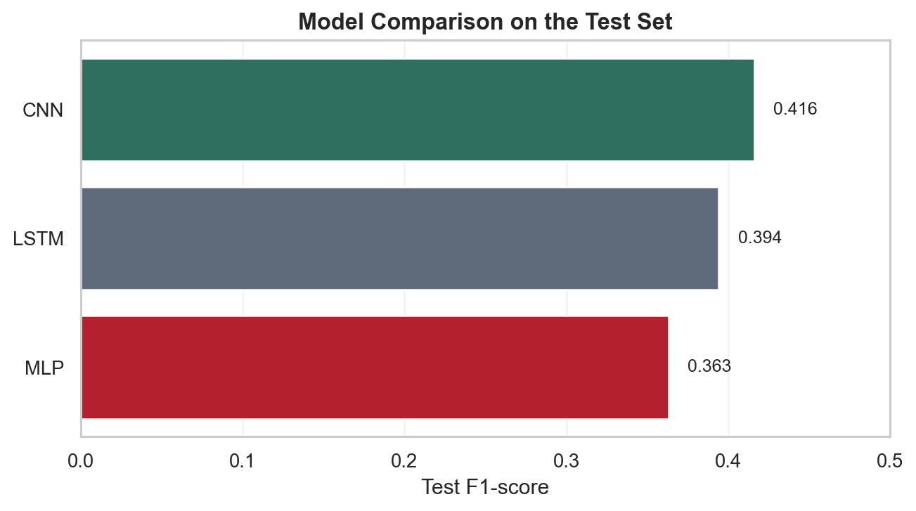
Results Summary
8
Ranking
Main finding
CNN = 0.416 LSTM = 0.394 MLP = 0.363
The CNN delivered the best overall balance of pattern recognition and generalization on the held-out test set.
The CNN had the highest test F1, suggesting that local temporal patterns matter for short-horizon spike prediction.
The LSTM remained competitive but did not surpass the CNN.
The MLP served its purpose as a simpler benchmark, but it captured less of the temporal structure in the data.
Scores used in this summary: CNN 0.416, LSTM 0.394, MLP 0.363

Slide 9
Key Takeaways
9
Takeaway 1
Takeaway 2
Takeaway 3
Electricity prices in Alberta are heavy-tailed, seasonal, and clearly linked to system tightness.
EDA supports the modeling logic: hours before spikes already look different in terms of load, wind, and reserve conditions.
Among the three neural models summarized here, the CNN produced the strongest final result.
This project shows that public AESO data contains useful short-run predictive signal for spike risk.
The summary result is straightforward: CNN first, LSTM second, MLP third.
Next improvements would likely come from weather, outages, and calibration rather than simply adding more text-book complexity.
Professional summary deck generated from project outputs

