Slide 1
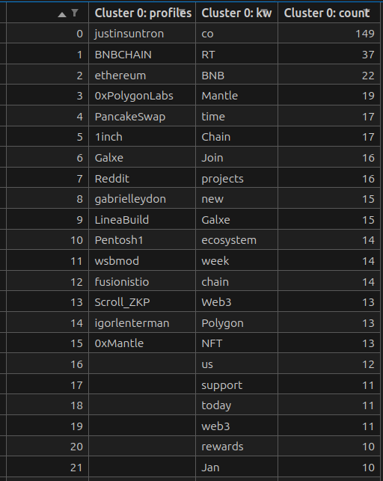
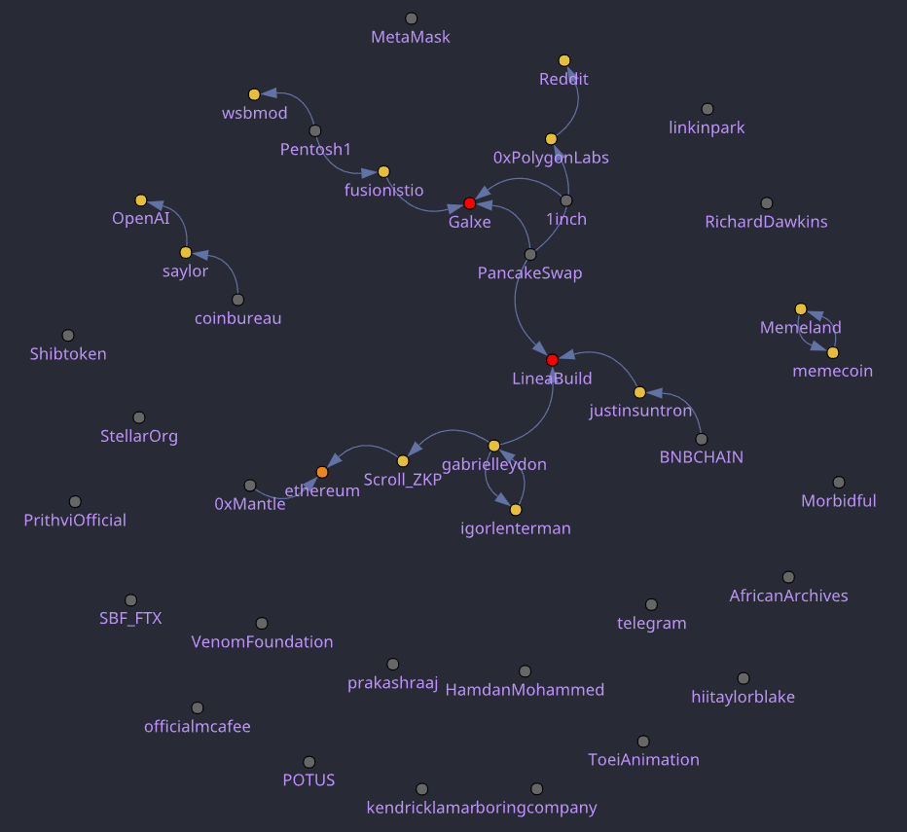
No
How users graph works?
Was the user scraped more than DAYS_TO_UPDATE_TWEETS days ago? Or the user does not exist in DB?
Enter the list of new users.
Yes
Collect Tweets and update User info (low cost, 1~3 requests/user)
Sort users by number of Followers
Maintains the N_BEST_USERS with the highest number of followers
Then, clusters of connected users will be generated within the graph. You can get the keywords by cluster, and individually.
From the set of resulting users. You get who follows who. (N*(N-1) requests for N users.) (high cost, be careful with big N)
With Tweets from the last DAYS_TO_UPDATE_TWEETS days, you get the keywords.

Slide 2
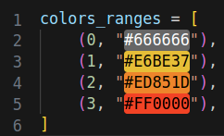
Real Graph of followers and following
The colors of the graph nodes depend on the number of followers within this plot. They can be modified by the user. https://htmlcolorcodes.com/

Slide 3
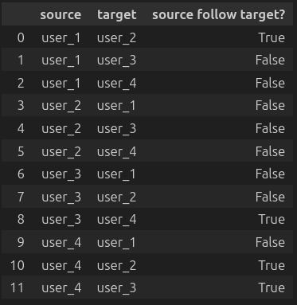
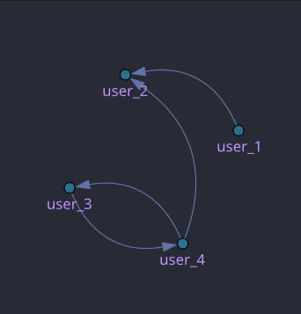
Example of collecting followers for 4 users.
The system needs to check for every possible pair of users, who follows who.
Which determines 2 requests per pair of users.
In this example with 4 users, 12 requests must be made to the server. Both True and False connections are saved in the DB.
And they will only be updated every DAYS_TO_UPDATE_FOLLOWS_LINK days.

Slide 4
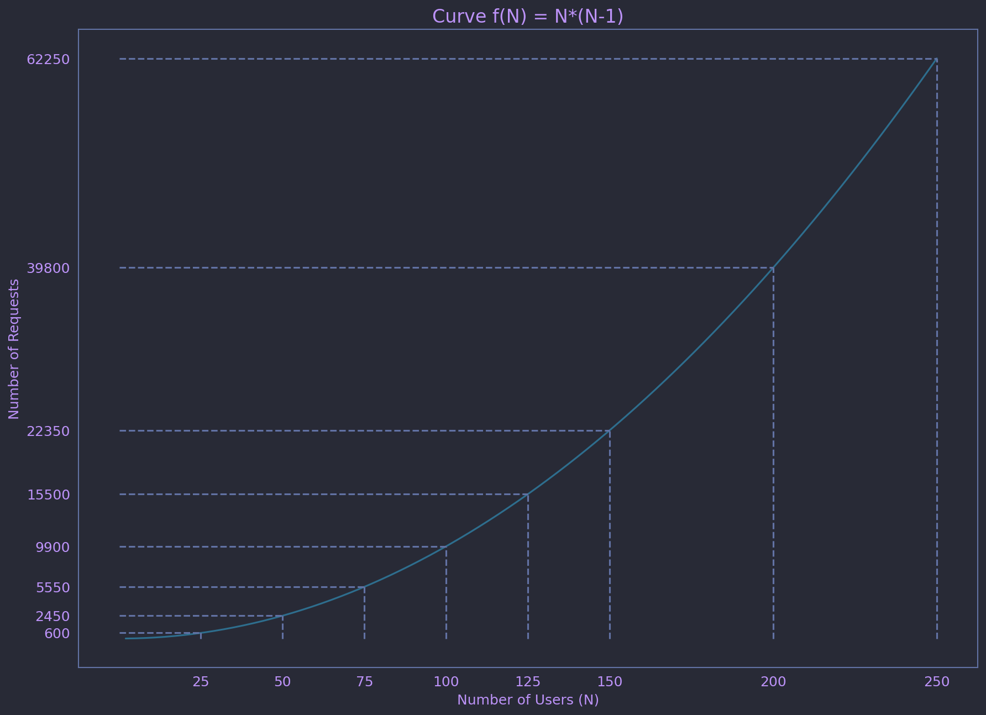
The following plot shows the number of requests to the server based on the number of users in the follower graph.

