Slide 1
Coding conventions

Slide 2
Overview:
1. General definitions and purpose of coding conventions.
2. General code writing standards and general principles.
3. Code Conventions for the JS Programming Language.
4. Tools for good coding.
5. Resours.

Slide 3
Coding conventions are a set of guidelines for a specific programming language that recommend programming style, practices, and methods for each aspect of a program written in that language.

Slide 4
„Any fool can write code that a computer can understand. Good programmers write code that humans can understand.“
Martin Fauler

Slide 5
Code conventions are important to programmers for a number of reasons:
● 40%–80% of the lifetime cost of a piece of software goes to maintenance.
● Hardly any software is maintained for its whole life by the original author.
● Code conventions improve the readability of the software, allowing engineers to understand new code more quickly and thoroughly.
● Following the rules of writing code reduces the possibility of error.

Slide 6
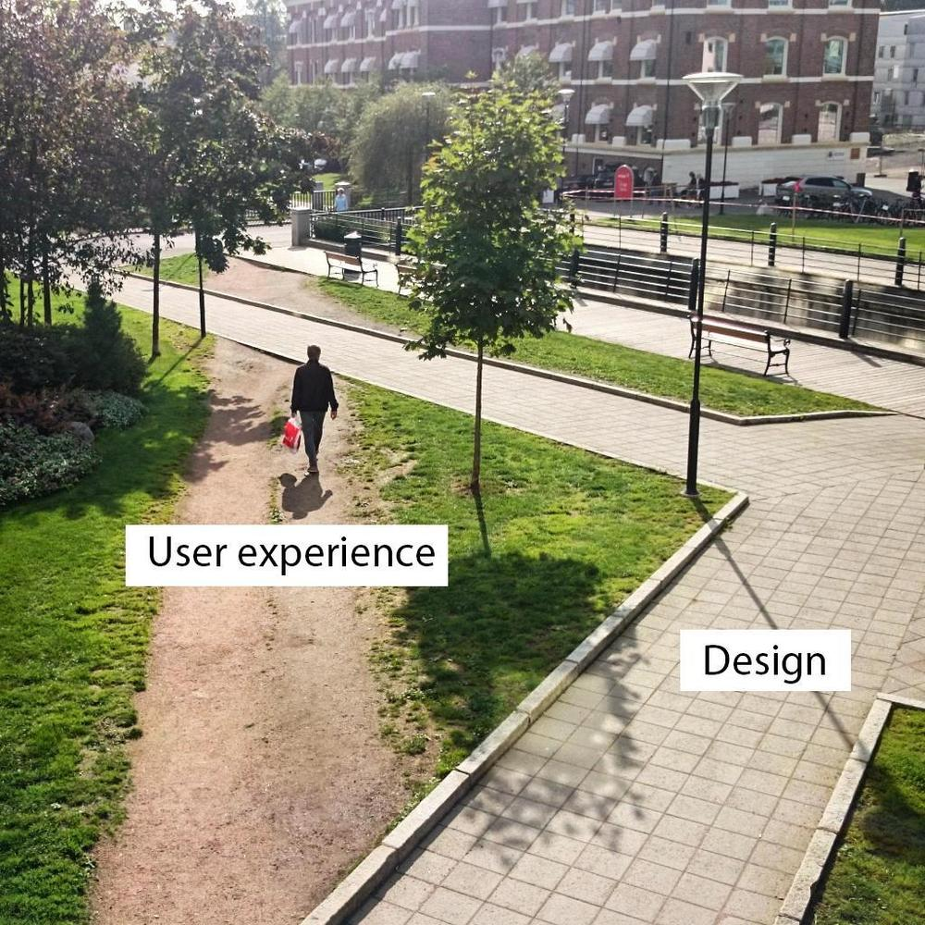

Slide 7
Common conventions:
● Comment conventions
● Indent style conventions
● Line length conventions
● Naming conventions
● Programming practices
● Programming principles
● Programming style conventions

Slide 8



Slide 9
JavaScript Coding Conventions:
● Naming Conventions
● Spaces Around Operators
● Statement Rules
● Comments
● Whitespace
● JavaScript Files
● Other Rules

Slide 10


Variable Names:
Bad Practices Best Practices
let FirstName = "John"; let firstName = "John";
let first-Name = "John"; const = “ALL_CAPS”
let first_Name = "John";
let 1Name = "John";
let golovneImia = "John";
let fN = "John";
let $first%Name = "John";
var firstName = "John";

Slide 11
Function and Class Names:
Bad Practices Best Practices
function x (){...} function doSomething() {...}
class y{...} class Figure {...}

Slide 12
Whitespace:
Bad Practices Best Practices
function x (){...} function doSomething() {...}
while(false) {...} while (true) {...}
let x =y+z/c*b; let x =y + z / c * b;
const values = [ 1,2,3 ]; const values = [1, 2, 3];

Slide 13
Code Indentation:
Bad Practices Best Practices
function pow(x, n) { function pow(x, n) {
let result = 1; let result = 1;
for (let i = 0; i < n; i++) { // <--
result *= x; for (let i = 0; i < n; i++) {
} result *= x;
return result; } } // <--
return result;
Do not use tabs (tabulators) for indentation! }

Slide 14
Curly Braces and Semicolons
● In most JavaScript projects curly braces are written in “Egyptian” style with the opening brace on the same line as the corresponding keyword – not on a new line. There should also be a space before the opening bracket, like this:
if (condition) {
// do this;
}
● A semicolon should be present after each statement, even if it could possibly be skipped.

Slide 15
Other simple rules:
● Line Length < 80;
● JavaScript programs should be stored in and delivered as .js files;
● Be generous with comments;
● Don't Use new Object();
● Use === Comparison;
● Use Parameter Defaults;

Slide 16
An example of bad code
function task(num) { // <-- bad name
const arr = [] // <-- without Semicolons
for (let i = 100; i < 999; i++) {
let b = i.toString().split('').map(Number) // отримуємо всі тризначні числа у вигляді набору цифр щоб потім отримати їх суму
let d = b.reduce((acc, curVal) => acc + curVal) // отримуємо суму чисел в вигляді числа
if (d < num) {
arr.push(b.join('')) // звіряємо чи менше число ніж 27 і якщо так, то додаємо число в масив
}
}
console.log(arr) // <-- without Semicolons
}
task(27)

Slide 17
An example of bad code
function findSumDivNum(a){ // <-- without whitespase before curly braces;
sumDiv=0;
for(i=1;i<a;i++){ // <-- without whitespase before braces;
if(a % i ===0){ // <-- no horizontal indentation, between operators;
sumDiv+=i;
}
}
return sumDiv;
}

Slide 18
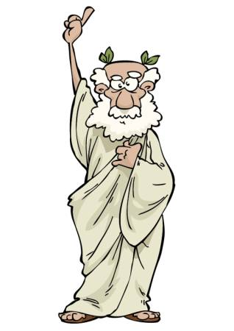

“errare humanum est”
ESLint

Slide 19
Resours:
1. https://www.w3schools.com/js/js_conventions.asp
2. “Refactoring: Improving the Design of Existing” - by Martin Fowler (Author);
3. https://www.crockford.com/code.html
4. “Clean Code” - by Robert C. Martin (Author);
5. https://learn.javascript.ru/coding-style

Slide 20


