Slide 1
Coupling and cohesion
KISS DRY YAGNI

Slide 2
Overview:
1. Introduction.
2. Coupling and cohesion .
3. DRY principle.
4. KISS principle.
5. YAGNI principle.
6. Conclusion.
7. Resours.

Slide 3
Introduction
Modules
As our application grows bigger, we want to split it into multiple files, so called “modules”. A module may contain a class or a library of functions for a specific purpose.
For a long time, JavaScript existed without a language-level module syntax. That wasn’t a problem, because initially scripts were small and simple, so there was no need.
But eventually scripts became more and more complex, so the community invented a variety of ways to organize code into modules, special libraries to load modules on demand.

Slide 4
Advantages of using modules:
● make them transparent
● speed up writing
● speed up testing of programs
● reduce maintenance costs
● lasy Loading
● possibility of reuse

Slide 5
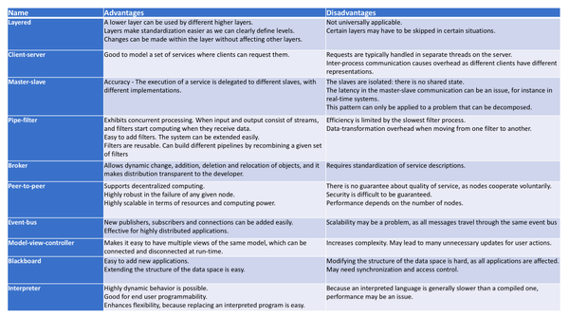

Slide 6
Low Coupling и High Cohesion
Quality design has a low coupling and high cohesion
This means that the software component has a small number of external links and is responsible for solving similar tasks.

Slide 7
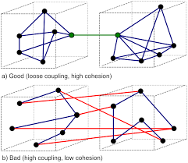

Slide 8
Coupling
Coupling - the ability and degree of interdependence between software modules; strength of relationships between modules; the degree of interdependence of different subroutines or modules.

Slide 9

High coupling
Low coupling
High coupling is considered a serious drawback, as it makes it difficult to understand the logic of the modules, their modification, autonomous testing, as well as reuse separately.
Low coupling, on the other hand, is a hallmark of a well-structured and well-designed system, and when combined with high cohesion, is consistent with overall readability and traceability.

Slide 10
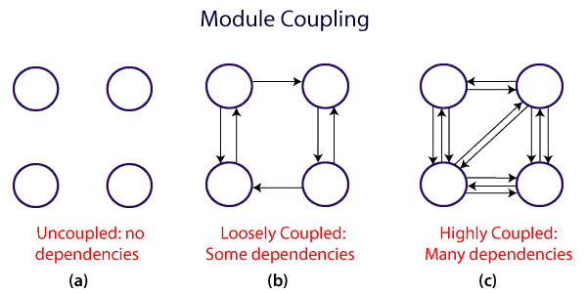
The various types of coupling techniques

Slide 11
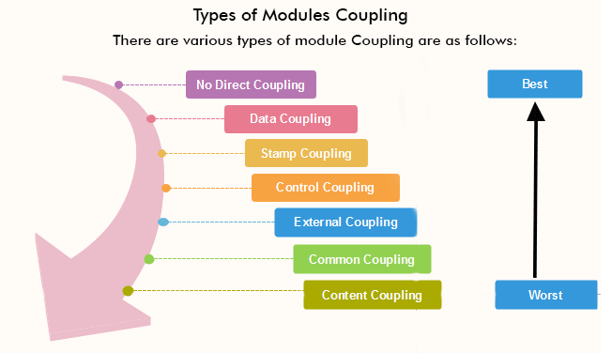
Types of Module Coupling

Slide 12
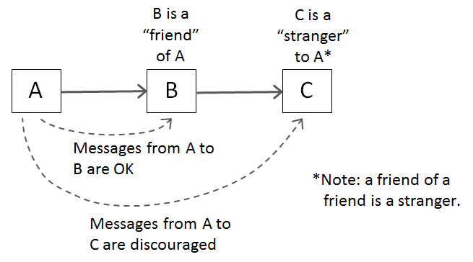
Law of Demeter, LoD

Slide 13
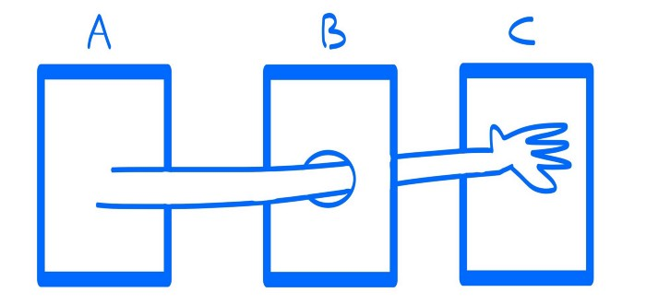
Law of Demeter, LoD

Slide 14
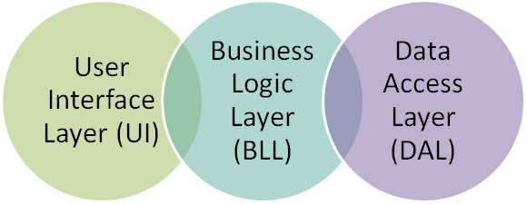
Cohesion

Slide 15
Cohesion
In computer programming, cohesion defines to the degree to which the elements of a module belong together. Thus, cohesion measures the strength of relationships between pieces of functionality within a given module. For example, in highly cohesive systems, functionality is strongly related.

Slide 16
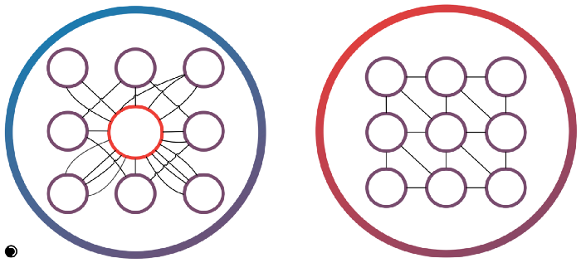
Cohesion

Slide 17
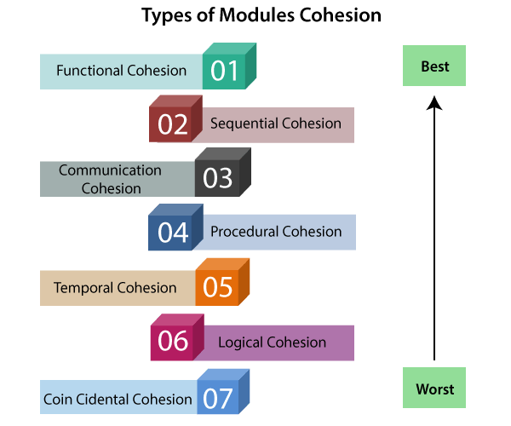
Types of Modules Cohesion

Slide 18
Differentiate between Coupling and Cohesion
Coupling Cohesion
Coupling is also called Inter-Module Binding. Cohesion is also called Intra-Module Binding.
Coupling shows the relationships between modules. Cohesion shows the relationship within the module.
Coupling shows the relative independence between Cohesion shows the module's relative functional the modules. strength.
While creating, you should aim for low coupling, i.e., While creating you should aim for high cohesion, i.e., a
dependency among modules should be less. cohesive component/ module focuses on a single function (i.e., single-mindedness) with little interaction with other modules of the system.
In coupling, modules are linked to the other modules. In cohesion, the module focuses on a single thing.

Slide 19
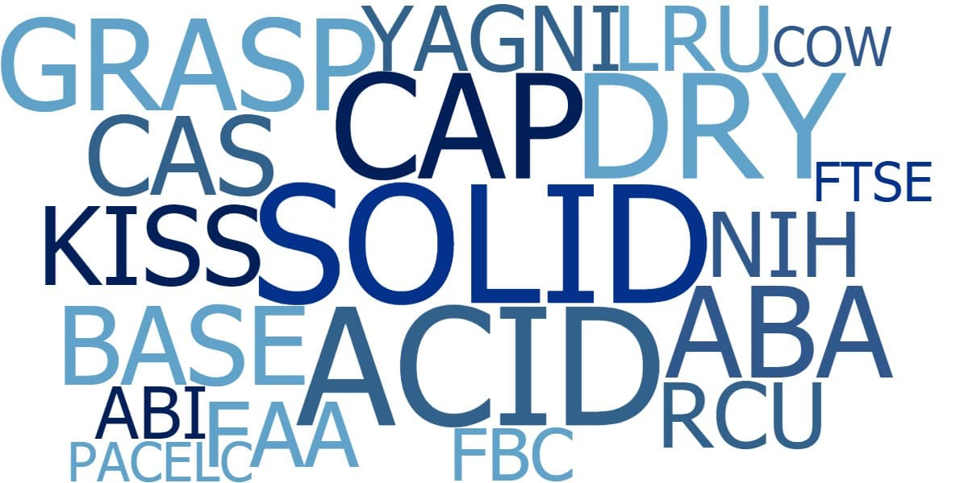

Slide 20
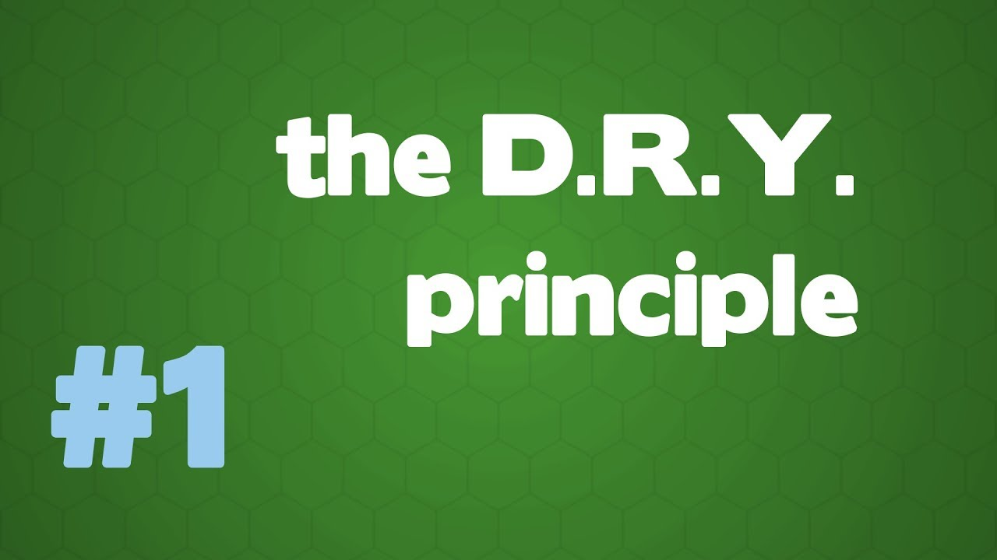

Slide 21
Every piece of knowledge must have a single, unambiguous, authoritative representation within a system.
DRY is about the duplication of knowledge, of intent. It’s about expressingthe same thing in two different places, possibly in two totally different ways

Slide 22
WET
write every time
write everything twice
we enjoy typing
waste everyone's time

Slide 23
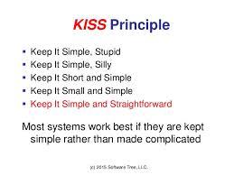

Slide 24
KISS Principle
This principle says about to make your code simple. You should avoid unnecessary complexity. A simple code it’s easier to maintain and easier to understand.

Slide 25
KISS Principle
In designing the following principles KISS is expressed
in the fact that:
- it makes no sense to implement additional functions that will not be used at all;
- it is not necessary to overload the interface with those options which will not be necessary to the majority of users;
- it is pointless to implement a complex business logic that teaches absolutely all possible options for the introduction of systems, user and environment;
- you should not connect a huge library if you only need a couple of functions from it;

Slide 26
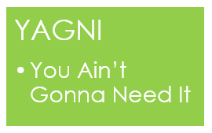

Slide 27
YAGNI Principle
It means that you should not implement functionality just because you think that you may need it someday, but implement it just when you really need it. Doing that you will avoid spending time with implementations that were not even necessary, and maybe will never be used.

Slide 28
YAGNI Principle
There are simply no "free" functions in software products!
Always implement things when you actually need them, never when you just foresee that you need them.

Slide 29
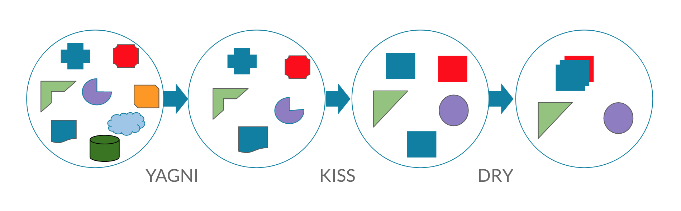
Conclusion

Slide 30
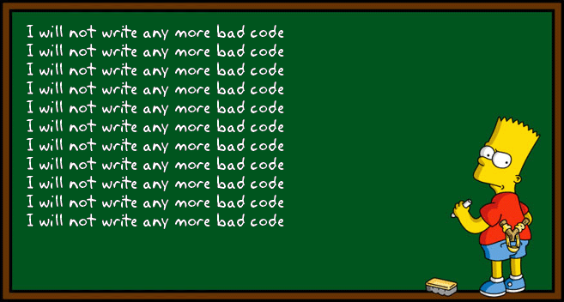

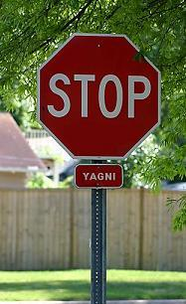

Slide 31


