Slide 1
NoSQL databases.
MongoDB. Mongoose.

Slide 2
Agenda
● What is NoSQL?
● SQL vs. NoSQL
● Types of NoSQL Databases
● Introduction to MongoDB
● Document Database
● Key Features
● Basic commands
● Mongoose
● How to use mongoose?
● Model, Schema

Slide 3
What is NoSQL?
NoSQL (not only SQL), is a term denoting a number of approaches aimed at implementing database repositories that have significant differences from the models used in traditional relational databases with access to these SQL tools.

Slide 4
Differences SQL vs. NoSQL
● SQL databases are relational, NoSQL are non-relational.
● SQL databases use structured query language and have a predefined schema. NoSQL databases have dynamic schemas for unstructured data.
● SQL databases are vertically scalable, NoSQL databases are horizontally scalable.
● SQL databases are table based, while NoSQL databases are document, key-value, graph or wide-column stores.
● SQL databases are better for multi-row transactions, NoSQL are better for unstructured data like documents or JSON.

Slide 5
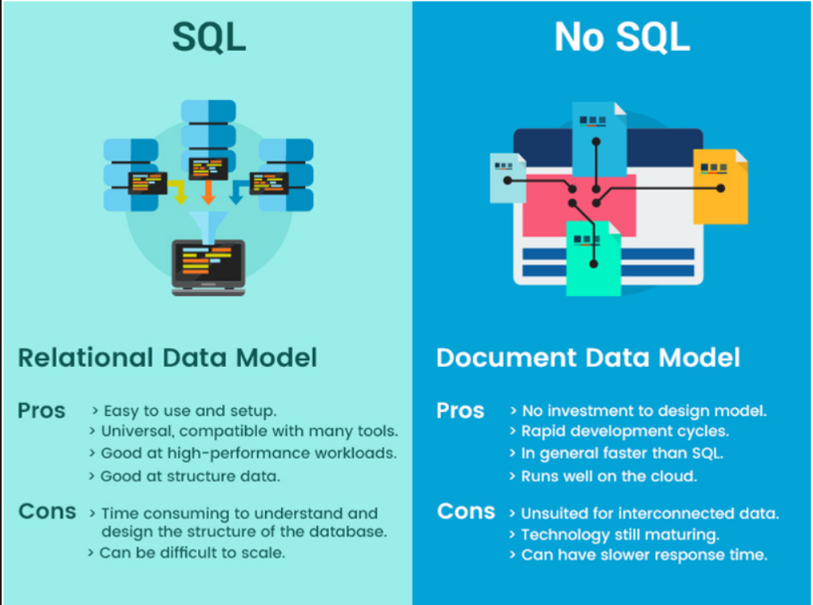
SQL vs. NoSQL

Slide 6
Why NoSQL is better?
Flexibility.
Thanks to the use of flexible data models, NoSQL databases are well suited for partially structured and unstructured data.
Scalability.
High performance.
NoSQL databases are optimized for specific data models.

Slide 7
Types of NoSQL Databases
NoSQL Databases are mainly categorized into four types: Key-value pair, Column-oriented, Graph-based and Document-oriented. Every category has its unique attributes and limitations. None of the above-specified database is better to solve all the problems. Users should select the database based on their product needs.

Slide 8
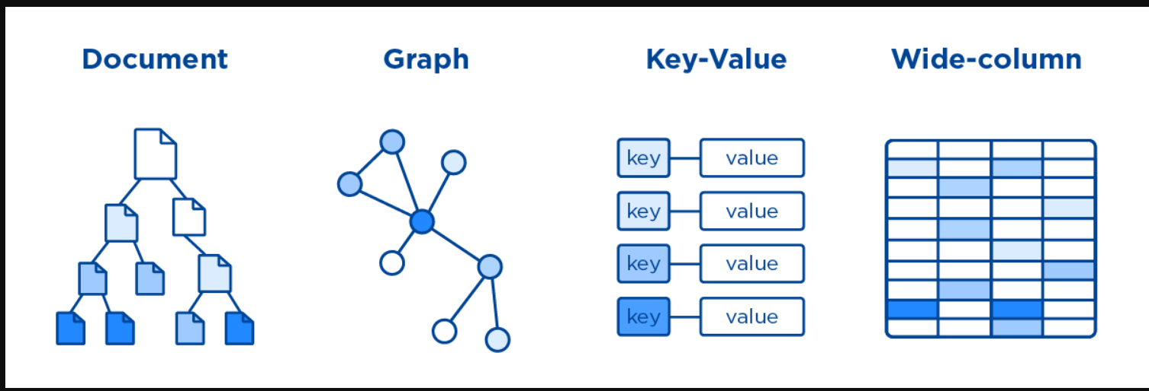
Types of NoSQL Databases

Slide 9
Types of NoSQL Databases
key-value database, aka key-value store, associates a value (which can be anything from a number or simple string, to a complex object) with a key, which is used to keep track of the object. In its simplest form, a key-value store is like a dictionary/array/map object as it exists in most programming paradigms, but which is stored in a persistent way and managed by a Database Management System (DBMS).
Redis, Dynamo, Riak are examples of key-value store DataBases.
column is a database object that contains columns of related data. It is a tuple (pair) that consists of a key-value pair, where the key is mapped to a value that is a set of columns. In analogy with relational databases, a column family is as a "table", each key-value pair being a "row".
HBase, Cassandra, HBase, Hypertable are NoSQL query examples of column based database.

Slide 10
Types of NoSQL Databases
graph type database stores entities as well the relations amongst those entities. The entity is stored as a node with the relationship as edges. An edge gives a relationship between nodes. Every node and edge has a unique identifier.
Compared to a relational database where tables are loosely connected, a Graph database is a multi-relational in nature. Traversing relationship is fast as they are already captured into the DB, and there is no need to calculate them.
Graph base database mostly used for social networks, logistics, spatial data.
Neo4J, Infinite Graph, OrientDB, FlockDB are some popular graph-based databases.
NoSQL document databases are based on a model that does not require SQL and tables, unlike relational databases. Instead of using tables with the data types, columns, rows, schemas, and tabular relations used in relational databases, NoSQL databases use documents with data type descriptions and values.
MongoDB, Riak, Lotus Notes, MongoDB, are popular Document originated DBMS systems.

Slide 11


Slide 12
MongoDB is a document database designed for ease of development and scaling.
A record in MongoDB is a document, which is a data structure composed of field and value pairs. MongoDB documents are similar to JSON objects. The values of fields may include other documents, arrays, and arrays of documents.
MongoDB code is written in C ++.
Unlike relational databases, MongoDB offers a document-oriented data model, which makes MongoDB faster, more scalable, and easier to use.

Slide 13
Key Features
● Data format in MongoDB
MongoDB's way of storing data is similar to JSON in this regard, although JSON is not formally used. For storage in MongoDB, a format is used called BSON (BiSon) or short for binary JSON.
● Cross-platform
MongoDB can be deployed on Windows, Linux, MacOS, Solaris platforms.

Slide 14
Key Features
● Documents instead of strings
Relational databases store strings, then MongoDB stores documents. Unlike strings, documents can store information that is complex in structure. A document can be thought of as a store of keys and values.
● Collections
The traditional SQL world has tables, the MongoDB world has collections. And if in relational databases tables store the same type of rigidly structured objects, then a collection can contain a variety of objects with a different structure and a different set of properties.

Slide 15
Key Features
● Ease of use
No rigid database schema this regard, no need to think about rebuilding the database and waste time building complex queries, scaling.
● GridFS
Special technology GridFS, which allows you to store data larger than 16 MB.

Slide 16
Database
The database is represented as a physical collection store.
Collection
A collection is a group of MongoDB documents.
Document
A document is a collection of key-value pairs.

Slide 17
Sample document
{
_id: ObjectId(7bf78ad8902c)
title: 'MongoDB',
description: 'Simple MongoDB Database',
by: 'proselyte',
url: 'proselyte.net',
tags: ['proselyte tutorials', 'NoSQL', 'MongoDB'],
developers: [
{
developer:'developer1',
specialty: 'Java Developer'
},
{
developer: 'developer2'
specialty: 'C++ Developer'
}
]
}

Slide 18
Data types
Timestamp
Min / Max
Object ID
Regular Expression
Code
Binary data
Date
Double
Integer
Boolean
String
Arrays
Object
Symbol
Null

Slide 19
Basic commands
> use name_db;
> db.createCollection(name_collection);
> show collections;
>db.name_collection.drop( );
> db.name_collection.find( );
> db.name_collection.insert( );
> db.name_collection.update( );
> db.name_collection.find( ).sort( )

Slide 20
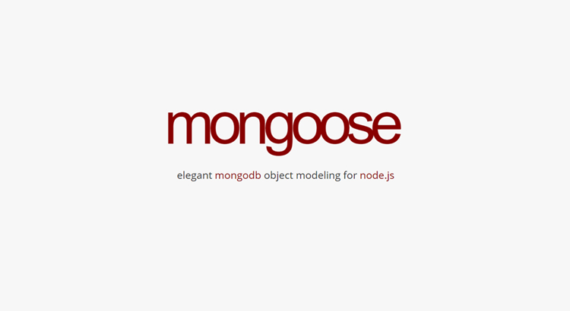

Slide 21
Mongoose is an interface to MongoDB, an open source NoSQL database that uses a document-oriented data model. In MongoDB, "collections" and "documents" are analogous to "tables" and "rows" in relational databases.

Slide 22
How to use mongoose?
$ npm install mongoose
// Using Node.js `require()`
const mongoose = require('mongoose');
// Connecting to MongoDB
await mongoose.connect('mongodb://localhost/my_database', {
useNewUrlParser: true,
useUnifiedTopology: true,
useFindAndModify: false,
useCreateIndex: true
});

Slide 23
Mongoose is a Node.js based Object Data Modeling (ODM) library for MongoDB.
A huge benefit of using a NoSQL database, like MongoDB, is that you are not constrained to a rigid data model.
But being too flexible can also be a challenge.
We have ODM's like Mongoose, which from the get-go force us into a semi-rigid schema.
We would first define a schema and then create an accompanying Mongoose model.

Slide 24
Defining a Model
Models are defined through the Schema interface.
const Schema = mongoose.Schema;
const ObjectId = Schema.ObjectId;
const User = new Schema( {
name: String,
sity: String,
age: Interger
} );

Slide 25
Using this scheme, we create a user model
const User = mongoose.model("User", userScheme);
Next, we can create objects of this model
const user = new User( {
name: "Bill",
sity: "Lviv",
age: 38
} );

Slide 26
Method save saves the current object to the database
user.save( function( err ) {
mongoose.disconnect( ); //disconnec
If ( err ) return console.log(err);
console.log("save", user);
} );

Slide 27


