Slide 1
MoodScriber Data Challenge Contest
Presentation by
Alekh Taori
Reg. No. 202000423
CSE, B Tech, 4th Year

Slide 2
Data Description and process
Dataset – “Input.xlsx”
Populated dataset – “Augmented_data.xlsx”
By reference from the Moodscriber App and Using Random choice:
(2100, 10) : New size after populating
New data:
Time of the day : Morning, afternoon, evening
Weather: 'Sunny', 'Cloudy', 'Rainy', 'Snowy’
Sleep hours: 4 to 10
Diet: 'Balanced', 'Unhealthy', 'Skipped Meals', 'Overeating’
Exercise: 'None', 'Light', 'Moderate', 'Intense’
Social Interactions: 0-10
Made sure data is clean. No blank fields, etc.

Slide 3
Here are some questions that would drive insightful information out of the data:
How does mood vary by day of the week? To determine if there are certain days when users generally feel better or worse.
What impact does the weather have on mood? Analyzing mood variations with different weather conditions like sunny, rainy, etc.
Is there a correlation between sleep hours and mood? Understanding if a lack of sleep correlates with negative moods or not.
Does the type of diet correlate with mood? Investigating if dietary choices (balanced, unhealthy, etc.) affect users' moods.
What are the common activities associated with positive and negative moods? Identifying activities that often lead to happiness or sadness.

Slide 4
6. How does the time of day affect mood? Examining mood fluctuations throughout the day (morning, afternoon, evening).
7. What is the effect of social interactions on mood? Analyzing how social interactions contribute to mood swings.
8. Is there any effect of diet on sleep? Can a good diet contribute to better sleep?
9. How does mood variation correlate with combined factors like diet and exercise? Examining the combined effect of multiple lifestyle factors on mood.

Slide 5
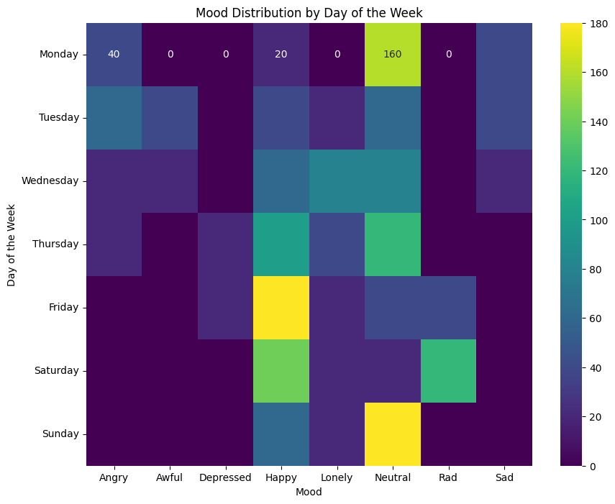
How does mood vary by day of the week?
Observations:
Most people have a neutral feeling on Mondays.
As the week progresses, people feel happier starting on Thursdays.
People are happiest during Fridays, followed by Saturdays - most logical explanation being the arrival of weekend.
As Sunday arrives there is a mixed feeling, since the next day is a Monday.

Slide 6
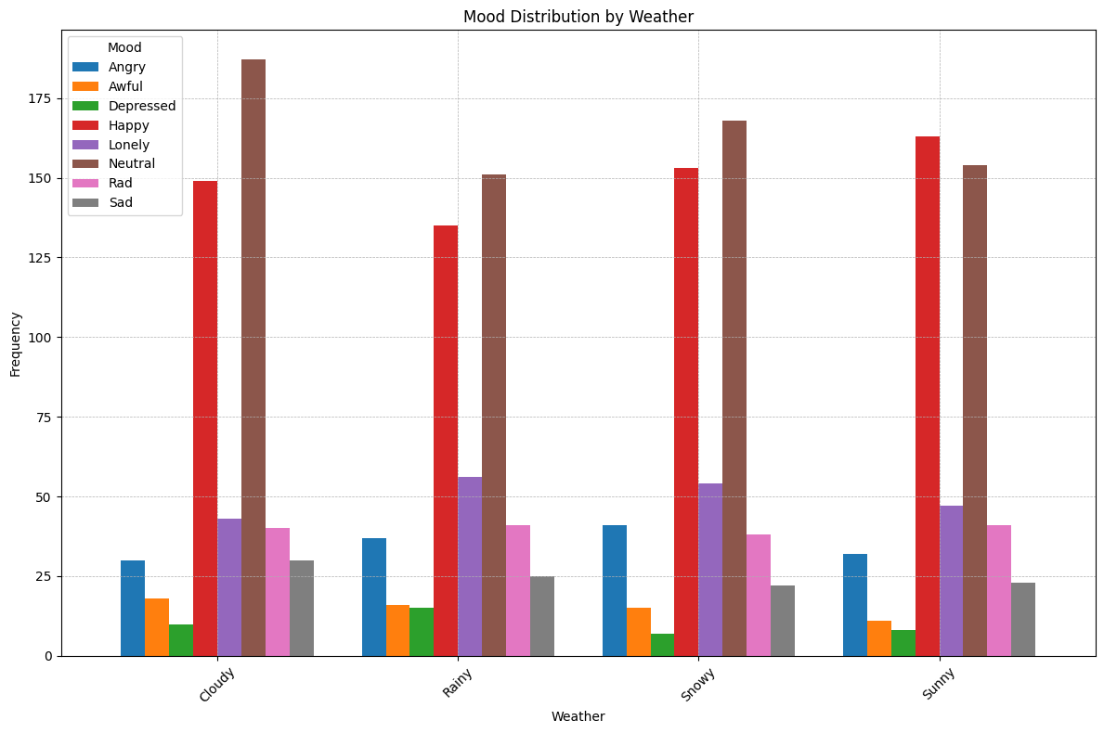
What impact does the weather have on mood?
Observations:
Most people have a neutral or a positive feeling irrespective of the weather.
However, people tend to show a negative emotion such as feeling lonely, depressed or awful during cloudy, rainy or snowy weather.
Most people show a positive state of emotions in a sunny weather.
This suggests sunlight can have a positive impact on people’s mood.

Slide 7
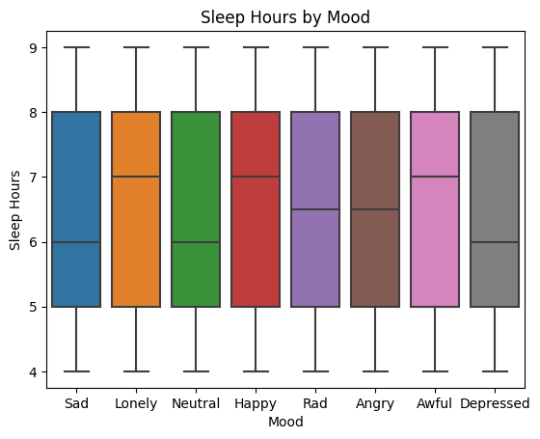
Is there a correlation between sleep hours and mood?
Observations:
The box plot of happy people’s distribution is negatively skewed suggesting that most people who sleep between 7-8 hours tend to be happier.
People having negative moods tend to either oversleep or under sleep.
This shows that sleep and mood are correlated in a way.

Slide 8
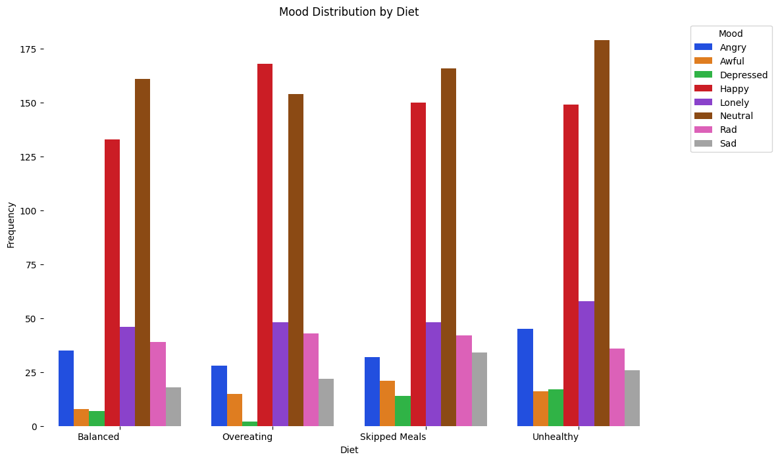
Does the type of diet correlate with mood?
Observations:
Most people tend to over-eat when they are happy. This might be true vice-versa.
People consuming unhealthy diet or skipping meals often tend to be having a negative mood such as sad, lonely or awful.
The diet and mood are hence intercorrelated.

Slide 9
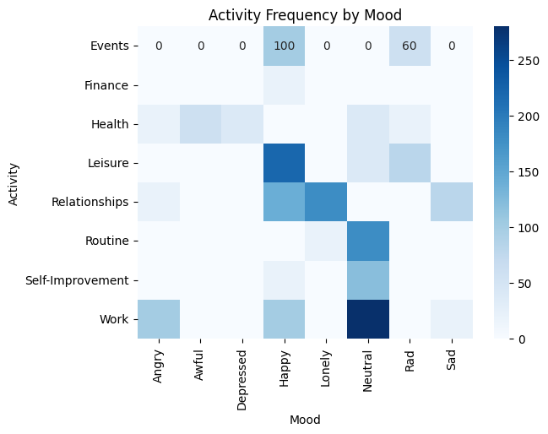
What are the common activities associated with positive and negative moods?
Observations:
Most people respond positively and are happy after activities such as having a leisure time, attending or taking part in an event or relationships.
However, people seem to have a negative feeling such sad or lonely when it comes to relationships.
While a high distribution showcases an angry mood regarding work, there is nearly an equal distribution of people happy about work.

Slide 10
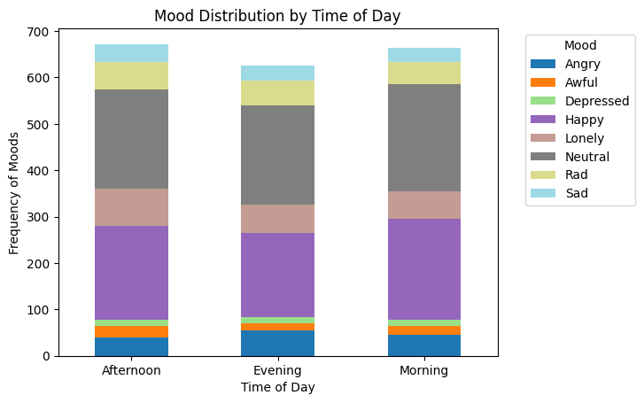
How does the time of day affect mood?
Observations:
Afternoons are usually when people have the most negative mood such as feeling lonely or awful.
Most people feel the happy during mornings.

Slide 11
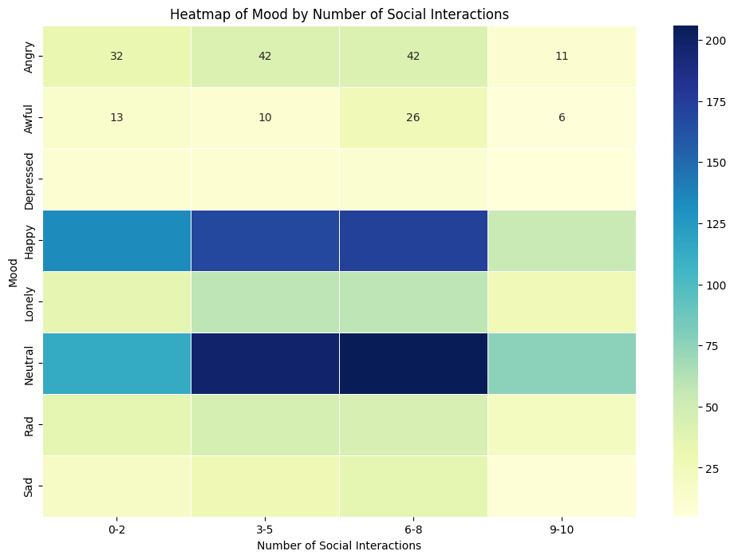
What is the effect of social interactions on mood?
Observations:
People who tend to have more social interactions seem to have a positive and happy mood.
On contrast, people who feel depressed, awful, lonely or even sad seem to have no social interaction.
This signifies that social interactions impact mood significantly.
This could also mean that the mood impacts social interactions.

Slide 12
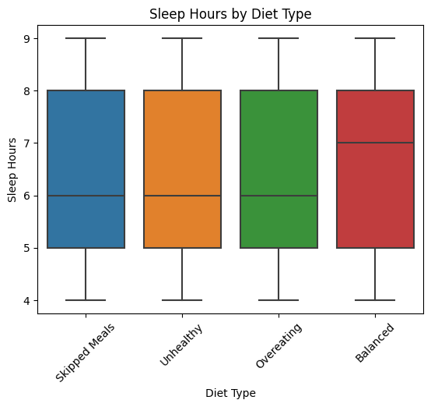
Is there any effect of diet on sleep?
Observations:
A balanced diet results in a better sleep overall.
This indicates that a healthy diet can improve sleep quality.

Slide 13
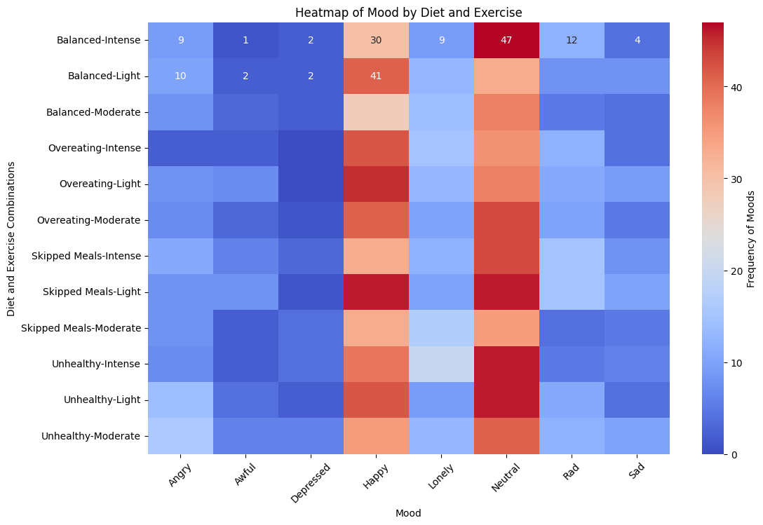
How does mood variation correlate with combined factors like diet and exercise?
Observations:
People who exercise irrespective of the intensity (light, moderate, intense) and food habits seem to show a positive mood and tend to be happy in general.
Skipping meals while also exercising usually is associated with extreme moods.

Slide 14
Conclusion:
Small patterns in the data can reveal significant insights, which can contribute towards people’s wellbeing.
Most people’s input is “Neutral” which might be because they are unaware of their current mood or what they felt.
MoodScriber is an extremely powerful personal mood tracker and journal app that can be helpful in obtaining clear image of one’s moods and what effects them, which would help them improve their quality of life over time.

Slide 15
Thank you

