Slide 1

Mini Project Final Presentation
on
“PLANT DISEASE DETECTION SYSTEM”
Alekh Taori (Reg. No. 202000423)
Jeewan Sharma (Reg. No. 202000381)
Aman Kumar Gupta (Reg. No. 202000547)
Under the guidance of:
Mr. BIRAJ UPADHYAYA
ASSISTANT PROFESSOR-I
DEPARTMENT OF COMPUTER SCIENCE AND ENGINEERING
SIKKIM MANIPAL INSTITUTE OF TECHNOLOGY
(A constituent college of Sikkim Manipal University)
MAJITAR, RANGPO, EAST SIKKIM – 737136

Slide 2

CONTENTS
Sl. No. | TITLE
 | Abstract
1 | Introduction
2 | Literature survey
3 | Problem definition
4 | Solution strategy
5 6 7 8 9 10 | Design Implementation Details Limitations of the project Future scope of the project Gantt Chart References

Slide 3
ABSTRACT
It has been observed farmers face issues due to plant diseases , since these disease affect the growth of their respective species.
Therefore the disease identification should be done early to avoid this.
Since going to labs and testing these plants can be very expensive to the farmers, an attempt has been made to make a model to detect by just using the picture of the plant.
Techniques including CNN, various standard dataset will be used in this project.

Slide 4
1. INTRODUCTION
Plant disease Detection is one of the huge issue that face while we talk about using Technology in Agriculture.
Plant diseases and pests are important factors determining the yield and quality of plants. Plant diseases and pests identification can be carried out by means of digital image processing.
In this project plant disease using deep learning and pre-processing the data using image processing.
This project is being made to compare the accuracy of this model with other models.
1

Slide 5

2. LITERATURE SURVEY
Sl. No. | Author(s) | Paper and Publication Details | Findings | Relevance to the project
1 | Ramprasath, Muthukrishnan, M. Vijay Anand, and Shanmugasundaram Hariharan. | Image classification using convolutional neural networks International Journal of Pure and Applied Mathematics, 119(17), 1307-1319. (2018) | CNN models can achieve high accuracy in image classification tasks, such as the number of layers and filters. | The use of transfer learning when limited training data is available. Design and training of CNN models for plant disease detection.
2 | Chohan, M., Khan, A., Chohan, R., Katpar, S. H., & Mahar, M. S. | Plant disease detection using deep learning. International Journal of Recent Technology and Engineering, 9(1), 909-914, (2020). | Transfer learning-based models outperformed CNN-based models in terms of accuracy and computational efficiency. | Effectiveness of deep learning techniques, particularly transfer learning-based models, can significantly improve the accuracy of the models.
2

Slide 6
2. LITERATURE SURVEY (contd..)
Sl. No. | Author(s) | Paper and Publication Details | Findings | Relevance to the project
3 | Ahmad, Aanis, Dharmendra Saraswat, and Aly El Gamal. | A survey on using deep learning techniques for plant disease diagnosis and recommendations for development of appropriate tools. Smart Agricultural Technology (2022): 100083. | Ensemble learning, where multiple models are combined, Explainable AI techniques can help in interpreting the results of deep learning models. Development of user-friendly interfaces can enhance the accessibility and usability | Uses of techniques for plant disease diagnosis and selecting appropriate techniques, preprocessing strategies, and developing user-friendly interfaces.
3

Slide 7
3. PROBLEM DEFINITION
Limited dataset: One of the major challenges in plant disease detection is the availability of limited labeled data.
Complex feature extraction: Plant disease detection requires identifying complex patterns and textures in the images, which can be challenging for traditional computer vision techniques.
4

Slide 8
4. SOLUTION STRATEGY
Loading all the images into the machine and convert it into desired format and batches .
Dividing the dataset int three classes(Early Blight ,Late Blight & Healthy Blight)
Splitting the dataset into subsets (Training, Validation & Testing).
Data Augmentation : Resizing and Rescaling the images(Horizontal and Vertical).
Using CNN to make the model : Max Pooling and Conv2D layers.
Flattening the output to make array of neurons.
Compiling the models using optimizers, metrics, loss.
Train the network on training dataset and validation dataset.
Running a test on test dataset and exporting model to the disk.

Slide 9
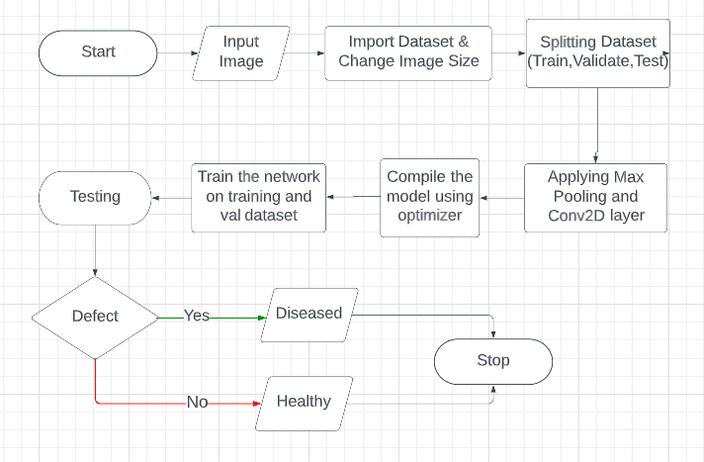
5. DESIGN
Fig 1: Block Diagram of the Model
7

Slide 10
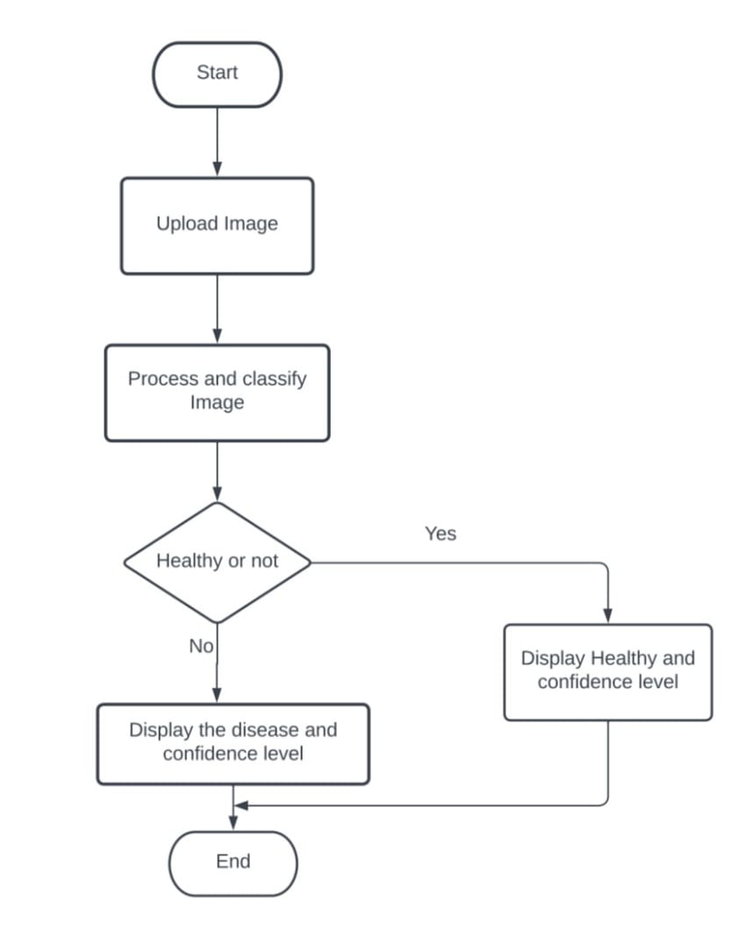
5. DESIGN (contd..)
Fig 2: Flowchart of the system

Slide 11
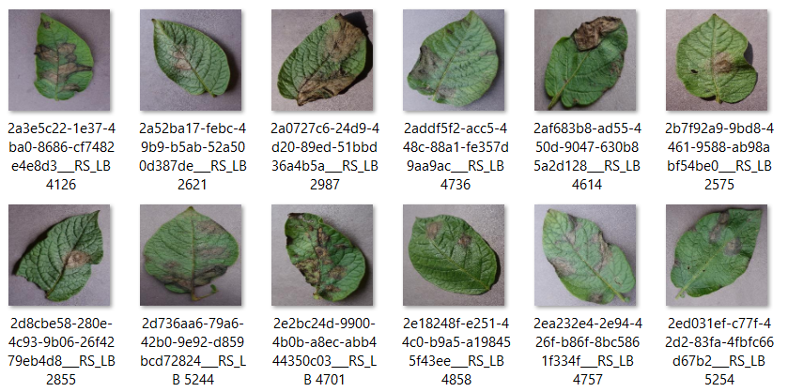
6. IMPLEMENTATION DETAILS
Fig-3: Late Blight Dataset

Slide 12
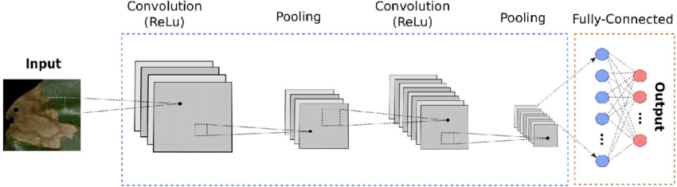
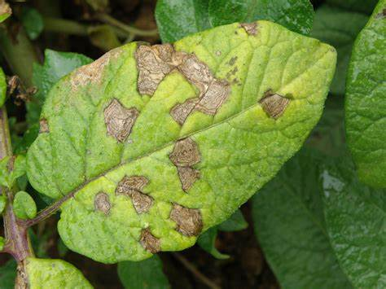
6. IMPLEMENTATION DETAILS(contd..)
Fig-4 : Architecture of CNN

Slide 13
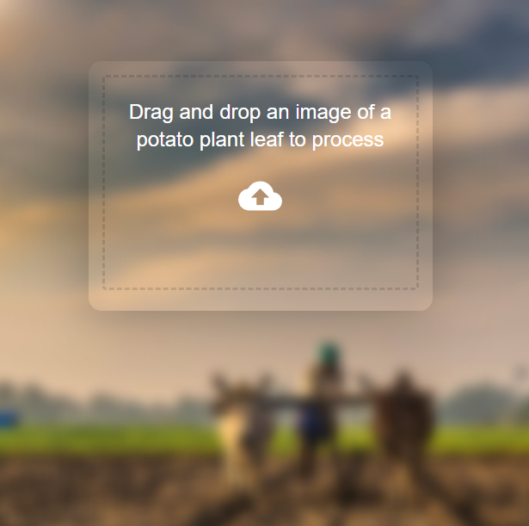
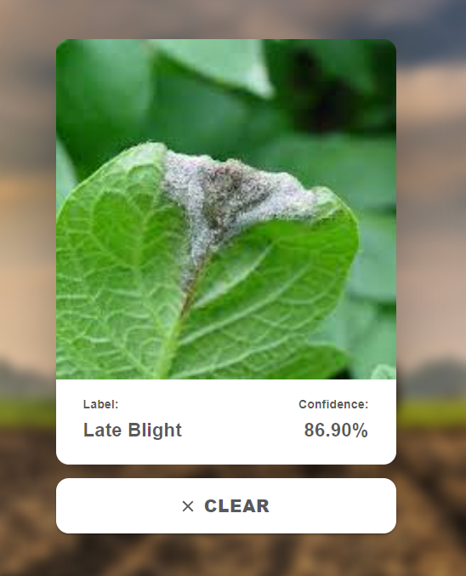
6. IMPLEMENTATION DETAILS(contd..)
Fig-5 : Output Showing Late Blight

Slide 14
7. LIMITATIONS OF THE PROJECT
Lack of diversity in the dataset used for training.
High computational power required for training, which is a challenge for small-scale farmers and researchers.

Slide 15
8. FUTURE SCOPE OF THE PROJECT
CNN-based plant disease detection can aid farmers and researchers.
Scaling up detection to more plant species.
Developing portable and user-friendly tools such as mobile apps.
Incorporating user feedback.

Slide 16
9. GANTT CHART
ACTIVITY | TIME FRAME
 | January 2023 | February 2023 | March 2023 | April 2023
Literature Survey
Problem Definition
Design
Implementation
Testing and Validation
Documentation
 | Proposed activity
 | Achieved activity
 | Ongoing activity
Notes:
16

Slide 17
10. REFERENCES
[1] Chohan, M., Khan, A., Chohan, R., Katpar, S. H., & Mahar, M. S. (2020). Plant disease detection using deep learning. International Journal of Recent Technology and Engineering, 9(1), 909-914.
[2] Ramprasath, M., Anand, M. V., & Hariharan, S. (2018). Image classification using convolutional neural networks. International Journal of Pure and Applied Mathematics, 119(17), 1307-1319.
[3] Ahmad, A., Saraswat, D., & El Gamal, A. (2022). A survey on using deep learning techniques for plant disease diagnosis and recommendations for development of appropriate tools. Smart Agricultural Technology, 100083.
[4] Ferentinos, K. P. (2018). Deep learning models for plant disease detection and diagnosis. Computers and electronics in agriculture, 145, 311-318.
[5] Shruthi, U., Nagaveni, V., & Raghavendra, B. K. (2019, March). A review on machine learning classification techniques for plant disease detection. In 2019 5th International conference on advanced computing & communication systems (ICACCS) (pp. 281-284). IEEE.
[6] Mahum, R., Munir, H., Mughal, Z. U. N., Awais, M., Sher Khan, F., Saqlain, M., ... & Tlili, I. (2023). A novel framework for potato leaf disease detection using an efficient deep learning model. Human and Ecological Risk Assessment: An International Journal, 29(2), 303-326.

Slide 18
THANK YOU

