Slide 1
Unlocking Profitability Drivers in the Superstore Dataset

Slide 2
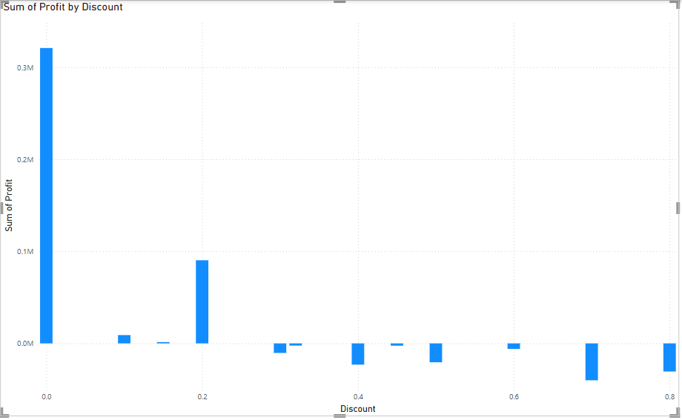
Profit Performance Across Discount Levels
The graph shows that as the discount percentage increases, the total profit initially increases, peaks at around 0.2, and then declines rapidly. This suggests that offering higher discounts may not necessarily lead to higher profits, and in fact, can be detrimental to the business.
The graph also shows that there are some discounts that result in a loss of profit. This suggests that it is important to carefully consider the impact of discounts on profitability before offering them to customers.

Slide 3
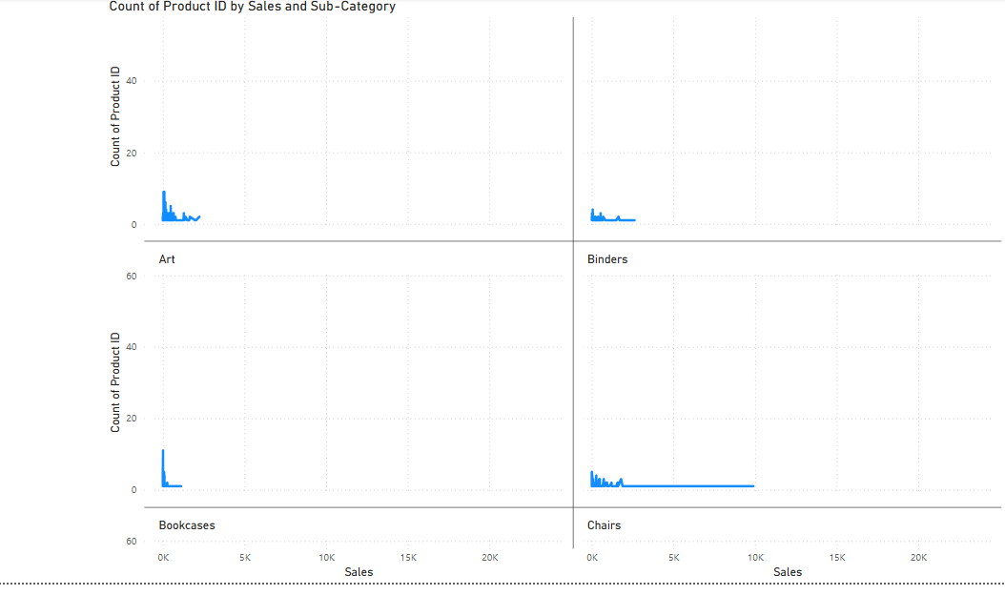
Sales Concentration and Product Range within Key Sub-Categories
High Sales Volume Doesn't Always Mean a Wide Variety of Products: For categories like "Binders" and "Chairs," the majority of sales appear to be concentrated within a relatively narrow range of sales values, and the count of distinct product IDs is also relatively low. This suggests that a smaller number of specific binder and chair products are driving the bulk of the sales in those sub-categories. This could indicate successful hero products or a lack of product diversification within these areas.
"Art" and "Bookcases" Show Lower Sales per Product Variety: Compared to "Binders" and "Chairs," the "Art" and "Bookcases" sub-categories seem to have a wider spread of product IDs across lower sales values. This implies a larger variety of art pieces and bookcases are being sold, but individually, they might not be generating the same high sales volume as the top-selling binders and chairs. This could suggest a more niche market for these items or a need to identify and potentially promote higher-performing products within these categories.

Slide 4
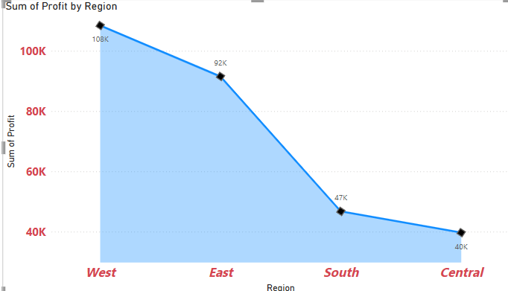
Distribution of Profit Across Geographic Regions
Here are key business analysis points from the graph "Sum of Profit by Region":
West Region is the Dominant Profit Generator: The graph clearly shows that the West region contributes the highest profit (108K) compared to all other regions (East: 92K, South: 47K, Central: 40K). This indicates that the West region is a key driver of overall profitability for the business and likely warrants further investigation to understand the factors contributing to this success (e.g., strong market presence, effective sales strategies, favorable customer base).
Profitability Declines Significantly Moving East to Central: There's a noticeable downward trend in profit as we move from the West to the East, then a more substantial drop to the South, and finally a slight decrease to the Central region. This suggests varying levels of market performance and profitability across different geographical areas. Understanding the reasons behind this decline (e.g., differing market sizes, competitive landscapes, operational costs, customer demand) is crucial for strategic decision-making.
South and Central Regions Present Opportunities for Improvement: The South (47K) and Central (40K) regions generate significantly lower profits compared to the West and East. This highlights potential areas for business improvement. Analysis should be conducted to identify the challenges in these regions and explore strategies to boost profitability, such as targeted marketing campaigns, cost optimization, or adjustments to product/service offerings to better suit the local market. These regions could represent untapped potential or areas requiring strategic intervention.

