Slide 1
Stock Price Prediction using Time Series Forecasting
ALEKHYA CHATTERJEE

Slide 2
Methodology
1. Data Collection The dataset for this study was sourced from yfinance API, including historical stock price data for selected companies. The data included key financial metrics such as closing price, trading volume, and other relevant indicators over a 1-year time period.
2. Data Preprocessing To ensure high-quality inputs for modeling, the following preprocessing steps were applied: ● Handling Missing Values: Missing data points were identified and either imputed using forward-fill techniques or removed if necessary. ● Feature Engineering: New features such as lagged returns, moving averages, and percentage changes were created to enhance predictive power. ● Stationarity Check: The ADF and KPSS tests were conducted to verify stationarity, and first-order differencing was applied to non-stationary series. ● Train-Test Split: The dataset was split into 80% training and 20% testing sets for model evaluation.
3. ARIMA Model Development The ARIMA (Autoregressive Integrated Moving Average) model was used for time-series forecasting: ● Parameter Selection: The ACF and PACF plots and Grid search Results were analyzed to determine optimal (p, d, q) values. ● Model Training: The ARIMA model was trained using the training dataset, and predictions were made on the test set.
4. XGBoost Model Development A Gradient Boosting approach using XGBoost was applied for predictive modeling: ● Feature Selection: Relevant features such as lagged prices, moving averages, and volume changes were used. ● Hyperparameter Tuning: Optuna was used to optimize hyperparameters for improved performance. ● Model Training: The model was trained on the training set and evaluated on the test set.
5. Model Evaluation Both models were assessed using the following metrics: ● Root Mean Squared Error (RMSE) ● Mean Absolute Error (MAE) ● R² Score (for XGBoost model) A comparative analysis was conducted to determine which model provided the most accurate and reliable stock price predictions.

Slide 3
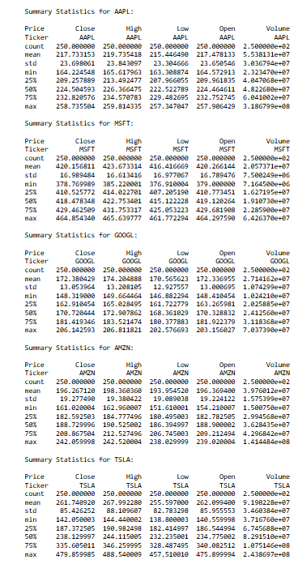
Exploratory Data Analysis (EDA)
Summary Statistics
To understand the fundamental characteristics of the dataset, we first computed summary statistics for each stock. These statistics include measures such as mean, median, standard deviation, minimum, and maximum values for key features like closing price and volume.

Slide 4
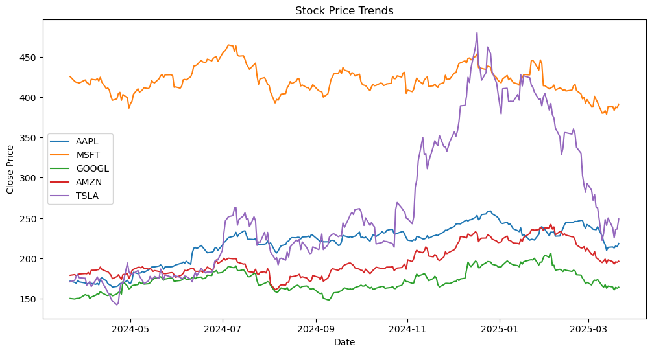
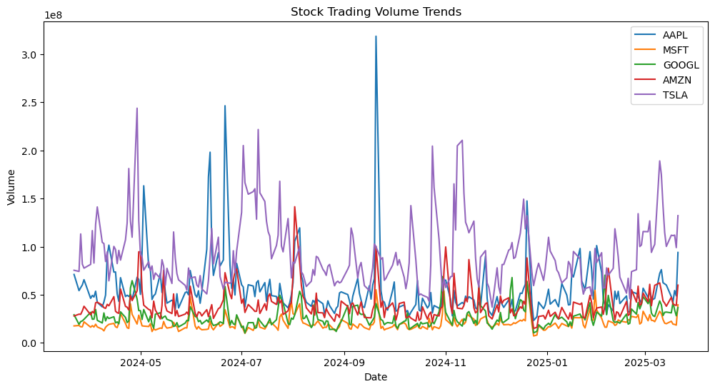
Stock Price Trends and Trading Volume Over Time
Stock Price Trends Over Time
Trading Volume Over Time

Slide 5
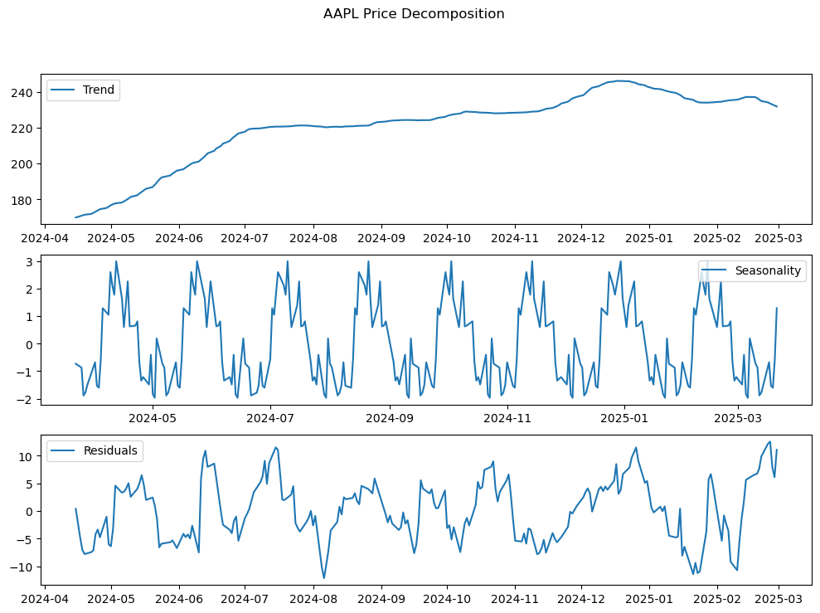
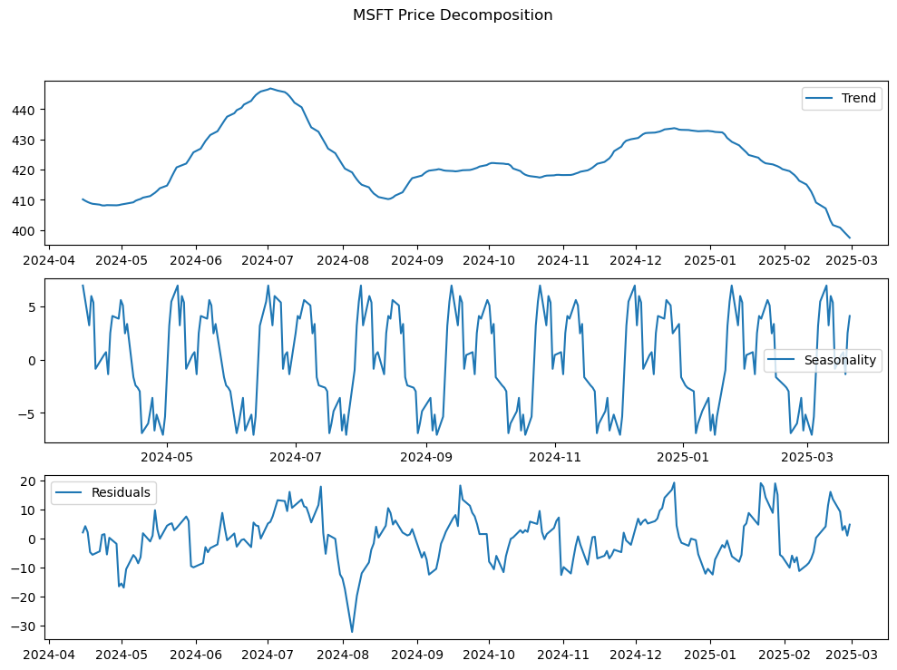
Seasonality & Trend Analysis
APPLE STOCK
MICROSOFT STOCK

Slide 6
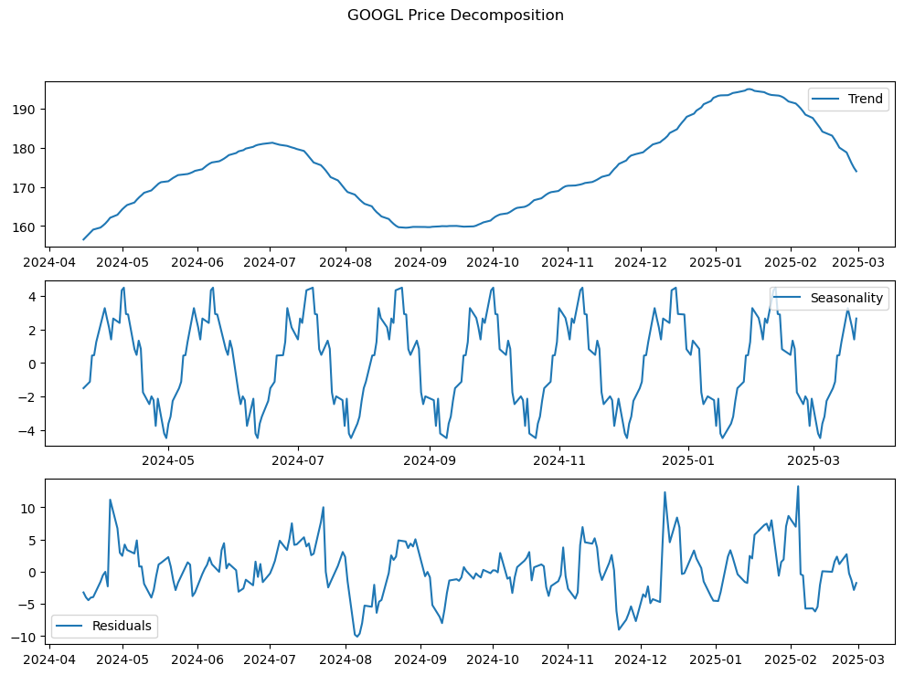
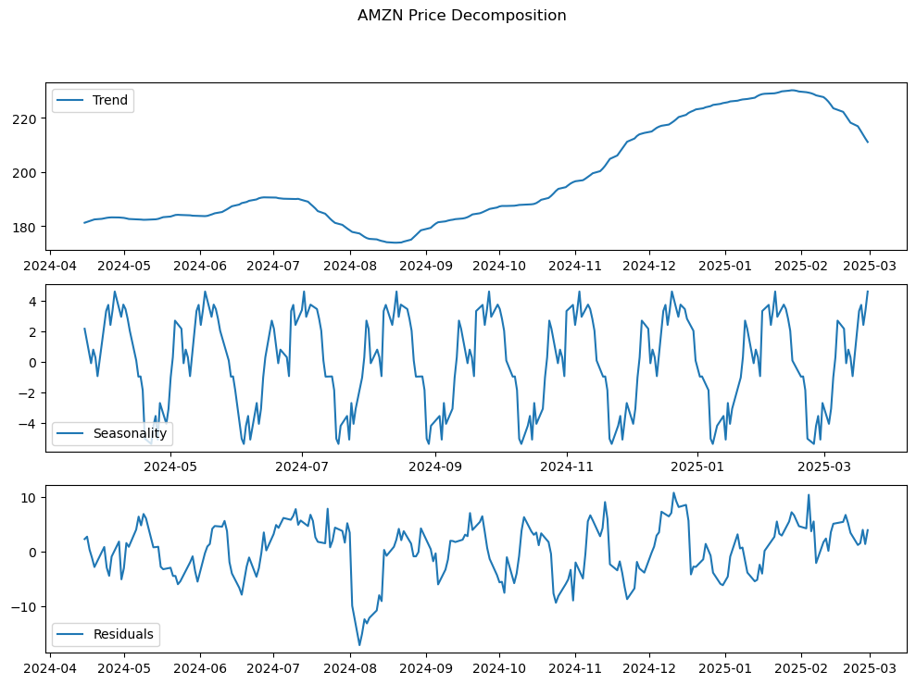
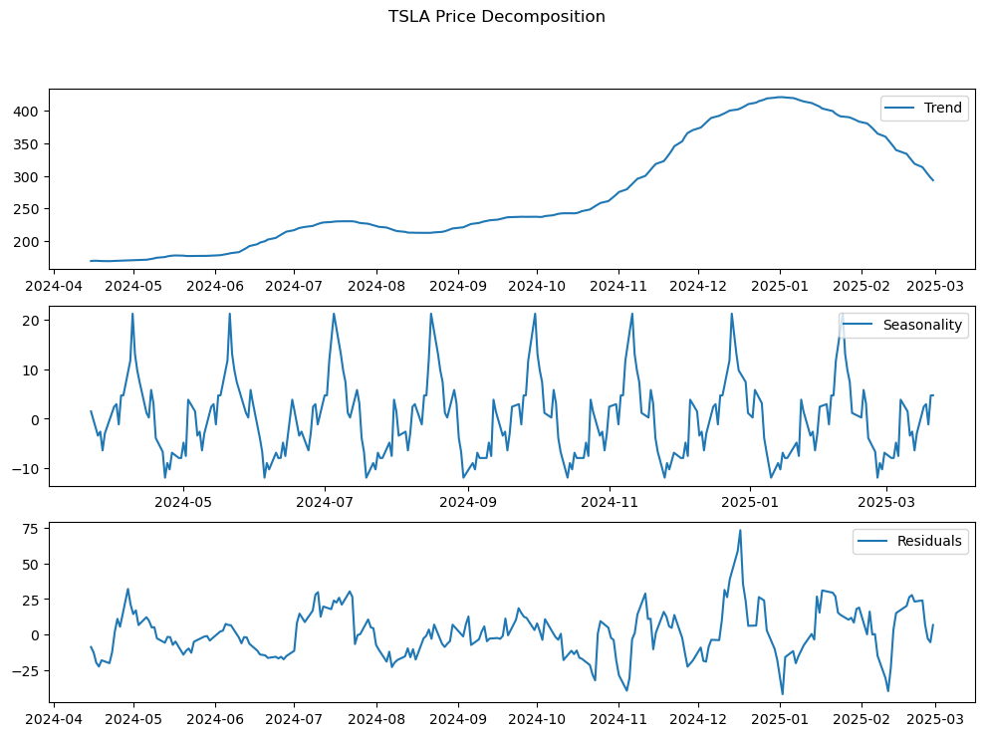
Seasonality & Trend Analysis
GOOGLE STOCK
AMAZON STOCK
TESLA STOCK

Slide 7
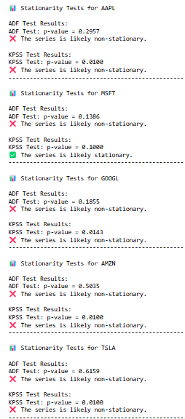
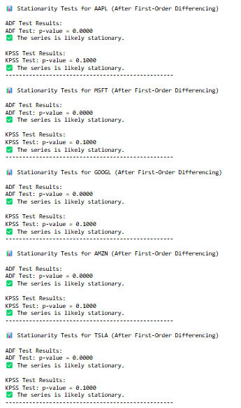
Stationarity Tests (ADF & KPSS Tests)
To assess stationarity (a key assumption for time-series models like ARIMA), we applied two tests:
● Augmented Dickey-Fuller (ADF) Test: Checks for unit roots (if present, data is non-stationary).
● KPSS Test: Tests whether a time series is stationary around a deterministic trend.
● Findings: Most stock prices were non-stationary, indicating trends over time.
● After first-order differencing, stationarity was achieved, making the data suitable for ARIMA modeling.

Slide 8
Feature Engineering
Feature Engineering
To improve predictive accuracy, additional features were created:
● Lagged Features: Previous day’s closing price (Lag_1).
● Rolling Window Features:
○ 5-day Moving Average (Rolling_Mean) to capture short-term trends.
○ 5-day Rolling Standard Deviation (Rolling_Std) to measure volatility.
● Daily Percentage Change (Pct_Change) to capture momentum. These features were used in machine learning models such as XGBoost to enhance prediction accuracy.

Slide 9
Model Development
ARIMA Model
We implemented an ARIMA (Autoregressive Integrated Moving Average) model to forecast stock prices. The ARIMA model was trained using historical closing prices, and the best order (p,d,q) was selected using ACF/PACF plots and GridSearch optimization.
Model Training
1.Data Preparation: The closing prices of Apple Inc. (AAPL) were used for ARIMA training.
2. Train-Test Split: 80% of the data was used for training, while the remaining 20% was used for testing.
3. Differencing: Since stock prices are often non-stationary, first-order differencing was applied to remove trends. 4. Model Order Selection: The ARIMA (p, d, q) parameters were set as (7,1,12) based on ACF and PACF analysis.
5. Training: The ARIMA model was fitted on the training dataset, and future prices were forecasted on the test set.
6. Prediction: The model forecasted the stock prices for the test set.
7. Evaluation: Performance was measured using MAE, RMSE

Slide 10
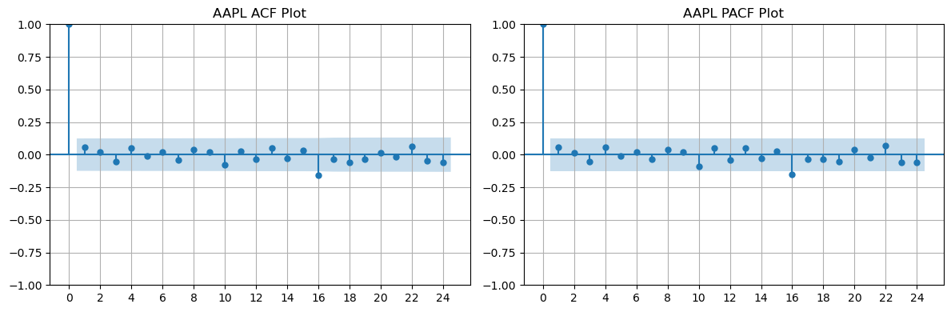
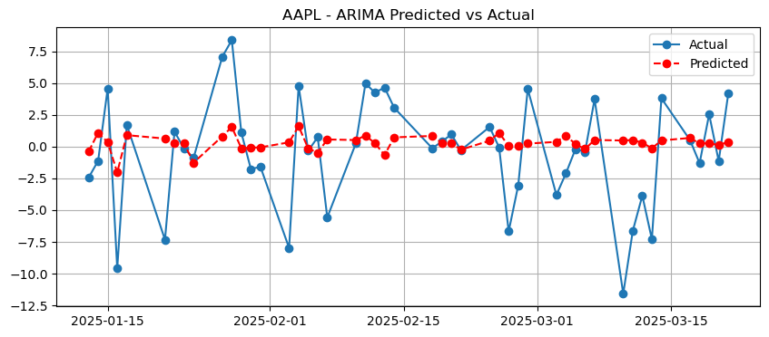
ARIMA Predicted vs Actual
AAPL Stock’s ACF and PACF Plot

Slide 11
XGBoost Model
To enhance predictive accuracy, we implemented an XGBoost (Extreme Gradient Boosting) model, a powerful tree-based algorithm. The features included lagged returns, moving averages, and volume changes.
Steps:
1. Feature Engineering:
○ Lag features (previous day's closing price) ○ Moving averages (5-day rolling mean) ○ Volatility measures (standard deviation of closing prices)
○ Percentage change in closing prices
2. Train-Test Split: 80% of the data was used for training, and 20% for testing.
3. Hyperparameter Optimization: Optuna was used for tuning parameters, and the best values found were:
○ n_estimators: 857
○ max_depth: 8
○ learning_rate: 0.4419
○ subsample: 0.73199
○ colsample_bytree: 0.60415
○ gamma: 4.4484
○ reg_alpha: 1.4281
○ reg_lambda: 1.6677
4. Model Training: XGBoost was trained with these optimized hyperparameters.
5. Prediction & Evaluation: The model predicted stock prices on the test set and was evaluated using MAE, RMSE, MAPE, and R² score.

Slide 12
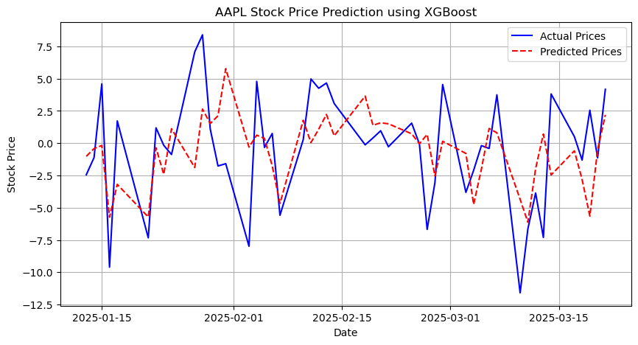
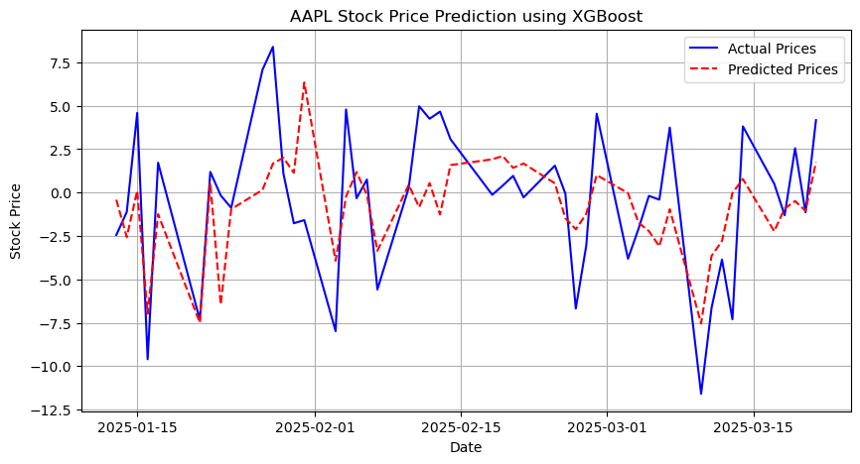
Before Hyperparameter Tuning
After Hyperparameter Tuning

Slide 13
Model Evaluation & Comparison
Evaluation Metrics
● Mean Absolute Error (MAE): Measures the average absolute difference between predicted and actual values.
● Root Mean Squared Error (RMSE): Measures the standard deviation of prediction errors, giving more weight to large errors.
● R-squared (R2 Score): Indicates how well the model explains variance in the actual values. A higher R2 score represents a better fit.
ARIMA Model Performance
For the ARIMA model, the evaluation metrics were as follows:
● MAE: 3.1521
● RMSE: 4.1892
● R2 Score: 0.0552
The ARIMA model performed reasonably well in predicting stock prices, but the low R2 score suggests that it does not explain much of the variance in stock prices.
XGBoost Model Performance
For the XGBoost model, the evaluation metrics were:
● MAE: 2.8341
● RMSE: 3.5096
● R2 Score: 0.3369 Compared to ARIMA, the XGBoost model achieved lower MAE and RMSE values, indicating better predictive accuracy. Additionally, the higher R2 score suggests that XGBoost explains a greater proportion of the variance in stock prices.
Model Comparison
Model ARIMA MAE RMSE R2 Score 3.1521 4.1892 0.0552 XGBoost 2.8341 3.5096 0.3369 From the above comparison, XGBoost outperforms ARIMA in all evaluation metrics, making it the preferred choice for stock price prediction in this study. Implications for Trading Strate

Slide 14
Implications for Trading Strategies
1. Short-Term Trading & Algorithmic Trading:
○ Given XGBoost’s superior accuracy, traders can integrate it into algorithmic trading systems to predict short-term price movements with greater confidence.
○ The model can be used to identify entry and exit points based on expected price trends, reducing the risk of false signals.
2. Risk Management & Stop-Loss Adjustments:
○ With lower error margins in predictions, traders can set more effective stop-loss and take-profit levels based on the forecasted price range.
○ XGBoost’s ability to capture trends helps in minimizing unexpected losses due to price fluctuations.
3. Portfolio Allocation & Position Sizing:
○ Investors seeking to allocate capital efficiently can use XGBoost-based forecasts to adjust portfolio weightings dynamically.
○ By analyzing price trends and volatility indicators, traders can make informed decisions on the size of positions taken in AAPL.
Conclusion
The comparison between ARIMA and XGBoost models highlights the importance of machine learning techniques in financial markets. The superior performance of XGBoost suggests that data-driven trading strategies, particularly in short-term trading, can yield better results compared to traditional statistical models. Traders and investors can leverage these insights to optimize their decision-making processes and enhance overall profitability.

Slide 15
Thank You!
Contact Info
Alekhya Chatterjee:-
alekhyachatterjee2@gmail.com
https://www.linkedin.com/in/alekhya-chatterjee-45918b324/?lipi=urn%3Ali%3Apage%3Ad_flagship3_notifications%3BDI%2BcT2aQTg%2B%2Fl%2BUb1zutzg%3D%3D
Questions?

