Slide 1
Analysis on Airbnb Data Submitted to Dr. Jongwook Woo CIS-5200 –System Analysis & Design
GROUP-4
Submitted by: Alekhya Raidu
Ashima Ashima
Upma Kumar
California State University, Los Angeles

Slide 2
Table of Content
About Project
Technical Specification
Hive Queries
Visualizations
Insights

Slide 3

About the Project
Why Airbnb
Increase in demand
Homely Feeling
Available in all prices
Can be shared or private

Slide 4
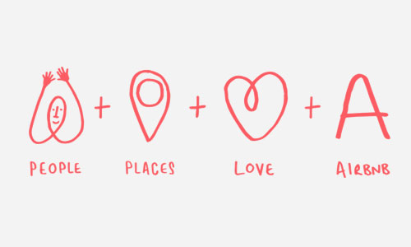
More facts about airbnb
In terms of awareness — represented here by Google search trends — Airbnb is already approaching the same frequency as mainstream hotel and travel-booking brands, such as Expedia and Marriott.​

Slide 5
Big Data Life Cycle-Flow Chart
Capture Data
(Raw data in CSV)
Visualize Data
(Visualization Using Tableau)
Process Data
(Combined Data using Macro)
Analyze Data
(Run HIVE commands)
Store Data
(Put data in HDFS)

Slide 6




Technical Specifications
BigInsight
Tableau
Excel
Hive
Data Size: 3GB

Slide 7
Data Analysis
Data Analysis is Done On..
Overall-satisfaction
Price
Records
Room Type
Cities-Location
Year

Slide 8
Hardware Specifications
Cluster Type – Hadoop IBM Big Insights
Number of Data Nodes -1 Node | vCPU = 4 (24GB RAM)
Number of Management Nodes - 1 | vCPU = 12 (48 GB RAM)
Version – IOP 4.2 (IBM Open Version Platform)
Operating System – CentOS 6.6 [Linux]
Data Disk- 1 TB SATA | Data Storage- 24.4 GB
CPU Speed 2.25 GHz

Slide 9
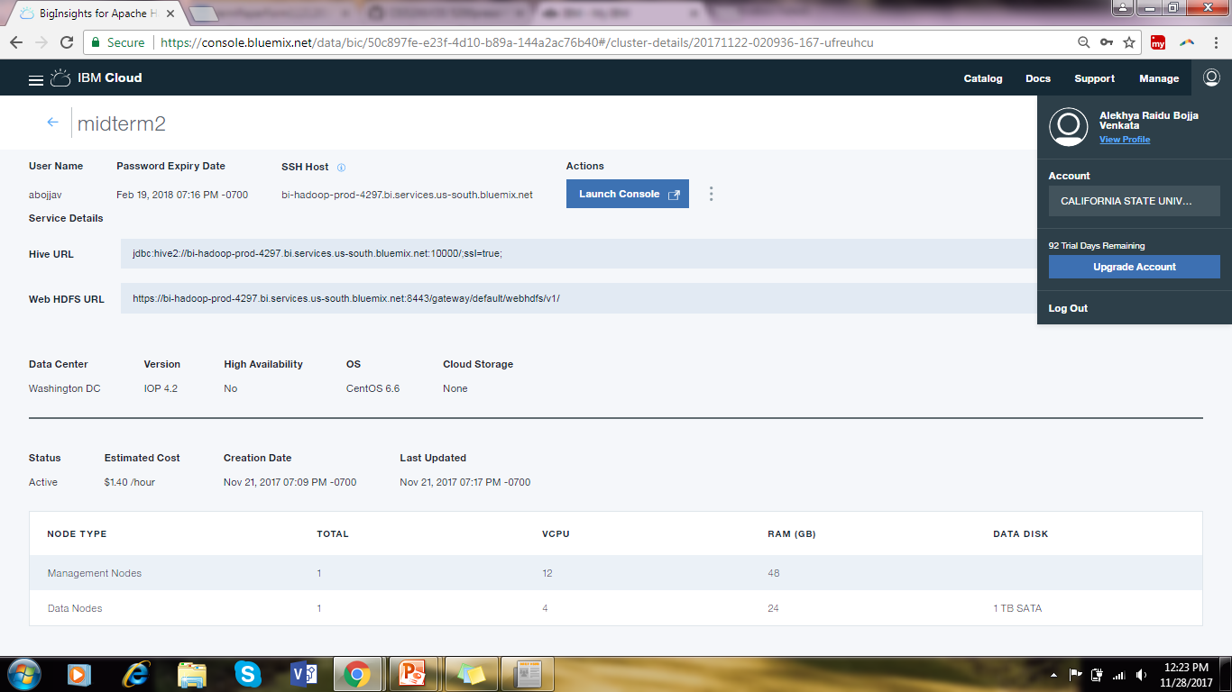
Cluster-Details

Slide 10
Hive Queries & Visualizations

Slide 11
Creating Table to Map Data
hive> Create external table airbnb_master( room_id double,host_id double,room_type string,borough string,neighborhood string,reviews string,overall_satisfaction string, accommodates string,bedrooms double,price double,minstay string,latitude double,longitude double,last_modified string, Survey_Date string,FolderName string) row format delimited fields terminated by '\t' LOCATION '/user/abojjav/';

Slide 12
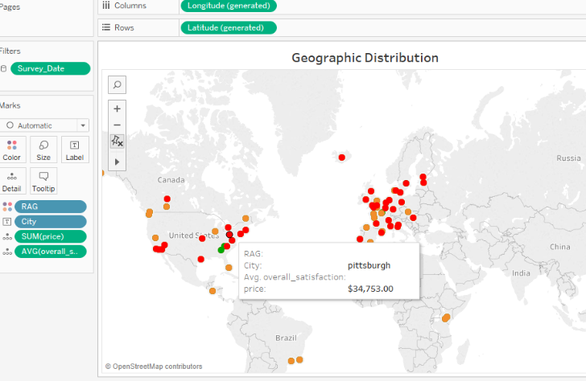
Sentiment Analysis-Overall Satisfaction (Geo-Spatial Representation)

Slide 13
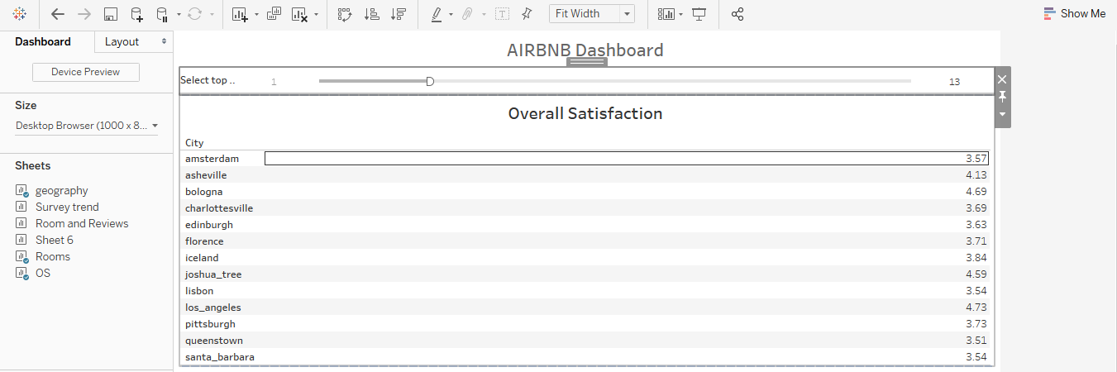
Displaying Top Cities with High Satisfaction Output-1

Slide 14
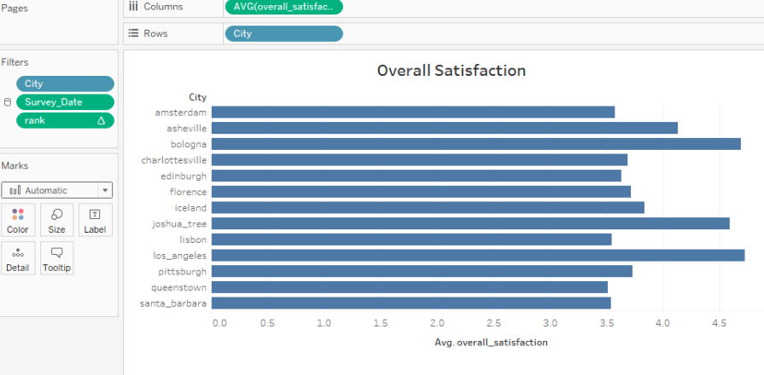
Displaying Top Cities with High Satisfaction
(Output-2)

Slide 15
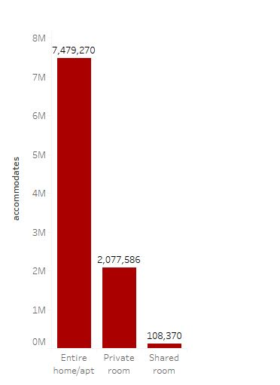
Room Preference
Room Preference
Entire home/Apartment
Private Room
Shared Room

Slide 16
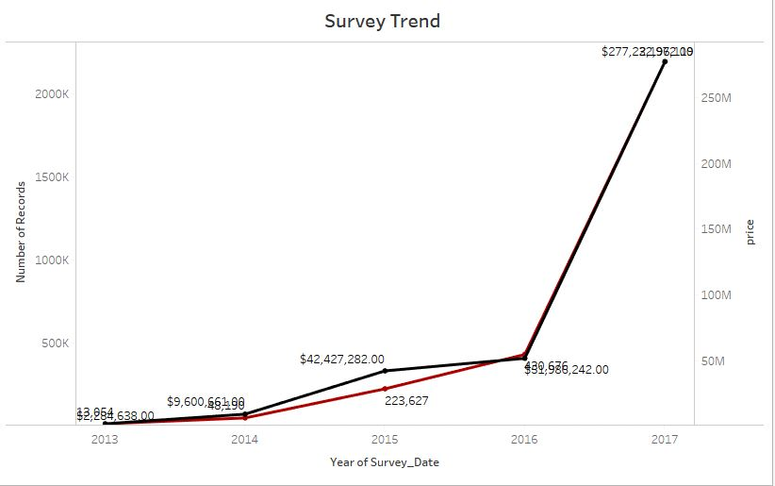
Airbnb Business Trend
Black – Price
Red – No. of people surveyed

Slide 17
Insights

Slide 18
Insights
Overall Satisfaction Around the Globe (Least Satisfied – To be focus for the Better business)
Top 10 cities satisfaction – Find Factors for positivity and apply to least Satisfied cities.
Room Preference- Which rooms are preferred more is area for more investment and more Profit.
Business Trend - Price Paid each year.

Slide 19
References
Guide for Hive: https://box/9zduux2so6z2xk461euzklmupck7vix2
Tableau Guide: https://app.box.com/s/rz05haaqyh6hhczqwe0q64ti38nw9yeb
Data URL: https://app.box.com/s/pf30acr2bpgz1mmbfor7gwqoqrq4j05r
https://app.box.com/s/5nuez5z9b9zetufmngmllf0kpff4j2yx

Slide 20
LINKS
GITHUB Link: https://github.com/AlekhyaRaidu/CIS-5200
Presentation Slideshare Link: https://www.slideshare.net/AlekhyaRaidu/5200-analysisairbnb-data
Dataset Link:
http://tomslee.net/airbnb-data-collection-get-the-data

Slide 21
Thank You
Q & A

