Slide 1
Parallel Merge Sort

Slide 2
Implementation : Parallel Merge Sort
Inter Process Communication : RMI
Programming Language : Java
Operating System : Windows

Slide 3
Outline
Sequential Merge Sort
Parallel Merge Sort
Design
RMI
Performance analysis
Advantages
Future Work

Slide 4
Merge sort Algorithm
Start with the unsorted list A of n numbers
Identify the mid point and divide A to two halves-A1 and A2
Split A1 and A2 recursively in two halves, till a single element is reached
Merge A1 and A2 recursively into a sorted list.

Slide 5
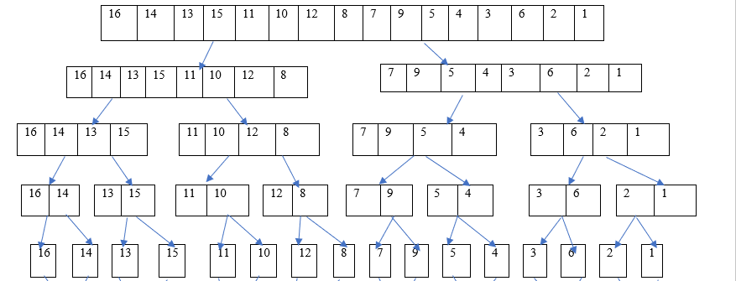
Example

Slide 6
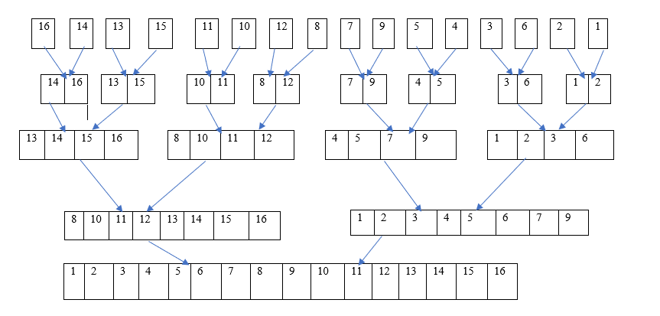
Example (cont’d..)

Slide 7
Parallel merge sort algorithm
Start with the unsorted list A of n numbers
Split A into 4 equal sub lists each of n/4 numbers and send to 4 processes (P1,P2,P3,P4)
Each process performs merge sort on the sub list in parallel
Processes exchange their sorted sub lists to perform parallel merge
Merge
Lower numbered process will store n/4 minimum numbers
Higher numbered process will store n/4 maximum numbers

Slide 8
Parallel merge sort algorithm (cont’d..)
Exchanges
(P1 and P2) and (P3 and P4) in parallel
(P1 and P3) and (P2 and P4) in parallel
P2 and P3
Concatenate final sorted sub list to a single sorted list

Slide 9
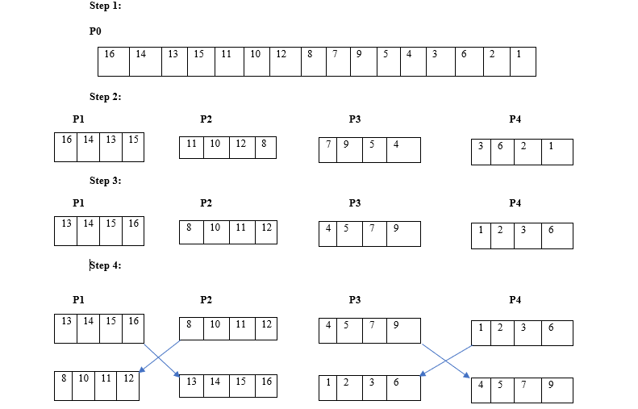
Example

Slide 10
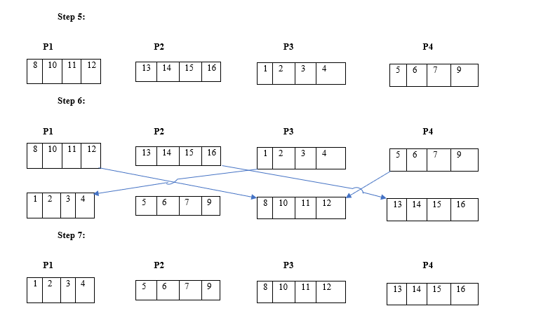
Example (cont’d..)

Slide 11
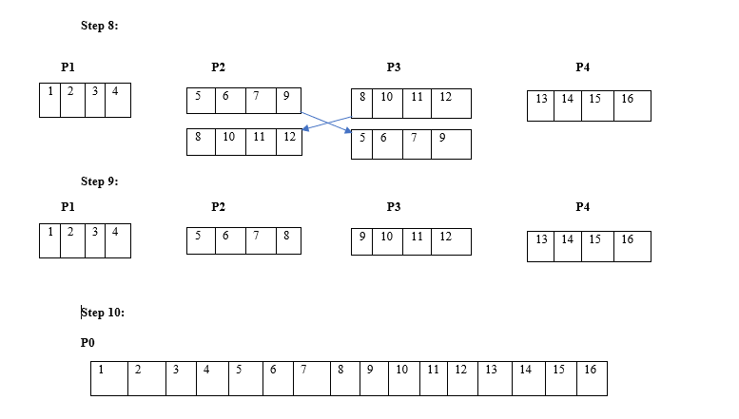
Example (cont’d..)

Slide 12
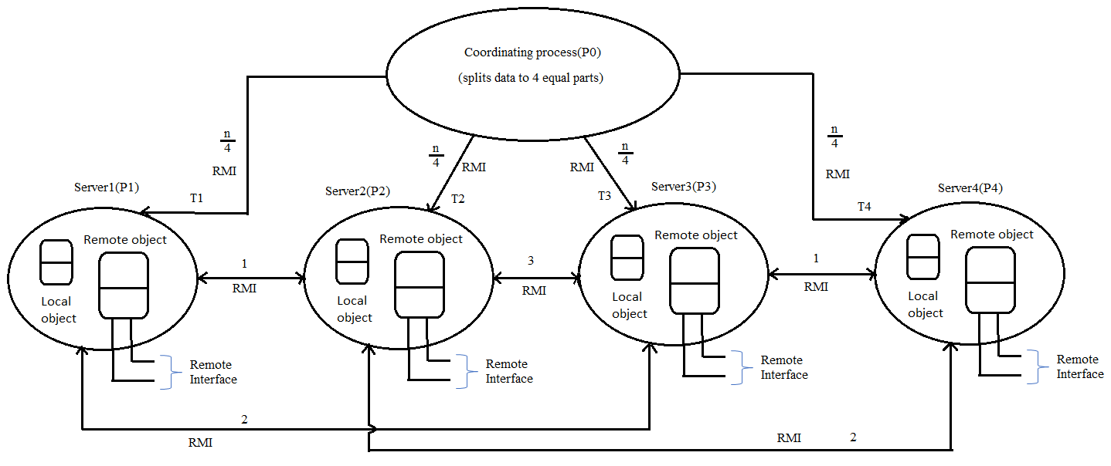
Design

Slide 13
Design (cont’d…)
Coordinating Process
Splits the input list into 4 equal parts and sends to 4 processes
Concatenates the final sorted sub lists from processes
Remote Method Invocations
Only the methods defined in remote Interface can be accessed by the objects in other process
A remote object is an instance of a class that implements the Remote interface
Objects in the same process (local objects) can access the methods in the remote interface as well as the other methods implemented by the remote object.

Slide 14
Remote Method Invocation (Java)
Each server creates an instance of the class which implements the methods of the remote interface.
MergeSort obj1 = new MergeSortServer()
Remote Interface remote object class that implements remote interface
(MergeSort) UnicastRemoteObject.exportObject(obj1, 0)
UnicastRemoteObject.exportObject is used to make the remote object(obj1) available to receive RMI invocations by an anonymous TCP port

Slide 15
RMI (cont’d…)
LocateRegistry.createRegistry(1901)
exports a Registry instance on the local host that accepts requests on the specified port
Naming.rebind("rmi://localhost:1901/mergeSort", obj1)
name remote object
used by a server to register the identifier of a remote object by name
MergeSort stub1=(MergeSort) Naming.lookup("rmi://localhost:1901/mergeSort")
used by a client or other servers to look up the remote object reference of a remote object of a server mentioned by server URL
Stub1 is used to send RMI to server with URL "rmi://localhost:1901/mergeSort")

Slide 16
Advantages of parallel merge sort
Memory efficient
Suitable for large data
Less time for sorting in distributed environment

Slide 17
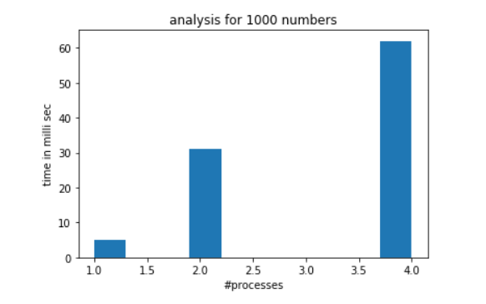
Performance Analysis
Time increases with number of processes
RMI calls
Exchange of data for merging
Context switching between processes

Slide 18
Future Work
Servers to exchange the data among themselves dynamically for parallel merge
To scale dynamically for any number of processes.

Slide 19
Thank You

