Slide 1


Naam:
PLAATS, DATUM:

Slide 2
Web Services
Web Service –It’s a technology which allows communication between different languages
Client will send the request over HTTP and server returns response
SOAP-simple object access protocol
Soap can interact with any other programming language
its a xml based protocol for accessing webservices over internet
Advantages:
security
Language platform independent
Disadvantages
slow becoz xml (xml have many standards)
support only wsdl not json ,cookies

Slide 3
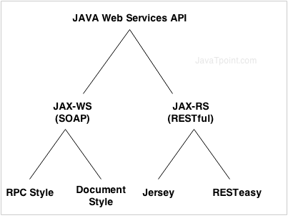

Slide 4
wsdl stands for WebServices Description langugae
WSDL is a language describing webservices and how to access them
WSDL written in XML
http://webservices.oorsprong.org/websamples.countryinfo/CountryInfoService.wso?WSDL
<soapenv:Envelope xmlns:soapenv="http://schemas.xmlsoap.org/soap/envelope/" xmlns:web="http://www.oorsprong.org/websamples.countryinfo">
<soapenv:Header/>
<soapenv:Body>
<web:CapitalCity>
<web:sCountryISOCode>?</web:sCountryISOCode>
</web:CapitalCity>
</soapenv:Body>
</soapenv:Envelope>

Slide 5
The envelope element is the mandatory element in the SOAP message and is used to encapsulate all of the data in the SOAP message.
The header element can be used to contain information such as authentication information or the definition of complex data types.
The body element is the main element which contains the definition of the web methods along with any parameter information if required.

Slide 6
REST
Representational state transfer
its a platform dependent
faster compare to SOAP
supports multiple format like Json,HTML,XML,plan textfile too

Slide 7
GET retrieving data from server
POST whenever we want to add new data
PUT whenever we want to UPDATE data
DELETE whenever we want to DELETE data
Response codes
1xx -means 100 to 199
1xx- information based
2xx--Success
3xx- Redirection
4xx-Client error
5xx-Server error

Slide 8
Useful links for Rest :
https://github.com/typicode/json-server#install
https://reqres.in/
https://github.com/typicode/json-server#install
http://localhost:3000/posts/1

Slide 9

?

Slide 10
Thank You

