Slide 1


Slide 2
Who Was First?
What company first proposed the web services concept?
Hewlett-Packard's e-Speak in 1999 was an enabler for e-services
Microsoft introduced the name "web services" in June 2000
MS "bet the company" on its web services strategy now every major vendor is a player

Slide 3
What is Web Service?
Web service is a standardized medium to propagate communication between the client and server applications on the World Wide Web.
Type of Web Service
There are mainly two types of web services.
SOAP web services.
RESTful web services.
How Does a Web Service Work?
A web service enables communication among various applications by using open standards such as HTML, XML, WSDL, and SOAP. A web service takes the help of −
XML to tag the data
SOAP to transfer a message
WSDL to describe the availability of service.

Slide 4
Why Web Service?
Exposing the Existing Function on the network - Web services allow you to expose the functionality of your existing code over the network using HTTP requests. Once it is exposed on the network, other applications can use the functionality of your program.
Interoperability - Web services allow various applications to talk to each other and share data and services among themselves Web services are used to make the application platform and technology independent.
Standardized Protocol- Web services use standardized industry standard protocol for the communication. standardization of protocol stack gives the business many advantages such as a wide range of choices, reduction in the cost due to competition, and increase in the quality.
Low Cost Communication - Web services use SOAP over HTTP protocol, so you can use your existing low-cost internet for implementing web services

Slide 5
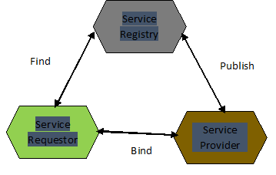
Web Service Architecture:
There are two ways to view the web service architecture −
The first is to examine the individual roles of each web service actor.
The second is to examine the emerging web service protocol stack.
1)Web Service Roles : There are three major roles within the web service architecture −
Service Provider: Service provider is responsible for creating the web service and making it accessible to the client applications over the internet.
Service Requestor: Service requestor is basically any client application which is accessing the web service.
Service Registry: Service registry is act as the centralized directory for the web services which helps to find web services for client applications.

Slide 6
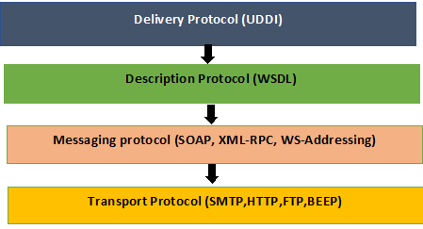
Web Service Architecture:
2)Web Service Protocol Stack
A second option for viewing the web service architecture is to examine the emerging web service protocol stack. The stack is still evolving, but currently has four main layers.
(Service)Transport Protocol: responsible for transporting messages between network applications
(XML) Messaging Protocol: responsible for encoding messages in a common XML format so that they can be understood at either end of a network connection.
(Service) Description Protocol: used for describing the public interface to a specific Web service. The WSDL interface format is typically used for this purpose
(Service) Discovery Protocol: centralizes services into a common registry so that network Web services can publish their location and description, and makes it easy to discover what services are available on the network

Slide 7
SOAP
SOAP-simple object access protocol
Soap can interact with any other programming language
its a xml based protocol for accessing WebServices over internet
SOAP message has three parts
envelope – wraps entire message and contains header and body
header – optional element with additional info such as security or routing
body – application-specific data being communicated

Slide 8
SOAP
Advantages:
security
Language platform independent
Disadvantages
slow becoz xml (xml have many standards)
support only wsdl not json ,cookies

Slide 9
WSDL
wsdl stands for WebServices Description langugae
Description is written in WSDL, an XML-based language through which a web service conveys to applications the methods that the service provides and how those methods are accessed
WSDL is meant to be read by applications
Ex: http://webservices.oorsprong.org/websamples.countryinfo/CountryInfoService.wso?WSDL
Soap Message :
<soapenv:Envelope xmlns:soapenv="http://schemas.xmlsoap.org/soap/envelope/" xmlns:web="http://www.oorsprong.org/websamples.countryinfo">
<soapenv:Header/>
<soapenv:Body>
<web:CapitalCity>
<web:sCountryISOCode>?</web:sCountryISOCode>
</web:CapitalCity>
</soapenv:Body></soapenv:Envelope>

Slide 10
Rest
REST is an architecture of networked system .REST is an acronym stands for Representational state transfer
RESTful web services are light weight, highly scalable and maintainable and are very commonly used to create APIs for web-based applications
In a REST based architecture everything is a Resource. A resource is accessed via common interface based on the HTTP standard methods
Representation of Resources
A resource in REST is a similar Object in Object Oriented Programming or is like an Entity in a Database.Resource can be represented as XML,JSON,XHTML,CSV
Ex: resource as JSON format
{
“id” :1,
“name” : ”ram”,
“designation”: “TL” }

Slide 11
Why REST ?
Performance should be good
Scalable
Easy to build and maintain
Monitoring should be easy
Reliable
Easy to use and test
Rest imposes certain constraints to achieve above characteristics:
Uniform Interface
Addressable
Connectedness
stateless
cacheable

Slide 12
How Restful services works ?
In webservice world most of the operations fall under 4 types
Http protocol methods:
Create --methods with POST
Return – methods with GET
Update – methods with PUT
Delete – methods with DELETE

Slide 13
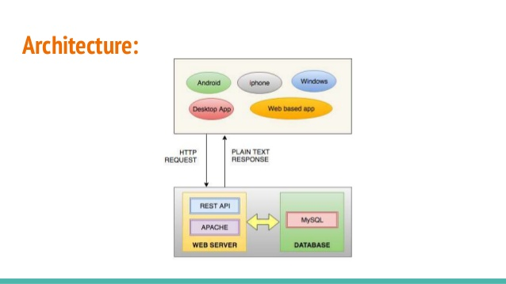
Rest Architecture

Slide 14
Rest webservice
Statelessness:
No State can be stored on the server
Every HTTP request executes in complete isolation to the server
Simpler to design and evolve
Easier to use
Avoid using Http sessions and cookies

Slide 15
Rest Methods:
GET retrieving data from server
POST whenever we want to add new data
PUT whenever we want to UPDATE data
DELETE whenever we want to DELETE data
Response codes:
1xx -means 100 to 199
1xx- information based
2xx--Success
3xx- Redirection
4xx-Client error
5xx-Server error

Slide 16
Rest frameworks
Restlet(java)
Rest-open-uri(ruby on rails)
System.web.HTTPweb requests(.net)
Django(python)

Slide 17
References:
https://github.com/typicode/json-server#install
Start JSON Server
json-server --watch db.json
Resources
http://localhost:3000/posts

Slide 18


Slide 19
Thank you

