Slide 1


Slide 2




What is Numpy?
A Library
Numerical Python An array

Slide 3




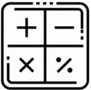

use of numpy
50x faster
Efficient and Maintain minimum memory provides lot of supporting funtions
Mathematical operations
Multi-dimensional arrays

Slide 4



Installation
By executing simple query
Import

Slide 5


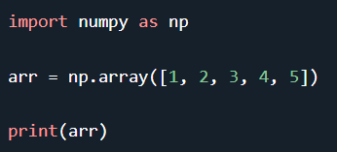
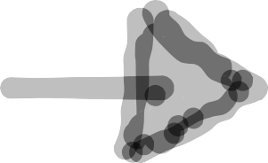

Creating an arrays
NumPy is used to work with arrays. The array object in NumPy is called ndarray.
We create by using array() funtion
result

Slide 6
Dimensions in arrays
0-D Arrays 1-D Arrays 2-D Arrays 3-D Arrays
Result

Slide 7
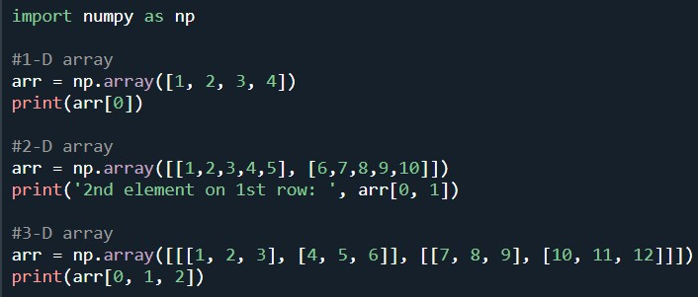


Numpy array Indexing
Access array element using index number
Result

Slide 8

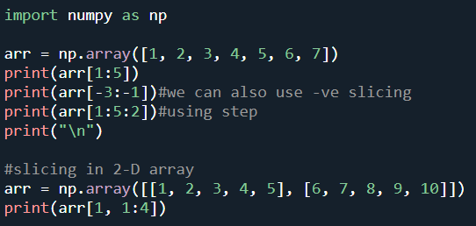
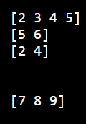
Numpy Array Slicing
syntax: [start:end:step]
Result

Slide 9
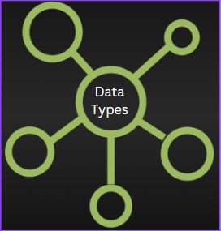
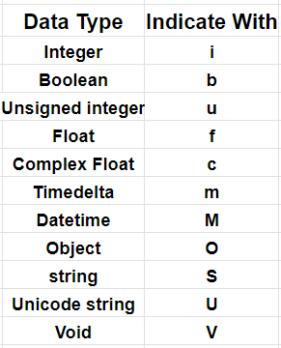
Data Types
Numpy has some extra datatypes along with python data types(String,Integer,Float,boolean,Complex )
Indicate with one character like i,b,u

Slide 10

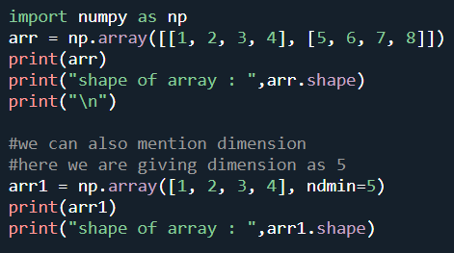
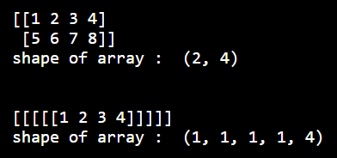
Numpy array shape and reshape
shape : Refers the number of elements in each dimension
Reshape : Changing the shape of an array
Example of Numpy array shape
Result

Slide 11
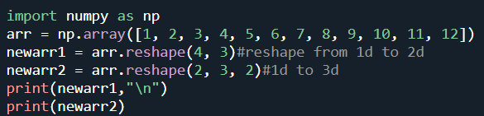
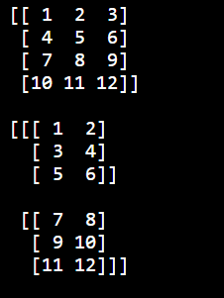
Example of Numpy array Reshape:
Reshape From 1-D to 2-D & 1-D to 3-D
Result

Slide 12

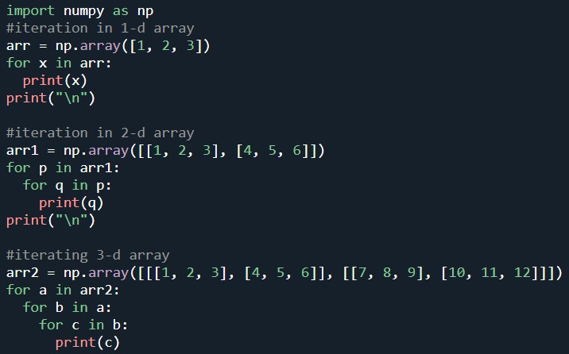

Iterating arrays
It means traversing through elements one by one using for loop
Result-->

Slide 13

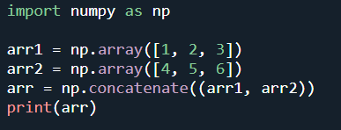

Joining Numpy arrays
Joining means combine the contents of two or more arrays in single array by using concatenate() function
Result

Slide 14

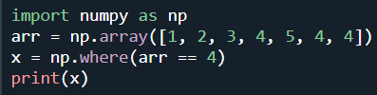

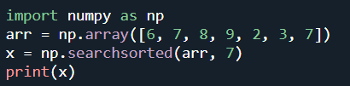
searching arrays
searching an array for perticular value and
return the indexes that get a match using where() method.
Result
searchsorted(): which performs a binary search in the array, and returns the index where the specified value would be inserted to maintain the search order.
output-->1

Slide 15
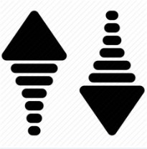
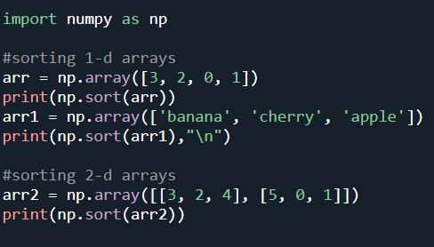
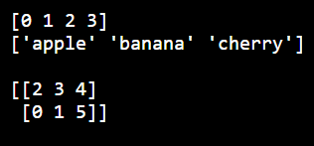
Sorting arrays
Sorting means putting elements in an ordered sequence using
sort() method.
Result:

