Slide 2
Python 3

Slide 3
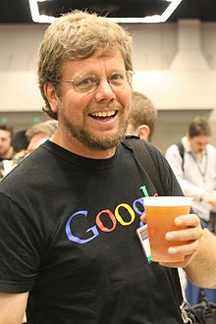
Developed by Gudo Van Rossum in the year 1989
official release in the year of 1991

Slide 4
Why the name python
Who is using Python

Slide 5
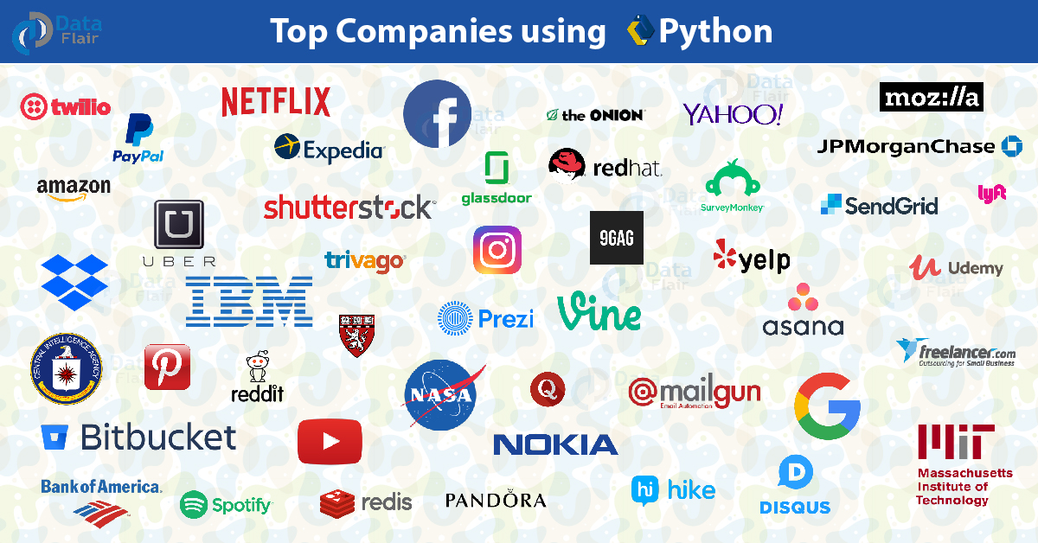

Slide 6
Where we can use python:
Desktop applications
Web applications
Developing Games
Data analysis
Network applications
Machine learning
AI
IOT
Data science
Automation

Slide 7
Python Features:
Simple and easy to learn
High level General purpose programing language
Freeware and open source
Platform independent and portable
Dynamically typed
Interpreted Language
Object oriented programing language
Huge library support
Extensible and integrated
GUI programming support

Slide 8
Limitations of python:
1. Performance and speed
2. Back ward compatibility
3. Mobile Applications
4. Need more Testing
5. Memory Consumption

Slide 9
Flavors of python:
Cpython
Jpython/jython
Iron python
Ruby python
Anaconda python
Pypy – contains JIT(just in compiler)

Slide 10
Python versions:
Python 0.9.0 Feb 1991
Python 1.0 Jan 1994
Python 2.0 Oct 2000
Python 3.0 Dec 2008
Latest 3.8.2 Feb 2020

