Slide 1
Python Set Properties
Set represents in curly braces - { }
In Set is unordered/order is not applicable
Duplicate objects are not allowed
Heterogeneous objects are allowed
In Set Indexing and slicing is not applicable
Set is dynamic
Set is mutable in nature
Set can not be nested
Notes:
If we want to represent group of unique objects as single entity and where order is not preserved and duplicates are not allowed, we can go for Set data structure
Data will be saved with the help of hash code in Set
Indexing and slicing are not applicable as the order is not preserved
If we add duplicate objects, It will not give any error and the duplicates will not be added

Slide 2
Creating a set object:
Creating empty set
Creating set with elements
s = {1,2,”python”,10.5}
Using Set function
s = set(sequence)
Notes:
We can’t create set with empty curly brasses, by default empty {} will be treated as dict
We need to use set function to create empty set(s = set())
If the sequence contains duplicate elements, then duplicates will be removed and creates the set

Slide 3
Mathematical operations on SET

Slide 4
Equality operators:
==
!=
Notes:
Number of elements must be same
Order of elements must not be same
Content must be same

Slide 5
Relational operators(Better not to use on SET):
<
>
<=
>=
Notes:
Relational operators (<,>, <=, >=)is applicable on SET, but not meaningfully developed, better not to use on SET, don’t know on what bases it will return True or False

Slide 6
Membership operators:
in
not in

Slide 7
Methods and functions on Set:
Len() function:
returns number of elements
add() method
adds the given element to the Set
ex: s.add(“python”)
Notes:
in case of list we use append() method, i.e the element will always add at the end of the list, but in Set, there is no guarantee where the element will be added, that’s why the method to add the elements are different
We should pass only single element to add() method

Slide 8
Methods and functions on Set:
update() method
To add multiple elements to the set
The input for update method must be itereble object like list,range , string
ex: s.update(sequence)

Slide 9
Methods and functions on Set:
Remove () method
Specified element will be removed from the SET, if the element is not present then, key error will be raised
ex: s.remeove(element)
Discord () method:
Specified element will be removed from the SET , if the element is not present in the Set, it will not be thrown any error

Slide 10
Methods and functions on Set:
Pop() method:
Pop method will not take any arguments, any one random element will be removed
If the set is empty, error will be raised
Clear() method:
Clear method will delete all the elements in the Set

Slide 11
Methods and functions on Set:
copy() method:
Syntax:
s2 = s1.copy()
Notes:
Aliasing and cloning is same as list

Slide 12
Set specific mathematical operators:
Union()
Intersection()
Difference()
Symmetric_differance()

Slide 13
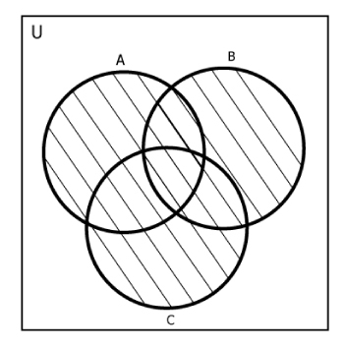
Union method()
Elements of different sets will be combined by excluding common elements
We can use union method or “ | ” pipe operator
Notes:
S3 = S1.union(s2)
S3 = s1 | s2

Slide 14
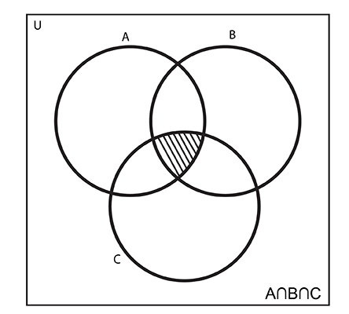
Intersection() method:
Intersection() method is used to create a new set, from common elements of different sets
We can use intersection method or (‘&’) operator
If there is no common elements, an empty set will be returned
Notes:
S3 = s1.intersection(s2)
S3 = s1 & s2

Slide 15
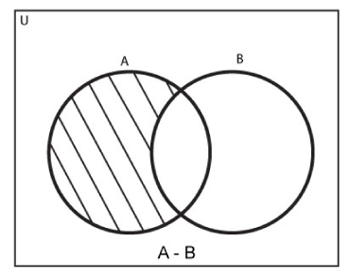
Difference() method:
Difference method is used to extract the elements which are not common in two sets
If there is no different elements in the two sets, then empty set will be returned
We can use difference method or ‘ – ‘ operator
Notes:
s1 = {1,2,3,4,5}
s2 = {4,5,6,7}
s3 = s1-s2
s3
{1, 2, 3}
s4 = s2-s1
s4
{6, 7}

Slide 16
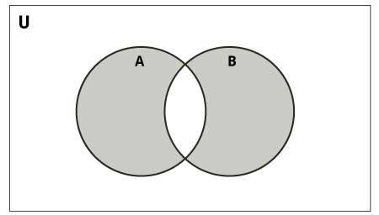
Symmetric_difference ()
Returns elements present in s1 and not in s2, the elements present in s2 but not in s1
i.e it will return except common elements, it will return all the elements
We can use symmetric_difference() or ‘ ^ ‘ to do this
If all the elements are common in both the set’s, it will return empty set

Slide 17
Set Comprehension :
Notes:
To get values from 1 to 9
S = { x for x in range(1,10) }

