Slide 1
Object Oriented Programming:
What is Class?
A class is a blueprint or prototype or a template.
What is an Object?
Object is an instance of a class
Per one class, we can create any number of objects
Notes:
Object is a physical existence of a class
One to many : one class , multiple objects

Slide 2
Object Oriented Programming:
What is Reference variable?
Which is used to refer an object, by using reference variable we can perform required operations on the object.
An object can have multiple reference variables
Notes:
Class with out any reference variables are kind of use less objects

Slide 3
Syntax to create a class and object:
class class_name:
‘’’ Documentation string‘’’
Variables
Methods
Syntax to create an object:
Reference_variable = class_name()
Notes:
Demo program 1:
class myClass:
''' this is my first class'''
print(myClass.__doc__)
---------
Demo program 2
#creating a class and an object
class myClass:
''' this is my first class'''
a = 10
obj1 = myClass()
print(obj1.a

Slide 4
What is self variable?
Self is a reference variable, which always points to current object within the class only
First argument to constructor and instance method is always self
Self is not a keyword, in place of self we can use any other name, but as per coding standards we must use “self”
Self is for only inside the class, outside the class we use instance variable
Notes:
First argument to constructor and instance method is always self, no need to pass any corresponding value for self-variable, while calling constructor or instance method python will take care.

Slide 5
What is Constructor:
Name of the constructor in python is always “__init__”
Defining a constructor is optional, in that case python will add default constructor
Whenever we create an object of the class, always the constructor will be called and executed
Constructor will be called only once, for each and every object we create
Use of constructor is to declare and initialize instance variable
Notes:
If we define multiple constructors, pvm considers last constructor, just like method if we have multiple method with same name, last defined method will execute(as it is interpreter )

Slide 6
Types of variables in python class:
1. Instance variables
Which are defined inside the class using self, and for every object a separate copy of instance variables are created
2. Static variables
If the value is common to all the objects created, then we need to go for static variables, so that we can save memory
3. Local variables
Variables, which are declared inside the class method
Notes:
Number of instance variables can be different between one object to another object

Slide 7
Types of inheritance:
Single inheritance
Multilevel inheritance
Multiple inheritance
Hierarchical inheritance
Hybrid inheritance
Cyclic inheritance

Slide 8
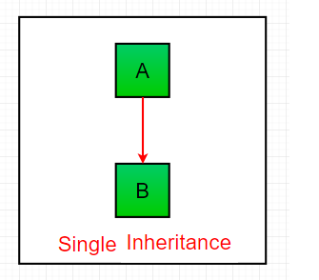
Single inheritance:
Inheriting members of one class to another class
One parent class and one child class

