Slide 1
Authors: Aleksa Arsić
Velibor Ilić
Bogdan Pavković
Dragan Samardžija
System for detecting driver’s drowsiness, fatigue and inattention
NOVEMBER 2021
Notes:
Hello, my name is Aleksa Arsić and I’m Bachelor with Honors in Electrical and Computer Engineering, currently enrolled in master studies on the same topic. Also, I’m employed as the Automotive Software Engineer by the RT-RK Automotive in Novi Sad. Today I would like to present you academic paper on the topic of System for detecting driver’s drowsiness, fatigue and inattention on which I’ve worked together with my colleagues Velibor Ilić, Bogdan Pavković and Dragan Samardžija.

Slide 2
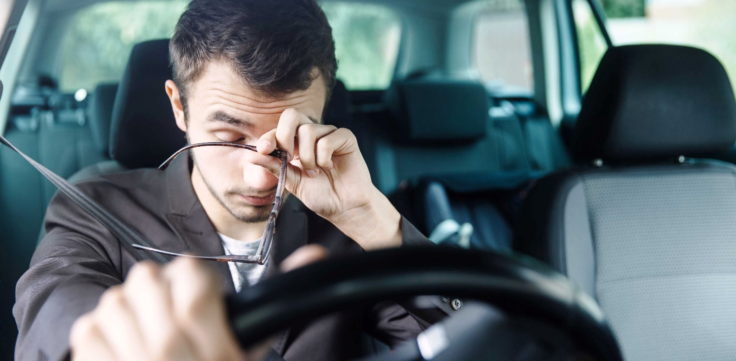
Introduction
Motivation: Third largest cause of road accidents due to driver’s drowsiness and other psychophysical conditions
Driver Monitoring System within ADAS systems
Machine learning and convolutional neural networks (CNN)
Notes:
Motivation behind the paper lies on the fact that in the Republic of Serbia in 2019, 25% of road accidents with fatal outcomes were caused by driver’s drowsiness, fatigue, inattention, and other similar psychophysical conditions. Such accidents make the third largest cause of road accidents with fatal outcomes in the country, with many European countries recording similar numbers.
With one of the main challenges and requirements of today’s automotive industry being, besides functional safety, to assure and secure the safety of the driver, passengers, other traffic participants, and environment, the Driver Monitoring System within ADAS systems would be of great use in modern vehicles since it can lower these numbers substantially.
One way this could be achieved is by using convolutional neural networks (CNN) and machine learning (ML) principles. In this paper, we present academic research on the topic which is based on three CNN’s used for monitoring the driver with a possibility to dispatch notification when concluded that his state of attention is not suitable for operating a motorized vehicle.

Slide 3
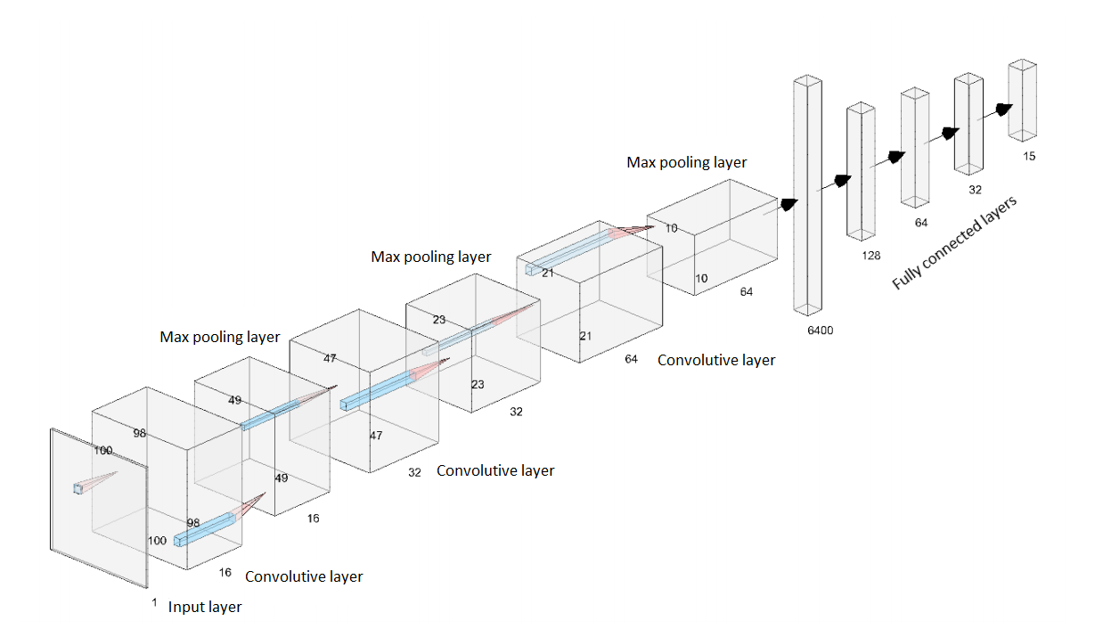
CNN architecture
Notes:
As said, we proposed a driver monitoring system based on three Deep Convolutional Neural Networks (CNN). Each CNN as the input layer uses 100x100 grey-scaled image which is propagated trough 3 convolutive layers, each followed by the Max pooling layer. After processing of the last max pooling layer, the data is flattened and propagated trough 3 fully connected layers, followed by the fourth and final fully connected layer, that is the output layer whose dimensions are unique for each of the three CNN used. Each CNN is trained on our own generated and manually labeled dataset for the particular network.

Slide 4
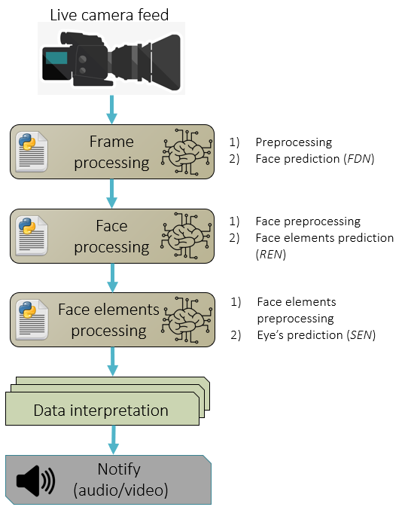
Driver attention software architecture
Notes:
The first CNN, face detection network (FDN), as input uses images captured from the simple web-camera, this network is trained to determine the frame that contains the driver's face. The second CNN network for selecting the region of eyes (REN), as input uses extracted image with face, and this network is trained to determine the frame that contains the eyes of the driver. The third CNN network, a network
for monitoring single eye (SEN), as input uses extracted image with eyes, and this network monitors individual eye. Before propagating data trough these 3 neural networks data is preprocessed in a way that suits each input layer of the respective neural network.
Each of the three CNN’s processes different parts of the image from the inside of the vehicle and are connected in a series in a way that the outputs of the previous are used as the inputs for the next CNN model in the series.
When determined lack of attention, an option of giving a sound warning is integrated to avoid potentially dangerous or even fatal situations.

Slide 5
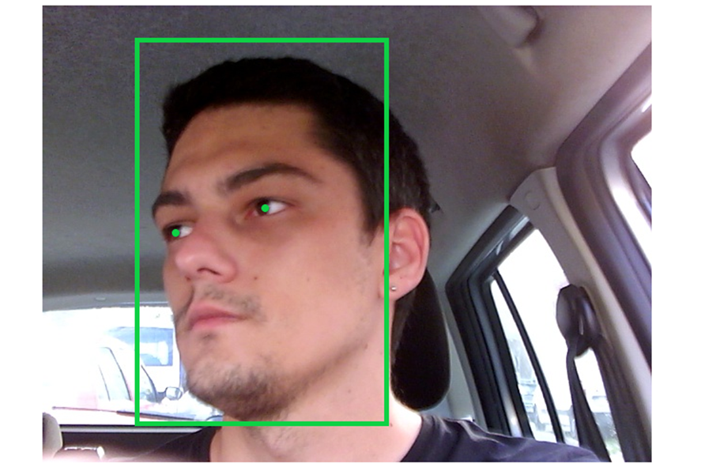
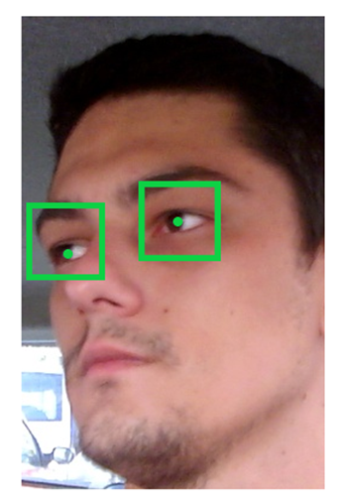
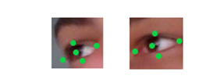
Points of interest of the CNN models
FDN outputs
REN outputs
SEN outputs
Notes:
After processing the image through these networks, it is sequentially assessed whether the driver lacks attention by monitoring driver’s eyes and head position in defined time interval. On the figures on the slide, it can be seen what each individual neural network is capable of tracking on respective input images.
Face detection network tracks center position of the eyes and face, region of eyes tracking network tracks center points of driver’s eyes and final single eye network is capable of tracking five different points of interest on the driver’s eyes. Beside that, face detection network calculates the probability of driver’s face being oriented left, right, up or down. And both region of eyes tracking network and the single eye neural network have the possibility of predicting the probability that the driver’s gaze is oriented left, right, up or down.

Slide 6
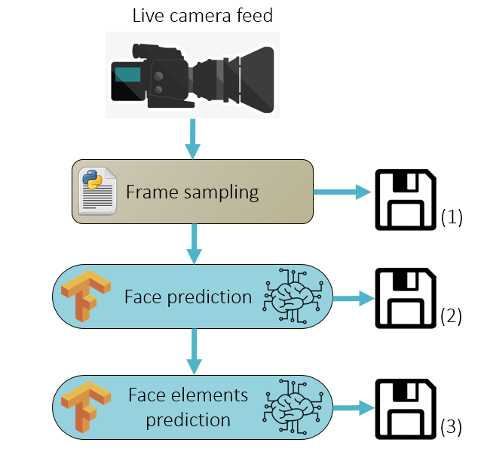
Generating datasets
Notes:
As mentioned, we generated our own datasets where each dataset contains images of eight people, five males, and three females, who voluntarily participated in the research. Every participant was asked to shoot a short video of themselves in a simulated environment. The datasets included videos of different distances from the camera, as well as videos from both the inside and outside of a parked vehicle. They were instructed to behave naturally as if they were in a real-life driving situation.
The process of generating our own datasets is shown in the figure and can be divided into several sections:
1. Individual frames are captured and saved from the video source. These frames are manually labeled and used in the training of the FDN model. This dataset contains numerous images with drivers’ face being inside captured frame (partially or whole) and images without the driver in them and has around 10 thousand images.
2. Using FDN model predictions from whole frames, face frames are cut, manually labeled, and used to train the REN model. This dataset consists of around 5 thousand images.
3. Using predictions of the REN model, face elements (eyes) are cut from face frames, manually labeled, and used to train the SEN model. This dataset also consists of around 5 thousand images.

Slide 7
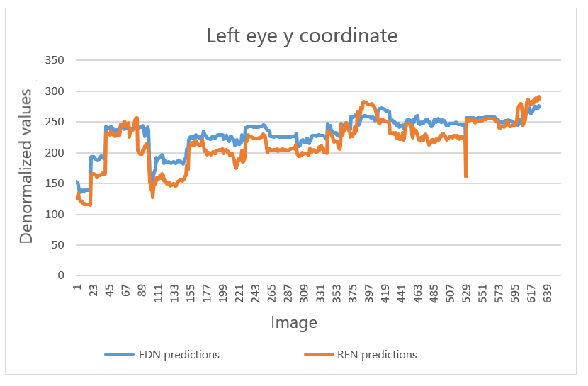
Results
CNN model | Test accuracy [%]
FDN | 90.79
REN | 86.68
SEN | 72.65
Testing accuracy of the three models
Possible exclusion of the REN model
Notes:
Testing results performed on the test datasets can be seen in the table on the slide. When used in the proposed system implementation of Simple Moving Average (SMA) with a window of fifteen past frames is used after every CNN model before predictions of the model are used for further processing. The use of SMA achieves greater error tolerance of the whole system. Even if the CNN models make a mistake in a few frames, it will not greatly impact the result of the overall assessment of the driver’s attention state.
It was mentioned earlier that the FDN model and REN model were both trained to predict the same points of interest, the central points of the driver’s eyes. Based on the obtained results we consider the REN model exclusion possibility. The difference between predictions of the FDN and the REN model are in the range from 20 to 40 pixels, which is an unacceptable and extremely large error. A conclusion is reached that the FDN model is not capable of reliably finding the central points of the left eye, i.e., it made sense to introduce the second, REN model into the system. Similar results were obtained when analyzing the right eye predictions of the mentioned models.

Slide 8
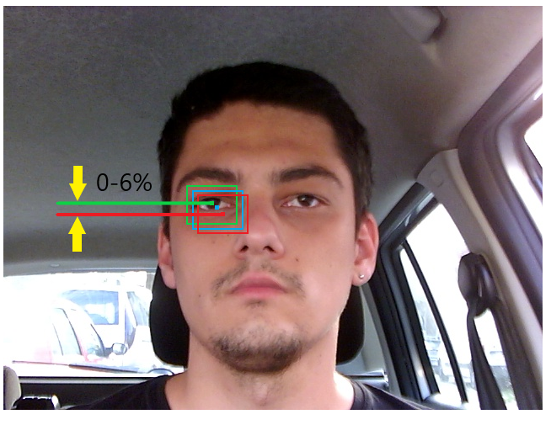
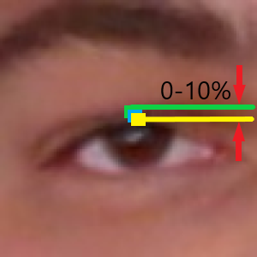
Results
Error margins of the experimental model
Error margins of the SEN model
Notes:
For experimental purposes, we have trained another CNN to once again considering the exclusion of both REN and the SEN model. This new model has the possibility of predicting all points of interest of the FDN, REN and SEN models.
On the left-hand side image, the green point represents the accurate, labeled, center of the eye, the blue point represents the prediction of the experimental CNN with an error margin of 3% and the red point represents the prediction of the experimental CNN with the error margin of 6%. Even with the error margin as small as 3%, the predicted center of the eye is greatly displaced from the real center, thus not accurate.
On the right-hand side, the green point represents the accurate, labeled, upper center point of the eye, the blue point represents prediction of the SEN model used in our system with the error margin of 5% and the yellow point represents the prediction of the SEN model with the error margin of 10%. Even when the error margin is high as 10% prediction of the upper center point of the eye is borderline accurate. Thus, we once again concluded that the dimensions of the driver’s eyes should be considered too small for one CNN to accurately predict points of interest.

Slide 9
Conclusion / Next steps
Additional assessment constraints/factors
Extending datasets
Optimization for embedded/automotive platform
Good starting reference
Notes:
Factors used to assess the attention levels in this system are far from enough for a complete assessment and there are many more factors that are not considered. For example, driving at night or under extreme sunlight can be another set of problems in which there should be an adequate solution for a video source that would assure undisturbed processing done by CNN’s.
On the other hand, it would be necessary to expand all three datasets used for training of the mentioned CNN models, which would include more people or volunteers involved with more precise instructions and conditions in which would they participate.
Also, as this was developed as the simple PC software and a lot of computing resources are needed for the software itself, it would be necessary to further optimize the algorithm if it was to be implemented in the modern vehicles.
At the end we conclude and point out that this is only academic research and by no means this can be a commercial solution integrated into modern ADAS systems, however, it could be a good starting reference for further development.

Slide 10
Notes:
That would be all from me, I hope you have enjoyed this presentation. Thank you for your attention.
Now I would like to show you a short demo video of the system itself and after that we can address any questions, if any ☺

