Slide 1
Поређење NewSQL Базе података
TiDB · CockroachDB · Spanner Omni
Алекса Милојковић 2100
Notes:
0:00-0:45 — TITLE + THESIS
Say the thesis out loud, verbatim, in the first fifteen seconds:
"All three of these systems solve the same problem with the same skeleton.
What separates them is how they tell time — and the visible consequence of
that choice is a different default isolation guarantee."
Then: "I'll show you the architecture in one slide, the mechanism that
matters, and one experiment that demonstrates the consequence."
Telling the audience the conclusion first is not a spoiler — it is what lets
them follow the rest. Do not build suspense; there aren't minutes for it.
Target the whole talk at 9:00, not 10:00.

Slide 2
Скалираље или SQL
Стара препрека | Шта добијамо | Шта морамо да платимо
Вертикално скалирање | Монолитан систем | Цена компонети машине; једна тачка пада
Реплике читања | Пропусни опсег читања | Само читања, могу се сервирати стари подаци
Ручно Паритионисање | Скалира се писање и читање | Нема трансакција или спојева преко партиција
Распоређене SQL партиције унутар базе података и одржавају једну SQL површину, са ACID својствима кроз партиције.
Spanner — почетак свега; граћен око синхронизације у ралном времену.
CockroachDB — исте гаранције, без специјалних сатова.
TiDB — MySQL-компатибилан, са колонарним мотором поред редног складишта.
Notes:
0:45-1:50 — THE PROBLEM
Say: read replicas scale reads only and serve stale data; manual sharding
costs you cross-shard transactions and joins. Distributed SQL refuses the
fork — it automates partitioning inside the database and keeps one SQL
interface over the result.
Do NOT define NewSQL formally. One clause is enough.
The three one-liners are the only per-system introduction in the talk —
say them once and move on. There is no per-engine architecture slide.

Slide 3
Један скелет, три језика
Дељиво између сва три: партиционисани кључеви · реплициран консензусом · MVCC · дистрибуирани трансакциони слој · дистрибуирани слој упита
 | Spanner | CockroachDB | TiDB
Јединица података | split | range | region
Консензус | Paxos | Raft | Raft
Одбабир локације | placement driver | Аllocator, по чвору | Placement driver
Query слој | distributed union | DistSQL | TiDB + coprocessor
Где се они заправо разликују: како распоредити догађаје у времену, како постићи сагласност при неуспеху и како атомично извршити упите преко партиције.
Notes:
1:50-3:00 — ONE ARCHITECTURE SLIDE (70 seconds — rehearse against a timer)
This is the slide people over-run on. One slide, not three.
Say: the skeleton is shared — sharded key ranges, consensus-replicated,
MVCC, a distributed transaction layer, a distributed query layer. Name the
three vocabularies once (splits / ranges / regions) and move on:
"same idea, three names — the paper has the per-operator detail."
Then land the pivot, which is the bottom box:
"Where they actually differ is in how they answer three questions: how to
order events in time, how to agree under failure, and how to commit
atomically across shards. The first one drives the rest."
Per-engine architecture diagrams are backup slide B4 if anyone asks.
CHECKPOINT: you should be leaving this slide at 3:00.

Slide 4
Три начина добављања времена, три различите цене
 | Механизам | Шта му треба | Која је цена
Spanner | TrueTime | Синхронизовани сатови | commit-wait на сваки упис
CockroachDB | HLC | / | рестарти несигурности
TiDB | TSO | један PD процес | повратно путовање по трансакцији
Сваки систем добавља време на свој начин са различитом ценом, због тога тај избор одређује који ниво исолације сваки систем може да понуди.
Notes:
3:00-4:00 — HOW EACH ONE TELLS TIME
Say: each buys ordering a different way and pays a different price.
- Spanner waits out its clock uncertainty at commit.
- CockroachDB pays in occasional restarts when a read falls inside the
uncertainty window.
- TiDB pays a round trip to a single process at every transaction start.
Then set up the payoff: "That choice determines what isolation level each
system can offer cheaply — which is what the next slide is about."
If you have five spare seconds, drop the teaser: "— and I'll come back to
the fact that Spanner now ships in a version that doesn't need those clocks
at all."
R2 caveat if asked: on Spanner Omni, TrueTime is software-defined — no GPS,
no atomic clocks. That is exactly what slide 8 is about.
CHECKPOINT: at 4:00 you must be starting slide 5. If you are behind, cut
slide 7 — not slide 6.

Slide 5
Две исправне трансакције, један нарушен инваријант
Инваријанта: најмање један лекар мора бити у дежурству. Почетно стање: два лекара су у дежурству.
Корак | Сесија A | Сесија B
1 · 2 | BEGIN | BEGIN
3 · 4 | reads: 2 on call | reads: 2 on call
5 · 6 | sets doctor 1 → off call | sets doctor 2 → off call
7 · 8 | COMMIT | COMMIT ←Шта би требало овде?
Свака трансакција је појединачно исправна: свака проверава инваријанту, свака посећује два лекара, свака узима само једног. Оне уписују различите редове. Ако обе изврше commit, ниједан лекар није на позиву и нико то није видео.
Notes:
4:00-5:00 — THE WRITE-SKEW SETUP (heart of the talk starts here)
The table reads instantly — do not narrate it row by row. Sessions are
strictly interleaved: A then B at every step.
Say: each transaction is individually correct — each checks the invariant,
each sees two doctors on call, each takes only one off. They write
*different rows*, so there is no write-write conflict for the engine to
detect. If both commit, zero doctors are on call and nobody ever saw it
happen. That is write skew, and snapshot isolation permits it.
If a demo is allowed: this is the only slide worth demoing, and run the
PRE-RECORDED version — C1 (skew occurs) and C3 (SQLSTATE 40001), 40 seconds
total. Keep the next slide's table as the actual result either way.

Slide 6
Аномалија прати ниво изолације, а не систем.
 | База података | Ниво изолације | Резултат
C1 | TiDB | Repeatable Read (SI) — подразумевано | write skew
C2 | TiDB | SI + SELECT … FOR UPDATE | write skew — закључавање није довољно
C2b | TiDB | FOR UPDATE + invariant check | prevented
C3 | CockroachDB | Serializable — подразумевано | prevented (SQLSTATE 40001)
C4 | CockroachDB | Read Committed — форсирано | write skew
C5 | Spanner Omni | read-write txn (not lowerable) | prevented (Aborted)
C3 и C4: иста база, иста шема. Променио се само ниво изолације.
Разлика између производа је у томе шта сваки од њих сматра безбедним подразумевано.
Notes:
5:00-6:45 — THE RESULT (the most important slide in the talk)
THE KEY SENTENCE — memorise this one, do not improvise it:
"Look at rows C3 and C4. The anomaly isn't a property of the vendor — it's a
property of the isolation level. The same engine produces it or prevents it
depending only on how you configure it. What actually differs between these
three products is which default each one considers safe to ship. That's a
judgement about their users, not a limit of their engineering."
PAUSE FOR TWO SECONDS after that sentence. It's the moment you want to land.
Second finding, briefly — C2 vs C2b: SELECT ... FOR UPDATE serialised the
reads (Session B did see the fresh count of 1) but the UPDATE ran anyway, so
the anomaly survived. Only the explicit application-level invariant check
closed it. The lock makes the re-validation possible; it does not perform it.
Third, one sentence then move on — WHERE the loser fails: pessimistic TiDB
blocks at step 6, before commit; optimistic CockroachDB and Spanner let both
writes through and reject one at commit, step 8.
Why C4 matters: without it you have compared two engines that differ in a
dozen ways and attributed one difference to one of them. C4 turns a demo
into an experiment.
Replication note if asked: this experiment ran on the RF=1 single-server
Spanner Omni build. Isolation-level behaviour does not depend on
replication factor — that is why it was not among the experiments redone at
RF=3 (see the limitations slide).

Slide 7
Додавање чвора у кластер – различити консензуси
CockroachDB
TiDB
Spanner Omni (RF=3)
Dodat 4. čvor bez restart-a
lease-holders (fast)
before 18 / 19 / 20
after 13 / 15 / 16 / 13
replike (slow, real data)
after 28 / 57 / 57 / 29
under-replicated: 0 throughout
4. TiKV store dodat uz komandu scale out, bez restart-a
peers per store
before 5 / 5 / 5
after 2 / 3 / 5 / 5
Novi store je odmah preuzeo opterećenje od najopterećenijeg store-a.
3 -> 4 root servera:
Odbijeno – broj root-a mora biti neparan(Paxos quorum)
4. non-root server:
Odmah dodat, 0 restart
Nije potrebno rebalansiranje
Politika plasmana je vezana samo za root servere
Рутирање се одвија брже од преноса података.
Овде смо агресивнији, али има само 5 региона, па је сваки потез велики.
"Додавање капацитета" и "додавање гласачког капацитета" се разликују.
Сва три су додала капацитет тренутном кластеру без прекида. Само Spanner га ограничава на кворумску паритет.
Notes:
6:45-7:35 — ONE SUPPORTING RESULT: rebalancing, not the benchmark
Say: add a node to a running cluster, data redistributes automatically, no
application change, no re-architecture. That is the promise the whole
category is built on, and all three deliver it — but not in the same way.
CockroachDB exposed two independently-paced signals: lease-holders (routing,
metadata-only) moved fast; replicas (physical data copies) lagged behind.
Zero under-replicated ranges throughout, so this is pacing, not a
correctness gap.
Spanner is the interesting one, and it is a real RF=3 result on the
3-root-server deployment: you cannot go 3 -> 4 root servers at all — the
chart's own validation rejects it, because root servers form a Paxos voting
group and need an odd member count. A 4th NON-root server joins live with
zero restart of the other three, but nothing rebalances onto it: placement
is scoped to root servers.
WHY NOT THE BENCHMARK: three engines, different internal topologies, one
laptop, over loopback, default settings, one a beta build. Any throughput
ranking would be wrong and it is the easiest thing in the talk to attack.
Rebalancing is visual, qualitative and unimpeachable. Charts are B1/B2 — and
explaining calmly why you didn't lead with them impresses more than the
chart would have.
If you are behind schedule, this is the slide to cut. Full evidence: B9.

Slide 8
Куда ово води?
1. Дистрибуирани SQL напушта cloud.
Спанер Омни је преузимајући Спанер: локално, у облаку или на лаптопу.
2. Аргумент сата се сузио.
Omni замењује GPS пријемнике и атомске сатове компаније TrueTime софтверски дефинисаном имплементацијом. Основни предлог CockroachDB гласио је: "Гаранције Spanner-а без Spanner-ових сатова".
3. Избегавање координације је контра-тренд.
Aurora DSQL (GA 2025) користи оптимистичку контролу истовремености и изолацију снимака, намерно слој који дозвољава асиметрије у писању, у замену за читања без координације.
Област се не слива на један одговор; она проналази различите начине плаћања.
Notes:
7:35-8:35 — WHERE THIS IS GOING
Lead with point 1 because you have first-hand evidence, and say so:
"this isn't from a press release, I ran it." That single sentence is worth
more than any other credibility signal in the talk. Be specific: three root
servers on local k3s, real Paxos replication, RF=3 — the same replication
factor as CockroachDB and TiDB, which is what makes the comparison fair.
Point 2 — the honest version: Omni's TrueTime is software-defined. That is
a caveat on my timing numbers AND the most interesting thing I found: if a
software clock can run the commit-wait protocol, the hardware half of
CockroachDB's original argument has narrowed.
Point 3 is the strongest note to end on because it loops straight back to
the write-skew slide: Aurora DSQL deliberately chooses the isolation tier
that permits the anomaly I demonstrated, and gets coordination-free local
reads for it.
CHECKPOINT: you must be starting this slide at 7:35.

Slide 9
Који да изаберете
 | Изаберите га када
Spanner | Доминирају снажна глобална доследност и оперативни обим
CockroachDB | PostgreSQL compatibility on arbitrary infrastructure dominate
TiDB | Доминантна је компатибилност са MySQL-ом и мешовите трансакцијске/аналитичке радне оптерећења.
Notes:
8:35-9:00 — WHEN TO CHOOSE WHICH
Twenty seconds. Do not elaborate — the table does the work. Read none of it
aloud verbatim; say one sentence of framing and move on:
"None of these is the best one. They differ in which constraint they let
you stop thinking about."
Then go straight to limitations.

Slide 10
Хвала на пажњи
Notes:
9:20- — THANK YOU / QUESTIONS
Nothing to read. Stop talking and take questions.
Finish early. Ending at 9:10 with a clean conclusion beats ending at 10:30
in the middle of a sentence, every time.
PREPARED ANSWERS (backup slides B1-B9 follow this one):
- "Isn't snapshot isolation good enough?" Usually yes — which is why TiDB
and Aurora DSQL both ship it. It fails on invariants spanning multiple
rows: inventory, scheduling, double-booking, balance constraints. The
developer has to know to lock, and the failure is silent when they don't.
- "Why not configure TiDB for serializable?" Its practical mechanism is
explicit pessimistic locking — condition C2/C2b. The experiment was about
defaults, plus C4 to isolate the variable.
- "One laptop — what does the benchmark show?" Deliberately not a ranking;
each engine's own response shape to concurrency. Then offer B2.
- "Is Omni's TrueTime the real TrueTime?" No — software-defined, no GPS or
atomic clocks. That's why the Spanner timing numbers are qualified.
- "Why not YugabyteDB / Aurora DSQL / OceanBase?" Scope: three systems with
published architecture papers, all deployable locally at matched
replication factor. DSQL is in the trends section as the outlier.
- "How do you know the write skew was real?" Invariant checked before and
after every run, five conditions, two producing the anomaly and three
preventing it, exact error text recorded for each.
- "CAP?" These are CP systems; PACELC is the more useful frame — the
interesting question is what they trade absent a partition: latency.

Slide 11
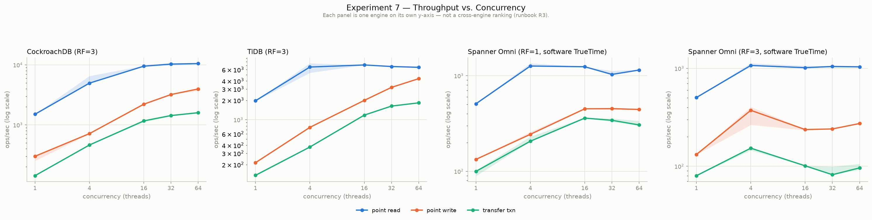
B1a
Throughput vs. concurrency, per engine
Notes:
BACKUP — only if asked about performance.
Throughput (top) and p99 (bottom), four panels each: CockroachDB, TiDB,
Spanner RF=1, Spanner RF=3. Deliberately not on a shared axis.
Shapes worth naming: CockroachDB's point_read climbs smoothly to 64 threads;
TiDB's declines past 16; Spanner RF=1 is flatter and lower throughout.
At RF=3 Spanner's point_read barely changes, but point_write throughput
roughly halves at 16+ threads and transfer's p99 goes 239ms -> 1303ms at 64
threads — a real consensus cost that RF=1 structurally could not show.
If they ask about performance, prefer B2.

Slide 12
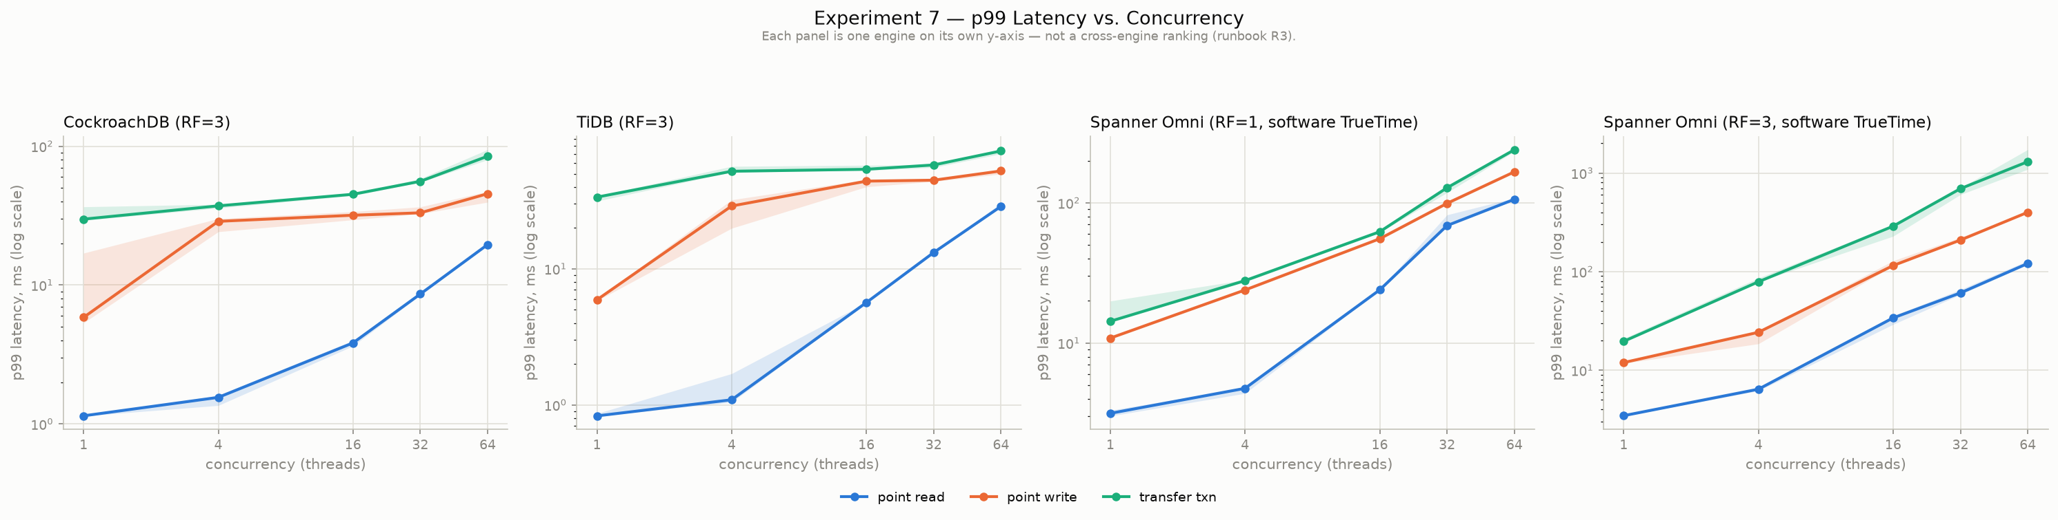
B1b
p99 latency vs. concurrency, per engine
Notes:
BACKUP - companion to B1a. Same sweep, 99th-percentile latency.
Log-scaled y-axis per panel. The RF=3 Spanner panel is the informative one:
point_read tracks RF=1 closely, but the two write workloads separate sharply
above 16 threads.

Slide 13
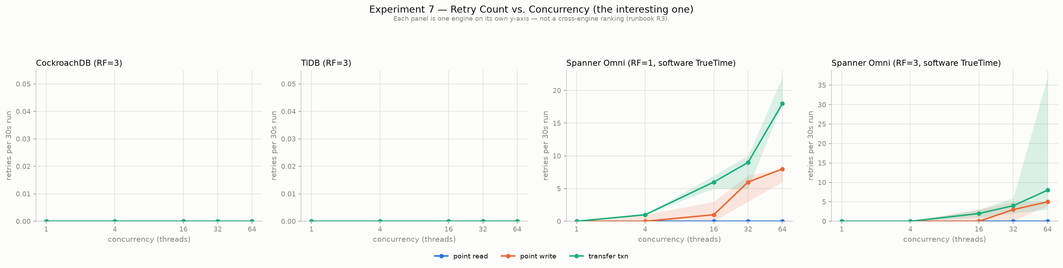
B2
Retry rate vs. concurrency
Notes:
BACKUP — the good one. Show this instead of B1 if asked about performance.
It connects performance straight back to the write-skew slide: serializable
validation converts contention into retries; snapshot isolation converts it
into anomalies instead. Zero retries on CockroachDB and TiDB across every
single combination — the workload simply doesn't contend at 50k accounts.
One counter-intuitive wrinkle worth volunteering: total retries were LOWER
at RF=3 than RF=1 for both write workloads — not less contention, just far
fewer transactions attempted in the same 30-second window at the higher
per-transaction latency.

Slide 14
B3
Три различита плана упита за један упит
CockroachDB
TiDB
Spanner Omni
EXPLAIN (VERBOSE)
header claims
distribution: full
but every operator ran
on one node (n2/us-east)
aggregation:
single hash agg,
centralised at the root
2 missing-index hints
surfaced automatically
EXPLAIN ANALYZE
filters pushed down to
cop[tikv]
aggregation:
HashAgg centralised at
the TiDB SQL layer
auto-created FK index
index:fk_2(product_id)
advisor recommends a
different index entirely
distributed union
genuine two-phase
aggregation:
local partial SUM
+ global SUM
RF=1 -> RF=3 re-run:
remote_server_calls
0/0 -> 7/7
rows scanned 20,676 (same)
same plan shape
45ms -> 104ms
Две базе податка централизују агрегацију док га једна дистрибуира
Notes:
BACKUP — query execution (Experiment 2).
The headline: where aggregation happens. CockroachDB and TiDB both push
filters down but pull the SUM/GROUP BY back to a single node; Spanner does
real two-phase aggregation — a local partial SUM per batch combined by a
global SUM.
The RF=3 re-run is the part worth stressing: the original write-up hedged
that distribution "would happen the same way" on a multi-server deployment.
That was untested at the time. Re-running the identical query at RF=3 showed
remote_server_calls going from 0/0 to 7/7 — real cross-server calls — with
the same plan shape, the same 20,676 rows scanned and the same result, at
about 2.3x the elapsed time. The hedge is now a measurement.
Also: CockroachDB's and Spanner's index advisors independently agreed on the
same missing index; TiDB's recommended something else. A genuine three-way
divergence.

Slide 15
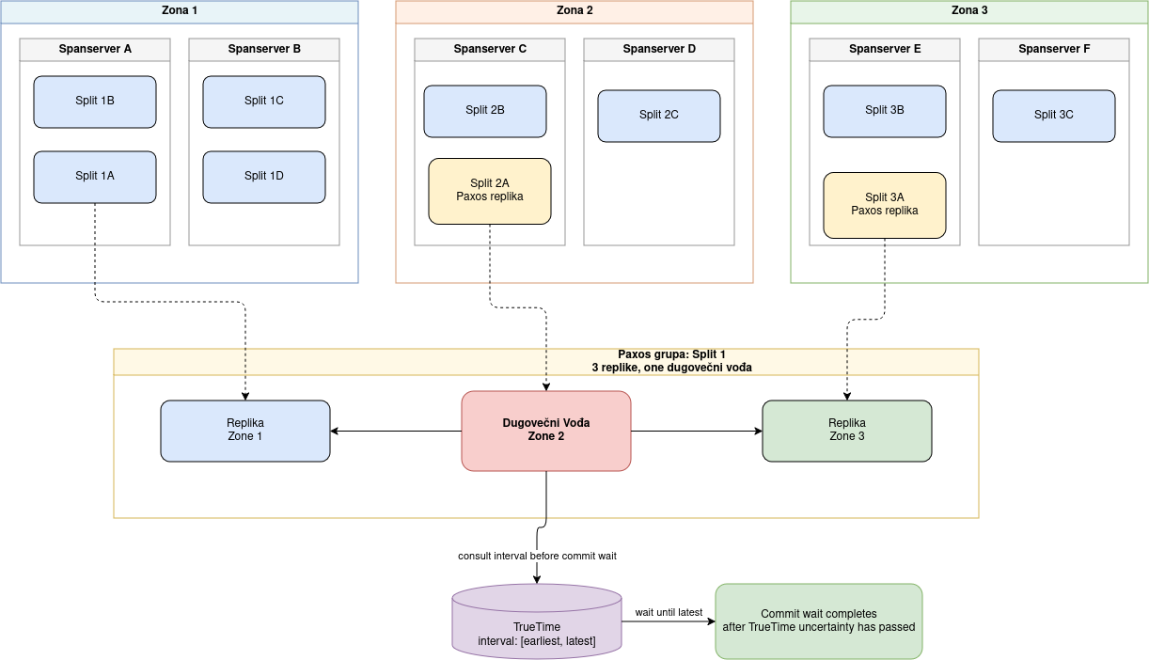
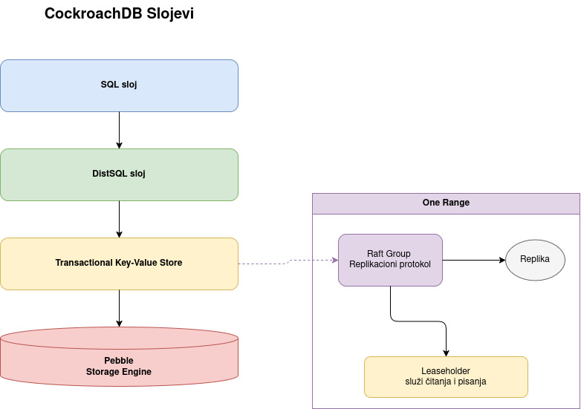
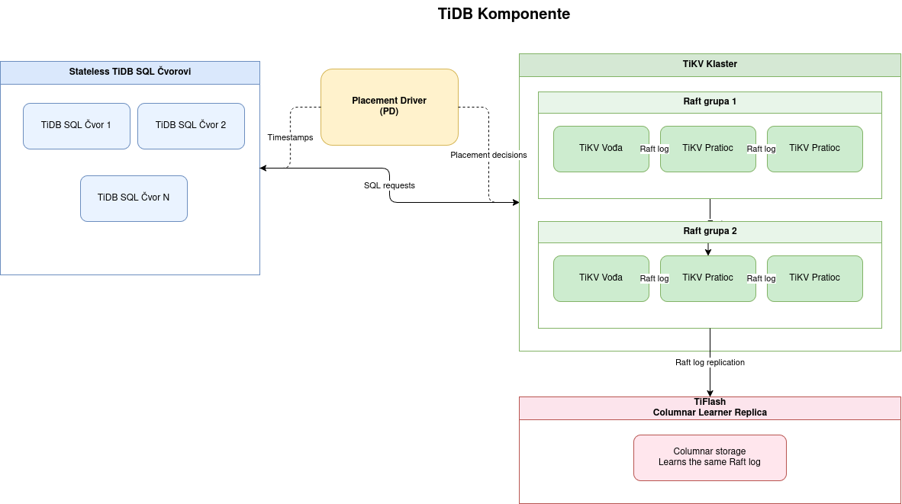
B4
Архитектуре по систему
Spanner
CockroachDB
TiDB
Notes:
BACKUP — the per-engine architecture diagrams deliberately left out of the
main talk (Figures 3.1-3.3 in the paper).
Only walk through one of them, and only if asked about a specific engine.
The talk's argument doesn't need them: the shared skeleton and the three
vocabularies are on the main architecture slide.

Slide 16
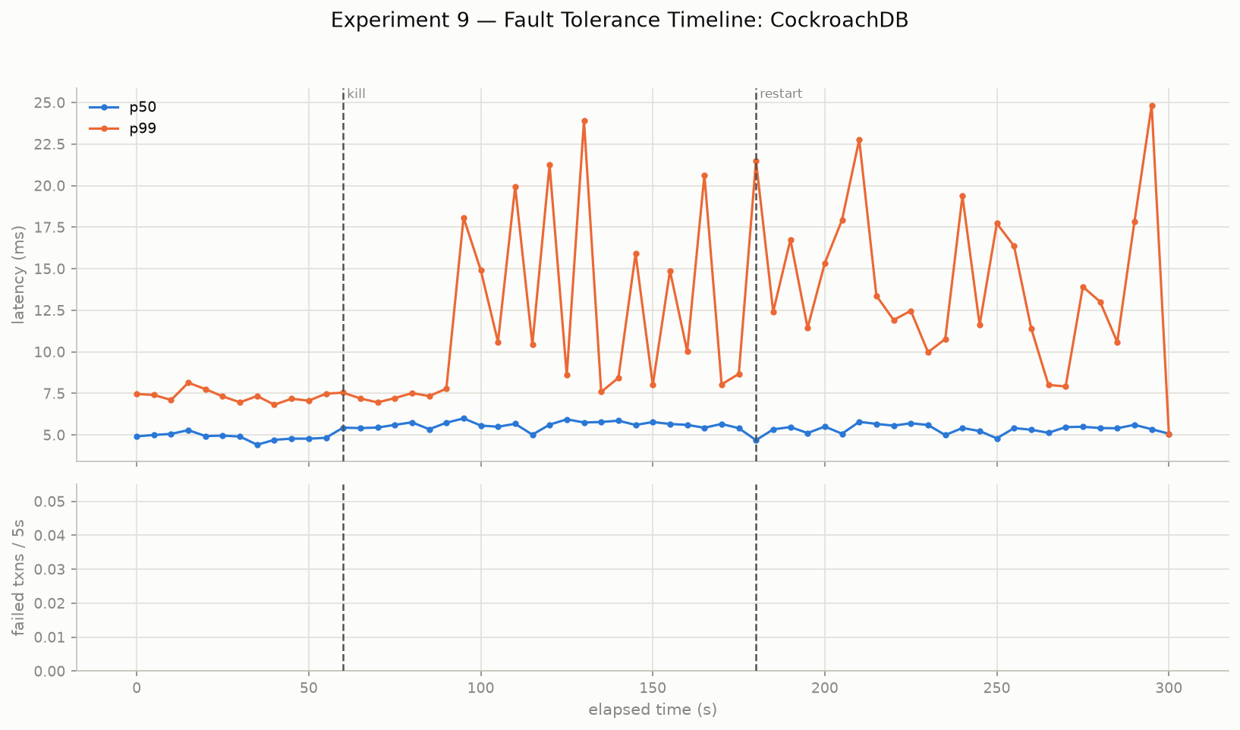
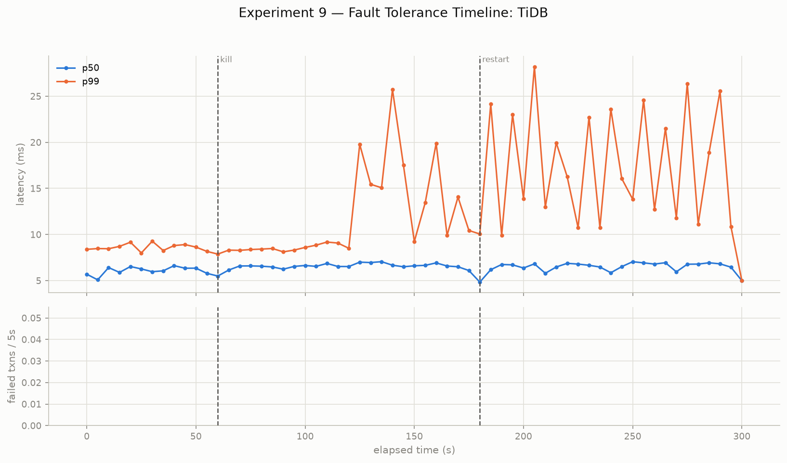
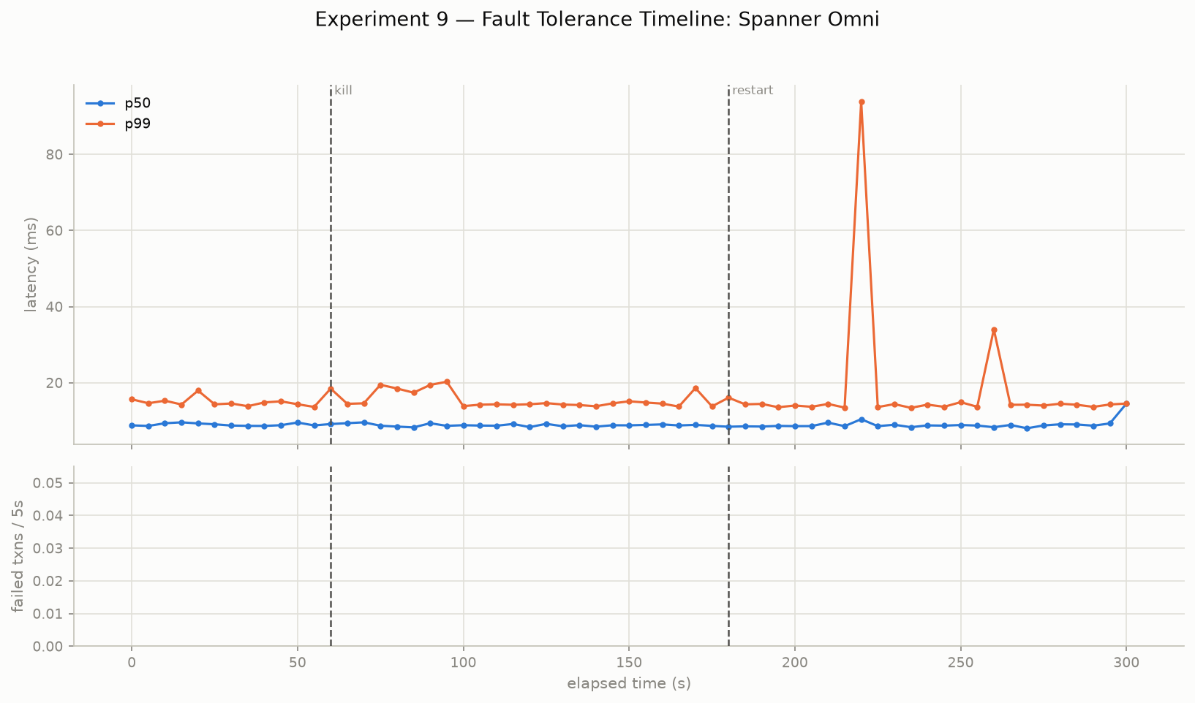
B5
Толерантност на грешке
CockroachDB
TiDB
Spanner Omni (RF=3)
 | CockroachDB | TiDB | Spanner Omni
Transactions / failures | 55,356 / 0 | 46,812 / 0 | 32,162 / 0
p99 након уништење чвора | Одмах деградира | деградира ~50s касније | Ништа се не дешава
p99 recovered by T+300s | не | не | /
Recovery | Ручни рестарт | Ручни рестарт | k8s self-heal, ~61s
Notes:
BACKUP — Experiment 9, all three at RF=3.
Zero failed transactions across ~134,000 transactions and three independent
node/server kills. The RF=3 quorum promise, demonstrated rather than
asserted.
The finding a pure success/failure count would have missed: CockroachDB's
and TiDB's p99 stayed elevated and volatile for the rest of the run and
never recovered to baseline — median latency stayed flat the whole time, so
only the tail shows it. CockroachDB degrades almost immediately after the
kill; TiDB waits about 50 seconds, plausibly different failure-detection
defaults (inferred from the timeline, not confirmed).
Spanner's redo showed neither degradation nor recovery lag — plausibly
because the Paxos group elected a new leader among the two survivors almost
immediately. That is a hypothesis from the timeline, not confirmed against
election logs. Do not turn any of this into "Spanner recovers better":
different substrate (Kubernetes vs bare processes), different topology, one
laptop, one Preview build.

Slide 17
B6
SQL компатибилност, где се системи разликују
Feature | CockroachDB | TiDB | Spanner Omni
Window функције | да | да | Не
CTEs / JSON access | да | да | да (JSON_VALUE)
RETURNING / THEN RETURN | Враћа ред | Нема за UPDATE | Прихваћено / CLI не штампа
Upsert semantics | По колони | По колони | Мења цео ред
Stored procedures | да (v22.2+) | не | Не, не постоји у GoogleSQL
UPSERT је права замка: INSERT OR UPDATE је преписао колоне које упит никада није ни навео.
Преношење UPSERT логике између ових система представља велики проблем.
Notes:
BACKUP — Experiment 8's compatibility matrix.
Two things worth saying precisely if this comes up:
1. Window functions: production Spanner documents RANK() and ROW_NUMBER()
as standard GoogleSQL. Their absence here is almost certainly a gap in
this specific Preview build, not a dialect limitation. Say it that way —
don't let it become "Spanner lacks window functions."
2. Upsert is the genuine semantic difference, verified directly: owner and
region were overwritten on Spanner even though only balance was meant to
change, while CockroachDB and TiDB left them at their seeded values.
This experiment was not redone at RF=3 — dialect support does not depend on
replication factor.

Slide 18
B7
Ниво изолације против аномалија
Ниво изолације | Non-repeatable read | Phantom | Write skew | Подразумевано
Read Uncommitted | допушта | допушта | допушта | —
Read Committed | допушта | допушта | допушта | —
Snapshot Isolation / Repeatable Read | забрањује | не гарантује | допушта | TiDB
Serializable | забрањује | забрањује | забрањује | CockroachDB; Spanner
Изолација (шта конкурентне трансакције виде једна о другој) и свежина (колико застарело може бити читање) су независне осе
Notes:
BACKUP — only if someone asks about consistency terminology, or conflates
"strong consistency" with "serializable".
The two-axis framing is the answer: isolation (what concurrent transactions
see of each other) and recency (how stale a read may be) are independent
dimensions. Spanner's external consistency is a claim on both axes at once,
which is why it costs commit-wait.

Slide 19
B8
Spanner Omni са RF=3
Постављање
Шта је променило
local k3s v1.36.2 + Helm chart 0.2.0
1 location / 1 zone / 3 root servers
spanner-a-0, -a-1, -a-2 (Paxos group)
1 vCPU + 4GB per pod, NodePort :30010
database: seminar-multiserver
two chart bugs found and fixed:
- node needs a topology zone label
a stock k3s node doesn't have
- default hard pod anti-affinity is
unsatisfiable on a 1-node cluster
Exp 1 distribution
one group, replicated on all 3 servers
Exp 2 query execution
remote_server_calls 0/0 -> 7/7
Exp 3 transactions
p50 9.95 -> 10.14ms p99 14.5 -> 16.7ms
Exp 6 scaling
3->4 roots rejected (odd quorum)
Exp 7 benchmark
reads ~unchanged; writes halve at 16+
threads; transfer p99 239 -> 1303ms
Exp 9 fault tolerance
32,162 txns, 0 failures, no p99 hit
Notes:
BACKUP — the replication-parity question, which is the sharpest
methodological question anyone can ask.
The story in one breath: Spanner Omni's documented multi-server path
targeted GKE and EKS, so the project started single-server at RF=1 while
CockroachDB and TiDB ran at RF=3. That is a real threat to any comparison,
so it was logged as a limitation rather than glossed. A local k3s + Helm
path was later found and stood up — three root servers forming a genuine
Paxos group — and every experiment whose result could depend on replication
was redone against it.
What the redo actually bought, concretely: the query-execution claim that
distribution "would happen the same way" at RF=3 stopped being a hedge and
became a measurement (0/0 -> 7/7 remote server calls). Transaction latency
turned out to be nearly RF-invariant at the median, confirming the gap over
CockroachDB was gRPC and commit-wait overhead rather than consensus cost —
but the tail rose measurably, so consensus is not free. And the benchmark
exposed a write cost that a single-server deployment structurally cannot
exhibit: no second replica means nothing to agree with.
The three not redone were checked, not assumed: isolation-level behaviour,
clock mechanism and SQL dialect support have no replication dependency.

