Slide 1
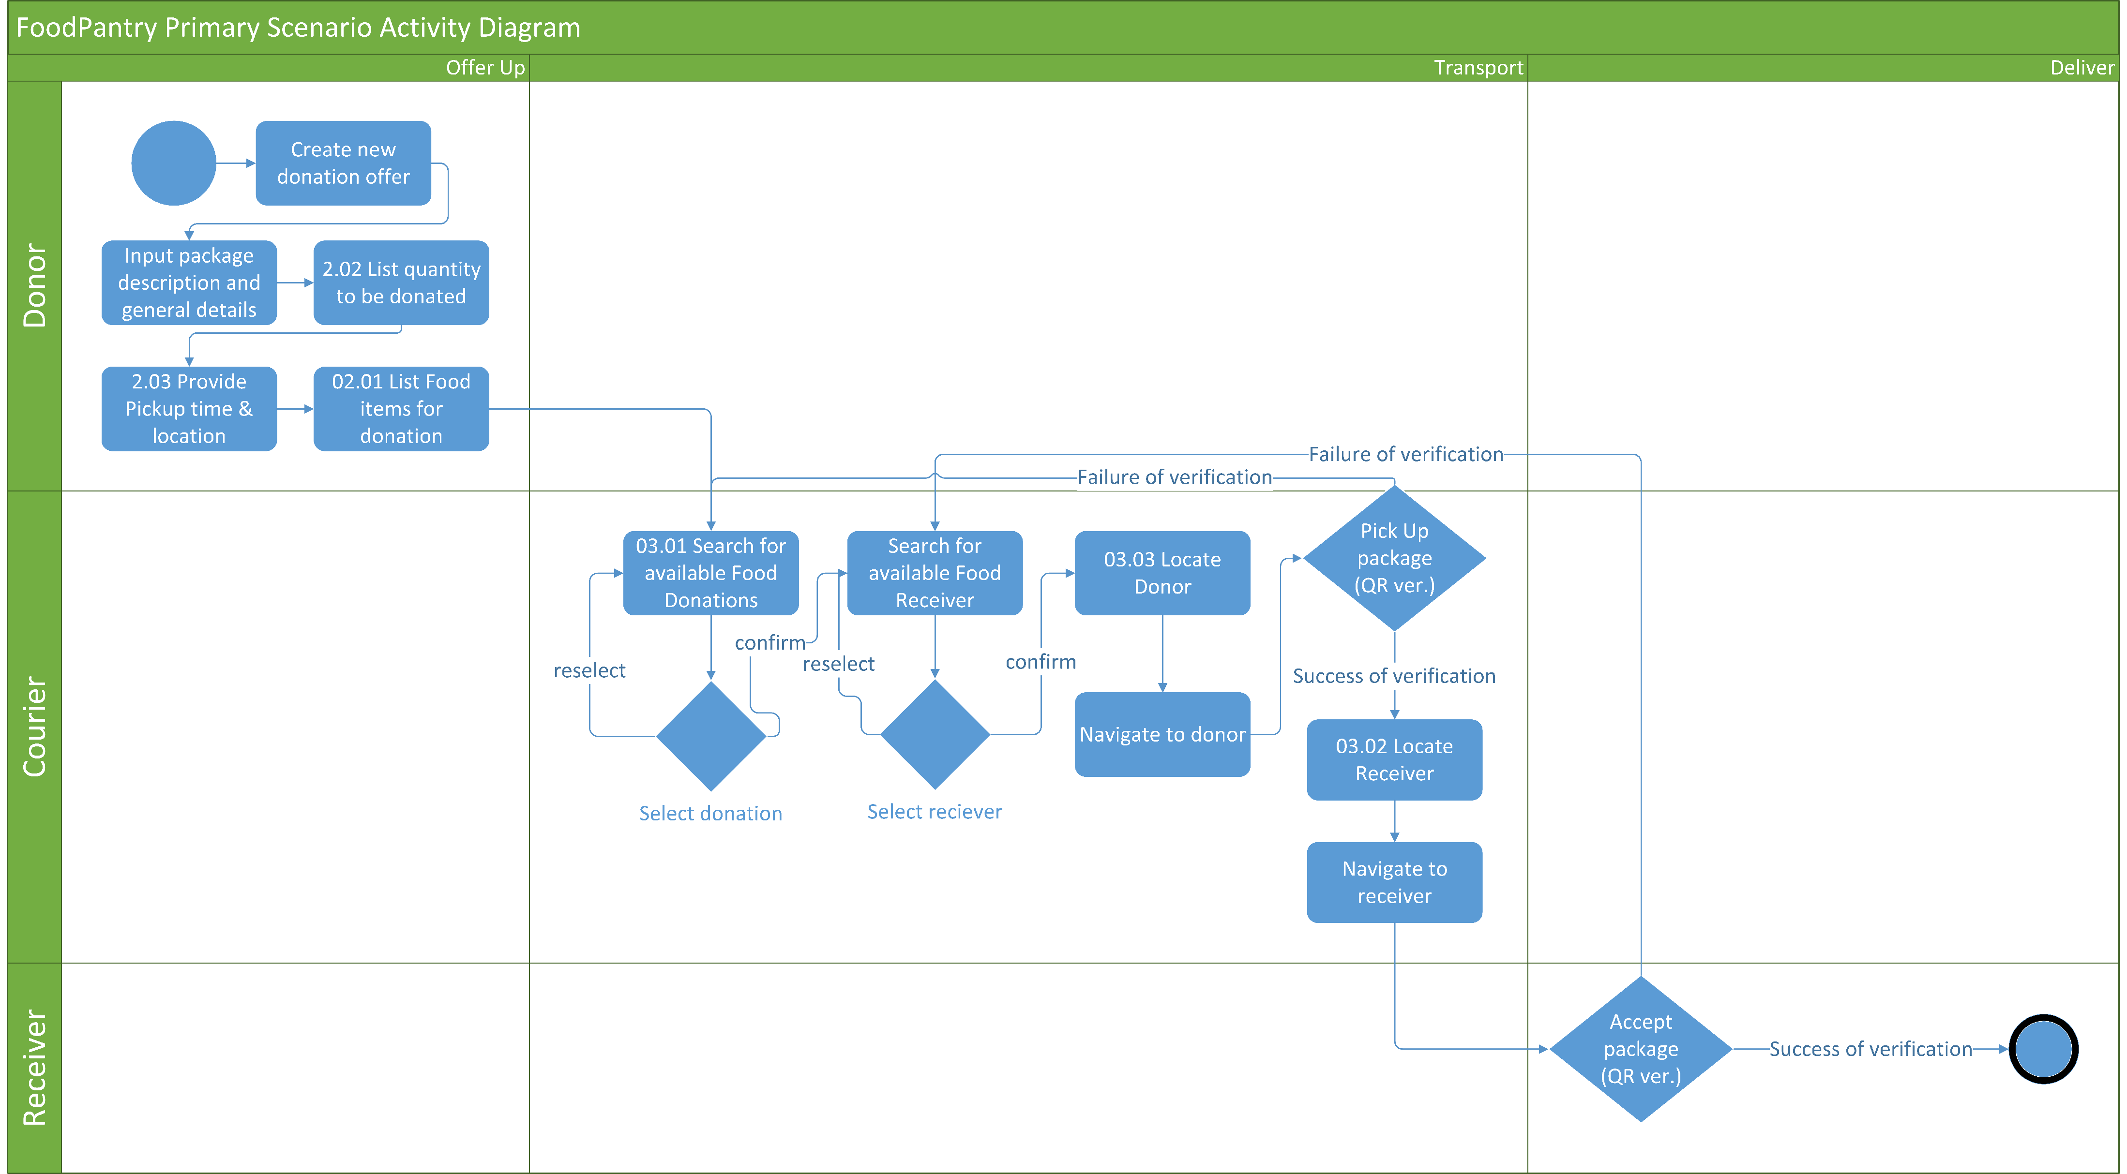
FoodPatry Activity Diagram

