Slide 1
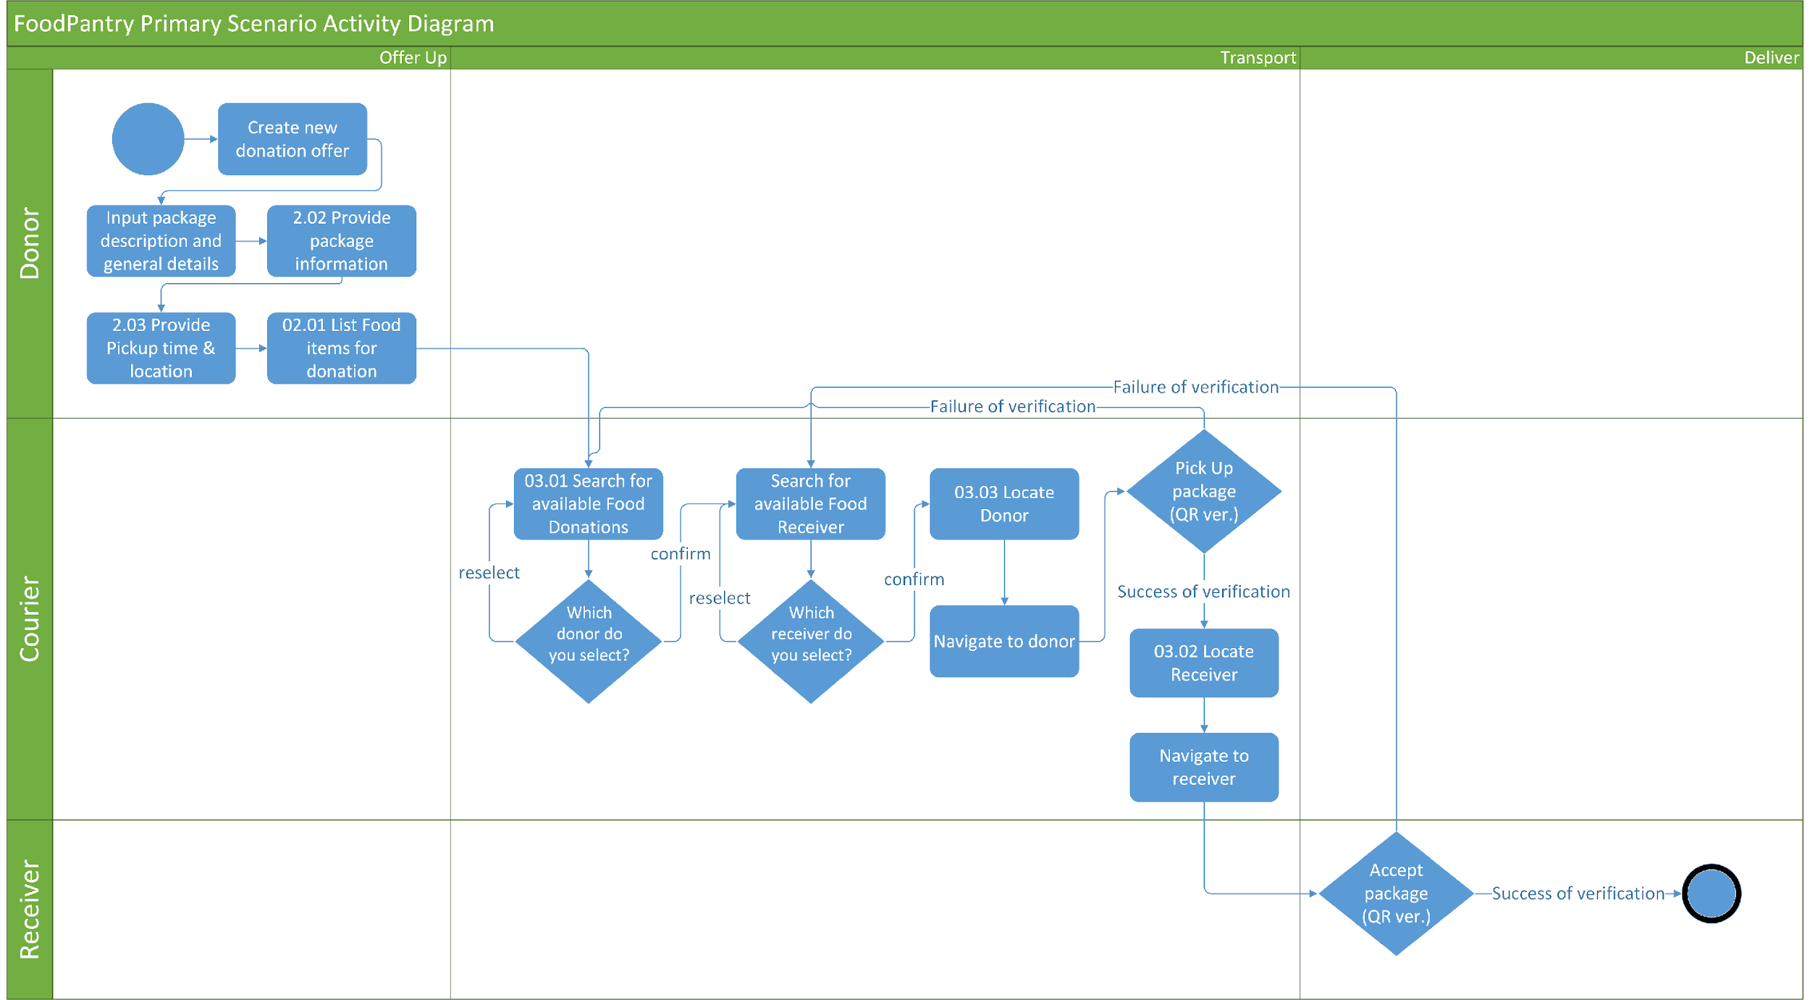
FoodPantry Activity Diagram

