Slide 1

Janta.bg

Slide 2
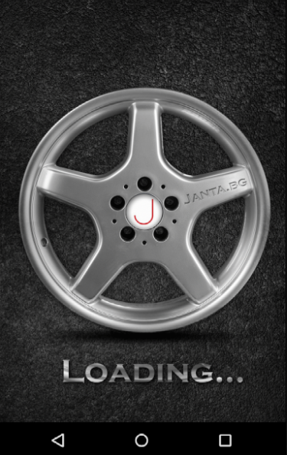
Splash Screen
Realization:
Thread
Photoshop
gif

Slide 3
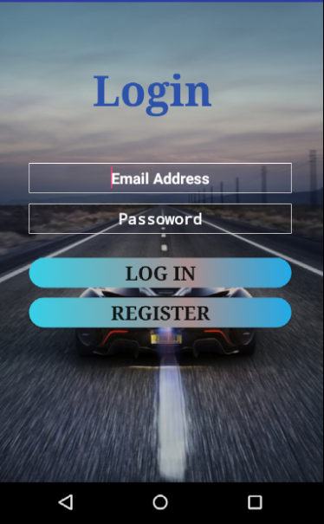
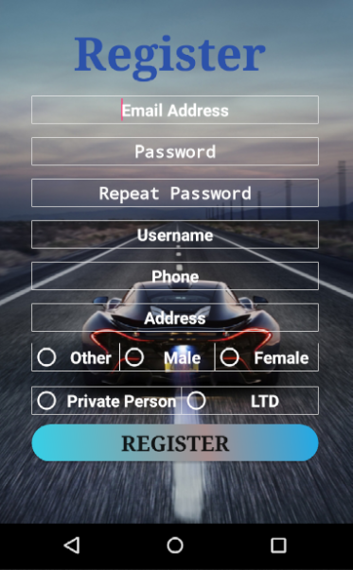
Login and Register Screens
Start activity for result
Loads Home Activity

Slide 4
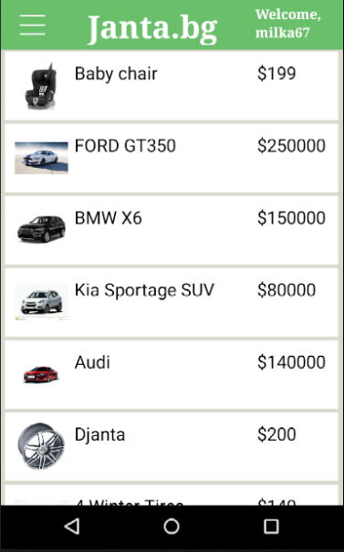
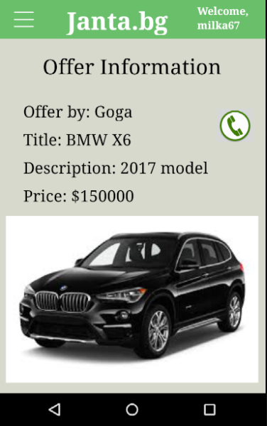
Home and Offer Information Fragment
Toolbar menu. Elements – Image button and two Text Views.
Calls the seller
After clicking the offer you want to see we are showing the information about it.

Slide 5
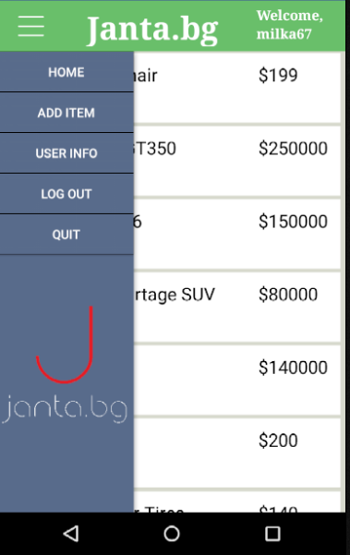
DRAWER LAYOUT
Drawer Layout. Two nested layouts in the Drawer Layout. One for the main screen and one for the hidden menu. The hidden menu has 5 buttons each of them loads different fragment of the application.
Home – loads the fragment with the offers.
Add Item – loads the fragment where you can add offers by yourself.
User Info – loads the fragment which shows your personal information.
Log out – goes to Login screen.
Quit – Closing the application.

Slide 6
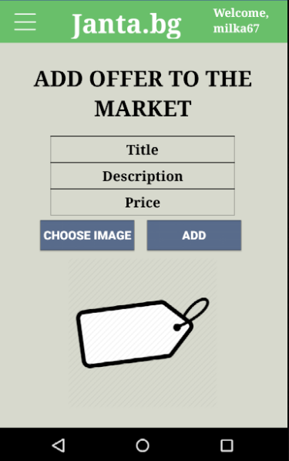
Add offer to the market Fragment
Insert your offer data.
Choosing image from your phone’s gallery.
If data is valid, offer is added to the market.
Image illustrated here.

Slide 7
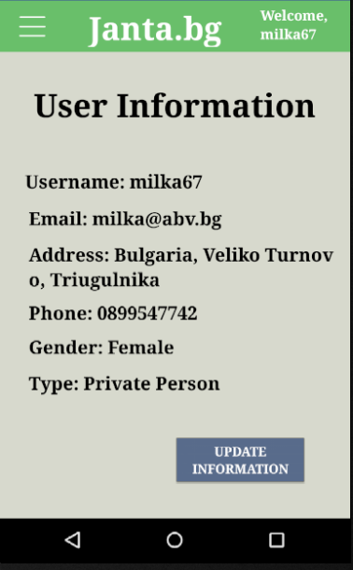
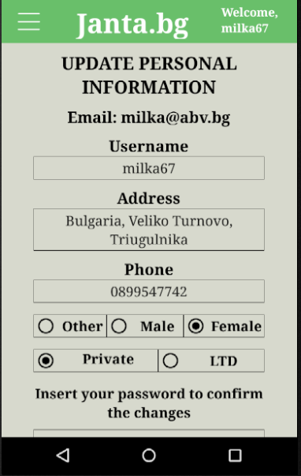
User personal information and Update personal information Fragments
This fragment is showing your personal information.
Scroll View
By clicking on this button, the user can change the most of the fields about himself.
Changing email and password is forbidden.

Slide 8
Project created by Ivan Georgiev and Aleksander Mironov
IT TALENTS
Group: Java/Android Season 8

