Slide 1
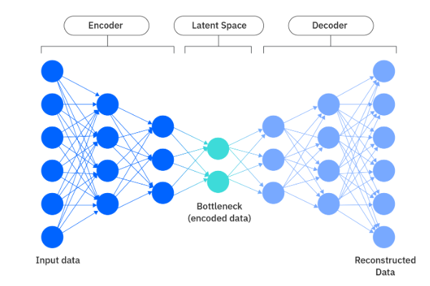
zlib[Autoencoder Bottleneck Features]
(a) Transfer information through autoencoder latent space + optional sparse error matrices. We apply zlib to these quantities.
zlib[Optional Spare Error Correction Matrices]
Training Dataset
Reconstructed images
(b) Transfer information by direct lossless compression with zlib of the whole dataset.
zlib[raw dataset]

Slide 2
Dataset
Reconstructed Dataset
Projection on smaller subspace

