Slide 1
Spoilers detection and extraction
Mateusz Kierznowski, Łukasz Pancer, Paweł Wesołowski

Slide 2
Agenda
Problem outline
Explanatory Data Analysis
LSTM approach
Transformers approach
Summary

Slide 3
Motivation
Reminder:
In the previous stage, we taught model to classify reviews.
Then, we checked if the rationale agrees with annotators.
Can we teach the models do detect spoilers within reviews?

Slide 4
Dataset
TV Tropes Books - 340k documents, 670k sentences, 110k spoiler sentences, 1:4 spoiler to non-spoiler reviews The only precisely annotated dataset available :(
Notes:
In the case of the datasets, it consists of reviews of books and each review might have some fragments contained between view spoiler and hide spoiler marks. As far as I know, these fragments are annotated by the community. As you can see, it's pretty imbalanced since probably it's main goal was not spoiler detection task so we are going to create balanced version of it as it was done by our teacher et al in one paper.
In the case of the second dataset, it provides us for each review the list of sentences, wheter each of these sentences contain spoilers and annotated spoiler text ranges.
In the final dataset, it's available on kaggle and it features only document level annotations
As a side note, there is also avaialbe TV tropes movies dataset but in this dataset every document is one sentence and basically we want to focus on documents which contain more than one sequence in general

Slide 5
TV Tropes Books sample
{
'page': 'https://tvtropes.org/...',
'trope': 'Kill the Cutie',
'has_spoiler': True,
'sentences': [[True, 'Walter, who was the ...', [[0, 89]]]]
}
Based on the information provided, we annotated every word as a spoiler or non-spoiler.
Notes:
In the case of the datasets, it consists of reviews of books and each review might have some fragments contained between view spoiler and hide spoiler marks. As far as I know, these fragments are annotated by the community. As you can see, it's pretty imbalanced since probably it's main goal was not spoiler detection task so we are going to create balanced version of it as it was done by our teacher et al in one paper.
In the case of the second dataset, it provides us for each review the list of sentences, wheter each of these sentences contain spoilers and annotated spoiler text ranges.
In the final dataset, it's available on kaggle and it features only document level annotations
As a side note, there is also avaialbe TV tropes movies dataset but in this dataset every document is one sentence and basically we want to focus on documents which contain more than one sequence in general

Slide 6
 | Total spoilers and non-spoiler in train set | Reviews consisting of mostly spoilers (>50%) | Reviews with at least 1 spoiler
True (Spoilers) | 1.38M | 29011 | 59374
False (Non-spoilers) | 1.57M | 30394 | 31
Notes:
In the case of the datasets, it consists of reviews of books and each review might have some fragments contained between view spoiler and hide spoiler marks. As far as I know, these fragments are annotated by the community. As you can see, it's pretty imbalanced since probably it's main goal was not spoiler detection task so we are going to create balanced version of it as it was done by our teacher et al in one paper.
In the case of the second dataset, it provides us for each review the list of sentences, wheter each of these sentences contain spoilers and annotated spoiler text ranges.
In the final dataset, it's available on kaggle and it features only document level annotations
As a side note, there is also avaialbe TV tropes movies dataset but in this dataset every document is one sentence and basically we want to focus on documents which contain more than one sequence in general

Slide 7
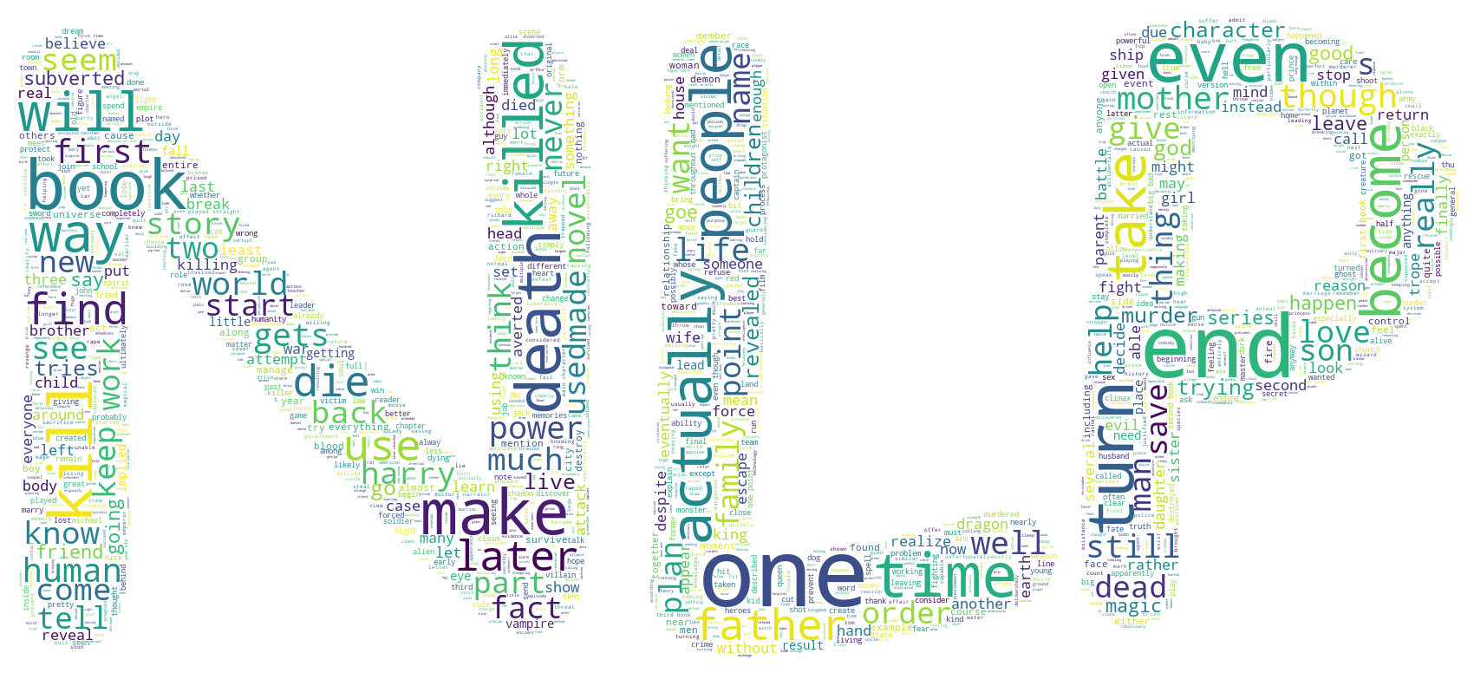
Notes:
In the case of the datasets, it consists of reviews of books and each review might have some fragments contained between view spoiler and hide spoiler marks. As far as I know, these fragments are annotated by the community. As you can see, it's pretty imbalanced since probably it's main goal was not spoiler detection task so we are going to create balanced version of it as it was done by our teacher et al in one paper.
In the case of the second dataset, it provides us for each review the list of sentences, wheter each of these sentences contain spoilers and annotated spoiler text ranges.
In the final dataset, it's available on kaggle and it features only document level annotations
As a side note, there is also avaialbe TV tropes movies dataset but in this dataset every document is one sentence and basically we want to focus on documents which contain more than one sequence in general

Slide 8
LSTM approach
Token classification with dense classification head on the top of:
Standard LSTM
LSTM with attention layer
Remarks:
512 input tokens
GloVe pretrained embeddings (case-insensitive)
Masked loss and metrics
Notes:
Of course we are going to use some powerful pretrained models. Its due to the fact that pretrained models are becoming quite standard due to better performance, reduc- tion of training time, electricity usage, etc. However, in some paper it was suggested that pretraining the model on some domain specific data may be worth considering. But we are not going to train the models from scratch on the IMDB data, we are goiung to somehow fine tune it on it. This dataset is pretty large so we believe it might be valuable. And we hope we will see some improvement compared to models built without this dataset. Of course we will try to measure their performances and compare them.

Slide 9
Results – TV Tropes Books test set
TV Tropes Books test set
 | ACC | Recall | Precision | Jaccard non-spoilers | Jaccard spoilers
LSTM vanilla | 0.6976 | 0.7402 | 0.6478 | 0.5432 | 0.5278
LSTM + Attention layer | 0.7048 | 0.6526 | 0.6857 | 0.5794 | 0.5024
Notes:
Of course we are going to use some powerful pretrained models. Its due to the fact that pretrained models are becoming quite standard due to better performance, reduc- tion of training time, electricity usage, etc. However, in some paper it was suggested that pretraining the model on some domain specific data may be worth considering. But we are not going to train the models from scratch on the IMDB data, we are goiung to somehow fine tune it on it. This dataset is pretty large so we believe it might be valuable. And we hope we will see some improvement compared to models built without this dataset. Of course we will try to measure their performances and compare them.

Slide 10
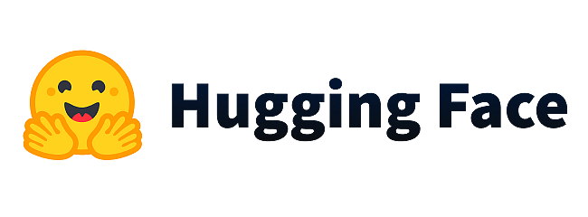
Transformers approach
Token classification with dense classification head on the top of:
BERT-base
DistilBERT
Remarks:
512 input tokens, either cased or uncased
May lead to different tokenization (##-tokens)
Padded elements identified by attention mask
No layers frozen during the final experiments
Notes:
Of course we are going to use some powerful pretrained models. Its due to the fact that pretrained models are becoming quite standard due to better performance, reduc- tion of training time, electricity usage, etc. However, in some paper it was suggested that pretraining the model on some domain specific data may be worth considering. But we are not going to train the models from scratch on the IMDB data, we are goiung to somehow fine tune it on it. This dataset is pretty large so we believe it might be valuable. And we hope we will see some improvement compared to models built without this dataset. Of course we will try to measure their performances and compare them.

Slide 11
Results – TV Tropes Books test set
TV Tropes Books test set
 | ACC | Recall | Precision | Jaccard non-spoilers | Jaccard spoilers
DistilBERT uncased | 0.7055 | 0.4938 | 0.7911 | 0.6183 | 0.4369
DistilBERT cased | 0.7232 | 0.5814 | 0.7640 | 0.6214 | 0.4929
BERT uncased | 0.7120 | 0.5024 | 0.8009 | 0.6248 | 0.4466
BERT cased | 0.7205 | 0.5374 | 0.7915 | 0.6280 | 0.4708
Notes:
Of course we are going to use some powerful pretrained models. Its due to the fact that pretrained models are becoming quite standard due to better performance, reduc- tion of training time, electricity usage, etc. However, in some paper it was suggested that pretraining the model on some domain specific data may be worth considering. But we are not going to train the models from scratch on the IMDB data, we are goiung to somehow fine tune it on it. This dataset is pretty large so we believe it might be valuable. And we hope we will see some improvement compared to models built without this dataset. Of course we will try to measure their performances and compare them.

Slide 12
Conclusions
Attention -> Recall decreases, Precision increases
Case sensitive tokens -> Recall increases, Precision decreases
The difference in performance between DistilBERT and BERT can be examined more closely
Notes:
Of course we are going to use some powerful pretrained models. Its due to the fact that pretrained models are becoming quite standard due to better performance, reduc- tion of training time, electricity usage, etc. However, in some paper it was suggested that pretraining the model on some domain specific data may be worth considering. But we are not going to train the models from scratch on the IMDB data, we are goiung to somehow fine tune it on it. This dataset is pretty large so we believe it might be valuable. And we hope we will see some improvement compared to models built without this dataset. Of course we will try to measure their performances and compare them.

Slide 13
Warning: spoilers ahead.
We would like to present our results in comparison to ground truth and to ChatGPT output.
Spoilers: Star Wars, Harry Potter, Spider-Man

Slide 14
Mila is quite interested in human society though she still prefers dolphins this starts to change as she regresses and she starts thinking more negative thoughts about humans
Source | Selected words as a spoilers
Ground Truth | this starts to change as she regresses and she starts thinking more negative thoughts about human
Attention LSTM | she regresses and she starts thinking more negative thoughts about humans
ChatGPT | "Mila starts thinking more negative thoughts about humans."

Slide 15
Lord Vater is a father of Luke Skywalker
Source | Selected words as a spoilers
Attention LSTM | Lord Vater is a father of Luke Skywalker
ChatGPT | Lord Vater is the father of Luke Skywalker

Slide 16
Peter Parker is a Spider man, he fight with villains dressed as a superhero.
Source | Selected words as a spoilers
Attention LSTM | Peter Parker is a Spider man
ChatGPT | No spoilers detected

Slide 17
Harry Potter is a young wizard in the Hogward school of witchcraft. Unfortunately for him he is a horcrux.
Source | Selected words as a spoilers
Attention LSTM | him he is a horcrux
ChatGPT | Harry Potter is a horcrux

Slide 18
Summary
PROBLEMS:
Lack of properly annotated datasets.
No reference scores (yet).
FUTURE WORK:
More extensive research on transformer-based architecture.
NER-approach? (beginnings and endings of NE)
Notes:
Of course we are going to use some powerful pretrained models. Its due to the fact that pretrained models are becoming quite standard due to better performance, reduc- tion of training time, electricity usage, etc. However, in some paper it was suggested that pretraining the model on some domain specific data may be worth considering. But we are not going to train the models from scratch on the IMDB data, we are goiung to somehow fine tune it on it. This dataset is pretty large so we believe it might be valuable. And we hope we will see some improvement compared to models built without this dataset. Of course we will try to measure their performances and compare them.

Slide 19
Thank you

