Slide 1
Spoilers detection and extraction
Mateusz Kierznowski, Łukasz Pancer, Paweł Wesołowski

Slide 2
Agenda
1. Datasets
2. Models & results
3. Application of LIME
4. Future work

Slide 3
Datasets
Goodreads - 1.3M documents, 17M sentences, 570k spoiler sentences, 1:15 spoiler to non-spoiler reviews
Goodreads (balanced) - 180k documents, 3.1M sentences, 570k spoiler sentences, 1:1 spoiler to non-spoiler reviews
TV Tropes Books - 340k documents, 670k sentences, 110k spoiler sentences, 1:4 spoiler to non-spoiler reviews
IMDB reviews - 5.5M documents, 1:4 spoiler to non-spoiler reviews
Notes:
In the case of the datasets, it consists of reviews of books and each review might have some fragments contained between view spoiler and hide spoiler marks. As far as I know, these fragments are annotated by the community. As you can see, it's pretty imbalanced since probably it's main goal was not spoiler detection task so we are going to create balanced version of it as it was done by our teacher et al in one paper.
In the case of the second dataset, it provides us for each review the list of sentences, wheter each of these sentences contain spoilers and annotated spoiler text ranges.
In the final dataset, it's available on kaggle and it features only document level annotations
As a side note, there is also avaialbe TV tropes movies dataset but in this dataset every document is one sentence and basically we want to focus on documents which contain more than one sequence in general

Slide 4
Goodreads sample
{
'user_id': '1ceef4796fb36190e72714895806835b',
'timestamp': 1445212800000,
'review_sentences': [[0, 'When I read through this ...'],
[1, 'She jerked around two really great guys...'], ...],
'rating': 3,
'has_spoiler': True,
'book_id': 18304322,
'review_id': '9e7cc14cc03b22a88875a21195e58454',
'genres': {'young-adult': 1763, 'romance': 438, 'fiction': 885}
}
Notes:
In the case of the datasets, it consists of reviews of books and each review might have some fragments contained between view spoiler and hide spoiler marks. As far as I know, these fragments are annotated by the community. As you can see, it's pretty imbalanced since probably it's main goal was not spoiler detection task so we are going to create balanced version of it as it was done by our teacher et al in one paper.
In the case of the second dataset, it provides us for each review the list of sentences, wheter each of these sentences contain spoilers and annotated spoiler text ranges.
In the final dataset, it's available on kaggle and it features only document level annotations
As a side note, there is also avaialbe TV tropes movies dataset but in this dataset every document is one sentence and basically we want to focus on documents which contain more than one sequence in general

Slide 5
TV Tropes Books sample
{
'page': 'https://tvtropes.org/...',
'trope': 'Kill the Cutie',
'has_spoiler': True,
'sentences': [[True, 'Walter, who was the ...', [[0, 89]]]]
}
Notes:
In the case of the datasets, it consists of reviews of books and each review might have some fragments contained between view spoiler and hide spoiler marks. As far as I know, these fragments are annotated by the community. As you can see, it's pretty imbalanced since probably it's main goal was not spoiler detection task so we are going to create balanced version of it as it was done by our teacher et al in one paper.
In the case of the second dataset, it provides us for each review the list of sentences, wheter each of these sentences contain spoilers and annotated spoiler text ranges.
In the final dataset, it's available on kaggle and it features only document level annotations
As a side note, there is also avaialbe TV tropes movies dataset but in this dataset every document is one sentence and basically we want to focus on documents which contain more than one sequence in general

Slide 6
IMDB sample
{
'review_id': 'rw1133942',
'reviewer': 'OriginalMovieBuff21',
'movie': 'Kill Bill: Vol. 2 (2004)',
'rating': 8.0,
'review_summary': 'Good follow up that answers all the questions',
'review_date': '24 July 2005',
'spoiler_tag': 0,
'review_detail': "After seeing Tarantino's Kill Bill Vol: 1, I ...",
'helpful': ['0', '1']
}
Notes:
In the case of the datasets, it consists of reviews of books and each review might have some fragments contained between view spoiler and hide spoiler marks. As far as I know, these fragments are annotated by the community. As you can see, it's pretty imbalanced since probably it's main goal was not spoiler detection task so we are going to create balanced version of it as it was done by our teacher et al in one paper.
In the case of the second dataset, it provides us for each review the list of sentences, wheter each of these sentences contain spoilers and annotated spoiler text ranges.
In the final dataset, it's available on kaggle and it features only document level annotations
As a side note, there is also avaialbe TV tropes movies dataset but in this dataset every document is one sentence and basically we want to focus on documents which contain more than one sequence in general

Slide 7
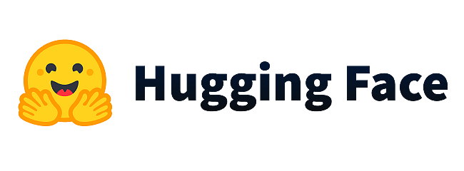
Models
Dense classification head on the top of:
BERT-base
DistilBERT - 40% smaller than the original BERT-base model, 60% faster than it, and retains 97% of its functionality
Remarks:
no layers were frozen during the final experiments
about 90% of spoiler reviews contain a spoiler in the first 512 tokens
Notes:
Of course we are going to use some powerful pretrained models. Its due to the fact that pretrained models are becoming quite standard due to better performance, reduc- tion of training time, electricity usage, etc. However, in some paper it was suggested that pretraining the model on some domain specific data may be worth considering. But we are not going to train the models from scratch on the IMDB data, we are goiung to somehow fine tune it on it. This dataset is pretty large so we believe it might be valuable. And we hope we will see some improvement compared to models built without this dataset. Of course we will try to measure their performances and compare them.

Slide 8
Results - Goodreads
Goodreads balanced test set
Entire Goodreads test set
 | ACC | ROC AUC | F1
BERT-base | 0.8196 | 0.9037 | 0.8171
DistilBERT | 0.8144 | 0.8990 | 0.8144
 | ACC | ROC AUC | F1
BERT-base | 0.8289 | 0.9019 | 0.0646
DistilBERT | 0.8100 | 0.8947 | 0.0588
Wróblewska et al. |  | 0.8821
SpoilerNet |  | 0.9190
Notes:
Of course we are going to use some powerful pretrained models. Its due to the fact that pretrained models are becoming quite standard due to better performance, reduc- tion of training time, electricity usage, etc. However, in some paper it was suggested that pretraining the model on some domain specific data may be worth considering. But we are not going to train the models from scratch on the IMDB data, we are goiung to somehow fine tune it on it. This dataset is pretty large so we believe it might be valuable. And we hope we will see some improvement compared to models built without this dataset. Of course we will try to measure their performances and compare them.

Slide 9
Results - TV Tropes Books & IMDB
TV Tropes Books test set
IMDB test set
 | ACC | ROC AUC | F1 | BACC
BERT-base | 0.8507 | 0.8750 | 0.6166 | 0.7415
DistilBERT | 0.8439 | 0.8670 | 0.5829 | 0.7208
Wróblewska et al. |  | 0.8471
 | ACC
BERT-base | 0.7782
Notes:
Of course we are going to use some powerful pretrained models. Its due to the fact that pretrained models are becoming quite standard due to better performance, reduc- tion of training time, electricity usage, etc. However, in some paper it was suggested that pretraining the model on some domain specific data may be worth considering. But we are not going to train the models from scratch on the IMDB data, we are goiung to somehow fine tune it on it. This dataset is pretty large so we believe it might be valuable. And we hope we will see some improvement compared to models built without this dataset. Of course we will try to measure their performances and compare them.

Slide 10
What about time?
In all cases, DistilBERT was trained about 2x faster than the BERT-base.
In all cases, DistilBERT inferred about 2.1x faster than the BERT-base.
Notes:
In the case of the datasets, it consists of reviews of books and each review might have some fragments contained between view spoiler and hide spoiler marks. As far as I know, these fragments are annotated by the community. As you can see, it's pretty imbalanced since probably it's main goal was not spoiler detection task so we are going to create balanced version of it as it was done by our teacher et al in one paper.
In the case of the second dataset, it provides us for each review the list of sentences, wheter each of these sentences contain spoilers and annotated spoiler text ranges.
In the final dataset, it's available on kaggle and it features only document level annotations
As a side note, there is also avaialbe TV tropes movies dataset but in this dataset every document is one sentence and basically we want to focus on documents which contain more than one sequence in general

Slide 11
Reusing weights from IMDB experiment
The BERT layers were frozen, only the parameters of the last dense layer remained trainable
Trained for an additional epoch for new datasets
Learning rates from 0.002 to 0.00002 tested

Slide 12
Results
TV Tropes Books test set
Goodreads balanced test set
Learning Rate | ACC | ROC AUC | F1
No finetuning | 0.6256 | 0.7581 | 0.47
0.0002 | 0.6256 | 0.7581 | 0.47
0.02 | 0.6333 | 0.7672 | 0.49
Learning Rate | ACC | ROC AUC | F1
No finetuning | 0.7623 | 0.8442 | 0.79
0.0002 | 0.7622 | 0.8442 | 0.79
0.002 | 0.7748 | 0.8550 | 0.78
0.02 | 0.7772 | 0.8619 | 0.78
Previous model | 0.8507 | 0.8750 | 0.6166
Previous model | 0.8196 | 0.9037 | 0.8171
Notes:
Of course we are going to use some powerful pretrained models. Its due to the fact that pretrained models are becoming quite standard due to better performance, reduc- tion of training time, electricity usage, etc. However, in some paper it was suggested that pretraining the model on some domain specific data may be worth considering. But we are not going to train the models from scratch on the IMDB data, we are goiung to somehow fine tune it on it. This dataset is pretty large so we believe it might be valuable. And we hope we will see some improvement compared to models built without this dataset. Of course we will try to measure their performances and compare them.

Slide 13
XAI – metrics with LIME
Sentence Based
Word Based
We introduced sentence-based statistics, which is based on LIME. We sum up LIME within a sentence such that we choose sentences with the highest score.
Furthermore, we compute:
Mean of positive prediction
Sum of at least one positive prediction (If at least one of chosen sentences is marked to contain spoilers)
. Additionally, we compute word-based statistics by comparing sets of words LIME consisting of spoilers and Spoilers For every document, we choose 10 words with the highest LIME value. Afterward, we investigate:
If in 10/5/1 words, there is at least one spoiler

Slide 14
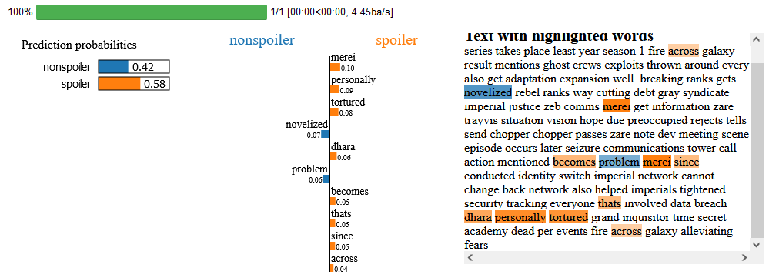
LIME Distil BERT

Slide 15
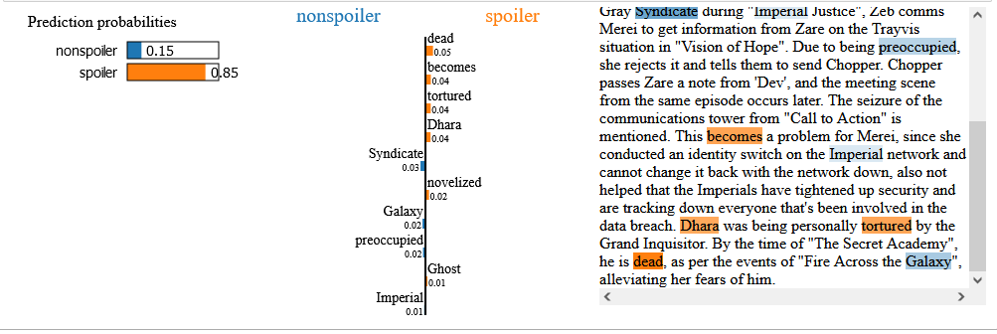
LIME BERT with stop words

Slide 16
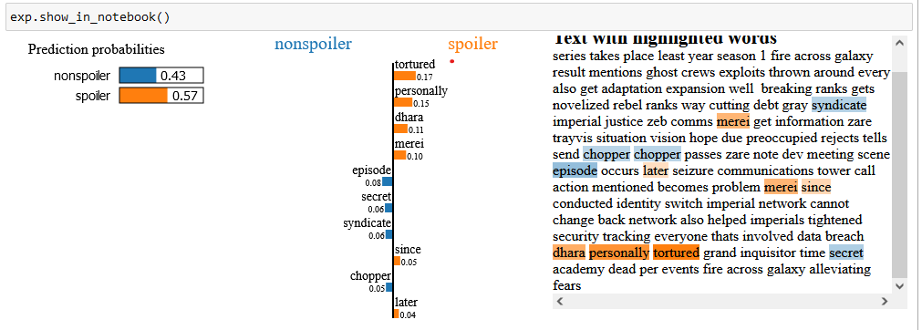
LIME BERT without stop words

Slide 17
Results
Sentence Based | At least one sentence in spoiler sentences | Set comparison
Bert | 0.16 | 0.06
Distil Bert | 0.16 | 0.06
Word Based | Best 10 words | Best 5 words | Best 1 word
Bert | 0.89 | 0.84 | 0.31
Distil Bert | 0.87 | 0.84 | 0.35

Slide 18
Further work
1. Training the model to extract spoiler phrases.
Remarks:
resembles classification task
many softmax outputs increase computational complexity
we only found one (blog) article on sentiment phrase extraction, has such a task been explored in the NLP field?
2. Reproducing the SpoilerNet paper (HAN + DF IIF).
Notes:
Of course we are going to use some powerful pretrained models. Its due to the fact that pretrained models are becoming quite standard due to better performance, reduc- tion of training time, electricity usage, etc. However, in some paper it was suggested that pretraining the model on some domain specific data may be worth considering. But we are not going to train the models from scratch on the IMDB data, we are goiung to somehow fine tune it on it. This dataset is pretty large so we believe it might be valuable. And we hope we will see some improvement compared to models built without this dataset. Of course we will try to measure their performances and compare them.

Slide 19
Thank you
Paweł Wesołowski
Łukasz Pancer
Mateusz Kierznowski

