Slide 1
Docker
Lading

Slide 2
Agenda
Docker structure
Installation
Docker file
Control commands
Docker registry

Slide 3
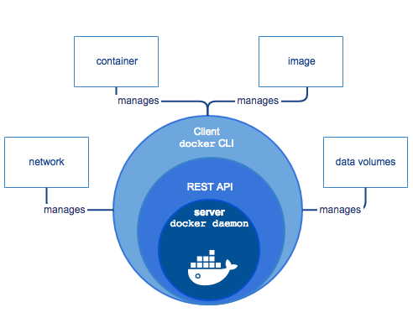
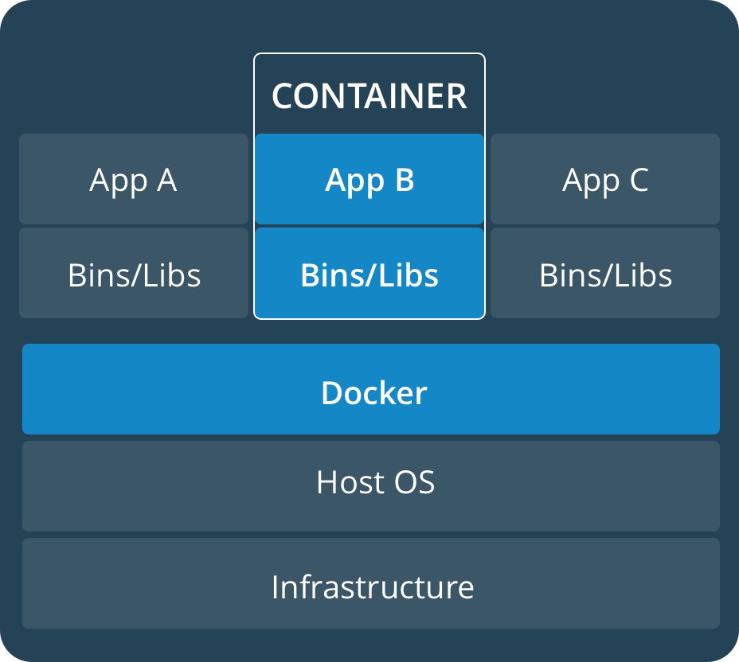
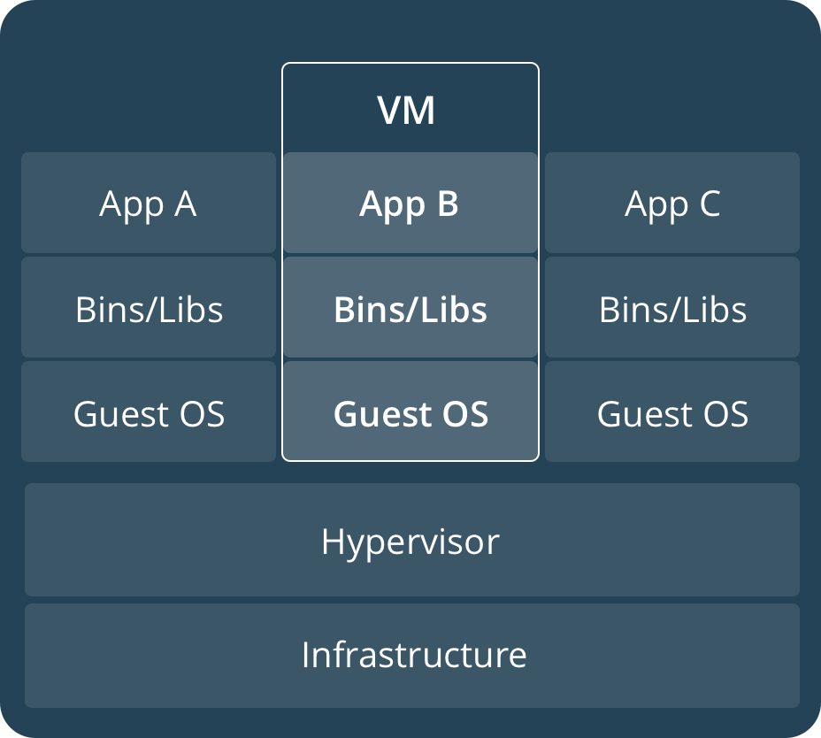
Docker. Structure
Docker technology
Docker layers
Docker network

Slide 4
Docker. Installation. Demo
Install docker service

Slide 5
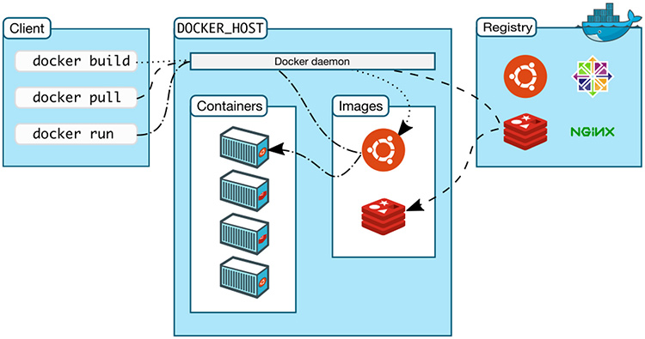
Docker. CLI
Used for interaction through the API with docker daemon

Slide 6
Docker. CLI. Demo
Search
Pull
Run
Monitor
Stop/Kill/Remove

Slide 7
Docker. Docker file
Collection of instructions
Has default name `Dockerfile`
Each line - new layer
Do not use like OS

Slide 8
Docker. Docker file. Demo
Create docker files
Layers in docker images
Security in Docker
Entrypoint image

Slide 9
Docker. Hub
Repository for Docker images
Provide one private repository
Very slow build images
Can be deployed internally
https://cloud.docker.com

Slide 10
Links
https://docs.docker.com/engine/install/ubuntu/

