Slide 1
TASK 4 / DOCUMENT PHOTO QUALITY
Document Photo Quality Gate
Model selection for a document processing pipeline
01
02
03
Photo upload
Quality check
Next step
The user takes and uploads
a document photo.
The model checks whether
the photo is clear enough.
Clear photos go to text reading.
Poor photos need a retake.
The quality check has a CPU latency limit of 100 ms per image.
Aleksandr Baev / AIb-24
1 / 4

Slide 2
TASK 4 / DOCUMENT PHOTO QUALITY
Model Comparison
Same 246 synthetic test images and the same CPU timing method
Model | Accuracy | Macro F1 | CPU ms | MiB
MobileNetV2 | 99.59% | 0.9959 | 57.47 | 11.06
YOLOv8n-cls | 98.78% | 0.9878 | 16.75 | 2.83
YOLOv8s-cls | 99.59% | 0.9959 | 32.74 | 9.78
EfficientNet-B0 | 97.97% | 0.9797 | 18.53 | 15.56
20 warm-up images and 100 timed images per model.
Aleksandr Baev / AIb-24
2 / 4

Slide 3
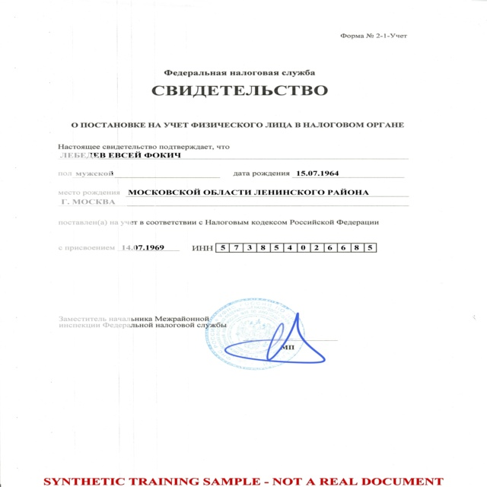
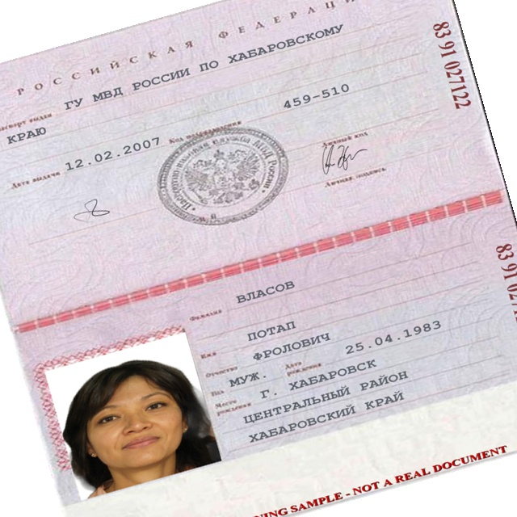
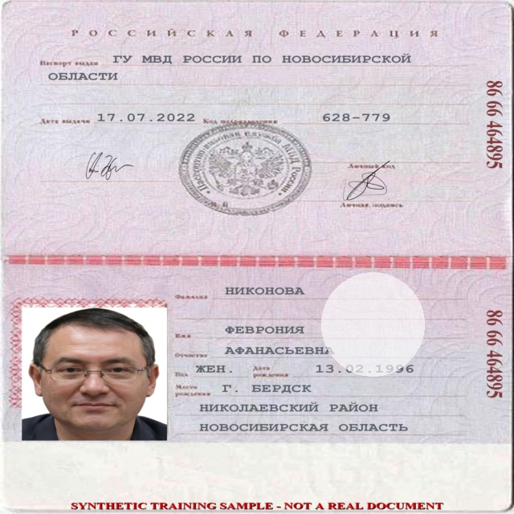
TASK 4 / DOCUMENT PHOTO QUALITY
Failure Gallery
All shown photos are from the synthetic test set
YOLOv8s-cls
YOLOv8n-cls
EfficientNet-B0
Glare on a tax document
Tilted passport
Glare on a passport
All three examples had the label ‘bad’. The models predicted ‘good’.
Glare was the hardest defect. It caused 7 of the 10 errors across the four models.
Aleksandr Baev / AIb-24
3 / 4

Slide 4
TASK 4 / DOCUMENT PHOTO QUALITY
Deployment Decision and Risks
YOLOv8s-cls for the CPU pilot
99.59%
32.74 ms
9.78 MiB
Test accuracy
Mean CPU time per image
Checkpoint size
Glare
Real photo risk
Add more training photos with reflections.
Send uncertain photos to an operator.
The task brief reports a 2.8–5.8% gap.
Test on real photos before wider use.
Start on the CPU server. Test ONNX or TFLite on mobile later.
Aleksandr Baev / AIb-24
4 / 4

