Slide 1
Разбираемся с интеграцией Docker в Visual Studio
И пользуемся с удовольствием

Slide 2
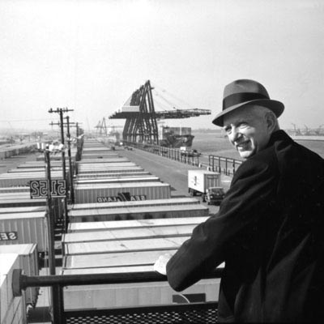
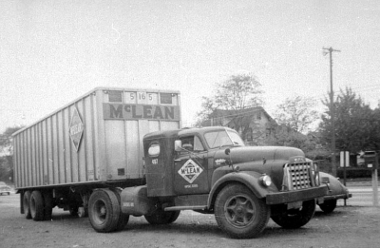
Контейнерная революция
Notes:
Малкольм Маклин

Slide 3
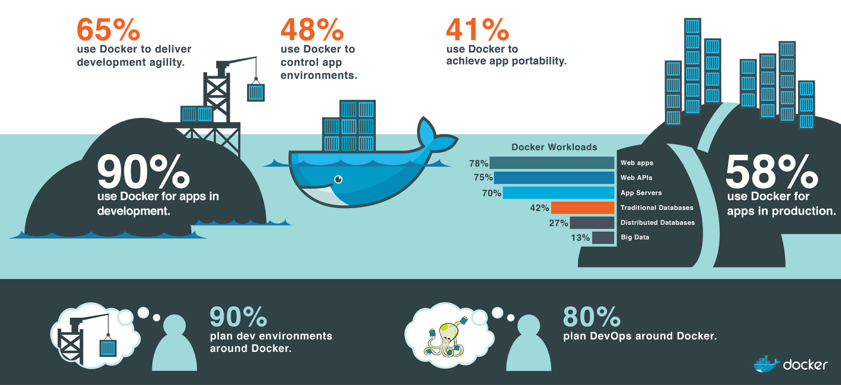
Docker

Slide 4
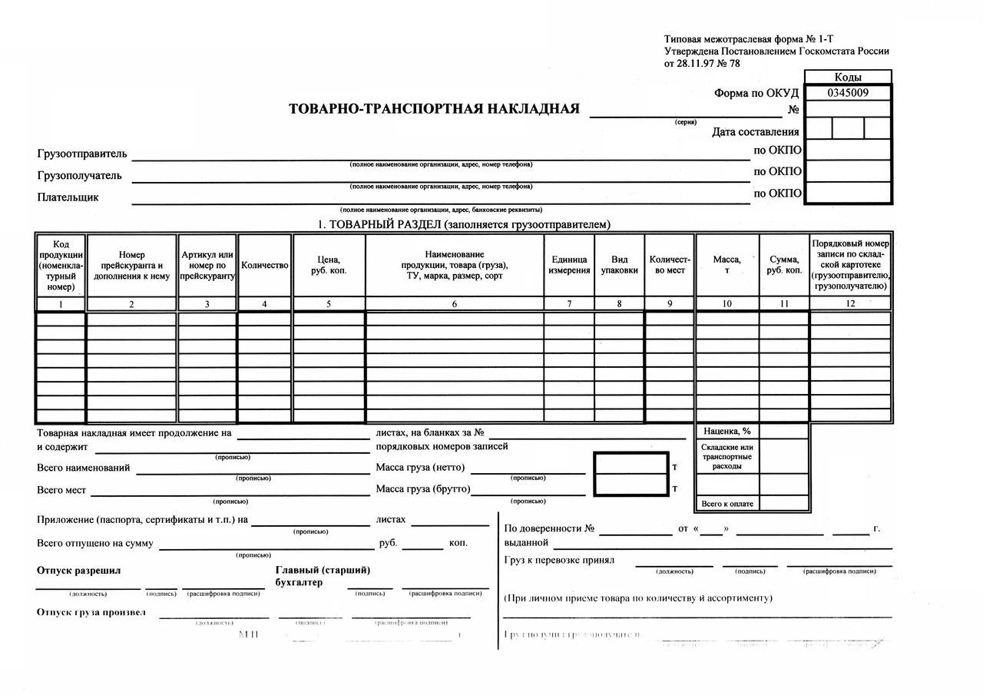
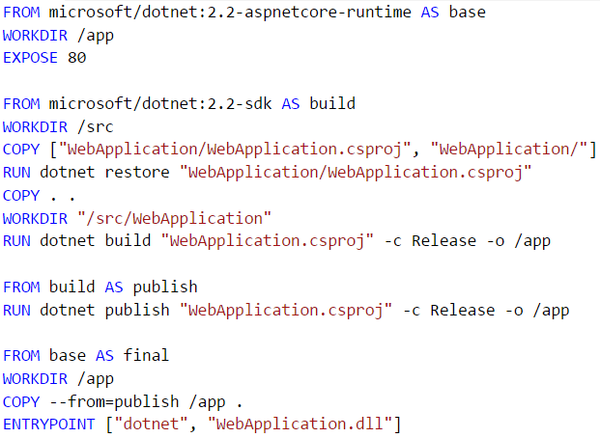
Workflow: Описание
Накладная
Dockerfile

Slide 5
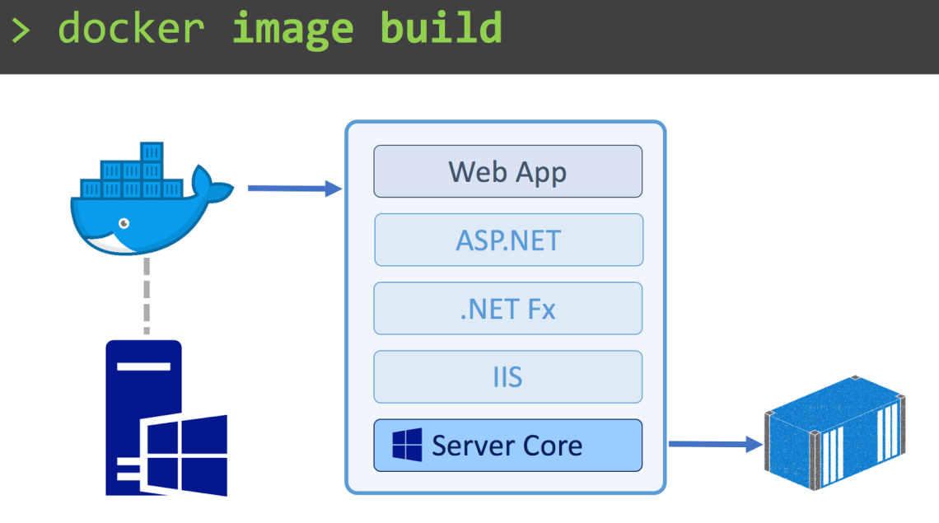
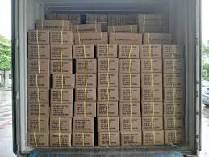
Workflow: Упаковка
Погрузка товара
Docker Image

Slide 6
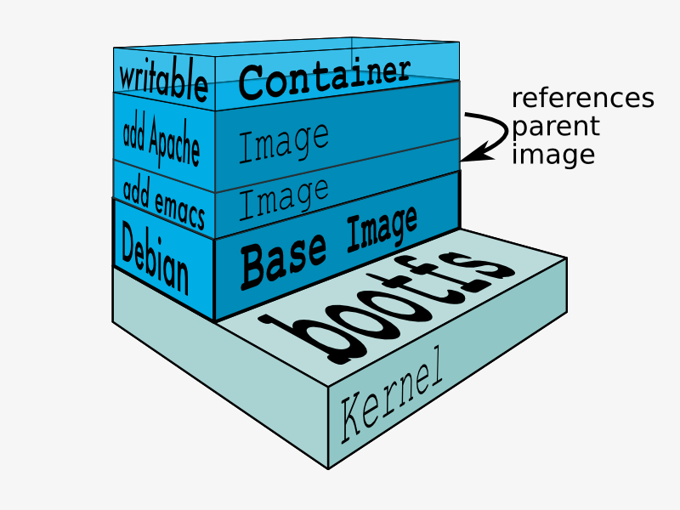
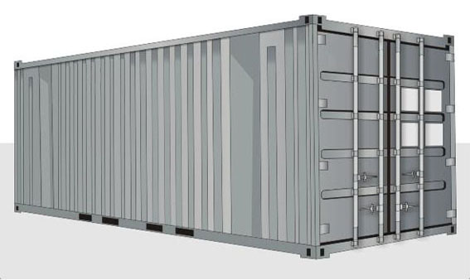
Workflow: Формирование
TEU Контейнер
Docker Container

Slide 7
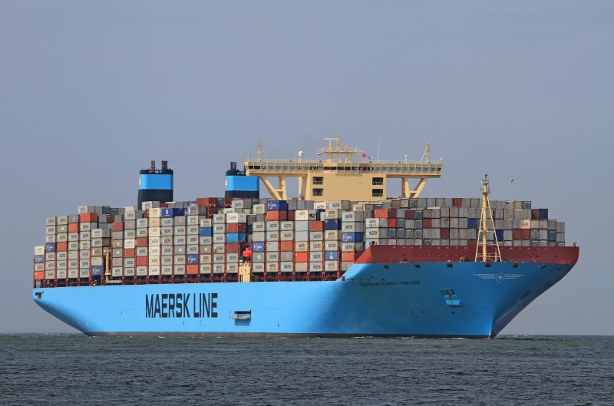
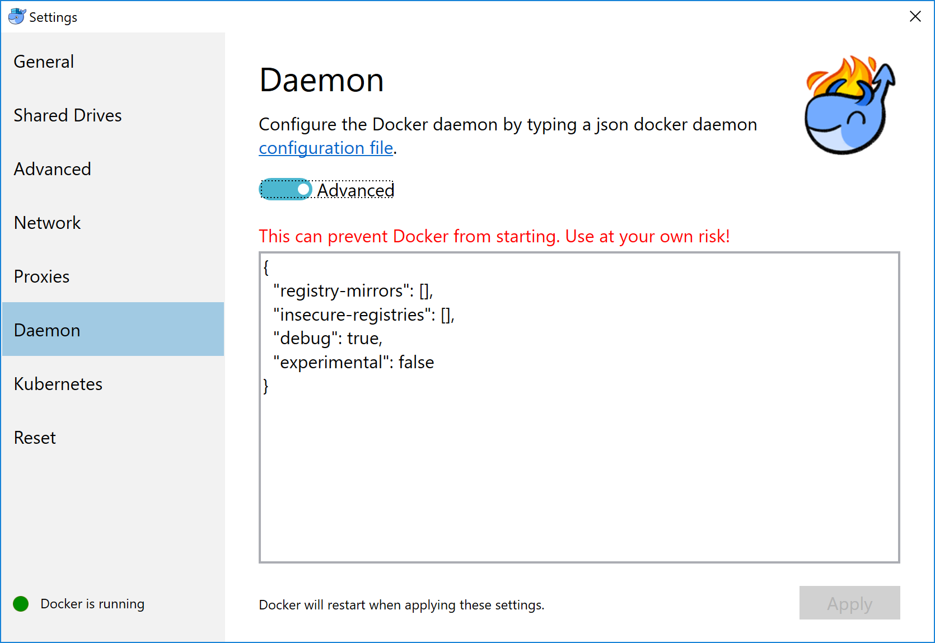
Workflow: Отправка
Контейнеровоз
Docker Daemon

Slide 8

Docker for Windows

Slide 9
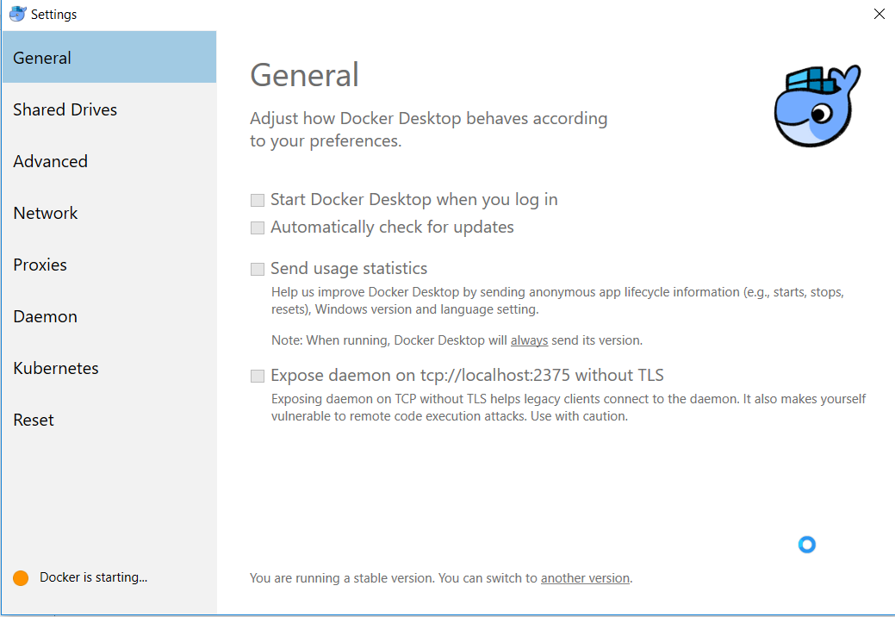
Docker for Windows

Slide 10
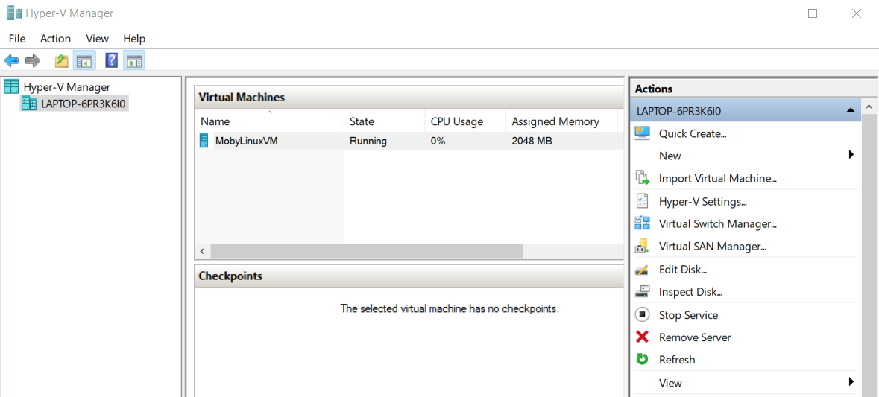
Hyper-V

Slide 11
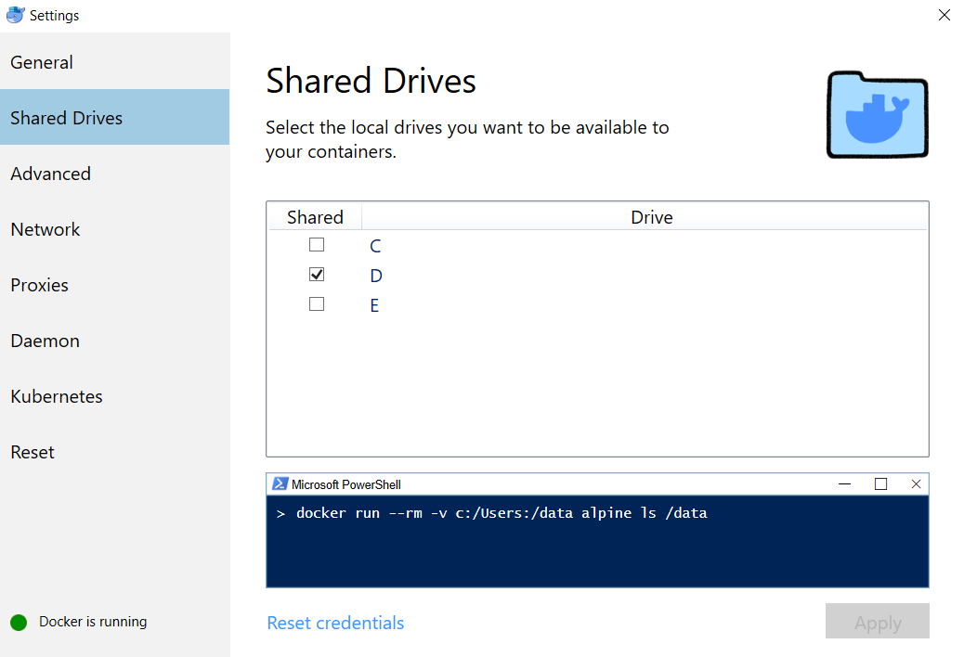
Shared file system

Slide 12
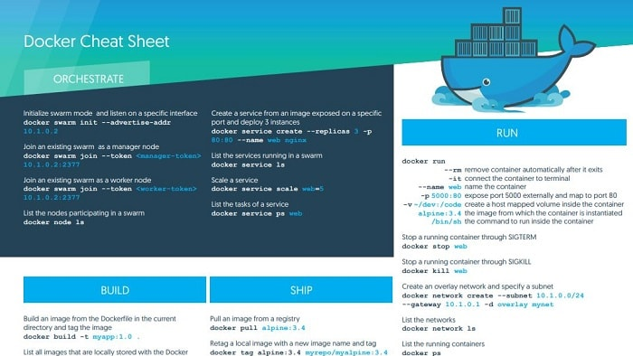
Notes:
Вообще, работать с докером немного страшненько. Консоль надо использовать.

Slide 13
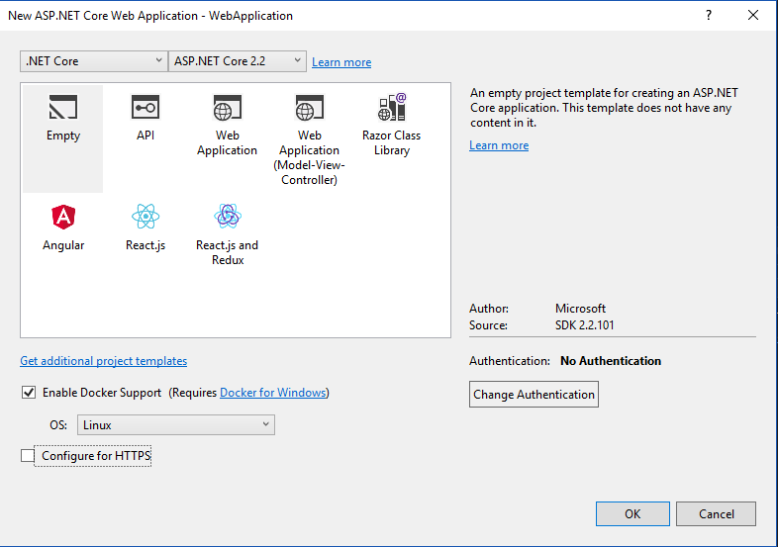
Notes:
Microsoft обещает нам

Slide 14
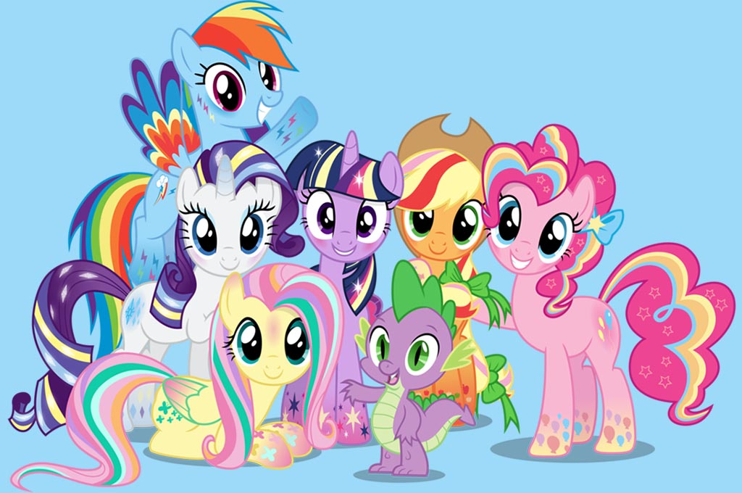
Docker + Visual Studio
Building
Debugging
Running
???
PROFIT
БОЛЬ!!!
Notes:
Тот же experience как и с обычными приложениями
Боль потому что нельзя просто взять и получить тот же experience, всегда будут компромисы

Slide 15
Зачем Docker + Visual Studio?
Входная точка для новичков
dotnet new … => все работает
Отладка
Всей команде не обязательно знать docker

Slide 16
План
Проанализируем scaffolding
Поймем, зачем так сделано
Разберемся, как оно работает на самом деле
Отметим опасные места
Решим, как с этим жить

Slide 17
Notes:
Давайте разберемся, как оно работает

Slide 18
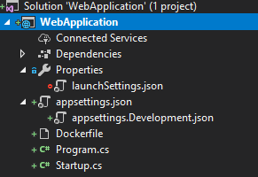
Результат scaffolding
Project
Properties
Dockerfile
[Name].csproj
launchSettings.json
…

Slide 19
launchSettings.json
{
"profiles": {
"Docker": {
"commandName": "Docker",
"launchBrowser": true,
"launchUrl": "{Scheme}://{ServiceHost}:{ServicePort}"
}
}
}

Slide 20
Dockerfile
FROM microsoft/dotnet:2.2-aspnetcore-runtime AS base
WORKDIR /app
EXPOSE 80
FROM microsoft/dotnet:2.2-sdk AS build
WORKDIR /src
COPY ["WebApplication/WebApplication.csproj", "WebApplication/"]
RUN dotnet restore "WebApplication/WebApplication.csproj"
COPY . .
WORKDIR "/src/WebApplication"
RUN dotnet build "WebApplication.csproj" -c Release -o /app
FROM build AS publish
RUN dotnet publish "WebApplication.csproj" -c Release -o /app
FROM base AS final
WORKDIR /app
COPY --from=publish /app .
ENTRYPOINT ["dotnet", "WebApplication.dll"]

Slide 21
Dockerfile
FROM microsoft/dotnet:2.2-aspnetcore-runtime AS base
WORKDIR /app
EXPOSE 80
FROM microsoft/dotnet:2.2-sdk AS build
WORKDIR /src
COPY ["WebApplication/WebApplication.csproj", "WebApplication/"]
RUN dotnet restore "WebApplication/WebApplication.csproj"
COPY . .
WORKDIR "/src/WebApplication"
RUN dotnet build "WebApplication.csproj" -c Release -o /app
FROM build AS publish
RUN dotnet publish "WebApplication.csproj" -c Release -o /app
FROM base AS final
WORKDIR /app
COPY --from=publish /app .
ENTRYPOINT ["dotnet", "WebApplication.dll"]
FROM
WORKDIR
COPY
EXPOSE
RUN
ENTRYPOINT

Slide 22
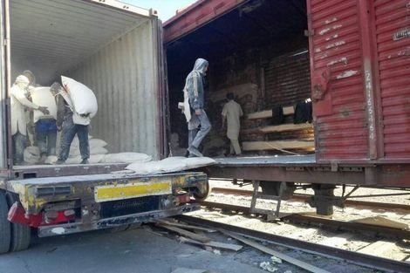
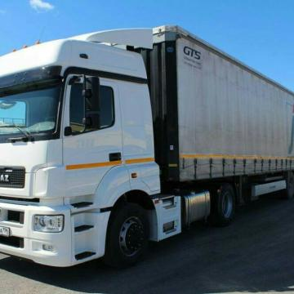
Run vs Entrypoint
RUN
ENTRYPOINT

Slide 23
Dockerfile
FROM microsoft/dotnet:2.2-aspnetcore-runtime AS base
WORKDIR /app
EXPOSE 80
FROM microsoft/dotnet:2.2-aspnetcore-runtime AS base
WORKDIR /app
EXPOSE 80
FROM microsoft/dotnet:2.2-sdk AS build
WORKDIR /src
COPY ["WebApplication/WebApplication.csproj", "WebApplication/"]
RUN dotnet restore "WebApplication/WebApplication.csproj"
COPY . .
WORKDIR "/src/WebApplication"
RUN dotnet build "WebApplication.csproj" -c Release -o /app
FROM build AS publish
RUN dotnet publish "WebApplication.csproj" -c Release -o /app
FROM base AS final
WORKDIR /app
COPY --from=publish /app .
ENTRYPOINT ["dotnet", "WebApplication.dll"]

Slide 24
Dockerfile
FROM microsoft/dotnet:2.2-aspnetcore-runtime AS base
WORKDIR /app
EXPOSE 80
FROM microsoft/dotnet:2.2-aspnetcore-runtime AS base
WORKDIR /app
EXPOSE 80
FROM microsoft/dotnet:2.2-sdk AS build
WORKDIR /src
COPY ["WebApplication/WebApplication.csproj", "WebApplication/"]
RUN dotnet restore "WebApplication/WebApplication.csproj"
COPY . .
WORKDIR "/src/WebApplication"
RUN dotnet build "WebApplication.csproj" -c Release -o /app
FROM build AS publish
RUN dotnet publish "WebApplication.csproj" -c Release -o /app
FROM base AS final
WORKDIR /app
COPY --from=publish /app .
ENTRYPOINT ["dotnet", "WebApplication.dll"]

Slide 25
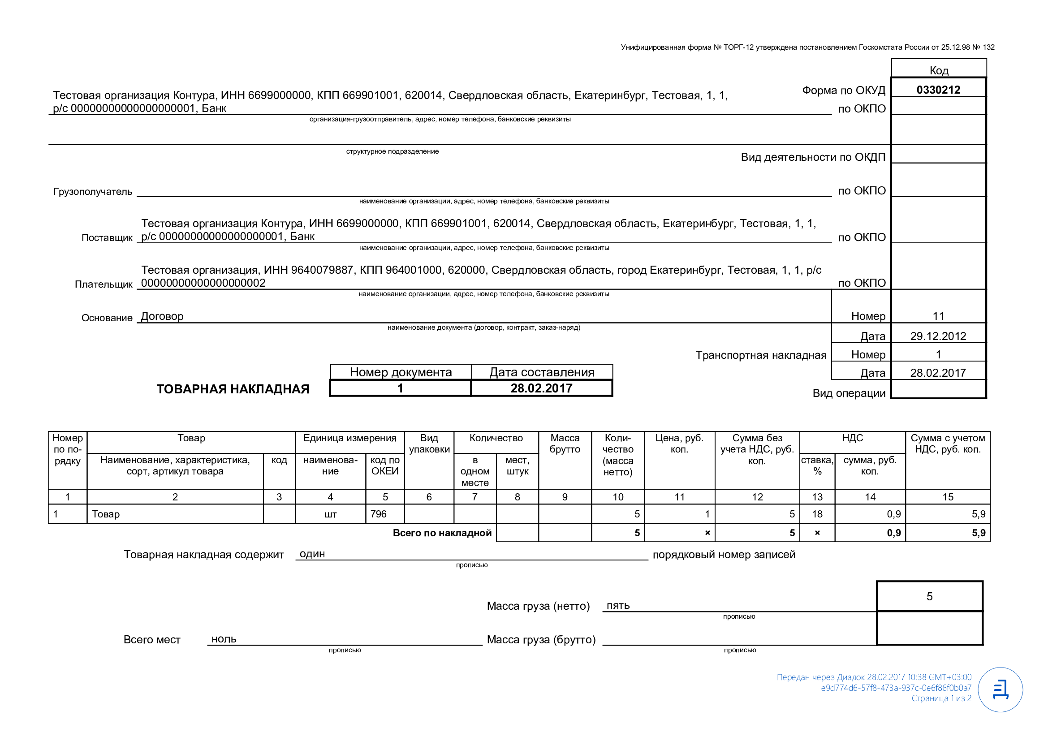
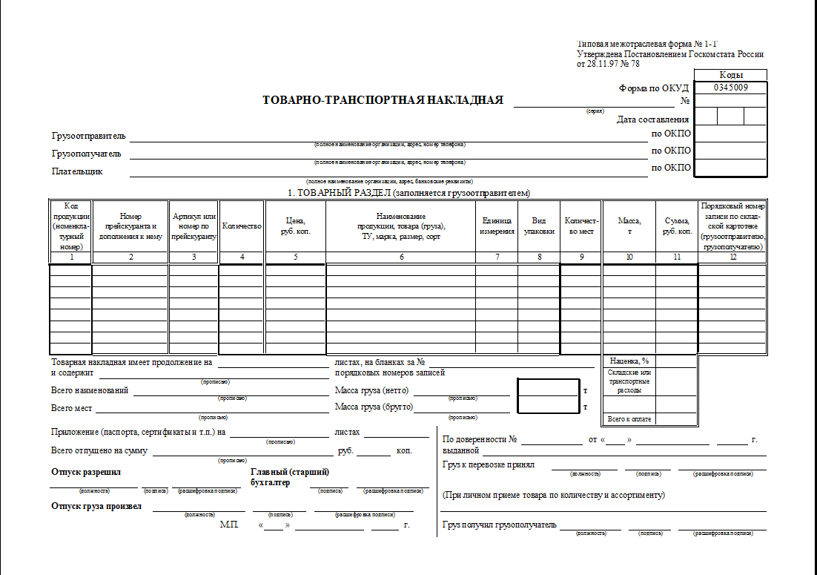
Base Image: microsoft/dotnet
Товарная накладная
Товарно Транспортная накладная
Notes:
В товарной – только товары
В товарно-транспортной – доп-информация по отправке

Slide 26
Dockerfile
FROM microsoft/dotnet:2.2-aspnetcore-runtime AS base
WORKDIR /app
EXPOSE 80
FROM microsoft/dotnet:2.2-aspnetcore-runtime AS base
WORKDIR /app
EXPOSE 80
FROM microsoft/dotnet:2.2-sdk AS build
WORKDIR /src
COPY ["WebApplication/WebApplication.csproj", "WebApplication/"]
RUN dotnet restore "WebApplication/WebApplication.csproj"
COPY . .
WORKDIR "/src/WebApplication"
RUN dotnet build "WebApplication.csproj" -c Release -o /app
FROM build AS publish
RUN dotnet publish "WebApplication.csproj" -c Release -o /app
FROM base AS final
WORKDIR /app
COPY --from=publish /app .
ENTRYPOINT ["dotnet", "WebApplication.dll"]

Slide 27
Multi-stage builds
FROM microsoft/dotnet:2.2-aspnetcore-runtime AS base
…
FROM microsoft/dotnet:2.2-sdk AS build
…
FROM build AS publish
…
FROM base AS final
FROM microsoft/dotnet:2.2-aspnetcore-runtime AS base
WORKDIR /app
EXPOSE 80
FROM microsoft/dotnet:2.2-sdk AS build
WORKDIR /src
COPY ["WebApplication/WebApplication.csproj", "WebApplication/"]
RUN dotnet restore "WebApplication/WebApplication.csproj"
COPY . .
WORKDIR "/src/WebApplication"
RUN dotnet build "WebApplication.csproj" -c Release -o /app
FROM build AS publish
RUN dotnet publish "WebApplication.csproj" -c Release -o /app
FROM base AS final
WORKDIR /app
COPY --from=publish /app .
ENTRYPOINT ["dotnet", "WebApplication.dll"]

Slide 28
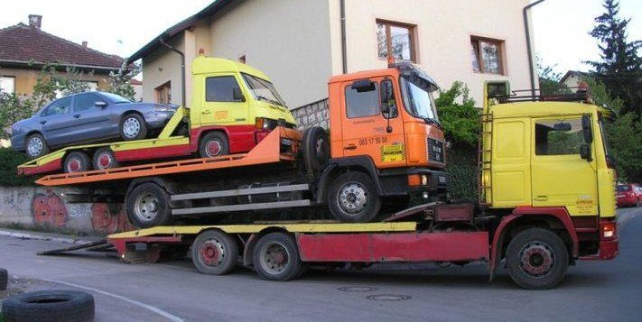
Multi-stage builds

Slide 29
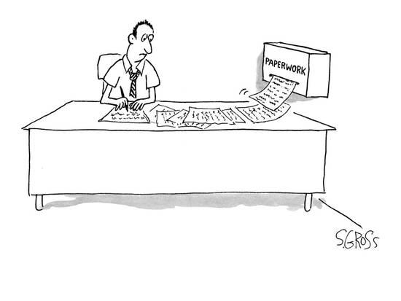
Накладная + нормативные акты

Slide 30

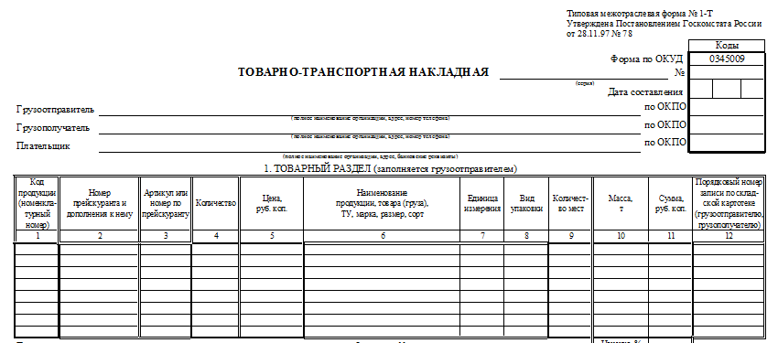
Накладная + нормативные акты

Slide 31
Multi-stage builds
FROM microsoft/dotnet:2.2-aspnetcore-runtime AS base
…
FROM microsoft/dotnet:2.2-sdk AS build
…
FROM build AS publish
…
FROM base AS final
FROM microsoft/dotnet:2.2-aspnetcore-runtime AS base
WORKDIR /app
EXPOSE 80
FROM microsoft/dotnet:2.2-sdk AS build
WORKDIR /src
COPY ["WebApplication/WebApplication.csproj", "WebApplication/"]
RUN dotnet restore "WebApplication/WebApplication.csproj"
COPY . .
WORKDIR "/src/WebApplication"
RUN dotnet build "WebApplication.csproj" -c Release -o /app
FROM build AS publish
RUN dotnet publish "WebApplication.csproj" -c Release -o /app
FROM base AS final
WORKDIR /app
COPY --from=publish /app .
ENTRYPOINT ["dotnet", "WebApplication.dll"]
Notes:
Мы же не будем прилагать к накладной толстую книжку ГК РФ

Slide 32
Dockerfile
FROM microsoft/dotnet:2.2-aspnetcore-runtime AS base
WORKDIR /app
EXPOSE 80
FROM microsoft/dotnet:2.2-sdk AS build
WORKDIR /src
COPY ["WebApplication/WebApplication.csproj", "WebApplication/"]
RUN dotnet restore "WebApplication/WebApplication.csproj"
COPY . .
WORKDIR "/src/WebApplication"
RUN dotnet build "WebApplication.csproj" -c Release -o /app
FROM build AS publish
RUN dotnet publish "WebApplication.csproj" -c Release -o /app
FROM base AS final
WORKDIR /app
COPY --from=publish /app .
ENTRYPOINT ["dotnet", "WebApplication.dll"]
FROM microsoft/dotnet:2.2-sdk AS build
WORKDIR /src
COPY ["WebApplication/WebApplication.csproj", "WebApplication/"]
RUN dotnet restore "WebApplication/WebApplication.csproj"

Slide 33
Dockerfile
FROM microsoft/dotnet:2.2-aspnetcore-runtime AS base
WORKDIR /app
EXPOSE 80
FROM microsoft/dotnet:2.2-sdk AS build
WORKDIR /src
COPY ["WebApplication/WebApplication.csproj", "WebApplication/"]
RUN dotnet restore "WebApplication/WebApplication.csproj"
COPY . .
WORKDIR "/src/WebApplication"
RUN dotnet build "WebApplication.csproj" -c Release -o /app
FROM build AS publish
RUN dotnet publish "WebApplication.csproj" -c Release -o /app
FROM base AS final
WORKDIR /app
COPY --from=publish /app .
ENTRYPOINT ["dotnet", "WebApplication.dll"]
COPY . .
WORKDIR "/src/WebApplication"
RUN dotnet build "WebApplication.csproj" -c Release -o /app

Slide 34
Dockerfile
FROM microsoft/dotnet:2.2-aspnetcore-runtime AS base
WORKDIR /app
EXPOSE 80
FROM microsoft/dotnet:2.2-sdk AS build
WORKDIR /src
COPY ["WebApplication/WebApplication.csproj", "WebApplication/"]
RUN dotnet restore "WebApplication/WebApplication.csproj"
COPY . .
WORKDIR "/src/WebApplication"
RUN dotnet build "WebApplication.csproj" -c Release -o /app
FROM build AS publish
RUN dotnet publish "WebApplication.csproj" -c Release -o /app
FROM base AS final
WORKDIR /app
COPY --from=publish /app .
ENTRYPOINT ["dotnet", "WebApplication.dll"]
FROM build AS publish
RUN dotnet publish "WebApplication.csproj" -c Release -o /app

Slide 35
Dockerfile
FROM microsoft/dotnet:2.2-aspnetcore-runtime AS base
WORKDIR /app
EXPOSE 80
FROM microsoft/dotnet:2.2-sdk AS build
WORKDIR /src
COPY ["WebApplication/WebApplication.csproj", "WebApplication/"]
RUN dotnet restore "WebApplication/WebApplication.csproj"
COPY . .
WORKDIR "/src/WebApplication"
RUN dotnet build "WebApplication.csproj" -c Release -o /app
FROM build AS publish
RUN dotnet publish "WebApplication.csproj" -c Release -o /app
FROM base AS final
WORKDIR /app
COPY --from=publish /app .
ENTRYPOINT ["dotnet", "WebApplication.dll"]
FROM base AS final
WORKDIR /app
COPY --from=publish /app .
ENTRYPOINT ["dotnet", "WebApplication.dll"]
Notes:
Водителем у нас будет Дотнеэ ВэбАппликашондэл

Slide 36
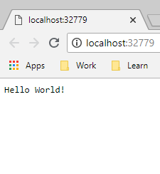
Запустим
Откуда такой порт?
Hosting environment: Development
Content root path: /app
Now listening on: http://[::]:80
Application started. Press Ctrl+C to shut down.

Slide 37
Что же у нас в консоли? > docker ps -a
IMAGE | COMMAND | PORTS | NAMES
webapplication:dev | "tail -f /dev/null" | 0.0.0.0:32779->80/tcp | stupefied_goldwasser

Slide 38
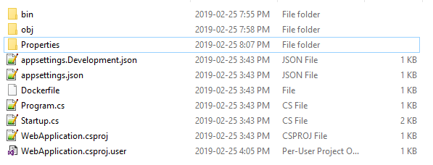
Содержимое
RUN

Slide 39
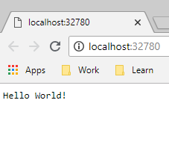
Запускаем еще раз
Pain #1: порт может меняться
В том числе и при clean project
Счетчик сбрасывается при перезагрузке
При колизии происходит инкремент
Notes:
Как с этим жить – см docker-compose

Slide 40
Но если включить SSL
Обновить Dockerfile
FROM microsoft/dotnet:2.…
WORKDIR /app
EXPOSE 80
EXPOSE 443
FROM microsoft/dotnet:2.…
WORKDIR /src
COPY WebApplication/WebA…
…

Slide 41
Но если включить SSL
Обновить Dockerfile
Добавить trusted certificate
dotnet dev-certs https
dotnet dev-certs https –trust
???
https://github.com/aspnet/Docs/issues/6199

Slide 42

Но если включить SSL
Обновить Dockerfile
Добавить trusted certificate
Добавить в launchSettings.json секцию iisSettings:iisExpress

Slide 43
launchSettings.json
{
"profiles": {
"Docker": {
"commandName": "Docker",
"launchBrowser": true,
"launchUrl": "{Scheme}://{ServiceHost}:{ServicePort}"
}
}
}

Slide 44
launchSettings.json
{
"profiles": {
"Docker": {
"commandName": "Docker",
"launchBrowser": true,
"launchUrl": "{Scheme}://{ServiceHost}:{ServicePort}"
}
}
}

Slide 45
launchSettings.json
{
"iisSettings": {
"iisExpress": {
"applicationUrl": "http://localhost:57382",
"sslPort": 44317
}
},
"profiles": {
"Docker": {
"commandName": "Docker",
"launchBrowser": true,
"launchUrl": "{Scheme}://{ServiceHost}:{ServicePort}"
}
}
}

Slide 46
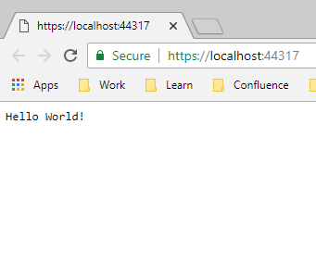
Запустим
{
"iisSettings": {
"iisExpress": {
"applicationUrl": "http://localhost:57382",
"sslPort": 44317
}
},
"profiles": {
"Docker": {
"commandName": "Docker",
"launchBrowser": true,
"launchUrl": "{Scheme}://{ServiceHost}:{ServicePort}"
}
}
}

Slide 47
Microsoft.VisualStudio.Docker.DotNetCore.dll
private void RetrievePortsAndSSLStatus(Hierarchy project, AppType appType){
if (appType != AppType.AspNetCore) return;
var unconfiguredProject = project.GetUnconfiguredProject();
GetFileNameWithoutExtension(project.ProjectFullPath);
_sslEnabled = unconfiguredProject.ProjectService.Services.ThreadingPolicy
.ExecuteSynchronously(unconfiguredProject.IsSSLEnabledAndAspNetCore21Async);
bool? sslEnabled = this._sslEnabled;
bool flag = true;
if (sslEnabled == true)
this._portMappings = null;
else
this._portMappings = unconfiguredProject.ProjectService.Services.ThreadingPolicy
.ExecuteSynchronously(unconfiguredProject.GetKestrelPortMappingsAsync);
}

Slide 48
Microsoft.VisualStudio.Docker.DotNetCore.dll
private void RetrievePortsAndSSLStatus(Hierarchy project, AppType appType){
if (appType != AppType.AspNetCore) return;
var unconfiguredProject = project.GetUnconfiguredProject();
GetFileNameWithoutExtension(project.ProjectFullPath);
_sslEnabled = unconfiguredProject.ProjectService.Services.ThreadingPolicy
.ExecuteSynchronously(unconfiguredProject.IsSSLEnabledAndAspNetCore21Async);
bool? sslEnabled = this._sslEnabled;
bool flag = true;
if (sslEnabled == true)
this._portMappings = null;
else
this._portMappings = unconfiguredProject.ProjectService.Services.ThreadingPolicy
.ExecuteSynchronously(unconfiguredProject.GetKestrelPortMappingsAsync);
}

Slide 49
Microsoft.VisualStudio.Containers.Tools.Common.dll
public class LaunchSettingsServerBinding {
public const string IISSettings = "iisSettings";
public const string IISExpress = "iisExpress";
[JsonProperty(PropertyName = "applicationUrl")]
public string ApplicationUrl { get; set; }
[JsonProperty(PropertyName = "sslPort")]
public int SSLPort { get; set; }
…

Slide 50
Порты
HTTP: генерируемый в рантайме
HTTPS: определяется по ключу iisSettings:iisExpress:sslPort
или генерируемый в рантайме

Slide 51
Dockerfile
FROM microsoft/dotnet:2.2-aspnetcore-runtime AS base
WORKDIR /app
EXPOSE 80
FROM microsoft/dotnet:2.2-sdk AS build
WORKDIR /src
COPY ["WebApplication/WebApplication.csproj", "WebApplication/"]
RUN dotnet restore "WebApplication/WebApplication.csproj"
COPY . .
WORKDIR "/src/WebApplication"
RUN dotnet build "WebApplication.csproj" -c Release -o /app
FROM build AS publish
RUN dotnet publish "WebApplication.csproj" -c Release -o /app
FROM base AS final
WORKDIR /app
COPY --from=publish /app .
ENTRYPOINT ["dotnet", "WebApplication.dll"]
Notes:
16 степов

Slide 52
Output window: Build
docker build -f "C:\Projects\my\presentations\2019_VisualStudio-And-Docker\src\WebApplication\WebApplication\Dockerfile" -t webapplication:dev --target base --label "com.microsoft.created-by=visual-studio" "C:\Projects\my\presentations\2019_VisualStudio-And-Docker\src\WebApplication"
Sending build context to Docker daemon 15.87kB
Step 1/4 : FROM microsoft/dotnet:2.2-aspnetcore-runtime AS base
---> 41db56126a6d
Step 2/4 : WORKDIR /app
---> Using cache
---> 7e759ee3b751
Step 3/4 : EXPOSE 80
---> Using cache
---> 7038720edcae
Step 4/4 : LABEL com.microsoft.created-by=visual-studio
---> Using cache
---> e4a97a881e70
Successfully built e4a97a881e70
Successfully tagged webapplication:dev
docker run -dt -v "C:\Users\Aleksandr_Kugushev\vsdbg\vs2017u5:/remote_debugger:rw" -v "C:\Projects\my\presentations\2019_VisualStudio-And-Docker\src\WebApplication\WebApplication:/app" -v "C:\Users\Aleksandr_Kugushev\.nuget\packages\:/root/.nuget/fallbackpackages2" -v "C:\Program Files\dotnet\sdk\NuGetFallbackFolder:/root/.nuget/fallbackpackages" -e "DOTNET_USE_POLLING_FILE_WATCHER=1" -e "ASPNETCORE_ENVIRONMENT=Development" -e "NUGET_PACKAGES=/root/.nuget/fallbackpackages2" -e "NUGET_FALLBACK_PACKAGES=/root/.nuget/fallbackpackages;/root/.nuget/fallbackpackages2" -P --entrypoint tail webapplication:dev -f /dev/null
39f6ec93ea66536bdc4da5648c49a9acc408081cb1cd6a8cafdcced4ef5e4695

Slide 53
Output window: Build
docker build -f ".\WebApplication\WebApplication\Dockerfile"
-t webapplication:dev
--target base
--label "com.microsoft.created-by=visual-studio"
“.\WebApplication"
docker build -f "C:\Projects\my\presentations\2019_VisualStudio-And-Docker\src\WebApplication\WebApplication\Dockerfile" -t webapplication:dev --target base --label "com.microsoft.created-by=visual-studio" "C:\Projects\my\presentations\2019_VisualStudio-And-Docker\src\WebApplication"
Sending build context to Docker daemon 15.87kB
Step 1/4 : FROM microsoft/dotnet:2.2-aspnetcore-runtime AS base
---> 41db56126a6d
Step 2/4 : WORKDIR /app
---> Using cache
---> 7e759ee3b751
Step 3/4 : EXPOSE 80
---> Using cache
---> 7038720edcae
Step 4/4 : LABEL com.microsoft.created-by=visual-studio
---> Using cache
---> e4a97a881e70
Successfully built e4a97a881e70
Successfully tagged webapplication:dev
docker run -dt -v "C:\Users\Aleksandr_Kugushev\vsdbg\vs2017u5:/remote_debugger:rw" -v "C:\Projects\my\presentations\2019_VisualStudio-And-Docker\src\WebApplication\WebApplication:/app" -v "C:\Users\Aleksandr_Kugushev\.nuget\packages\:/root/.nuget/fallbackpackages2" -v "C:\Program Files\dotnet\sdk\NuGetFallbackFolder:/root/.nuget/fallbackpackages" -e "DOTNET_USE_POLLING_FILE_WATCHER=1" -e "ASPNETCORE_ENVIRONMENT=Development" -e "NUGET_PACKAGES=/root/.nuget/fallbackpackages2" -e "NUGET_FALLBACK_PACKAGES=/root/.nuget/fallbackpackages;/root/.nuget/fallbackpackages2" -P --entrypoint tail webapplication:dev -f /dev/null
39f6ec93ea66536bdc4da5648c49a9acc408081cb1cd6a8cafdcced4ef5e4695

Slide 54
Dockerfile
FROM microsoft/dotnet:2.2-aspnetcore-runtime AS base
WORKDIR /app
EXPOSE 80
FROM microsoft/dotnet:2.2-sdk AS build
WORKDIR /src
COPY ["WebApplication/WebApplication.csproj", "WebApplication/"]
RUN dotnet restore "WebApplication/WebApplication.csproj"
COPY . .
WORKDIR "/src/WebApplication"
RUN dotnet build "WebApplication.csproj" -c Release -o /app
FROM build AS publish
RUN dotnet publish "WebApplication.csproj" -c Release -o /app
FROM base AS final
WORKDIR /app
COPY --from=publish /app .
ENTRYPOINT ["dotnet", "WebApplication.dll"]

Slide 55
Dockerfile
FROM microsoft/dotnet:2.2-aspnetcore-runtime AS base
WORKDIR /app
EXPOSE 80
FROM microsoft/dotnet:2.2-sdk AS build
WORKDIR /src
COPY ["WebApplication/WebApplication.csproj", "WebApplication/"]
RUN dotnet restore "WebApplication/WebApplication.csproj"
COPY . .
WORKDIR "/src/WebApplication"
RUN dotnet build "WebApplication.csproj" -c Release -o /app
FROM build AS publish
RUN dotnet publish "WebApplication.csproj" -c Release -o /app
FROM base AS final
WORKDIR /app
COPY --from=publish /app .
ENTRYPOINT ["dotnet", "WebApplication.dll"]

Slide 56
Output window: Build
docker build -f "C:\Projects\my\presentations\2019_VisualStudio-And-Docker\src\WebApplication\WebApplication\Dockerfile" -t webapplication:dev --target base --label "com.microsoft.created-by=visual-studio" "C:\Projects\my\presentations\2019_VisualStudio-And-Docker\src\WebApplication"
Sending build context to Docker daemon 15.87kB
Step 1/4 : FROM microsoft/dotnet:2.2-aspnetcore-runtime AS base
---> 41db56126a6d
Step 2/4 : WORKDIR /app
---> Using cache
---> 7e759ee3b751
Step 3/4 : EXPOSE 80
---> Using cache
---> 7038720edcae
Step 4/4 : LABEL com.microsoft.created-by=visual-studio
---> Using cache
---> e4a97a881e70
Successfully built e4a97a881e70
Successfully tagged webapplication:dev
docker run -dt -v "C:\Users\Aleksandr_Kugushev\vsdbg\vs2017u5:/remote_debugger:rw" -v "C:\Projects\my\presentations\2019_VisualStudio-And-Docker\src\WebApplication\WebApplication:/app" -v "C:\Users\Aleksandr_Kugushev\.nuget\packages\:/root/.nuget/fallbackpackages2" -v "C:\Program Files\dotnet\sdk\NuGetFallbackFolder:/root/.nuget/fallbackpackages" -e "DOTNET_USE_POLLING_FILE_WATCHER=1" -e "ASPNETCORE_ENVIRONMENT=Development" -e "NUGET_PACKAGES=/root/.nuget/fallbackpackages2" -e "NUGET_FALLBACK_PACKAGES=/root/.nuget/fallbackpackages;/root/.nuget/fallbackpackages2" -P --entrypoint tail webapplication:dev -f /dev/null
39f6ec93ea66536bdc4da5648c49a9acc408081cb1cd6a8cafdcced4ef5e4695
Sending build context to Docker daemon 15.87kB
Step 1/4 : FROM microsoft/dotnet:2.2-aspnetcore-runtime AS base
---> 41db56126a6d
Step 2/4 : WORKDIR /app
---> Using cache
---> 7e759ee3b751
Step 3/4 : EXPOSE 80
---> Using cache
---> 7038720edcae
Step 4/4 : LABEL com.microsoft.created-by=visual-studio
---> Using cache
---> e4a97a881e70
Successfully built e4a97a881e70
Successfully tagged webapplication:dev

Slide 57
Output window: Build
docker build -f "C:\Projects\my\presentations\2019_VisualStudio-And-Docker\src\WebApplication\WebApplication\Dockerfile" -t webapplication:dev --target base --label "com.microsoft.created-by=visual-studio" "C:\Projects\my\presentations\2019_VisualStudio-And-Docker\src\WebApplication"
Sending build context to Docker daemon 15.87kB
Step 1/4 : FROM microsoft/dotnet:2.2-aspnetcore-runtime AS base
---> 41db56126a6d
Step 2/4 : WORKDIR /app
---> Using cache
---> 7e759ee3b751
Step 3/4 : EXPOSE 80
---> Using cache
---> 7038720edcae
Step 4/4 : LABEL com.microsoft.created-by=visual-studio
---> Using cache
---> e4a97a881e70
Successfully built e4a97a881e70
Successfully tagged webapplication:dev
docker run -dt -v "C:\Users\Aleksandr_Kugushev\vsdbg\vs2017u5:/remote_debugger:rw" -v "C:\Projects\my\presentations\2019_VisualStudio-And-Docker\src\WebApplication\WebApplication:/app" -v "C:\Users\Aleksandr_Kugushev\.nuget\packages\:/root/.nuget/fallbackpackages2" -v "C:\Program Files\dotnet\sdk\NuGetFallbackFolder:/root/.nuget/fallbackpackages" -e "DOTNET_USE_POLLING_FILE_WATCHER=1" -e "ASPNETCORE_ENVIRONMENT=Development" -e "NUGET_PACKAGES=/root/.nuget/fallbackpackages2" -e "NUGET_FALLBACK_PACKAGES=/root/.nuget/fallbackpackages;/root/.nuget/fallbackpackages2" -P --entrypoint tail webapplication:dev -f /dev/null
39f6ec93ea66536bdc4da5648c49a9acc408081cb1cd6a8cafdcced4ef5e4695

Slide 58
Output window: Build
docker build -f "C:\Projects\my\presentations\2019_VisualStudio-And-Docker\src\WebApplication\WebApplication\Dockerfile" -t webapplication:dev --target base --label "com.microsoft.created-by=visual-studio" "C:\Projects\my\presentations\2019_VisualStudio-And-Docker\src\WebApplication"
Sending build context to Docker daemon 15.87kB
Step 1/4 : FROM microsoft/dotnet:2.2-aspnetcore-runtime AS base
---> 41db56126a6d
Step 2/4 : WORKDIR /app
---> Using cache
---> 7e759ee3b751
Step 3/4 : EXPOSE 80
---> Using cache
---> 7038720edcae
Step 4/4 : LABEL com.microsoft.created-by=visual-studio
---> Using cache
---> e4a97a881e70
Successfully built e4a97a881e70
Successfully tagged webapplication:dev
docker run -dt -v "C:\Users\Aleksandr_Kugushev\vsdbg\vs2017u5:/remote_debugger:rw" -v "C:\Projects\my\presentations\2019_VisualStudio-And-Docker\src\WebApplication\WebApplication:/app" -v "C:\Users\Aleksandr_Kugushev\.nuget\packages\:/root/.nuget/fallbackpackages2" -v "C:\Program Files\dotnet\sdk\NuGetFallbackFolder:/root/.nuget/fallbackpackages" -e "DOTNET_USE_POLLING_FILE_WATCHER=1" -e "ASPNETCORE_ENVIRONMENT=Development" -e "NUGET_PACKAGES=/root/.nuget/fallbackpackages2" -e "NUGET_FALLBACK_PACKAGES=/root/.nuget/fallbackpackages;/root/.nuget/fallbackpackages2" -P --entrypoint tail webapplication:dev -f /dev/null
39f6ec93ea66536bdc4da5648c49a9acc408081cb1cd6a8cafdcced4ef5e4695
docker run -dt
-v "C:\Users\...\vsdbg\vs2017u5:/remote_debugger:rw"
-v “.\WebApplication\WebApplication:/app"
-v "C:\Users\...\.nuget\packages\:/root/.nuget/fallbackpackages2"
-v "C:\Program Files\dotnet\sdk\NuGetFallbackFolder:/root/.nuget/fallbackpackages"
-e "DOTNET_USE_POLLING_FILE_WATCHER=1" -e "ASPNETCORE_ENVIRONMENT=Development"
-e "NUGET_PACKAGES=/root/.nuget/fallbackpackages2"
-e "NUGET_FALLBACK_PACKAGES=/root/.nuget/fallbackpackages;/root/.nuget/fallbackpackages2"
-P --entrypoint tail webapplication:dev -f /dev/null

Slide 59
Заглянем в контейнер
docker container top <container_id>
tail -f /dev/null
/remote_debugger/vsdbg --interpreter=vscode
/usr/bin/dotnet --additionalProbingPath /root/.nuget/fallbackpackages2 --additionalProbingPath /root/.nuget/fallbackpackages bin/Debug/netcoreapp2.2/WebApplication.dll

Slide 60
Так как же оно работает?
Visual Studio собирает dll локально
В docker image вырезается все, кроме базового образа
Контейнер запускается
C подключением volumes с собранными dll и дополнительными библиотеками
Пустым entry point
В запущенном контейнер с помощью exec запускается отладчик VsDbg: aka.ms/getvsdbgsh
Pain #2: Ваши dockerized приложения работают не идентично

Slide 61
Проблема с Add Existing Project
src
WebApplication
WebApplication
WebApplication.sln
ExternalProject
WebApplication.csproj
ExternalProject.csproj

Slide 62
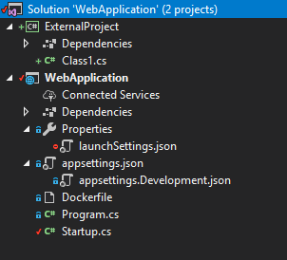
Проблема с Add Existing Project
Добавим существующий проект в Solution
Добавим ссылку на него
Запустим

Slide 63
Проблема с Add Existing Project
Добавим новый проект
Добавим ссылку на него
Запустим
Success

Slide 64
Проблема с Add Existing Project
docker build -f .\WebApplication\Dockerfile .
Step 10/16 : RUN dotnet build "WebApplication.csproj" -c Release -o /app
---> Running in 136094fbaed6
Microsoft (R) Build Engine version 15.9.20+g88f5fadfbe for .NET Core
Copyright (C) Microsoft Corporation. All rights reserved.
Skipping project "/ExternalProject/ExternalProject.csproj" because it was not found.
Restore completed in 56.78 ms for /src/WebApplication/WebApplication.csproj.
/usr/share/dotnet/sdk/2.2.104/Microsoft.Common.CurrentVersion.targets(1879,5): warning : The referenced project '../../ExternalProject/ExternalProject.csproj' does not exist. [/src/WebApplication/WebApplication.csproj]
Startup.cs(5,7): error CS0246: The type or namespace name 'ExternalProject' could not be found (are you missing a using directive or an assembly reference?) [/src/WebApplication/WebApplication.csproj]
Build FAILED.

Slide 65
Помните про контекст
src
WebApplication (.)
WebApplication
WebApplication.sln
ExternalProject
WebApplication.csproj
ExternalProject.csproj
Notes:
Это

Slide 66
Помните про контекст
Reference projects
NuGet.config
Resources

Slide 67
Помните про контекст
src
WebApplication (.)
WebApplication
ExternalProject
WebApplication.csproj
ExternalProject.csproj
WebApplication.sln
Notes:
Это

Slide 68
Помните про контекст
src
WebApplication (.)
WebApplication
InternalProject
WebApplication.csproj
InternalProject.csproj
WebApplication.sln
Notes:
Это

Slide 69
А как же Release?
docker build -f "C:\Projects\my\presentations\2019_VisualStudio-And-Docker\src\WebApplication\WebApplication\Dockerfile" -t webapplication --label "com.microsoft.created-by=visual-studio" "C:\Projects\my\presentations\2019_VisualStudio-And-Docker\src\WebApplication"
Sending build context to Docker daemon 15.87kB
Step 1/17 : FROM microsoft/dotnet:2.2-aspnetcore-runtime AS base
Step 2/17 : WORKDIR /app
---> 41db56126a6d
---> Using cache
---> 7e759ee3b751
Step 3/17 : EXPOSE 80
---> Using cache
---> 7038720edcae
Step 4/17 : FROM microsoft/dotnet:2.2-sdk AS build
Step 5/17 : WORKDIR /src
---> d5dbee97f68e
---> 850d5d91e4d2
Step 6/17 : COPY ["WebApplication/WebApplication.csproj", "WebApplication/"]
---> Using cache
---> c1ae3917c28c
Step 7/17 : RUN dotnet restore "WebApplication/WebApplication.csproj"
---> Running in 613f8b34ceaa
Restoring packages for /src/WebApplication/WebApplication.csproj...
Installing Microsoft.VisualStudio.Azure.Containers.Tools.Targets 1.0.2105168.
Generating MSBuild file /src/WebApplication/obj/WebApplication.csproj.nuget.g.props.
Generating MSBuild file /src/WebApplication/obj/WebApplication.csproj.nuget.g.targets.
Restore completed in 3.73 sec for /src/WebApplication/WebApplication.csproj.
Removing intermediate container 613f8b34ceaa
---> f4daf8a2b7e3
Step 8/17 : COPY . .
---> ad5d885d623e
Step 9/17 : WORKDIR "/src/WebApplication"
---> Running in a16ab71b95d6
Removing intermediate container a16ab71b95d6
Step 10/17 : RUN dotnet build "WebApplication.csproj" -c Release -o /app
---> cfc45b064f9c
---> Running in e3d5d9dcf82e
Microsoft (R) Build Engine version 15.9.20+g88f5fadfbe for .NET Core
Copyright (C) Microsoft Corporation. All rights reserved.
Restore completed in 44.79 ms for /src/WebApplication/WebApplication.csproj.
WebApplication -> /app/WebApplication.dll
Build succeeded.
0 Warning(s)
0 Error(s)
Time Elapsed 00:00:03.23
Removing intermediate container e3d5d9dcf82e
---> 0a36051d4b1a
Step 11/17 : FROM build AS publish
---> 0a36051d4b1a
Step 12/17 : RUN dotnet publish "WebApplication.csproj" -c Release -o /app
---> Running in 8cd7da93d9bd
Microsoft (R) Build Engine version 15.9.20+g88f5fadfbe for .NET Core
Copyright (C) Microsoft Corporation. All rights reserved.
Restore completed in 45.93 ms for /src/WebApplication/WebApplication.csproj.
WebApplication -> /src/WebApplication/bin/Release/netcoreapp2.2/WebApplication.dll
WebApplication -> /app/
Removing intermediate container 8cd7da93d9bd
---> 98522599fd9a
Step 13/17 : FROM base AS final
---> 7038720edcae
Step 14/17 : WORKDIR /app
---> Running in bdcce4b3939c
Removing intermediate container bdcce4b3939c
---> 602aa5e49c2d
Step 15/17 : COPY --from=publish /app .
---> 2b6fcec6c77f
Step 16/17 : ENTRYPOINT ["dotnet", "WebApplication.dll"]
---> Running in c3090d23667f
Removing intermediate container c3090d23667f
---> cdde2be12ec1
Step 17/17 : LABEL com.microsoft.created-by=visual-studio
---> Running in de34daeb46f8
Removing intermediate container de34daeb46f8
---> 08008fb9e5b6
Successfully built 08008fb9e5b6
Successfully tagged webapplication:latest
SECURITY WARNING: You are building a Docker image from Windows against a non-Windows Docker host. All files and directories added to build context will have '-rwxr-xr-x' permissions. It is recommended to double check and reset permissions for sensitive files and directories.
docker run -dt -v "C:\Users\Aleksandr_Kugushev\vsdbg\vs2017u5:/remote_debugger:rw" -e "ASPNETCORE_ENVIRONMENT=Development" -P --entrypoint tail webapplication -f /dev/null
d16a24df8b4adebb9b388085c616b9a6ea73247746b4c71544174d52b2d1317e

Slide 70
А как же Release?
docker build -f “.\WebApplication\WebApplication\Dockerfile"
-t webapplication
--label "com.microsoft.created-by=visual-studio"
“.\WebApplication"
docker build -f "C:\Projects\my\presentations\2019_VisualStudio-And-Docker\src\WebApplication\WebApplication\Dockerfile" -t webapplication --label "com.microsoft.created-by=visual-studio" "C:\Projects\my\presentations\2019_VisualStudio-And-Docker\src\WebApplication"
Sending build context to Docker daemon 15.87kB
Step 1/17 : FROM microsoft/dotnet:2.2-aspnetcore-runtime AS base
Step 2/17 : WORKDIR /app
---> 41db56126a6d
---> Using cache
---> 7e759ee3b751
Step 3/17 : EXPOSE 80
---> Using cache
---> 7038720edcae
Step 4/17 : FROM microsoft/dotnet:2.2-sdk AS build
Step 5/17 : WORKDIR /src
---> d5dbee97f68e
---> 850d5d91e4d2
Step 6/17 : COPY ["WebApplication/WebApplication.csproj", "WebApplication/"]
---> Using cache
---> c1ae3917c28c
Step 7/17 : RUN dotnet restore "WebApplication/WebApplication.csproj"
---> Running in 613f8b34ceaa
Restoring packages for /src/WebApplication/WebApplication.csproj...
Installing Microsoft.VisualStudio.Azure.Containers.Tools.Targets 1.0.2105168.
Generating MSBuild file /src/WebApplication/obj/WebApplication.csproj.nuget.g.props.
Generating MSBuild file /src/WebApplication/obj/WebApplication.csproj.nuget.g.targets.
Restore completed in 3.73 sec for /src/WebApplication/WebApplication.csproj.
Removing intermediate container 613f8b34ceaa
---> f4daf8a2b7e3
Step 8/17 : COPY . .
---> ad5d885d623e
Step 9/17 : WORKDIR "/src/WebApplication"
---> Running in a16ab71b95d6
Removing intermediate container a16ab71b95d6
Step 10/17 : RUN dotnet build "WebApplication.csproj" -c Release -o /app
---> cfc45b064f9c
---> Running in e3d5d9dcf82e
Microsoft (R) Build Engine version 15.9.20+g88f5fadfbe for .NET Core
Copyright (C) Microsoft Corporation. All rights reserved.
Restore completed in 44.79 ms for /src/WebApplication/WebApplication.csproj.
WebApplication -> /app/WebApplication.dll
Build succeeded.
0 Warning(s)
0 Error(s)
Time Elapsed 00:00:03.23
Removing intermediate container e3d5d9dcf82e
---> 0a36051d4b1a
Step 11/17 : FROM build AS publish
---> 0a36051d4b1a
Step 12/17 : RUN dotnet publish "WebApplication.csproj" -c Release -o /app
---> Running in 8cd7da93d9bd
Microsoft (R) Build Engine version 15.9.20+g88f5fadfbe for .NET Core
Copyright (C) Microsoft Corporation. All rights reserved.
Restore completed in 45.93 ms for /src/WebApplication/WebApplication.csproj.
WebApplication -> /src/WebApplication/bin/Release/netcoreapp2.2/WebApplication.dll
WebApplication -> /app/
Removing intermediate container 8cd7da93d9bd
---> 98522599fd9a
Step 13/17 : FROM base AS final
---> 7038720edcae
Step 14/17 : WORKDIR /app
---> Running in bdcce4b3939c
Removing intermediate container bdcce4b3939c
---> 602aa5e49c2d
Step 15/17 : COPY --from=publish /app .
---> 2b6fcec6c77f
Step 16/17 : ENTRYPOINT ["dotnet", "WebApplication.dll"]
---> Running in c3090d23667f
Removing intermediate container c3090d23667f
---> cdde2be12ec1
Step 17/17 : LABEL com.microsoft.created-by=visual-studio
---> Running in de34daeb46f8
Removing intermediate container de34daeb46f8
---> 08008fb9e5b6
Successfully built 08008fb9e5b6
Successfully tagged webapplication:latest
SECURITY WARNING: You are building a Docker image from Windows against a non-Windows Docker host. All files and directories added to build context will have '-rwxr-xr-x' permissions. It is recommended to double check and reset permissions for sensitive files and directories.
docker run -dt -v "C:\Users\Aleksandr_Kugushev\vsdbg\vs2017u5:/remote_debugger:rw" -e "ASPNETCORE_ENVIRONMENT=Development" -P --entrypoint tail webapplication -f /dev/null
d16a24df8b4adebb9b388085c616b9a6ea73247746b4c71544174d52b2d1317e
Notes:
Target не подменяется

Slide 71
А как же Release?
docker build -f "C:\Projects\my\presentations\2019_VisualStudio-And-Docker\src\WebApplication\WebApplication\Dockerfile" -t webapplication --label "com.microsoft.created-by=visual-studio" "C:\Projects\my\presentations\2019_VisualStudio-And-Docker\src\WebApplication"
Sending build context to Docker daemon 15.87kB
Step 1/17 : FROM microsoft/dotnet:2.2-aspnetcore-runtime AS base
Step 2/17 : WORKDIR /app
---> 41db56126a6d
---> Using cache
---> 7e759ee3b751
Step 3/17 : EXPOSE 80
---> Using cache
---> 7038720edcae
Step 4/17 : FROM microsoft/dotnet:2.2-sdk AS build
Step 5/17 : WORKDIR /src
---> d5dbee97f68e
---> 850d5d91e4d2
Step 6/17 : COPY ["WebApplication/WebApplication.csproj", "WebApplication/"]
---> Using cache
---> c1ae3917c28c
Step 7/17 : RUN dotnet restore "WebApplication/WebApplication.csproj"
---> Running in 613f8b34ceaa
Restoring packages for /src/WebApplication/WebApplication.csproj...
Installing Microsoft.VisualStudio.Azure.Containers.Tools.Targets 1.0.2105168.
Generating MSBuild file /src/WebApplication/obj/WebApplication.csproj.nuget.g.props.
Generating MSBuild file /src/WebApplication/obj/WebApplication.csproj.nuget.g.targets.
Restore completed in 3.73 sec for /src/WebApplication/WebApplication.csproj.
Removing intermediate container 613f8b34ceaa
---> f4daf8a2b7e3
Step 8/17 : COPY . .
---> ad5d885d623e
Step 9/17 : WORKDIR "/src/WebApplication"
---> Running in a16ab71b95d6
Removing intermediate container a16ab71b95d6
Step 10/17 : RUN dotnet build "WebApplication.csproj" -c Release -o /app
---> cfc45b064f9c
---> Running in e3d5d9dcf82e
Microsoft (R) Build Engine version 15.9.20+g88f5fadfbe for .NET Core
Copyright (C) Microsoft Corporation. All rights reserved.
Restore completed in 44.79 ms for /src/WebApplication/WebApplication.csproj.
WebApplication -> /app/WebApplication.dll
Build succeeded.
0 Warning(s)
0 Error(s)
Time Elapsed 00:00:03.23
Removing intermediate container e3d5d9dcf82e
---> 0a36051d4b1a
Step 11/17 : FROM build AS publish
---> 0a36051d4b1a
Step 12/17 : RUN dotnet publish "WebApplication.csproj" -c Release -o /app
---> Running in 8cd7da93d9bd
Microsoft (R) Build Engine version 15.9.20+g88f5fadfbe for .NET Core
Copyright (C) Microsoft Corporation. All rights reserved.
Restore completed in 45.93 ms for /src/WebApplication/WebApplication.csproj.
WebApplication -> /src/WebApplication/bin/Release/netcoreapp2.2/WebApplication.dll
WebApplication -> /app/
Removing intermediate container 8cd7da93d9bd
---> 98522599fd9a
Step 13/17 : FROM base AS final
---> 7038720edcae
Step 14/17 : WORKDIR /app
---> Running in bdcce4b3939c
Removing intermediate container bdcce4b3939c
---> 602aa5e49c2d
Step 15/17 : COPY --from=publish /app .
---> 2b6fcec6c77f
Step 16/17 : ENTRYPOINT ["dotnet", "WebApplication.dll"]
---> Running in c3090d23667f
Removing intermediate container c3090d23667f
---> cdde2be12ec1
Step 17/17 : LABEL com.microsoft.created-by=visual-studio
---> Running in de34daeb46f8
Removing intermediate container de34daeb46f8
---> 08008fb9e5b6
Successfully built 08008fb9e5b6
Successfully tagged webapplication:latest
SECURITY WARNING: You are building a Docker image from Windows against a non-Windows Docker host. All files and directories added to build context will have '-rwxr-xr-x' permissions. It is recommended to double check and reset permissions for sensitive files and directories.
docker run -dt -v "C:\Users\Aleksandr_Kugushev\vsdbg\vs2017u5:/remote_debugger:rw" -e "ASPNETCORE_ENVIRONMENT=Development" -P --entrypoint tail webapplication -f /dev/null
d16a24df8b4adebb9b388085c616b9a6ea73247746b4c71544174d52b2d1317e

Slide 72
А как же Release?
docker build -f "C:\Projects\my\presentations\2019_VisualStudio-And-Docker\src\WebApplication\WebApplication\Dockerfile" -t webapplication --label "com.microsoft.created-by=visual-studio" "C:\Projects\my\presentations\2019_VisualStudio-And-Docker\src\WebApplication"
Sending build context to Docker daemon 15.87kB
Step 1/17 : FROM microsoft/dotnet:2.2-aspnetcore-runtime AS base
Step 2/17 : WORKDIR /app
---> 41db56126a6d
---> Using cache
---> 7e759ee3b751
Step 3/17 : EXPOSE 80
---> Using cache
---> 7038720edcae
Step 4/17 : FROM microsoft/dotnet:2.2-sdk AS build
Step 5/17 : WORKDIR /src
---> d5dbee97f68e
---> 850d5d91e4d2
Step 6/17 : COPY ["WebApplication/WebApplication.csproj", "WebApplication/"]
---> Using cache
---> c1ae3917c28c
Step 7/17 : RUN dotnet restore "WebApplication/WebApplication.csproj"
---> Running in 613f8b34ceaa
Restoring packages for /src/WebApplication/WebApplication.csproj...
Installing Microsoft.VisualStudio.Azure.Containers.Tools.Targets 1.0.2105168.
Generating MSBuild file /src/WebApplication/obj/WebApplication.csproj.nuget.g.props.
Generating MSBuild file /src/WebApplication/obj/WebApplication.csproj.nuget.g.targets.
Restore completed in 3.73 sec for /src/WebApplication/WebApplication.csproj.
Removing intermediate container 613f8b34ceaa
---> f4daf8a2b7e3
Step 8/17 : COPY . .
---> ad5d885d623e
Step 9/17 : WORKDIR "/src/WebApplication"
---> Running in a16ab71b95d6
Removing intermediate container a16ab71b95d6
Step 10/17 : RUN dotnet build "WebApplication.csproj" -c Release -o /app
---> cfc45b064f9c
---> Running in e3d5d9dcf82e
Microsoft (R) Build Engine version 15.9.20+g88f5fadfbe for .NET Core
Copyright (C) Microsoft Corporation. All rights reserved.
Restore completed in 44.79 ms for /src/WebApplication/WebApplication.csproj.
WebApplication -> /app/WebApplication.dll
Build succeeded.
0 Warning(s)
0 Error(s)
Time Elapsed 00:00:03.23
Removing intermediate container e3d5d9dcf82e
---> 0a36051d4b1a
Step 11/17 : FROM build AS publish
---> 0a36051d4b1a
Step 12/17 : RUN dotnet publish "WebApplication.csproj" -c Release -o /app
---> Running in 8cd7da93d9bd
Microsoft (R) Build Engine version 15.9.20+g88f5fadfbe for .NET Core
Copyright (C) Microsoft Corporation. All rights reserved.
Restore completed in 45.93 ms for /src/WebApplication/WebApplication.csproj.
WebApplication -> /src/WebApplication/bin/Release/netcoreapp2.2/WebApplication.dll
WebApplication -> /app/
Removing intermediate container 8cd7da93d9bd
---> 98522599fd9a
Step 13/17 : FROM base AS final
---> 7038720edcae
Step 14/17 : WORKDIR /app
---> Running in bdcce4b3939c
Removing intermediate container bdcce4b3939c
---> 602aa5e49c2d
Step 15/17 : COPY --from=publish /app .
---> 2b6fcec6c77f
Step 16/17 : ENTRYPOINT ["dotnet", "WebApplication.dll"]
---> Running in c3090d23667f
Removing intermediate container c3090d23667f
---> cdde2be12ec1
Step 17/17 : LABEL com.microsoft.created-by=visual-studio
---> Running in de34daeb46f8
Removing intermediate container de34daeb46f8
---> 08008fb9e5b6
Successfully built 08008fb9e5b6
Successfully tagged webapplication:latest
SECURITY WARNING: You are building a Docker image from Windows against a non-Windows Docker host. All files and directories added to build context will have '-rwxr-xr-x' permissions. It is recommended to double check and reset permissions for sensitive files and directories.
docker run -dt -v "C:\Users\Aleksandr_Kugushev\vsdbg\vs2017u5:/remote_debugger:rw" -e "ASPNETCORE_ENVIRONMENT=Development" -P --entrypoint tail webapplication -f /dev/null
d16a24df8b4adebb9b388085c616b9a6ea73247746b4c71544174d52b2d1317e
docker run -dt
-v "C:\Users\Aleksandr_Kugushev\vsdbg\vs2017u5:/remote_debugger:rw"
-e "ASPNETCORE_ENVIRONMENT=Development"
-P --entrypoint tail webapplication -f /dev/null
Pain #3: Entrypoint всегда один и тот же
Notes:
dotnet test
dotnet ef

Slide 73
Изучим .csproj файл
<Project Sdk="Microsoft.NET.Sdk.Web">
<PropertyGroup>
<TargetFramework>netcoreapp2.2</TargetFramework>
<AspNetCoreHostingModel>InProcess</AspNetCoreHostingModel>
<DockerDefaultTargetOS>Linux</DockerDefaultTargetOS>
</PropertyGroup>
<ItemGroup>
<PackageReference Include="Microsoft.AspNetCore.App" />
<PackageReference Include="Microsoft.AspNetCore.Razor.Design" Version="2.2.0" PrivateAssets="All" />
<PackageReference Include="Microsoft.VisualStudio.Azure.Containers.Tools.Targets" Version="1.0.2105168" />
</ItemGroup>

Slide 74
Изучим .csproj файл
<Project Sdk="Microsoft.NET.Sdk.Web">
<PropertyGroup>
<TargetFramework>netcoreapp2.2</TargetFramework>
<AspNetCoreHostingModel>InProcess</AspNetCoreHostingModel>
<DockerDefaultTargetOS>Linux</DockerDefaultTargetOS>
</PropertyGroup>
<ItemGroup>
<PackageReference Include="Microsoft.AspNetCore.App" />
<PackageReference Include="Microsoft.AspNetCore.Razor.Design" Version="2.2.0" PrivateAssets="All" />
<PackageReference Include="Microsoft.VisualStudio.Azure.Containers.Tools.Targets" Version="1.0.2105168" />
</ItemGroup>

Slide 75
Изучим .csproj файл
<Project Sdk="Microsoft.NET.Sdk.Web">
<PropertyGroup>
<TargetFramework>netcoreapp2.2</TargetFramework>
<AspNetCoreHostingModel>InProcess</AspNetCoreHostingModel>
<DockerDefaultTargetOS>Linux</DockerDefaultTargetOS>
<AssemblyName>RenamedWebApplication</AssemblyName>
</PropertyGroup>
<ItemGroup>
<PackageReference Include="Microsoft.AspNetCore.App" />
<PackageReference Include="Microsoft.AspNetCore.Razor.Design" Version="2.2.0" PrivateAssets="All" />
<PackageReference Include="Microsoft.VisualStudio.Azure.Containers.Tools.Targets" Version="1.0.2105168" />
</ItemGroup>

Slide 76
Проблема AssemblyName
docker build -f .\WebApplication\Dockerfile -t test .
Success
docker run -it -p 4242:80 test
Did you mean to run dotnet SDK commands? Please install dotnet SDK from:
http://go.microsoft.com/fwlink/?LinkID=798306&clcid=0x409

Slide 77
Проблема AssemblyName
docker ps -a
IMAGE COMMAND STATUS
test "dotnet WebApplicati…“ Exited (145) 6 seconds ago

Slide 78
Проблема AssemblyName
bin\Release\netcoreapp2.2
Dockerfile
RenamedWebApplication.dll
ENTRYPOINT ["dotnet","WebApplication.dll"]
Pain #4: При переименовании необходимо исправлять Dockerfile

Slide 79
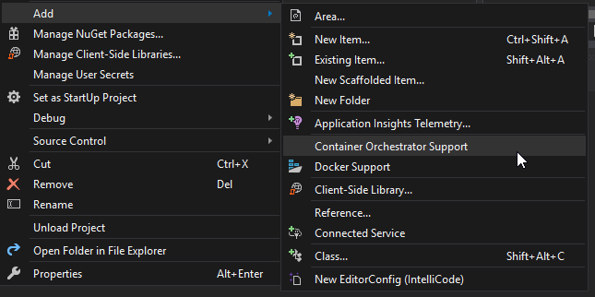
Использование docker-compose
Notes:
Docker-compose был изначально

Slide 80
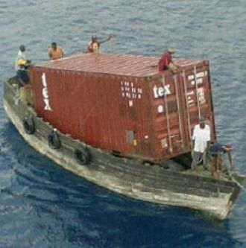
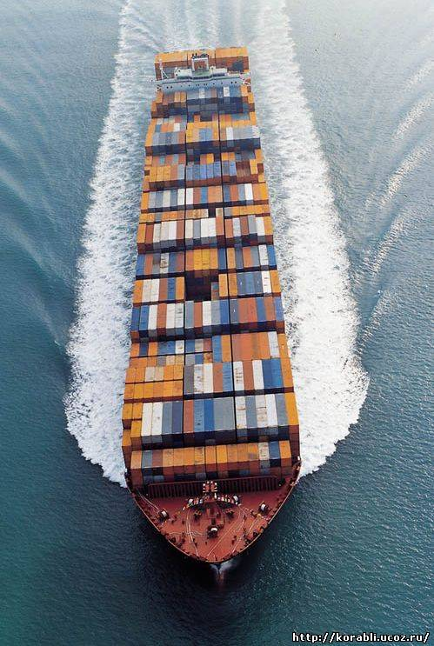
Так что это?
console: docker run …
docker-compose

Slide 81
Зачем docker-compose в Visual Studio?
Больший контроль за процессом
Можно указать произвольные env variables
Контролировать, что пойдет в production, а что останется у разработчиков
Поддержка решений из нескольких приложений
docker-compose = оркестратор
Внешние зависимости
Можно поднять вместе с приложением базу данных
Интеграционные тесты
Везде работает отладка

Slide 82
Результат scaffolding
Src
docker-compose.dcproj
docker-compose.yml
docker-compose.override.yml
WebApplication
WebApplication.sln

Slide 83
.dcproj – это как .csproj, но для docker
Src
docker-compose.dcproj
docker-compose.yml
docker-compose.override.yml
WebApplication
WebApplication.sln

Slide 84
docker-compose.dcproj
<?xml version="1.0" encoding="utf-8"?>
<Project ToolsVersion="15.0" Sdk="Microsoft.Docker.Sdk">
<PropertyGroup Label="Globals">
<ProjectVersion>2.1</ProjectVersion>
<DockerTargetOS>Linux</DockerTargetOS>
<ProjectGuid>c4c1bde9-e611-47ac-a05a-211d5dc21aa9</ProjectGuid>
<DockerLaunchAction>LaunchBrowser</DockerLaunchAction>
<DockerServiceUrl>{Scheme}://localhost:{ServicePort}</DockerServiceUrl>
<DockerServiceName>webapplication</DockerServiceName>
</PropertyGroup>
<ItemGroup>
<None Include="docker-compose.override.yml">
<DependentUpon>docker-compose.yml</DependentUpon>
</None>
<None Include="docker-compose.yml" />
<None Include=".dockerignore" />
</ItemGroup>
</Project>

Slide 85
docker-compose.dcproj
<?xml version="1.0" encoding="utf-8"?>
<Project ToolsVersion="15.0" Sdk="Microsoft.Docker.Sdk">
<PropertyGroup Label="Globals">
<ProjectVersion>2.1</ProjectVersion>
<DockerTargetOS>Linux</DockerTargetOS>
<ProjectGuid>c4c1bde9-e611-47ac-a05a-211d5dc21aa9</ProjectGuid>
<DockerLaunchAction>LaunchBrowser</DockerLaunchAction>
<DockerServiceUrl>{Scheme}://localhost:{ServicePort}</DockerServiceUrl>
<DockerServiceName>webapplication</DockerServiceName>
</PropertyGroup>
<ItemGroup>
<None Include="docker-compose.override.yml">
<DependentUpon>docker-compose.yml</DependentUpon>
</None>
<None Include="docker-compose.yml" />
<None Include=".dockerignore" />
</ItemGroup>
</Project>

Slide 86
docker-compose.yml
version: '3.4‘
services:
webapplication:
image: ${DOCKER_REGISTRY-}webapplication
build:
context: .
dockerfile: WebApplication/Dockerfile

Slide 87
docker-compose.yml
version: '3.4‘
services:
webapplication:
image: ${DOCKER_REGISTRY-}webapplication
build:
context: .
dockerfile: WebApplication/Dockerfile
Notes:
Контекст! Та же проблема с хождением назад

Slide 88
docker-compose.override.yml
version: '3.4'
services:
webapplication:
environment:
- ASPNETCORE_ENVIRONMENT=Development
ports:
- "80"

Slide 89
docker-compose.override.yml
version: '3.4'
services:
webapplication:
environment:
- ASPNETCORE_ENVIRONMENT=Development
ports:
- "80"

Slide 90
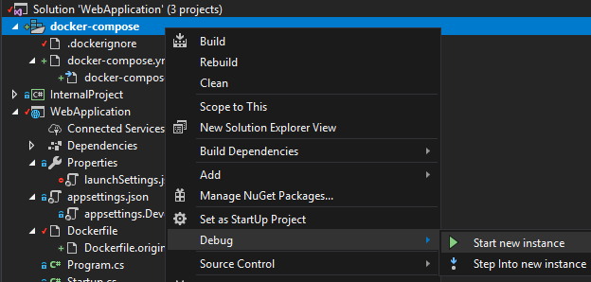
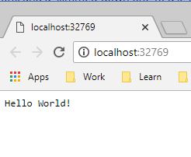
Запустим

Slide 91
Произвольный порт
version: '3.4'
services:
webapplication:
environment:
- ASPNETCORE_ENVIRONMENT=Development
ports:
- "80"

Slide 92
Произвольный порт
version: '3.4'
services:
webapplication:
environment:
- ASPNETCORE_ENVIRONMENT=Development
ports:
- "42421:80"

Slide 93
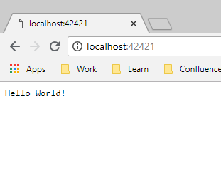
Произвольный порт: Запускаем
version: '3.4'
services:
webapplication:
environment:
- ASPNETCORE_Deve…
ports:
- "42421:80"

Slide 95
Go to logs
docker-compose
-f ".\src\WebApplication\docker-compose.yml"
-f ".\src\WebApplication\docker-compose.override.yml"
-f ".\src\WebApplication\obj\Docker\docker-compose.vs.debug.g.yml"
-p dockercompose14033542462966976843
--no-ansi config
Notes:
Посмотрим на логи

Slide 96
docker-compose.vs.debug.g.yml
version: '3.4'
services:
webapplication:
image: webapplication:dev
build:
target: base
environment:
- DOTNET_USE_POLLING_FILE_WATCHER=1
- NUGET_FALLBACK_PACKAGES=/root/.nuget/fallbackpackages
volumes:
- C:\Projects\my\presentations\2019_VisualStudio-And-Docker\src\WebApplication\WebApplication:/app
- C:\Users\Aleksandr_Kugushev\vsdbg\vs2017u5:/remote_debugger:ro
- C:\Users\Aleksandr_Kugushev\.nuget\packages\:/root/.nuget/packages:ro
- C:\Program Files\dotnet\sdk\NuGetFallbackFolder:/root/.nuget/fallbackpackages:ro
entrypoint: tail -f /dev/null
labels:
com.microsoft.visualstudio.debuggee.program: "dotnet"
com.microsoft.visualstudio.debuggee.arguments: " --additionalProbingPath /root/.nuget/packages --additionalProbingPath /root/.nuget/fallbackpackages bin/Debug/netcoreapp2.2/RenamedWebApplication.dll"
com.microsoft.visualstudio.debuggee.workingdirectory: "/app"
com.microsoft.visualstudio.debuggee.killprogram: "/bin/bash -c \"if PID=$$(pidof -x dotnet); then kill $$PID; fi\""

Slide 97
docker-compose.vs.debug.g.yml
version: '3.4'
services:
webapplication:
image: webapplication:dev
build:
target: base
version: '3.4'
services:
webapplication:
image: webapplication:dev
build:
target: base
environment:
- DOTNET_USE_POLLING_FILE_WATCHER=1
- NUGET_FALLBACK_PACKAGES=/root/.nuget/fallbackpackages
volumes:
- C:\Projects\my\presentations\2019_VisualStudio-And-Docker\src\WebApplication\WebApplication:/app
- C:\Users\Aleksandr_Kugushev\vsdbg\vs2017u5:/remote_debugger:ro
- C:\Users\Aleksandr_Kugushev\.nuget\packages\:/root/.nuget/packages:ro
- C:\Program Files\dotnet\sdk\NuGetFallbackFolder:/root/.nuget/fallbackpackages:ro
entrypoint: tail -f /dev/null
labels:
com.microsoft.visualstudio.debuggee.program: "dotnet"
com.microsoft.visualstudio.debuggee.arguments: " --additionalProbingPath /root/.nuget/packages --additionalProbingPath /root/.nuget/fallbackpackages bin/Debug/netcoreapp2.2/RenamedWebApplication.dll"
com.microsoft.visualstudio.debuggee.workingdirectory: "/app"
com.microsoft.visualstudio.debuggee.killprogram: "/bin/bash -c \"if PID=$$(pidof -x dotnet); then kill $$PID; fi\""

Slide 98
docker-compose.vs.debug.g.yml
FROM microsoft/dotnet:2.2-aspnetcore-runtime AS base
WORKDIR /app
EXPOSE 80
FROM microsoft/dotnet:2.2-sdk AS build
WORKDIR /src
COPY ["WebApplication/WebApplication.csproj", "WebApplication/"]
RUN dotnet restore "WebApplication/WebApplication.csproj"
COPY . .
WORKDIR "/src/WebApplication"
RUN dotnet build "WebApplication.csproj" -c Release -o /app
FROM build AS publish
RUN dotnet publish "WebApplication.csproj" -c Release -o /app
FROM base AS final
WORKDIR /app
COPY --from=publish /app .
ENTRYPOINT ["dotnet", "WebApplication.dll"]
version: '3.4'
services:
webapplication:
image: webapplication:dev
build:
target: base
version: '3.4'
services:
webapplication:
image: webapplication:dev
build:
target: base
environment:
- DOTNET_USE_POLLING_FILE_WATCHER=1
- NUGET_FALLBACK_PACKAGES=/root/.nuget/fallbackpackages
volumes:
- C:\Projects\my\presentations\2019_VisualStudio-And-Docker\src\WebApplication\WebApplication:/app
- C:\Users\Aleksandr_Kugushev\vsdbg\vs2017u5:/remote_debugger:ro
- C:\Users\Aleksandr_Kugushev\.nuget\packages\:/root/.nuget/packages:ro
- C:\Program Files\dotnet\sdk\NuGetFallbackFolder:/root/.nuget/fallbackpackages:ro
entrypoint: tail -f /dev/null
labels:
com.microsoft.visualstudio.debuggee.program: "dotnet"
com.microsoft.visualstudio.debuggee.arguments: " --additionalProbingPath /root/.nuget/packages --additionalProbingPath /root/.nuget/fallbackpackages bin/Debug/netcoreapp2.2/RenamedWebApplication.dll"
com.microsoft.visualstudio.debuggee.workingdirectory: "/app"
com.microsoft.visualstudio.debuggee.killprogram: "/bin/bash -c \"if PID=$$(pidof -x dotnet); then kill $$PID; fi\""

Slide 99
docker-compose.vs.debug.g.yml
FROM microsoft/dotnet:2.2-aspnetcore-runtime AS base
WORKDIR /app
EXPOSE 80
version: '3.4'
services:
webapplication:
image: webapplication:dev
build:
target: base
version: '3.4'
services:
webapplication:
image: webapplication:dev
build:
target: base
environment:
- DOTNET_USE_POLLING_FILE_WATCHER=1
- NUGET_FALLBACK_PACKAGES=/root/.nuget/fallbackpackages
volumes:
- C:\Projects\my\presentations\2019_VisualStudio-And-Docker\src\WebApplication\WebApplication:/app
- C:\Users\Aleksandr_Kugushev\vsdbg\vs2017u5:/remote_debugger:ro
- C:\Users\Aleksandr_Kugushev\.nuget\packages\:/root/.nuget/packages:ro
- C:\Program Files\dotnet\sdk\NuGetFallbackFolder:/root/.nuget/fallbackpackages:ro
entrypoint: tail -f /dev/null
labels:
com.microsoft.visualstudio.debuggee.program: "dotnet"
com.microsoft.visualstudio.debuggee.arguments: " --additionalProbingPath /root/.nuget/packages --additionalProbingPath /root/.nuget/fallbackpackages bin/Debug/netcoreapp2.2/RenamedWebApplication.dll"
com.microsoft.visualstudio.debuggee.workingdirectory: "/app"
com.microsoft.visualstudio.debuggee.killprogram: "/bin/bash -c \"if PID=$$(pidof -x dotnet); then kill $$PID; fi\""

Slide 100
docker-compose.vs.debug.g.yml
version: '3.4'
services:
webapplication:
image: webapplication:dev
build:
target: base
environment:
- DOTNET_USE_POLLING_FILE_WATCHER=1
- NUGET_FALLBACK_PACKAGES=/root/.nuget/fallbackpackages
volumes:
- C:\Projects\my\presentations\2019_VisualStudio-And-Docker\src\WebApplication\WebApplication:/app
- C:\Users\Aleksandr_Kugushev\vsdbg\vs2017u5:/remote_debugger:ro
- C:\Users\Aleksandr_Kugushev\.nuget\packages\:/root/.nuget/packages:ro
- C:\Program Files\dotnet\sdk\NuGetFallbackFolder:/root/.nuget/fallbackpackages:ro
entrypoint: tail -f /dev/null
labels:
com.microsoft.visualstudio.debuggee.program: "dotnet"
com.microsoft.visualstudio.debuggee.arguments: " --additionalProbingPath /root/.nuget/packages --additionalProbingPath /root/.nuget/fallbackpackages bin/Debug/netcoreapp2.2/RenamedWebApplication.dll"
com.microsoft.visualstudio.debuggee.workingdirectory: "/app"
com.microsoft.visualstudio.debuggee.killprogram: "/bin/bash -c \"if PID=$$(pidof -x dotnet); then kill $$PID; fi\""
environment:
- DOTNET_USE_POLLING_FILE_WATCHER=1
- NUGET_FALLBACK_PACKAGES=/root/.nuget/fallbackpackages
volumes:
- .\src\WebApplication\WebApplication:/app
- %HOMEPATH%\vsdbg\vs2017u5:/remote_debugger:ro
- %HOMEPATH%\.nuget\packages\:/root/.nuget/packages:ro
- C:\Program Files\dotnet\sdk\NuGetFallbackFolder:/root/.nuget/fallbackpackages:ro

Slide 101
docker-compose.vs.debug.g.yml
version: '3.4'
services:
webapplication:
image: webapplication:dev
build:
target: base
environment:
- DOTNET_USE_POLLING_FILE_WATCHER=1
- NUGET_FALLBACK_PACKAGES=/root/.nuget/fallbackpackages
volumes:
- C:\Projects\my\presentations\2019_VisualStudio-And-Docker\src\WebApplication\WebApplication:/app
- C:\Users\Aleksandr_Kugushev\vsdbg\vs2017u5:/remote_debugger:ro
- C:\Users\Aleksandr_Kugushev\.nuget\packages\:/root/.nuget/packages:ro
- C:\Program Files\dotnet\sdk\NuGetFallbackFolder:/root/.nuget/fallbackpackages:ro
entrypoint: tail -f /dev/null
labels:
com.microsoft.visualstudio.debuggee.program: "dotnet"
com.microsoft.visualstudio.debuggee.arguments: " --additionalProbingPath /root/.nuget/packages --additionalProbingPath /root/.nuget/fallbackpackages bin/Debug/netcoreapp2.2/RenamedWebApplication.dll"
com.microsoft.visualstudio.debuggee.workingdirectory: "/app"
com.microsoft.visualstudio.debuggee.killprogram: "/bin/bash -c \"if PID=$$(pidof -x dotnet); then kill $$PID; fi\""
entrypoint: tail -f /dev/null

Slide 102
docker-compose.vs.debug.g.yml
version: '3.4'
services:
webapplication:
image: webapplication:dev
build:
target: base
environment:
- DOTNET_USE_POLLING_FILE_WATCHER=1
- NUGET_FALLBACK_PACKAGES=/root/.nuget/fallbackpackages
volumes:
- C:\Projects\my\presentations\2019_VisualStudio-And-Docker\src\WebApplication\WebApplication:/app
- C:\Users\Aleksandr_Kugushev\vsdbg\vs2017u5:/remote_debugger:ro
- C:\Users\Aleksandr_Kugushev\.nuget\packages\:/root/.nuget/packages:ro
- C:\Program Files\dotnet\sdk\NuGetFallbackFolder:/root/.nuget/fallbackpackages:ro
entrypoint: tail -f /dev/null
labels:
com.microsoft.visualstudio.debuggee.program: "dotnet"
com.microsoft.visualstudio.debuggee.arguments: " --additionalProbingPath /root/.nuget/packages --additionalProbingPath /root/.nuget/fallbackpackages bin/Debug/netcoreapp2.2/RenamedWebApplication.dll"
com.microsoft.visualstudio.debuggee.workingdirectory: "/app"
com.microsoft.visualstudio.debuggee.killprogram: "/bin/bash -c \"if PID=$$(pidof -x dotnet); then kill $$PID; fi\""
labels:
com.microsoft.visualstudio.debuggee.program: "dotnet"
com.microsoft.visualstudio.debuggee.arguments: "
--additionalProbingPath /root/.nuget/packages
--additionalProbingPath /root/.nuget/fallbackpackages
bin/Debug/netcoreapp2.2/RenamedWebApplication.dll"
com.microsoft.visualstudio.debuggee.workingdirectory: "/app"
com.microsoft.visualstudio.debuggee.killprogram: “
/bin/bash -c \"if PID=$$(pidof -x dotnet); then kill $$PID; fi\""

Slide 103
Компоновка
docker-compose.yml
docker-compose.vs.debug.g.yml
result
docker-compose.override.yml
Pain #5: VS перестает работать, если имена сервисов в yml файлах
не соответствуют

Slide 104
Компоновка
docker-compose.yml
docker-compose.override.yml
docker-compose.vs.debug.g.yml
PRODUCTION
LOCAL
AUTO-GENERATED

Slide 105

Все что справедливо для «обычной» docker интеграции, справедливо и для compose

Slide 106
VS издевается над нашими Dockerfiles
FROM microsoft/dotnet:2.2-aspnetcore-runtime AS base
WORKDIR /app
EXPOSE 80
FROM microsoft/dotnet:2.2-sdk AS build
WORKDIR /src
COPY ["WebApplication/WebApplication.csproj", "WebApplication/"]
RUN dotnet restore "WebApplication/WebApplication.csproj"
COPY . .
WORKDIR "/src/WebApplication"
RUN dotnet build "WebApplication.csproj" -c Release -o /app
FROM build AS publish
RUN dotnet publish "WebApplication.csproj" -c Release -o /app
FROM base AS final
WORKDIR /app
COPY --from=publish /app .
ENTRYPOINT ["dotnet", "WebApplication.dll"]
Обрезает тело

Slide 107
VS издевается над нашими Dockerfiles
FROM microsoft/dotnet:2.2-aspnetcore-runtime AS base
WORKDIR /app
EXPOSE 80
Обрезает тело

Slide 108
VS издевается над нашими Dockerfiles
Обрезает тело
Привязывает к голове хвост
… --entrypoint tail webapplication:dev -f /dev/null
ИЛИ
…
entrypoint: tail -f /dev/null
…

Slide 109
VS издевается над нашими Dockerfiles
Обрезает тело
Привязывает к голове хвост
Путает порты
{
"iisSettings": {
"iisExpress": {
"sslPort": 44317
}
},
"profiles": {
"Docker": {
"commandName": "Docker",
"launchUrl": "{Scheme}://{ServiceH…
}
}
}

Slide 110
И взамен мы получаем
Обрезает тело
Привязывает к голове хвост
Путает порты
Из-коробки-отладку
Простой scaffolding
Богатые возможности
HAVE FUN

