Slide 1
Roslyn
How to start using it and save your mind

Slide 2
Why?
How can we use syntax tree?
How can we write a help generator?
How can we write a DTO generator?

Slide 3
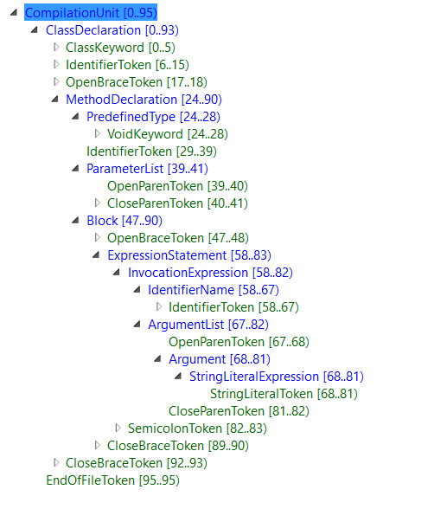
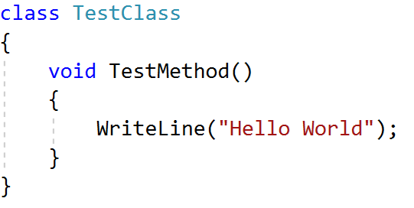
Syntax Tree

