Slide 1
Visual Studio + Docker = PainLove

Slide 2
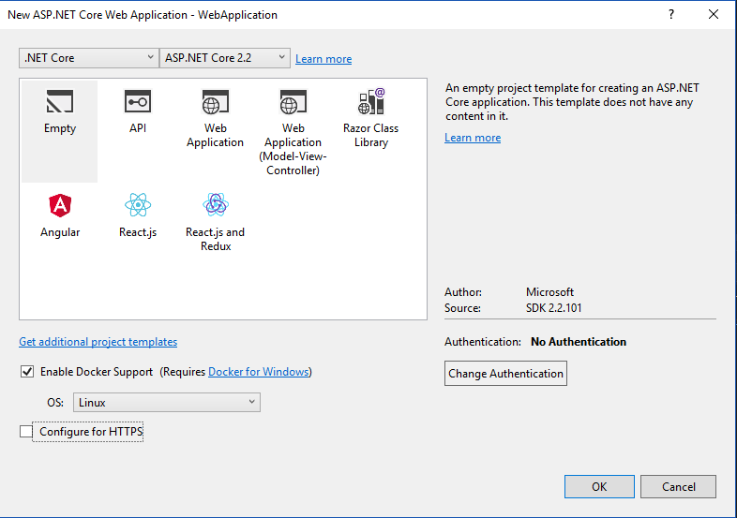

Slide 3
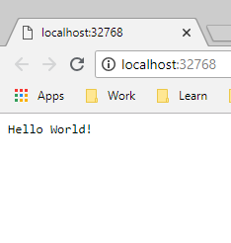
Запустим
Hosting environment: Development
Content root path: /app
Now listening on: http://[::]:80
Application started. Press Ctrl+C to shut down.

Slide 4
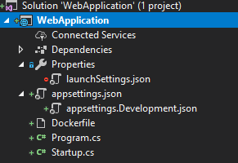
Результат scaffolding
Project
Properties
Dockerfile
[Name].csproj
launchSettings.json
…

Slide 5
launchSettings.json
{
"iisSettings": {
"windowsAuthentication": false,
"anonymousAuthentication": true,
"iisExpress": {
"applicationUrl": "http://localhost:50517",
"sslPort": 0
}
},
"profiles": {
"Docker": {
"commandName": "Docker",
"launchBrowser": true,
"launchUrl": "{Scheme}://{ServiceHost}:{ServicePort}"
}
}
}

