Slide 1
Unity – NullReferenceException =

Slide 2
About me

Slide 3

Billion Dollar Mistake
Notes:
Ни один доклад про Nullable Reference Types не обходится без фотографии этого человека

Slide 4

The Root Cause: Misunderstanding
TODO: add GetComponent class
How can we understand if the return type is not null? Or can?

Slide 5
How to express it?
TODO: example with [NotNull] and [Null] attributes
Problems:
Annotating every parameter and variable is annoying
We can’t guarantee that [NotNull] variable is really not null

Slide 6
How Nullable Reference Types work
Breaking change: by default, each variable/parameter is not null
Like the Nullable Value Types approach
You can annotate each variable/parameter with “can be null” (?) annotation
TODO: example
Compiler checks the full path of each variable/parameter
TODO: example (string? canBeNull = null; string notNull = canBeNull; (warning))
No runtime checks

Slide 7
Detailed example
Todo: from docs.microost

Slide 8
How to enable Nullable Reference Types?
Put #nullable enable to each class
Specify <Nullable>true</Nullable> to csproj
Add –nullable:enable parameter, e.g. dotnet build –nullable:enable

Slide 9

Demo

Slide 10
Summary
How to enable Nullable Reference Types?
Add Directory.Build.props to the root folder of your project
TODO: add content
Specify –nullable: enable to Player/Additional Compiler Arguments
TODO: add screenshot

Slide 11
Summary
How to deal with [SerializeField]?
Suppress with “= null!” or “=default!”
Check with pattern matching
TODO: add examples
Use assertion
Put file with attributes to your project (TODO: add it to github)
Create NullAssertMethod
TODO: add body of method

Slide 12
Summary
How to deal with UnityEngine API?
Specify “?” annotation to each API result
TODO: example with GetComponent
General Strategies
https://docs.microsoft.com/en-us/dotnet/csharp/nullable-migration-strategies

Slide 13
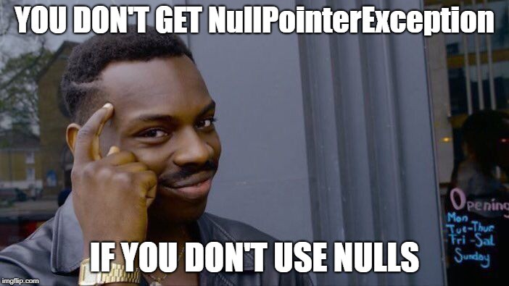
Conclusion

