Slide 1
Unity - NullReferenceException = ♥
How to use Nullable Reference Types in Unity

Slide 2

About Me
Kugushev Aleksandr
EPAM (Lead Software Engineer)
Podcast DotNet&More:
dotnetmore.ru
vk.com/dotnetmore
twitter.com/dotnetmore
t.me/dotnetmore

Slide 3
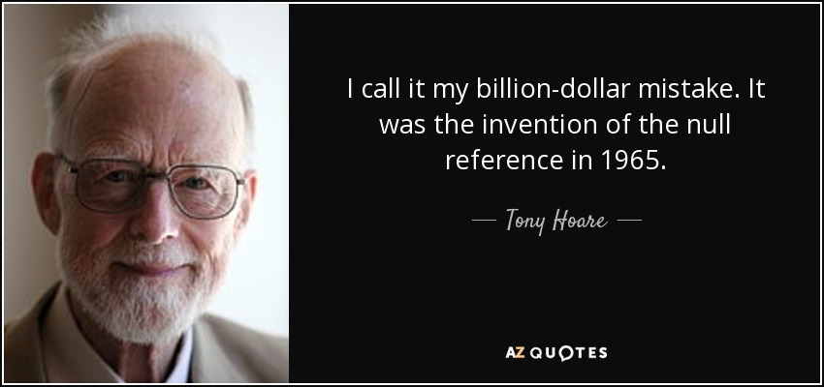
Billion Dollar Mistake
Notes:
Ни один доклад про Nullable Reference Types не обходится без фотографии этого человека

Slide 4
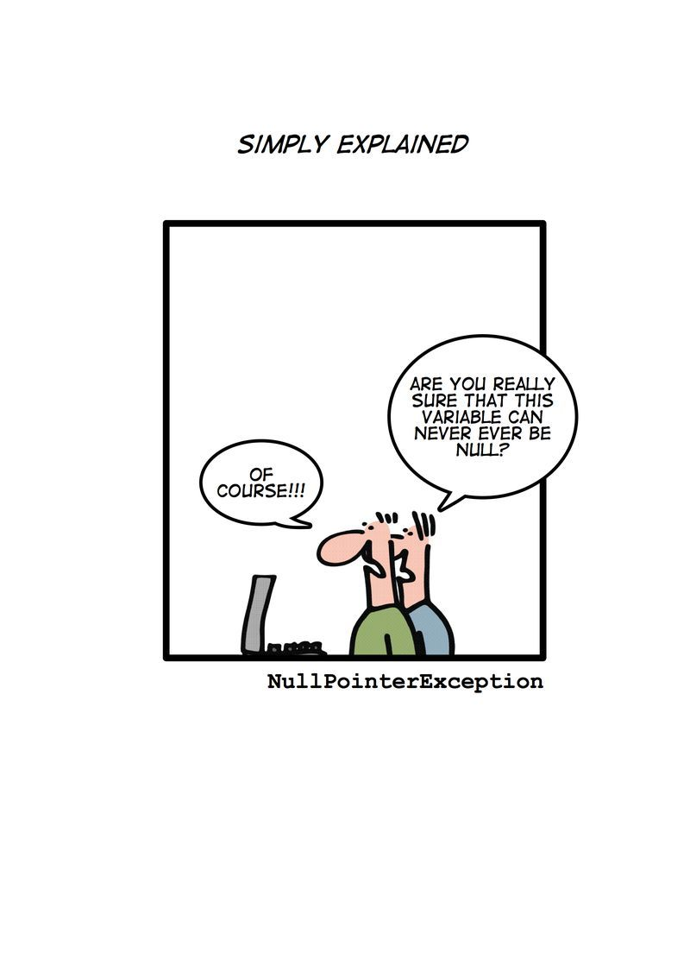
The Root Cause: Misunderstanding
var spriteRenderer = GetComponent<SpriteRenderer>();
How can we understand if the return type might return null?
How can we express in our methods that they might return null?
How can we be sure if the variable is not null?

Slide 5
How to express it?
[return:NotNull] string Method([NotNull] string notNullInput, string nullInput)
Problems:
Annotating every parameter and variable is annoying
The majority of variables are actually not nullable
We can’t guarantee that [NotNull] variable is really not null
Method(null, null);

Slide 6
How to express it?
string Method(string notNullInput, [Null] string nullInput)
Problems:
Annotating every parameter and variable is annoying
The majority of variables are actually not nullable
We can’t guarantee that [NotNull] variable is really not null
Method(null, null);

Slide 7
How to express it?
string Method(string notNullInput, string? nullInput)
Problems:
Annotating every parameter and variable is annoying
The majority of variables are actually not nullable
We can’t guarantee that [NotNull] variable is really not null
Method(null, null);

Slide 8
How to express it?
Static Code Analysis
string Method(string notNullInput, string? nullInput)
Problems:
Annotating every parameter and variable is annoying
The majority of variables are actually not nullable
We can’t guarantee that [NotNull] variable is really not null
Method(null, null);

Slide 9
How Nullable Reference Types work
Breaking changes: by default, each variable/parameter is not null
string Example(int notNullValueType, string notNullReferenceType)
You can annotate each variable/parameter with “can be null” (?) annotation
string? Example(int? nullableValueType, string? nullableReferenceType)
The compiler checks the full lifetime of each variable/parameter
string? nullable = null; string notNull = nullable;
No runtime checks
Warning: Converting null literal or possible null value to non-nullable type

Slide 10
How to enable Nullable Reference Types?
Put #nullable enable to each class
Specify <Nullable>enable</Nullable> to .csproj files
Add -nullable:enable compiler argument, e.g. dotnet build -nullable:enable

Slide 11

Demo

Slide 12
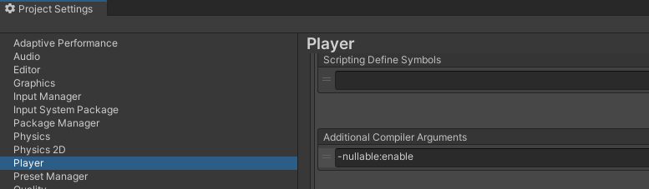
Summary
How to enable Nullable Reference Types?
Add Directory.Build.props to the root folder of your project
<Project> <PropertyGroup> <Nullable>enable</Nullable> </PropertyGroup> </Project>
Specify -nullable:enable to Player / Additional Compiler Arguments

Slide 13
Summary
How to deal with [SerializeField] and [Inject]?
Suppress with = null! or = default!
Check with pattern matching
if (field is null)
if (field is { })
Use assertion
Put file with attributes to your project : https://github.com/kugushev/unity-tools/blob/main/src/NullableAttributes.cs
public static void ThrowWhenNull([NotNull] object? value, string valueExpression = "") => _ = value ?? throw new ArgumentNullException(valueExpression);

Slide 14
Summary
How to deal with UnityEngine API?
Specify ? annotation to each API result
NavMeshAgent? agent = GetComponent<NavMeshAgent>();
Wrap API interaction by annotated classes
public static T? GetComponentNullable<T>(this MonoBehaviour monoBehaviour) where T : class => monoBehaviour.GetComponent<T>();
Use #nullable disable in UI Layer, it should implement interface declared in #nullable enable scope

Slide 15
Use #nullable disable in UI Layer, it should implement interface declared in #nullable enable scope
#nullable enable public interface IPathfinder { bool TryFindPath(Vector3 target, [NotNullWhen(true)] out IReadOnlyList<Vector3>? path); }
#nullable disable public class Pathfinder : MonoBehaviour, IPathfinder { public bool TryFindPath(Vector3 target, out IReadOnlyList<Vector3> path) { var agent = GetComponent<NavMeshAgent>(); if (agent == null) { path = null; return false; } var navMeshPath = new NavMeshPath(); bool success = agent.CalculatePath(target, navMeshPath); path = success ? null : navMeshPath.corners; return success; } }

Slide 16
Links
Tutorial: Express your design intent more clearly with nullable and non-nullable reference types: https://docs.microsoft.com/en-us/dotnet/csharp/whats-new/tutorials/nullable-reference-types
Nullability Attributes: https://github.com/kugushev/unity-tools/blob/main/src/NullableAttributes.cs
Reserved attributes contribute to the compiler's null state static analysis: https://docs.microsoft.com/en-us/dotnet/csharp/language-reference/attributes/nullable-analysis
Update libraries to use nullable reference types and communicate nullable rules to callers: https://docs.microsoft.com/en-us/dotnet/csharp/nullable-migration-strategies

