Slide 1
Visual Studio + Docker = PainLove

Slide 2
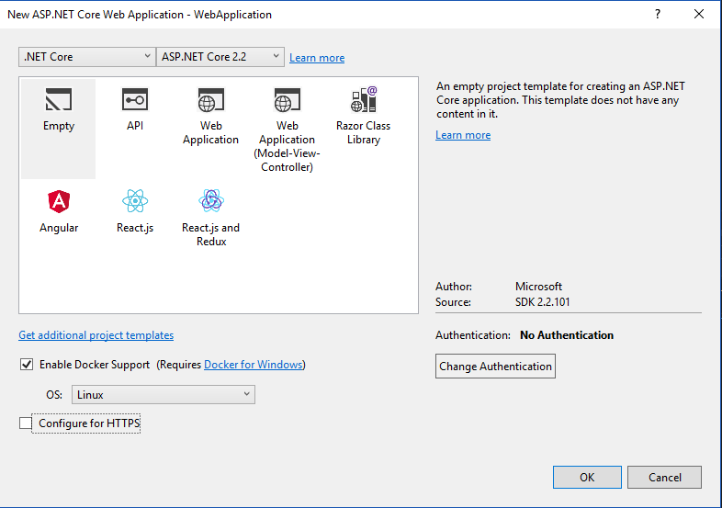

Slide 3
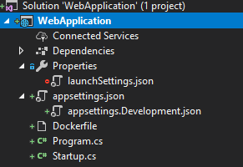
Результат scaffolding
Project
Properties
Dockerfile
[Name].csproj
launchSettings.json
…

Slide 4
launchSettings.json
{
"profiles": {
"Docker": {
"commandName": "Docker",
"launchBrowser": true,
"launchUrl": "{Scheme}://{ServiceHost}:{ServicePort}"
}
}
}

Slide 5
Dockerfile
FROM microsoft/dotnet:2.2-aspnetcore-runtime AS base
WORKDIR /app
EXPOSE 80
FROM microsoft/dotnet:2.2-sdk AS build
WORKDIR /src
COPY ["WebApplication/WebApplication.csproj", "WebApplication/"]
RUN dotnet restore "WebApplication/WebApplication.csproj"
COPY . .
WORKDIR "/src/WebApplication"
RUN dotnet build "WebApplication.csproj" -c Release -o /app
FROM build AS publish
RUN dotnet publish "WebApplication.csproj" -c Release -o /app
FROM base AS final
WORKDIR /app
COPY --from=publish /app .
ENTRYPOINT ["dotnet", "WebApplication.dll"]

Slide 6
Dockerfile
FROM microsoft/dotnet:2.2-aspnetcore-runtime AS base
WORKDIR /app
EXPOSE 80
FROM microsoft/dotnet:2.2-aspnetcore-runtime AS base
WORKDIR /app
EXPOSE 80
FROM microsoft/dotnet:2.2-sdk AS build
WORKDIR /src
COPY ["WebApplication/WebApplication.csproj", "WebApplication/"]
RUN dotnet restore "WebApplication/WebApplication.csproj"
COPY . .
WORKDIR "/src/WebApplication"
RUN dotnet build "WebApplication.csproj" -c Release -o /app
FROM build AS publish
RUN dotnet publish "WebApplication.csproj" -c Release -o /app
FROM base AS final
WORKDIR /app
COPY --from=publish /app .
ENTRYPOINT ["dotnet", "WebApplication.dll"]

Slide 7
Dockerfile
FROM microsoft/dotnet:2.2-aspnetcore-runtime AS base
WORKDIR /app
EXPOSE 80
FROM microsoft/dotnet:2.2-sdk AS build
WORKDIR /src
COPY ["WebApplication/WebApplication.csproj", "WebApplication/"]
RUN dotnet restore "WebApplication/WebApplication.csproj"
COPY . .
WORKDIR "/src/WebApplication"
RUN dotnet build "WebApplication.csproj" -c Release -o /app
FROM build AS publish
RUN dotnet publish "WebApplication.csproj" -c Release -o /app
FROM base AS final
WORKDIR /app
COPY --from=publish /app .
ENTRYPOINT ["dotnet", "WebApplication.dll"]
FROM microsoft/dotnet:2.2-aspnetcore-runtime AS base
WORKDIR /app
EXPOSE 80

Slide 8
Dockerfile
FROM microsoft/dotnet:2.2-aspnetcore-runtime AS base
WORKDIR /app
EXPOSE 80
FROM microsoft/dotnet:2.2-sdk AS build
WORKDIR /src
COPY ["WebApplication/WebApplication.csproj", "WebApplication/"]
RUN dotnet restore "WebApplication/WebApplication.csproj"
COPY . .
WORKDIR "/src/WebApplication"
RUN dotnet build "WebApplication.csproj" -c Release -o /app
FROM build AS publish
RUN dotnet publish "WebApplication.csproj" -c Release -o /app
FROM base AS final
WORKDIR /app
COPY --from=publish /app .
ENTRYPOINT ["dotnet", "WebApplication.dll"]
FROM microsoft/dotnet:2.2-sdk AS build
WORKDIR /src
COPY ["WebApplication/WebApplication.csproj", "WebApplication/"]
RUN dotnet restore "WebApplication/WebApplication.csproj"

Slide 9
Dockerfile
FROM microsoft/dotnet:2.2-aspnetcore-runtime AS base
WORKDIR /app
EXPOSE 80
FROM microsoft/dotnet:2.2-sdk AS build
WORKDIR /src
COPY ["WebApplication/WebApplication.csproj", "WebApplication/"]
RUN dotnet restore "WebApplication/WebApplication.csproj"
COPY . .
WORKDIR "/src/WebApplication"
RUN dotnet build "WebApplication.csproj" -c Release -o /app
FROM build AS publish
RUN dotnet publish "WebApplication.csproj" -c Release -o /app
FROM base AS final
WORKDIR /app
COPY --from=publish /app .
ENTRYPOINT ["dotnet", "WebApplication.dll"]
COPY . .
WORKDIR "/src/WebApplication"
RUN dotnet build "WebApplication.csproj" -c Release -o /app

Slide 10
Dockerfile
FROM microsoft/dotnet:2.2-aspnetcore-runtime AS base
WORKDIR /app
EXPOSE 80
FROM microsoft/dotnet:2.2-sdk AS build
WORKDIR /src
COPY ["WebApplication/WebApplication.csproj", "WebApplication/"]
RUN dotnet restore "WebApplication/WebApplication.csproj"
COPY . .
WORKDIR "/src/WebApplication"
RUN dotnet build "WebApplication.csproj" -c Release -o /app
FROM build AS publish
RUN dotnet publish "WebApplication.csproj" -c Release -o /app
FROM base AS final
WORKDIR /app
COPY --from=publish /app .
ENTRYPOINT ["dotnet", "WebApplication.dll"]
FROM build AS publish
RUN dotnet publish "WebApplication.csproj" -c Release -o /app

Slide 11
Dockerfile
FROM microsoft/dotnet:2.2-aspnetcore-runtime AS base
WORKDIR /app
EXPOSE 80
FROM microsoft/dotnet:2.2-sdk AS build
WORKDIR /src
COPY ["WebApplication/WebApplication.csproj", "WebApplication/"]
RUN dotnet restore "WebApplication/WebApplication.csproj"
COPY . .
WORKDIR "/src/WebApplication"
RUN dotnet build "WebApplication.csproj" -c Release -o /app
FROM build AS publish
RUN dotnet publish "WebApplication.csproj" -c Release -o /app
FROM base AS final
WORKDIR /app
COPY --from=publish /app .
ENTRYPOINT ["dotnet", "WebApplication.dll"]
FROM base AS final
WORKDIR /app
COPY --from=publish /app .
ENTRYPOINT ["dotnet", "WebApplication.dll"]

Slide 12
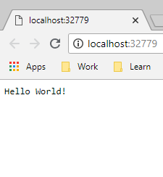
Запустим
Откуда такой порт?
Hosting environment: Development
Content root path: /app
Now listening on: http://[::]:80
Application started. Press Ctrl+C to shut down.

Slide 13
Что же у нас в консоли? > docker ps -a
IMAGE | COMMAND | PORTS | NAMES
webapplication:dev | "tail -f /dev/null" | 0.0.0.0:32779->80/tcp | stupefied_goldwasser

Slide 14
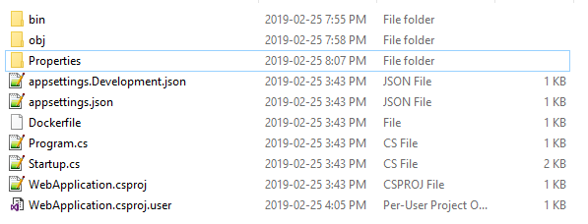
Содержимое
RUN

Slide 15
Output window: Build
docker build -f "C:\Projects\my\presentations\2019_VisualStudio-And-Docker\src\WebApplication\WebApplication\Dockerfile" -t webapplication:dev --target base --label "com.microsoft.created-by=visual-studio" "C:\Projects\my\presentations\2019_VisualStudio-And-Docker\src\WebApplication"
Sending build context to Docker daemon 15.87kB
Step 1/4 : FROM microsoft/dotnet:2.2-aspnetcore-runtime AS base
---> 41db56126a6d
Step 2/4 : WORKDIR /app
---> Using cache
---> 7e759ee3b751
Step 3/4 : EXPOSE 80
---> Using cache
---> 7038720edcae
Step 4/4 : LABEL com.microsoft.created-by=visual-studio
---> Using cache
---> e4a97a881e70
Successfully built e4a97a881e70
Successfully tagged webapplication:dev
docker run -dt -v "C:\Users\Aleksandr_Kugushev\vsdbg\vs2017u5:/remote_debugger:rw" -v "C:\Projects\my\presentations\2019_VisualStudio-And-Docker\src\WebApplication\WebApplication:/app" -v "C:\Users\Aleksandr_Kugushev\.nuget\packages\:/root/.nuget/fallbackpackages2" -v "C:\Program Files\dotnet\sdk\NuGetFallbackFolder:/root/.nuget/fallbackpackages" -e "DOTNET_USE_POLLING_FILE_WATCHER=1" -e "ASPNETCORE_ENVIRONMENT=Development" -e "NUGET_PACKAGES=/root/.nuget/fallbackpackages2" -e "NUGET_FALLBACK_PACKAGES=/root/.nuget/fallbackpackages;/root/.nuget/fallbackpackages2" -P --entrypoint tail webapplication:dev -f /dev/null
39f6ec93ea66536bdc4da5648c49a9acc408081cb1cd6a8cafdcced4ef5e4695

Slide 16
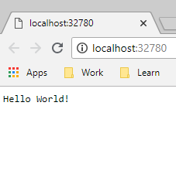
Запускаем еще раз
Откуда этот порт?
Почему в контейнере dev/null command?
Как оно вообще работает?

