Slide 1
Visual Studio + Docker = PainLove

Slide 2
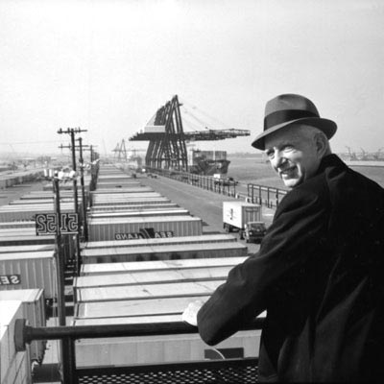
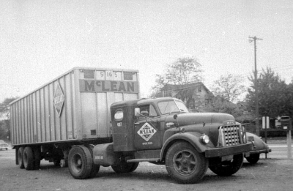
Контейнерная революция
Notes:
Малкольм Маклин

Slide 3
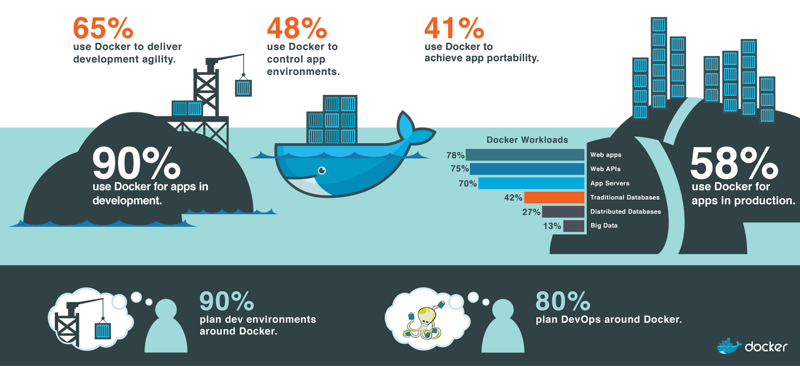
Docker

Slide 4
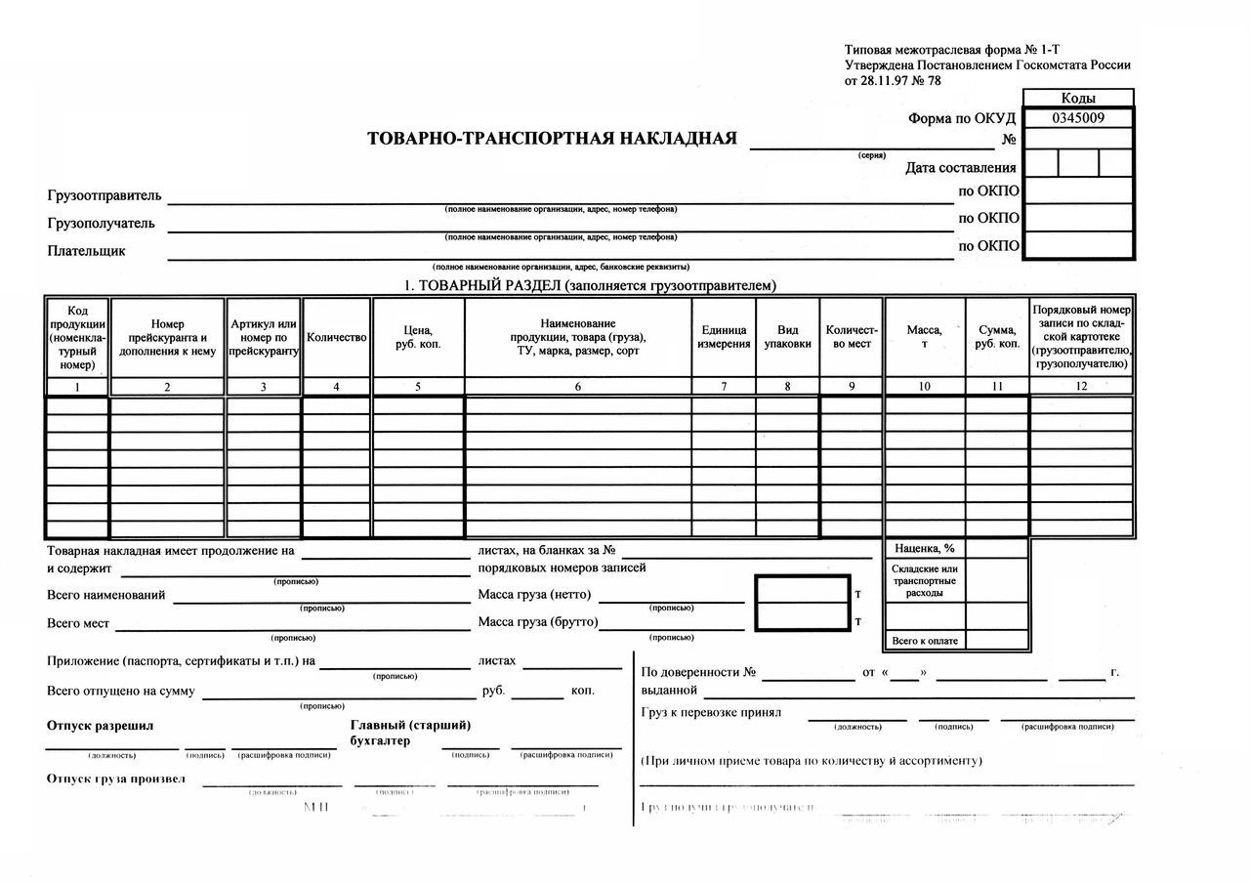
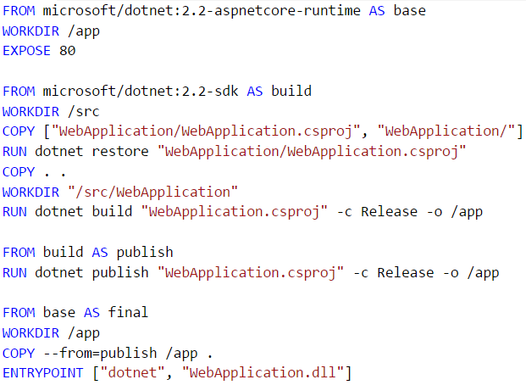
Workflow: Описание
Накладная
Dockerfile

Slide 5
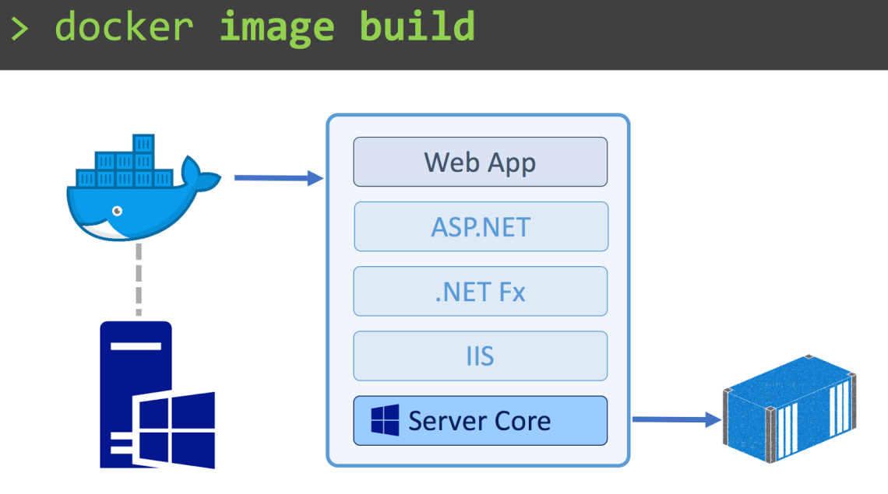
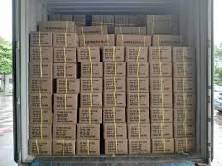
Workflow: Упаковка
Погрузка товара
Docker Image

Slide 6
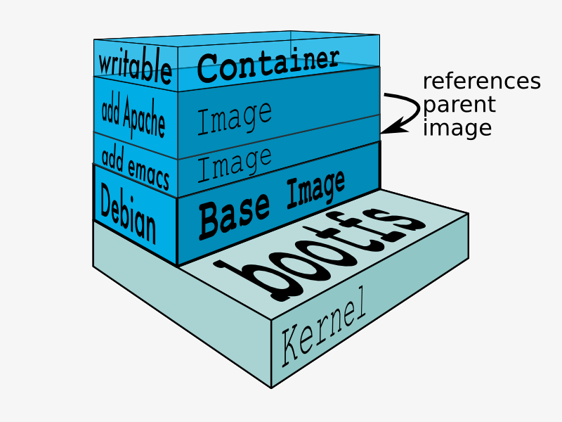
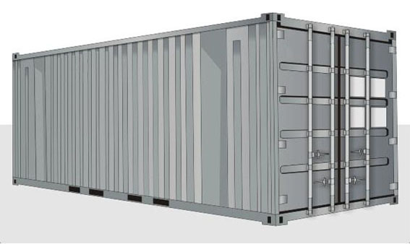
Workflow: Формирование
TEU Контейнер
Docker Container

Slide 7
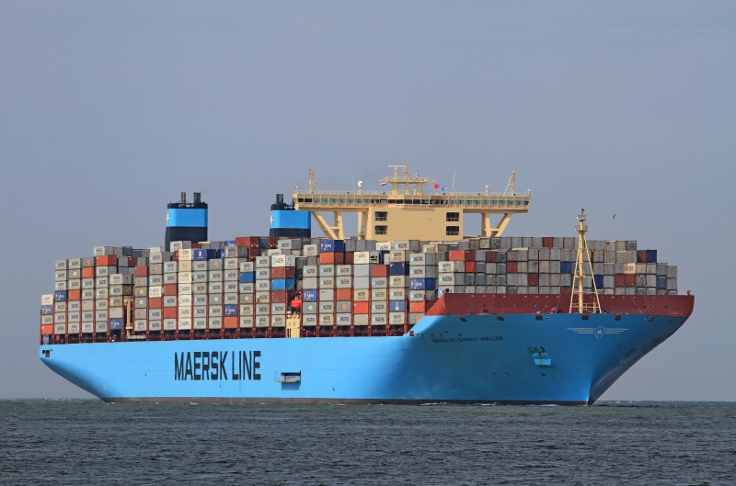
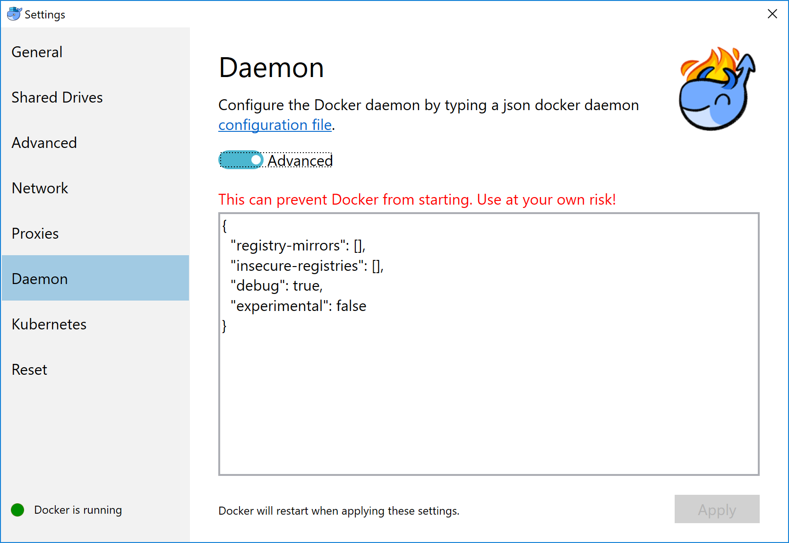
Workflow: Отправка
Контейнеровоз
Docker Daemon

Slide 8

Docker for Windows

Slide 9
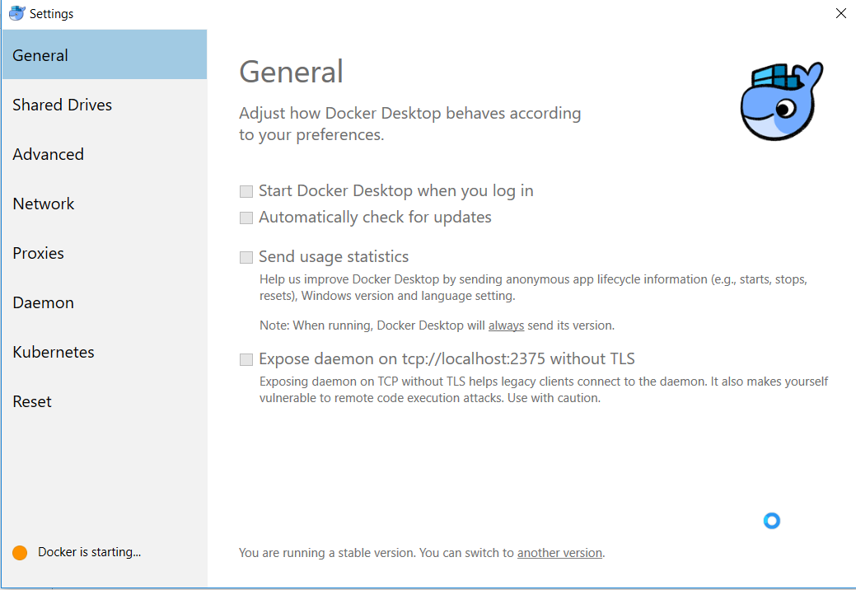
Docker for Windows

Slide 10
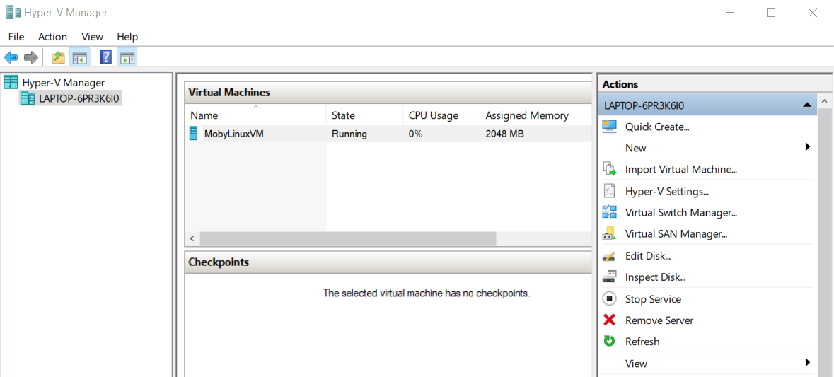
Hyper-V

Slide 11
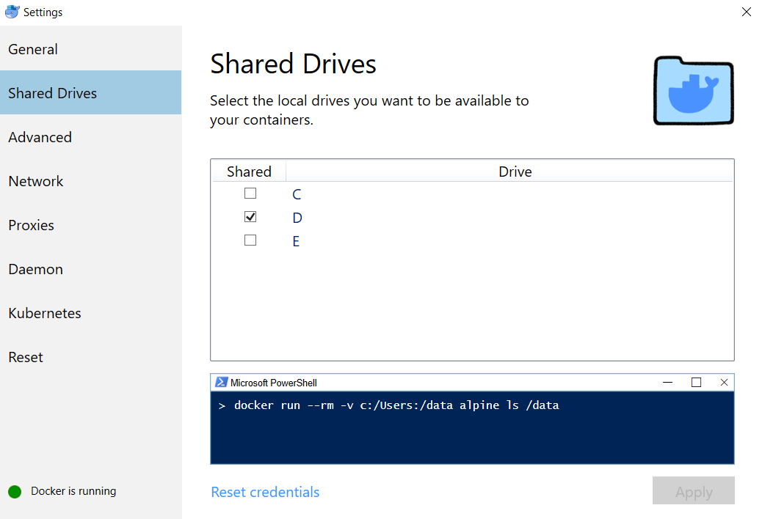
Shared file system

Slide 12
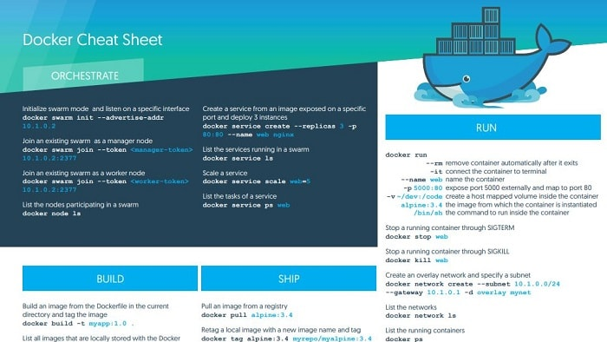
Notes:
Вообще, работать с докером немного страшненько. Консоль надо использовать.

Slide 13
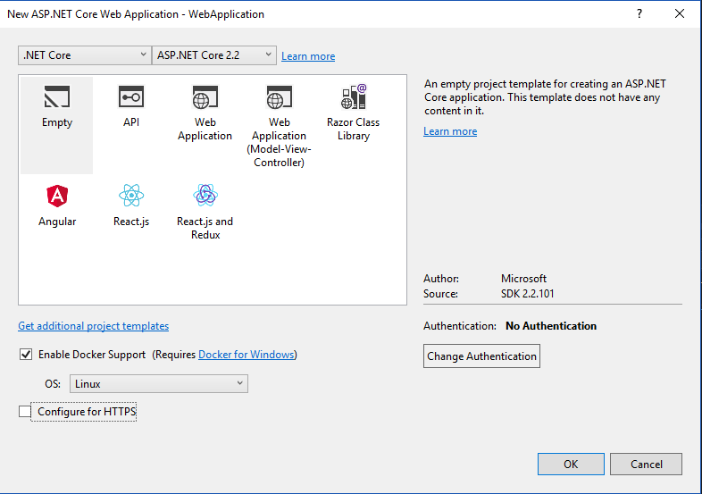
Notes:
Microsoft обещает нам

Slide 14
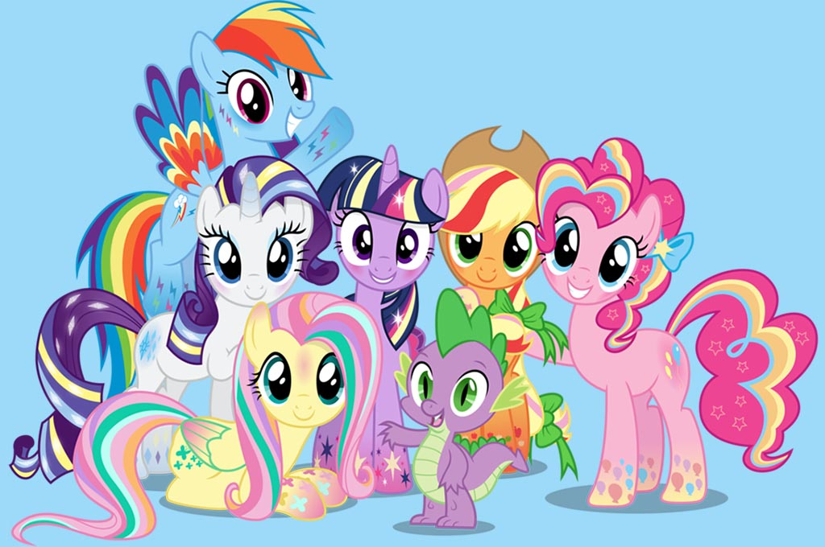
Docker + Visual Studio
Building
Debugging
Running
???
PROFIT
БОЛЬ!!!
Notes:
Тот же experience как и с обычными приложениями
Боль потому что нельзя просто взять и получить тот же experience, всегда будут компромисы

Slide 15
Зачем Docker + Visual Studio?
Входная точка для новичков
dotnet new … => все работает
Отладка
Всей команде не обязательно знать docker

Slide 16
Notes:
Давайте разберемся, как оно работает

Slide 17
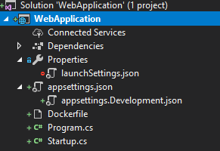
Результат scaffolding
Project
Properties
Dockerfile
[Name].csproj
launchSettings.json
…

Slide 18
launchSettings.json
{
"profiles": {
"Docker": {
"commandName": "Docker",
"launchBrowser": true,
"launchUrl": "{Scheme}://{ServiceHost}:{ServicePort}"
}
}
}

Slide 19
Dockerfile
FROM microsoft/dotnet:2.2-aspnetcore-runtime AS base
WORKDIR /app
EXPOSE 80
FROM microsoft/dotnet:2.2-sdk AS build
WORKDIR /src
COPY ["WebApplication/WebApplication.csproj", "WebApplication/"]
RUN dotnet restore "WebApplication/WebApplication.csproj"
COPY . .
WORKDIR "/src/WebApplication"
RUN dotnet build "WebApplication.csproj" -c Release -o /app
FROM build AS publish
RUN dotnet publish "WebApplication.csproj" -c Release -o /app
FROM base AS final
WORKDIR /app
COPY --from=publish /app .
ENTRYPOINT ["dotnet", "WebApplication.dll"]

Slide 20
Dockerfile
FROM microsoft/dotnet:2.2-aspnetcore-runtime AS base
WORKDIR /app
EXPOSE 80
FROM microsoft/dotnet:2.2-aspnetcore-runtime AS base
WORKDIR /app
EXPOSE 80
FROM microsoft/dotnet:2.2-sdk AS build
WORKDIR /src
COPY ["WebApplication/WebApplication.csproj", "WebApplication/"]
RUN dotnet restore "WebApplication/WebApplication.csproj"
COPY . .
WORKDIR "/src/WebApplication"
RUN dotnet build "WebApplication.csproj" -c Release -o /app
FROM build AS publish
RUN dotnet publish "WebApplication.csproj" -c Release -o /app
FROM base AS final
WORKDIR /app
COPY --from=publish /app .
ENTRYPOINT ["dotnet", "WebApplication.dll"]

Slide 21
Dockerfile
FROM microsoft/dotnet:2.2-aspnetcore-runtime AS base
WORKDIR /app
EXPOSE 80
FROM microsoft/dotnet:2.2-sdk AS build
WORKDIR /src
COPY ["WebApplication/WebApplication.csproj", "WebApplication/"]
RUN dotnet restore "WebApplication/WebApplication.csproj"
COPY . .
WORKDIR "/src/WebApplication"
RUN dotnet build "WebApplication.csproj" -c Release -o /app
FROM build AS publish
RUN dotnet publish "WebApplication.csproj" -c Release -o /app
FROM base AS final
WORKDIR /app
COPY --from=publish /app .
ENTRYPOINT ["dotnet", "WebApplication.dll"]
FROM microsoft/dotnet:2.2-aspnetcore-runtime AS base
WORKDIR /app
EXPOSE 80

Slide 22
Dockerfile
FROM microsoft/dotnet:2.2-aspnetcore-runtime AS base
WORKDIR /app
EXPOSE 80
FROM microsoft/dotnet:2.2-sdk AS build
WORKDIR /src
COPY ["WebApplication/WebApplication.csproj", "WebApplication/"]
RUN dotnet restore "WebApplication/WebApplication.csproj"
COPY . .
WORKDIR "/src/WebApplication"
RUN dotnet build "WebApplication.csproj" -c Release -o /app
FROM build AS publish
RUN dotnet publish "WebApplication.csproj" -c Release -o /app
FROM base AS final
WORKDIR /app
COPY --from=publish /app .
ENTRYPOINT ["dotnet", "WebApplication.dll"]
FROM microsoft/dotnet:2.2-sdk AS build
WORKDIR /src
COPY ["WebApplication/WebApplication.csproj", "WebApplication/"]
RUN dotnet restore "WebApplication/WebApplication.csproj"

Slide 23
Dockerfile
FROM microsoft/dotnet:2.2-aspnetcore-runtime AS base
WORKDIR /app
EXPOSE 80
FROM microsoft/dotnet:2.2-sdk AS build
WORKDIR /src
COPY ["WebApplication/WebApplication.csproj", "WebApplication/"]
RUN dotnet restore "WebApplication/WebApplication.csproj"
COPY . .
WORKDIR "/src/WebApplication"
RUN dotnet build "WebApplication.csproj" -c Release -o /app
FROM build AS publish
RUN dotnet publish "WebApplication.csproj" -c Release -o /app
FROM base AS final
WORKDIR /app
COPY --from=publish /app .
ENTRYPOINT ["dotnet", "WebApplication.dll"]
COPY . .
WORKDIR "/src/WebApplication"
RUN dotnet build "WebApplication.csproj" -c Release -o /app

Slide 24
Dockerfile
FROM microsoft/dotnet:2.2-aspnetcore-runtime AS base
WORKDIR /app
EXPOSE 80
FROM microsoft/dotnet:2.2-sdk AS build
WORKDIR /src
COPY ["WebApplication/WebApplication.csproj", "WebApplication/"]
RUN dotnet restore "WebApplication/WebApplication.csproj"
COPY . .
WORKDIR "/src/WebApplication"
RUN dotnet build "WebApplication.csproj" -c Release -o /app
FROM build AS publish
RUN dotnet publish "WebApplication.csproj" -c Release -o /app
FROM base AS final
WORKDIR /app
COPY --from=publish /app .
ENTRYPOINT ["dotnet", "WebApplication.dll"]
FROM build AS publish
RUN dotnet publish "WebApplication.csproj" -c Release -o /app

Slide 25
Dockerfile
FROM microsoft/dotnet:2.2-aspnetcore-runtime AS base
WORKDIR /app
EXPOSE 80
FROM microsoft/dotnet:2.2-sdk AS build
WORKDIR /src
COPY ["WebApplication/WebApplication.csproj", "WebApplication/"]
RUN dotnet restore "WebApplication/WebApplication.csproj"
COPY . .
WORKDIR "/src/WebApplication"
RUN dotnet build "WebApplication.csproj" -c Release -o /app
FROM build AS publish
RUN dotnet publish "WebApplication.csproj" -c Release -o /app
FROM base AS final
WORKDIR /app
COPY --from=publish /app .
ENTRYPOINT ["dotnet", "WebApplication.dll"]
FROM base AS final
WORKDIR /app
COPY --from=publish /app .
ENTRYPOINT ["dotnet", "WebApplication.dll"]

Slide 26
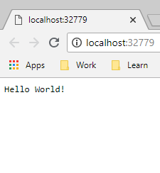
Запустим
Откуда такой порт?
Hosting environment: Development
Content root path: /app
Now listening on: http://[::]:80
Application started. Press Ctrl+C to shut down.

Slide 27
Что же у нас в консоли? > docker ps -a
IMAGE | COMMAND | PORTS | NAMES
webapplication:dev | "tail -f /dev/null" | 0.0.0.0:32779->80/tcp | stupefied_goldwasser

Slide 28
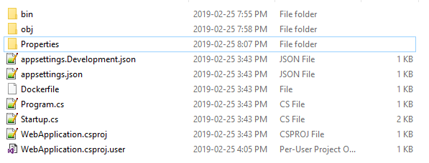
Содержимое
RUN

Slide 29
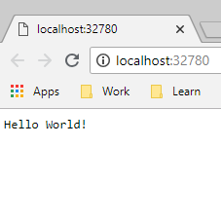
Запускаем еще раз
Pain #1: порт может меняться
В том числе и при clean project
Счетчик сбрасывается при перезагрузке
При колизии происходит инкремент
Notes:
TODO: в хардкорной версии запилить больше подробностей – порт меняется после перезагрузки + инкрементится если контейнер уже занят

Slide 30
Output window: Build
docker build -f "C:\Projects\my\presentations\2019_VisualStudio-And-Docker\src\WebApplication\WebApplication\Dockerfile" -t webapplication:dev --target base --label "com.microsoft.created-by=visual-studio" "C:\Projects\my\presentations\2019_VisualStudio-And-Docker\src\WebApplication"
Sending build context to Docker daemon 15.87kB
Step 1/4 : FROM microsoft/dotnet:2.2-aspnetcore-runtime AS base
---> 41db56126a6d
Step 2/4 : WORKDIR /app
---> Using cache
---> 7e759ee3b751
Step 3/4 : EXPOSE 80
---> Using cache
---> 7038720edcae
Step 4/4 : LABEL com.microsoft.created-by=visual-studio
---> Using cache
---> e4a97a881e70
Successfully built e4a97a881e70
Successfully tagged webapplication:dev
docker run -dt -v "C:\Users\Aleksandr_Kugushev\vsdbg\vs2017u5:/remote_debugger:rw" -v "C:\Projects\my\presentations\2019_VisualStudio-And-Docker\src\WebApplication\WebApplication:/app" -v "C:\Users\Aleksandr_Kugushev\.nuget\packages\:/root/.nuget/fallbackpackages2" -v "C:\Program Files\dotnet\sdk\NuGetFallbackFolder:/root/.nuget/fallbackpackages" -e "DOTNET_USE_POLLING_FILE_WATCHER=1" -e "ASPNETCORE_ENVIRONMENT=Development" -e "NUGET_PACKAGES=/root/.nuget/fallbackpackages2" -e "NUGET_FALLBACK_PACKAGES=/root/.nuget/fallbackpackages;/root/.nuget/fallbackpackages2" -P --entrypoint tail webapplication:dev -f /dev/null
39f6ec93ea66536bdc4da5648c49a9acc408081cb1cd6a8cafdcced4ef5e4695

Slide 31
Output window: Build
docker build -f ".\WebApplication\WebApplication\Dockerfile"
-t webapplication:dev
--target base
--label "com.microsoft.created-by=visual-studio"
“.\WebApplication"
docker build -f "C:\Projects\my\presentations\2019_VisualStudio-And-Docker\src\WebApplication\WebApplication\Dockerfile" -t webapplication:dev --target base --label "com.microsoft.created-by=visual-studio" "C:\Projects\my\presentations\2019_VisualStudio-And-Docker\src\WebApplication"
Sending build context to Docker daemon 15.87kB
Step 1/4 : FROM microsoft/dotnet:2.2-aspnetcore-runtime AS base
---> 41db56126a6d
Step 2/4 : WORKDIR /app
---> Using cache
---> 7e759ee3b751
Step 3/4 : EXPOSE 80
---> Using cache
---> 7038720edcae
Step 4/4 : LABEL com.microsoft.created-by=visual-studio
---> Using cache
---> e4a97a881e70
Successfully built e4a97a881e70
Successfully tagged webapplication:dev
docker run -dt -v "C:\Users\Aleksandr_Kugushev\vsdbg\vs2017u5:/remote_debugger:rw" -v "C:\Projects\my\presentations\2019_VisualStudio-And-Docker\src\WebApplication\WebApplication:/app" -v "C:\Users\Aleksandr_Kugushev\.nuget\packages\:/root/.nuget/fallbackpackages2" -v "C:\Program Files\dotnet\sdk\NuGetFallbackFolder:/root/.nuget/fallbackpackages" -e "DOTNET_USE_POLLING_FILE_WATCHER=1" -e "ASPNETCORE_ENVIRONMENT=Development" -e "NUGET_PACKAGES=/root/.nuget/fallbackpackages2" -e "NUGET_FALLBACK_PACKAGES=/root/.nuget/fallbackpackages;/root/.nuget/fallbackpackages2" -P --entrypoint tail webapplication:dev -f /dev/null
39f6ec93ea66536bdc4da5648c49a9acc408081cb1cd6a8cafdcced4ef5e4695

Slide 32
Dockerfile
FROM microsoft/dotnet:2.2-aspnetcore-runtime AS base
WORKDIR /app
EXPOSE 80
FROM microsoft/dotnet:2.2-sdk AS build
WORKDIR /src
COPY ["WebApplication/WebApplication.csproj", "WebApplication/"]
RUN dotnet restore "WebApplication/WebApplication.csproj"
COPY . .
WORKDIR "/src/WebApplication"
RUN dotnet build "WebApplication.csproj" -c Release -o /app
FROM build AS publish
RUN dotnet publish "WebApplication.csproj" -c Release -o /app
FROM base AS final
WORKDIR /app
COPY --from=publish /app .
ENTRYPOINT ["dotnet", "WebApplication.dll"]

Slide 33
Dockerfile
FROM microsoft/dotnet:2.2-aspnetcore-runtime AS base
WORKDIR /app
EXPOSE 80
FROM microsoft/dotnet:2.2-sdk AS build
WORKDIR /src
COPY ["WebApplication/WebApplication.csproj", "WebApplication/"]
RUN dotnet restore "WebApplication/WebApplication.csproj"
COPY . .
WORKDIR "/src/WebApplication"
RUN dotnet build "WebApplication.csproj" -c Release -o /app
FROM build AS publish
RUN dotnet publish "WebApplication.csproj" -c Release -o /app
FROM base AS final
WORKDIR /app
COPY --from=publish /app .
ENTRYPOINT ["dotnet", "WebApplication.dll"]

Slide 34
Output window: Build
docker build -f "C:\Projects\my\presentations\2019_VisualStudio-And-Docker\src\WebApplication\WebApplication\Dockerfile" -t webapplication:dev --target base --label "com.microsoft.created-by=visual-studio" "C:\Projects\my\presentations\2019_VisualStudio-And-Docker\src\WebApplication"
Sending build context to Docker daemon 15.87kB
Step 1/4 : FROM microsoft/dotnet:2.2-aspnetcore-runtime AS base
---> 41db56126a6d
Step 2/4 : WORKDIR /app
---> Using cache
---> 7e759ee3b751
Step 3/4 : EXPOSE 80
---> Using cache
---> 7038720edcae
Step 4/4 : LABEL com.microsoft.created-by=visual-studio
---> Using cache
---> e4a97a881e70
Successfully built e4a97a881e70
Successfully tagged webapplication:dev
docker run -dt -v "C:\Users\Aleksandr_Kugushev\vsdbg\vs2017u5:/remote_debugger:rw" -v "C:\Projects\my\presentations\2019_VisualStudio-And-Docker\src\WebApplication\WebApplication:/app" -v "C:\Users\Aleksandr_Kugushev\.nuget\packages\:/root/.nuget/fallbackpackages2" -v "C:\Program Files\dotnet\sdk\NuGetFallbackFolder:/root/.nuget/fallbackpackages" -e "DOTNET_USE_POLLING_FILE_WATCHER=1" -e "ASPNETCORE_ENVIRONMENT=Development" -e "NUGET_PACKAGES=/root/.nuget/fallbackpackages2" -e "NUGET_FALLBACK_PACKAGES=/root/.nuget/fallbackpackages;/root/.nuget/fallbackpackages2" -P --entrypoint tail webapplication:dev -f /dev/null
39f6ec93ea66536bdc4da5648c49a9acc408081cb1cd6a8cafdcced4ef5e4695
Sending build context to Docker daemon 15.87kB
Step 1/4 : FROM microsoft/dotnet:2.2-aspnetcore-runtime AS base
---> 41db56126a6d
Step 2/4 : WORKDIR /app
---> Using cache
---> 7e759ee3b751
Step 3/4 : EXPOSE 80
---> Using cache
---> 7038720edcae
Step 4/4 : LABEL com.microsoft.created-by=visual-studio
---> Using cache
---> e4a97a881e70
Successfully built e4a97a881e70
Successfully tagged webapplication:dev

Slide 35
Output window: Build
docker build -f "C:\Projects\my\presentations\2019_VisualStudio-And-Docker\src\WebApplication\WebApplication\Dockerfile" -t webapplication:dev --target base --label "com.microsoft.created-by=visual-studio" "C:\Projects\my\presentations\2019_VisualStudio-And-Docker\src\WebApplication"
Sending build context to Docker daemon 15.87kB
Step 1/4 : FROM microsoft/dotnet:2.2-aspnetcore-runtime AS base
---> 41db56126a6d
Step 2/4 : WORKDIR /app
---> Using cache
---> 7e759ee3b751
Step 3/4 : EXPOSE 80
---> Using cache
---> 7038720edcae
Step 4/4 : LABEL com.microsoft.created-by=visual-studio
---> Using cache
---> e4a97a881e70
Successfully built e4a97a881e70
Successfully tagged webapplication:dev
docker run -dt -v "C:\Users\Aleksandr_Kugushev\vsdbg\vs2017u5:/remote_debugger:rw" -v "C:\Projects\my\presentations\2019_VisualStudio-And-Docker\src\WebApplication\WebApplication:/app" -v "C:\Users\Aleksandr_Kugushev\.nuget\packages\:/root/.nuget/fallbackpackages2" -v "C:\Program Files\dotnet\sdk\NuGetFallbackFolder:/root/.nuget/fallbackpackages" -e "DOTNET_USE_POLLING_FILE_WATCHER=1" -e "ASPNETCORE_ENVIRONMENT=Development" -e "NUGET_PACKAGES=/root/.nuget/fallbackpackages2" -e "NUGET_FALLBACK_PACKAGES=/root/.nuget/fallbackpackages;/root/.nuget/fallbackpackages2" -P --entrypoint tail webapplication:dev -f /dev/null
39f6ec93ea66536bdc4da5648c49a9acc408081cb1cd6a8cafdcced4ef5e4695

Slide 36
Output window: Build
docker build -f "C:\Projects\my\presentations\2019_VisualStudio-And-Docker\src\WebApplication\WebApplication\Dockerfile" -t webapplication:dev --target base --label "com.microsoft.created-by=visual-studio" "C:\Projects\my\presentations\2019_VisualStudio-And-Docker\src\WebApplication"
Sending build context to Docker daemon 15.87kB
Step 1/4 : FROM microsoft/dotnet:2.2-aspnetcore-runtime AS base
---> 41db56126a6d
Step 2/4 : WORKDIR /app
---> Using cache
---> 7e759ee3b751
Step 3/4 : EXPOSE 80
---> Using cache
---> 7038720edcae
Step 4/4 : LABEL com.microsoft.created-by=visual-studio
---> Using cache
---> e4a97a881e70
Successfully built e4a97a881e70
Successfully tagged webapplication:dev
docker run -dt -v "C:\Users\Aleksandr_Kugushev\vsdbg\vs2017u5:/remote_debugger:rw" -v "C:\Projects\my\presentations\2019_VisualStudio-And-Docker\src\WebApplication\WebApplication:/app" -v "C:\Users\Aleksandr_Kugushev\.nuget\packages\:/root/.nuget/fallbackpackages2" -v "C:\Program Files\dotnet\sdk\NuGetFallbackFolder:/root/.nuget/fallbackpackages" -e "DOTNET_USE_POLLING_FILE_WATCHER=1" -e "ASPNETCORE_ENVIRONMENT=Development" -e "NUGET_PACKAGES=/root/.nuget/fallbackpackages2" -e "NUGET_FALLBACK_PACKAGES=/root/.nuget/fallbackpackages;/root/.nuget/fallbackpackages2" -P --entrypoint tail webapplication:dev -f /dev/null
39f6ec93ea66536bdc4da5648c49a9acc408081cb1cd6a8cafdcced4ef5e4695
docker run -dt
-v "C:\Users\...\vsdbg\vs2017u5:/remote_debugger:rw"
-v “.\WebApplication\WebApplication:/app"
-v "C:\Users\...\.nuget\packages\:/root/.nuget/fallbackpackages2"
-v "C:\Program Files\dotnet\sdk\NuGetFallbackFolder:/root/.nuget/fallbackpackages"
-e "DOTNET_USE_POLLING_FILE_WATCHER=1" -e "ASPNETCORE_ENVIRONMENT=Development"
-e "NUGET_PACKAGES=/root/.nuget/fallbackpackages2"
-e "NUGET_FALLBACK_PACKAGES=/root/.nuget/fallbackpackages;/root/.nuget/fallbackpackages2"
-P --entrypoint tail webapplication:dev -f /dev/null

Slide 37
Заглянем в контейнер
docker container top <container_id>
tail -f /dev/null
/remote_debugger/vsdbg --interpreter=vscode
/usr/bin/dotnet --additionalProbingPath /root/.nuget/fallbackpackages2 --additionalProbingPath /root/.nuget/fallbackpackages bin/Debug/netcoreapp2.2/WebApplication.dll

Slide 38
Так как же оно работает?
Visual Studio собирает dll локально
В docker image вырезается все, кроме базового образа
Контейнер запускается
C подключением volumes с собранными dll и дополнительными библиотеками
Пустым entry point
В запущенном контейнер с помощью exec запускается отладчик VsDbg: aka.ms/getvsdbgsh
Pain #2: Ваши dockerized приложения работают не идентично

Slide 39
Проблема с Add Existing Project
src
WebApplication
WebApplication
WebApplication.sln
ExternalProject
WebApplication.csproj
ExternalProject.csproj

Slide 40
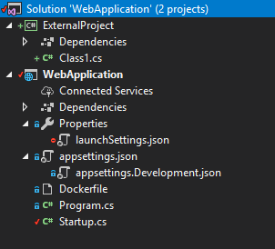
Проблема с Add Existing Project
Добавим существующий проект в Solution
Добавим ссылку на него
Запустим

Slide 41
Проблема с Add Existing Project
Добавим новый проект
Добавим ссылку на него
Запустим
Success

Slide 42
Проблема с Add Existing Project
docker build -f .\WebApplication\Dockerfile .
Step 10/16 : RUN dotnet build "WebApplication.csproj" -c Release -o /app
---> Running in 136094fbaed6
Microsoft (R) Build Engine version 15.9.20+g88f5fadfbe for .NET Core
Copyright (C) Microsoft Corporation. All rights reserved.
Skipping project "/ExternalProject/ExternalProject.csproj" because it was not found.
Restore completed in 56.78 ms for /src/WebApplication/WebApplication.csproj.
/usr/share/dotnet/sdk/2.2.104/Microsoft.Common.CurrentVersion.targets(1879,5): warning : The referenced project '../../ExternalProject/ExternalProject.csproj' does not exist. [/src/WebApplication/WebApplication.csproj]
Startup.cs(5,7): error CS0246: The type or namespace name 'ExternalProject' could not be found (are you missing a using directive or an assembly reference?) [/src/WebApplication/WebApplication.csproj]
Build FAILED.

Slide 43
Помните про контекст
src
WebApplication (.)
WebApplication
WebApplication.sln
ExternalProject
WebApplication.csproj
ExternalProject.csproj
Notes:
Это

Slide 44
Помните про контекст
Reference projects
NuGet.config
Resources

Slide 45
Помните про контекст
src
WebApplication (.)
WebApplication
ExternalProject
WebApplication.csproj
ExternalProject.csproj
WebApplication.sln
Notes:
Это

Slide 46
Помните про контекст
src
WebApplication (.)
WebApplication
InternalProject
WebApplication.csproj
InternalProject.csproj
WebApplication.sln
Notes:
Это

Slide 47
А как же Release?
docker build -f "C:\Projects\my\presentations\2019_VisualStudio-And-Docker\src\WebApplication\WebApplication\Dockerfile" -t webapplication --label "com.microsoft.created-by=visual-studio" "C:\Projects\my\presentations\2019_VisualStudio-And-Docker\src\WebApplication"
Sending build context to Docker daemon 15.87kB
Step 1/17 : FROM microsoft/dotnet:2.2-aspnetcore-runtime AS base
Step 2/17 : WORKDIR /app
---> 41db56126a6d
---> Using cache
---> 7e759ee3b751
Step 3/17 : EXPOSE 80
---> Using cache
---> 7038720edcae
Step 4/17 : FROM microsoft/dotnet:2.2-sdk AS build
Step 5/17 : WORKDIR /src
---> d5dbee97f68e
---> 850d5d91e4d2
Step 6/17 : COPY ["WebApplication/WebApplication.csproj", "WebApplication/"]
---> Using cache
---> c1ae3917c28c
Step 7/17 : RUN dotnet restore "WebApplication/WebApplication.csproj"
---> Running in 613f8b34ceaa
Restoring packages for /src/WebApplication/WebApplication.csproj...
Installing Microsoft.VisualStudio.Azure.Containers.Tools.Targets 1.0.2105168.
Generating MSBuild file /src/WebApplication/obj/WebApplication.csproj.nuget.g.props.
Generating MSBuild file /src/WebApplication/obj/WebApplication.csproj.nuget.g.targets.
Restore completed in 3.73 sec for /src/WebApplication/WebApplication.csproj.
Removing intermediate container 613f8b34ceaa
---> f4daf8a2b7e3
Step 8/17 : COPY . .
---> ad5d885d623e
Step 9/17 : WORKDIR "/src/WebApplication"
---> Running in a16ab71b95d6
Removing intermediate container a16ab71b95d6
Step 10/17 : RUN dotnet build "WebApplication.csproj" -c Release -o /app
---> cfc45b064f9c
---> Running in e3d5d9dcf82e
Microsoft (R) Build Engine version 15.9.20+g88f5fadfbe for .NET Core
Copyright (C) Microsoft Corporation. All rights reserved.
Restore completed in 44.79 ms for /src/WebApplication/WebApplication.csproj.
WebApplication -> /app/WebApplication.dll
Build succeeded.
0 Warning(s)
0 Error(s)
Time Elapsed 00:00:03.23
Removing intermediate container e3d5d9dcf82e
---> 0a36051d4b1a
Step 11/17 : FROM build AS publish
---> 0a36051d4b1a
Step 12/17 : RUN dotnet publish "WebApplication.csproj" -c Release -o /app
---> Running in 8cd7da93d9bd
Microsoft (R) Build Engine version 15.9.20+g88f5fadfbe for .NET Core
Copyright (C) Microsoft Corporation. All rights reserved.
Restore completed in 45.93 ms for /src/WebApplication/WebApplication.csproj.
WebApplication -> /src/WebApplication/bin/Release/netcoreapp2.2/WebApplication.dll
WebApplication -> /app/
Removing intermediate container 8cd7da93d9bd
---> 98522599fd9a
Step 13/17 : FROM base AS final
---> 7038720edcae
Step 14/17 : WORKDIR /app
---> Running in bdcce4b3939c
Removing intermediate container bdcce4b3939c
---> 602aa5e49c2d
Step 15/17 : COPY --from=publish /app .
---> 2b6fcec6c77f
Step 16/17 : ENTRYPOINT ["dotnet", "WebApplication.dll"]
---> Running in c3090d23667f
Removing intermediate container c3090d23667f
---> cdde2be12ec1
Step 17/17 : LABEL com.microsoft.created-by=visual-studio
---> Running in de34daeb46f8
Removing intermediate container de34daeb46f8
---> 08008fb9e5b6
Successfully built 08008fb9e5b6
Successfully tagged webapplication:latest
SECURITY WARNING: You are building a Docker image from Windows against a non-Windows Docker host. All files and directories added to build context will have '-rwxr-xr-x' permissions. It is recommended to double check and reset permissions for sensitive files and directories.
docker run -dt -v "C:\Users\Aleksandr_Kugushev\vsdbg\vs2017u5:/remote_debugger:rw" -e "ASPNETCORE_ENVIRONMENT=Development" -P --entrypoint tail webapplication -f /dev/null
d16a24df8b4adebb9b388085c616b9a6ea73247746b4c71544174d52b2d1317e

Slide 48
А как же Release?
docker build -f “.\WebApplication\WebApplication\Dockerfile"
-t webapplication
--label "com.microsoft.created-by=visual-studio"
“.\WebApplication"
docker build -f "C:\Projects\my\presentations\2019_VisualStudio-And-Docker\src\WebApplication\WebApplication\Dockerfile" -t webapplication --label "com.microsoft.created-by=visual-studio" "C:\Projects\my\presentations\2019_VisualStudio-And-Docker\src\WebApplication"
Sending build context to Docker daemon 15.87kB
Step 1/17 : FROM microsoft/dotnet:2.2-aspnetcore-runtime AS base
Step 2/17 : WORKDIR /app
---> 41db56126a6d
---> Using cache
---> 7e759ee3b751
Step 3/17 : EXPOSE 80
---> Using cache
---> 7038720edcae
Step 4/17 : FROM microsoft/dotnet:2.2-sdk AS build
Step 5/17 : WORKDIR /src
---> d5dbee97f68e
---> 850d5d91e4d2
Step 6/17 : COPY ["WebApplication/WebApplication.csproj", "WebApplication/"]
---> Using cache
---> c1ae3917c28c
Step 7/17 : RUN dotnet restore "WebApplication/WebApplication.csproj"
---> Running in 613f8b34ceaa
Restoring packages for /src/WebApplication/WebApplication.csproj...
Installing Microsoft.VisualStudio.Azure.Containers.Tools.Targets 1.0.2105168.
Generating MSBuild file /src/WebApplication/obj/WebApplication.csproj.nuget.g.props.
Generating MSBuild file /src/WebApplication/obj/WebApplication.csproj.nuget.g.targets.
Restore completed in 3.73 sec for /src/WebApplication/WebApplication.csproj.
Removing intermediate container 613f8b34ceaa
---> f4daf8a2b7e3
Step 8/17 : COPY . .
---> ad5d885d623e
Step 9/17 : WORKDIR "/src/WebApplication"
---> Running in a16ab71b95d6
Removing intermediate container a16ab71b95d6
Step 10/17 : RUN dotnet build "WebApplication.csproj" -c Release -o /app
---> cfc45b064f9c
---> Running in e3d5d9dcf82e
Microsoft (R) Build Engine version 15.9.20+g88f5fadfbe for .NET Core
Copyright (C) Microsoft Corporation. All rights reserved.
Restore completed in 44.79 ms for /src/WebApplication/WebApplication.csproj.
WebApplication -> /app/WebApplication.dll
Build succeeded.
0 Warning(s)
0 Error(s)
Time Elapsed 00:00:03.23
Removing intermediate container e3d5d9dcf82e
---> 0a36051d4b1a
Step 11/17 : FROM build AS publish
---> 0a36051d4b1a
Step 12/17 : RUN dotnet publish "WebApplication.csproj" -c Release -o /app
---> Running in 8cd7da93d9bd
Microsoft (R) Build Engine version 15.9.20+g88f5fadfbe for .NET Core
Copyright (C) Microsoft Corporation. All rights reserved.
Restore completed in 45.93 ms for /src/WebApplication/WebApplication.csproj.
WebApplication -> /src/WebApplication/bin/Release/netcoreapp2.2/WebApplication.dll
WebApplication -> /app/
Removing intermediate container 8cd7da93d9bd
---> 98522599fd9a
Step 13/17 : FROM base AS final
---> 7038720edcae
Step 14/17 : WORKDIR /app
---> Running in bdcce4b3939c
Removing intermediate container bdcce4b3939c
---> 602aa5e49c2d
Step 15/17 : COPY --from=publish /app .
---> 2b6fcec6c77f
Step 16/17 : ENTRYPOINT ["dotnet", "WebApplication.dll"]
---> Running in c3090d23667f
Removing intermediate container c3090d23667f
---> cdde2be12ec1
Step 17/17 : LABEL com.microsoft.created-by=visual-studio
---> Running in de34daeb46f8
Removing intermediate container de34daeb46f8
---> 08008fb9e5b6
Successfully built 08008fb9e5b6
Successfully tagged webapplication:latest
SECURITY WARNING: You are building a Docker image from Windows against a non-Windows Docker host. All files and directories added to build context will have '-rwxr-xr-x' permissions. It is recommended to double check and reset permissions for sensitive files and directories.
docker run -dt -v "C:\Users\Aleksandr_Kugushev\vsdbg\vs2017u5:/remote_debugger:rw" -e "ASPNETCORE_ENVIRONMENT=Development" -P --entrypoint tail webapplication -f /dev/null
d16a24df8b4adebb9b388085c616b9a6ea73247746b4c71544174d52b2d1317e
Notes:
Target не подменяется

Slide 49
А как же Release?
docker build -f "C:\Projects\my\presentations\2019_VisualStudio-And-Docker\src\WebApplication\WebApplication\Dockerfile" -t webapplication --label "com.microsoft.created-by=visual-studio" "C:\Projects\my\presentations\2019_VisualStudio-And-Docker\src\WebApplication"
Sending build context to Docker daemon 15.87kB
Step 1/17 : FROM microsoft/dotnet:2.2-aspnetcore-runtime AS base
Step 2/17 : WORKDIR /app
---> 41db56126a6d
---> Using cache
---> 7e759ee3b751
Step 3/17 : EXPOSE 80
---> Using cache
---> 7038720edcae
Step 4/17 : FROM microsoft/dotnet:2.2-sdk AS build
Step 5/17 : WORKDIR /src
---> d5dbee97f68e
---> 850d5d91e4d2
Step 6/17 : COPY ["WebApplication/WebApplication.csproj", "WebApplication/"]
---> Using cache
---> c1ae3917c28c
Step 7/17 : RUN dotnet restore "WebApplication/WebApplication.csproj"
---> Running in 613f8b34ceaa
Restoring packages for /src/WebApplication/WebApplication.csproj...
Installing Microsoft.VisualStudio.Azure.Containers.Tools.Targets 1.0.2105168.
Generating MSBuild file /src/WebApplication/obj/WebApplication.csproj.nuget.g.props.
Generating MSBuild file /src/WebApplication/obj/WebApplication.csproj.nuget.g.targets.
Restore completed in 3.73 sec for /src/WebApplication/WebApplication.csproj.
Removing intermediate container 613f8b34ceaa
---> f4daf8a2b7e3
Step 8/17 : COPY . .
---> ad5d885d623e
Step 9/17 : WORKDIR "/src/WebApplication"
---> Running in a16ab71b95d6
Removing intermediate container a16ab71b95d6
Step 10/17 : RUN dotnet build "WebApplication.csproj" -c Release -o /app
---> cfc45b064f9c
---> Running in e3d5d9dcf82e
Microsoft (R) Build Engine version 15.9.20+g88f5fadfbe for .NET Core
Copyright (C) Microsoft Corporation. All rights reserved.
Restore completed in 44.79 ms for /src/WebApplication/WebApplication.csproj.
WebApplication -> /app/WebApplication.dll
Build succeeded.
0 Warning(s)
0 Error(s)
Time Elapsed 00:00:03.23
Removing intermediate container e3d5d9dcf82e
---> 0a36051d4b1a
Step 11/17 : FROM build AS publish
---> 0a36051d4b1a
Step 12/17 : RUN dotnet publish "WebApplication.csproj" -c Release -o /app
---> Running in 8cd7da93d9bd
Microsoft (R) Build Engine version 15.9.20+g88f5fadfbe for .NET Core
Copyright (C) Microsoft Corporation. All rights reserved.
Restore completed in 45.93 ms for /src/WebApplication/WebApplication.csproj.
WebApplication -> /src/WebApplication/bin/Release/netcoreapp2.2/WebApplication.dll
WebApplication -> /app/
Removing intermediate container 8cd7da93d9bd
---> 98522599fd9a
Step 13/17 : FROM base AS final
---> 7038720edcae
Step 14/17 : WORKDIR /app
---> Running in bdcce4b3939c
Removing intermediate container bdcce4b3939c
---> 602aa5e49c2d
Step 15/17 : COPY --from=publish /app .
---> 2b6fcec6c77f
Step 16/17 : ENTRYPOINT ["dotnet", "WebApplication.dll"]
---> Running in c3090d23667f
Removing intermediate container c3090d23667f
---> cdde2be12ec1
Step 17/17 : LABEL com.microsoft.created-by=visual-studio
---> Running in de34daeb46f8
Removing intermediate container de34daeb46f8
---> 08008fb9e5b6
Successfully built 08008fb9e5b6
Successfully tagged webapplication:latest
SECURITY WARNING: You are building a Docker image from Windows against a non-Windows Docker host. All files and directories added to build context will have '-rwxr-xr-x' permissions. It is recommended to double check and reset permissions for sensitive files and directories.
docker run -dt -v "C:\Users\Aleksandr_Kugushev\vsdbg\vs2017u5:/remote_debugger:rw" -e "ASPNETCORE_ENVIRONMENT=Development" -P --entrypoint tail webapplication -f /dev/null
d16a24df8b4adebb9b388085c616b9a6ea73247746b4c71544174d52b2d1317e

Slide 50
А как же Release?
docker build -f "C:\Projects\my\presentations\2019_VisualStudio-And-Docker\src\WebApplication\WebApplication\Dockerfile" -t webapplication --label "com.microsoft.created-by=visual-studio" "C:\Projects\my\presentations\2019_VisualStudio-And-Docker\src\WebApplication"
Sending build context to Docker daemon 15.87kB
Step 1/17 : FROM microsoft/dotnet:2.2-aspnetcore-runtime AS base
Step 2/17 : WORKDIR /app
---> 41db56126a6d
---> Using cache
---> 7e759ee3b751
Step 3/17 : EXPOSE 80
---> Using cache
---> 7038720edcae
Step 4/17 : FROM microsoft/dotnet:2.2-sdk AS build
Step 5/17 : WORKDIR /src
---> d5dbee97f68e
---> 850d5d91e4d2
Step 6/17 : COPY ["WebApplication/WebApplication.csproj", "WebApplication/"]
---> Using cache
---> c1ae3917c28c
Step 7/17 : RUN dotnet restore "WebApplication/WebApplication.csproj"
---> Running in 613f8b34ceaa
Restoring packages for /src/WebApplication/WebApplication.csproj...
Installing Microsoft.VisualStudio.Azure.Containers.Tools.Targets 1.0.2105168.
Generating MSBuild file /src/WebApplication/obj/WebApplication.csproj.nuget.g.props.
Generating MSBuild file /src/WebApplication/obj/WebApplication.csproj.nuget.g.targets.
Restore completed in 3.73 sec for /src/WebApplication/WebApplication.csproj.
Removing intermediate container 613f8b34ceaa
---> f4daf8a2b7e3
Step 8/17 : COPY . .
---> ad5d885d623e
Step 9/17 : WORKDIR "/src/WebApplication"
---> Running in a16ab71b95d6
Removing intermediate container a16ab71b95d6
Step 10/17 : RUN dotnet build "WebApplication.csproj" -c Release -o /app
---> cfc45b064f9c
---> Running in e3d5d9dcf82e
Microsoft (R) Build Engine version 15.9.20+g88f5fadfbe for .NET Core
Copyright (C) Microsoft Corporation. All rights reserved.
Restore completed in 44.79 ms for /src/WebApplication/WebApplication.csproj.
WebApplication -> /app/WebApplication.dll
Build succeeded.
0 Warning(s)
0 Error(s)
Time Elapsed 00:00:03.23
Removing intermediate container e3d5d9dcf82e
---> 0a36051d4b1a
Step 11/17 : FROM build AS publish
---> 0a36051d4b1a
Step 12/17 : RUN dotnet publish "WebApplication.csproj" -c Release -o /app
---> Running in 8cd7da93d9bd
Microsoft (R) Build Engine version 15.9.20+g88f5fadfbe for .NET Core
Copyright (C) Microsoft Corporation. All rights reserved.
Restore completed in 45.93 ms for /src/WebApplication/WebApplication.csproj.
WebApplication -> /src/WebApplication/bin/Release/netcoreapp2.2/WebApplication.dll
WebApplication -> /app/
Removing intermediate container 8cd7da93d9bd
---> 98522599fd9a
Step 13/17 : FROM base AS final
---> 7038720edcae
Step 14/17 : WORKDIR /app
---> Running in bdcce4b3939c
Removing intermediate container bdcce4b3939c
---> 602aa5e49c2d
Step 15/17 : COPY --from=publish /app .
---> 2b6fcec6c77f
Step 16/17 : ENTRYPOINT ["dotnet", "WebApplication.dll"]
---> Running in c3090d23667f
Removing intermediate container c3090d23667f
---> cdde2be12ec1
Step 17/17 : LABEL com.microsoft.created-by=visual-studio
---> Running in de34daeb46f8
Removing intermediate container de34daeb46f8
---> 08008fb9e5b6
Successfully built 08008fb9e5b6
Successfully tagged webapplication:latest
SECURITY WARNING: You are building a Docker image from Windows against a non-Windows Docker host. All files and directories added to build context will have '-rwxr-xr-x' permissions. It is recommended to double check and reset permissions for sensitive files and directories.
docker run -dt -v "C:\Users\Aleksandr_Kugushev\vsdbg\vs2017u5:/remote_debugger:rw" -e "ASPNETCORE_ENVIRONMENT=Development" -P --entrypoint tail webapplication -f /dev/null
d16a24df8b4adebb9b388085c616b9a6ea73247746b4c71544174d52b2d1317e
docker run -dt
-v "C:\Users\Aleksandr_Kugushev\vsdbg\vs2017u5:/remote_debugger:rw"
-e "ASPNETCORE_ENVIRONMENT=Development"
-P --entrypoint tail webapplication -f /dev/null

Slide 51
Изучим .csproj файл
<Project Sdk="Microsoft.NET.Sdk.Web">
<PropertyGroup>
<TargetFramework>netcoreapp2.2</TargetFramework>
<AspNetCoreHostingModel>InProcess</AspNetCoreHostingModel>
<DockerDefaultTargetOS>Linux</DockerDefaultTargetOS>
</PropertyGroup>
<ItemGroup>
<PackageReference Include="Microsoft.AspNetCore.App" />
<PackageReference Include="Microsoft.AspNetCore.Razor.Design" Version="2.2.0" PrivateAssets="All" />
<PackageReference Include="Microsoft.VisualStudio.Azure.Containers.Tools.Targets" Version="1.0.2105168" />
</ItemGroup>

Slide 52
Изучим .csproj файл
<Project Sdk="Microsoft.NET.Sdk.Web">
<PropertyGroup>
<TargetFramework>netcoreapp2.2</TargetFramework>
<AspNetCoreHostingModel>InProcess</AspNetCoreHostingModel>
<DockerDefaultTargetOS>Linux</DockerDefaultTargetOS>
</PropertyGroup>
<ItemGroup>
<PackageReference Include="Microsoft.AspNetCore.App" />
<PackageReference Include="Microsoft.AspNetCore.Razor.Design" Version="2.2.0" PrivateAssets="All" />
<PackageReference Include="Microsoft.VisualStudio.Azure.Containers.Tools.Targets" Version="1.0.2105168" />
</ItemGroup>

Slide 53
Изучим .csproj файл
<Project Sdk="Microsoft.NET.Sdk.Web">
<PropertyGroup>
<TargetFramework>netcoreapp2.2</TargetFramework>
<AspNetCoreHostingModel>InProcess</AspNetCoreHostingModel>
<DockerDefaultTargetOS>Linux</DockerDefaultTargetOS>
<AssemblyName>RenamedWebApplication</AssemblyName>
</PropertyGroup>
<ItemGroup>
<PackageReference Include="Microsoft.AspNetCore.App" />
<PackageReference Include="Microsoft.AspNetCore.Razor.Design" Version="2.2.0" PrivateAssets="All" />
<PackageReference Include="Microsoft.VisualStudio.Azure.Containers.Tools.Targets" Version="1.0.2105168" />
</ItemGroup>

Slide 54
Проблема AssemblyName
docker build -f .\WebApplication\Dockerfile -t test .
Success
docker run -it -p 4242:80 test
Did you mean to run dotnet SDK commands? Please install dotnet SDK from:
http://go.microsoft.com/fwlink/?LinkID=798306&clcid=0x409

Slide 55
Проблема AssemblyName
docker ps -a
IMAGE COMMAND STATUS
test "dotnet WebApplicati…“ Exited (145) 6 seconds ago

Slide 56
Проблема AssemblyName
bin\Release\netcoreapp2.2
Dockerfile
RenamedWebApplication.dll
ENTRYPOINT ["dotnet","WebApplication.dll"]
Pain #3: При переименовании необходимо исправлять Dockerfile

Slide 57
TODO: Использование docker-compose

Slide 58
Use Case #1: Деплой

Slide 59
Use Case #2: Интеграционные тесты

