Slide 2
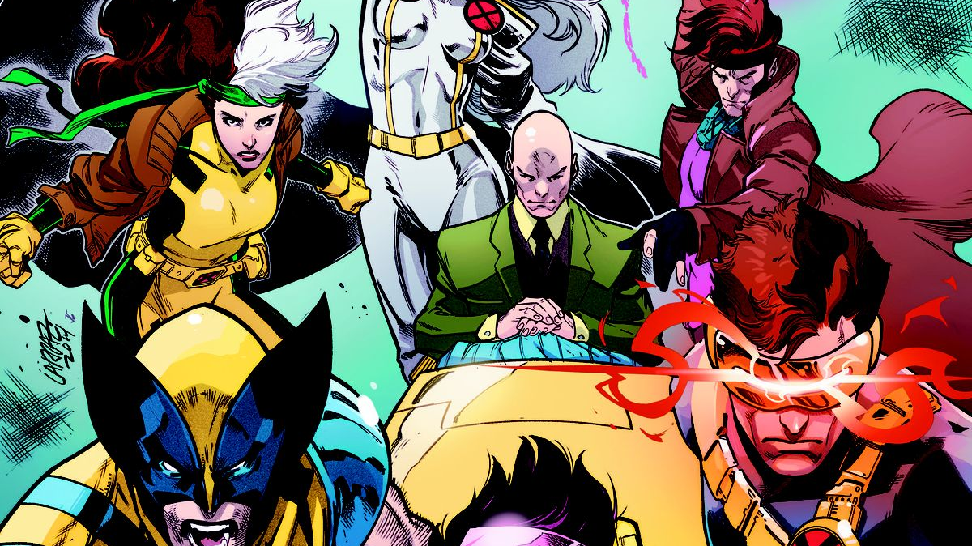

Slide 3
Mutants Catalogue
GET api/combat?attacker&defender
GET api/combat/epic?attacker&defender
GET api/mutants/{name}
POST api/mutants

Slide 4
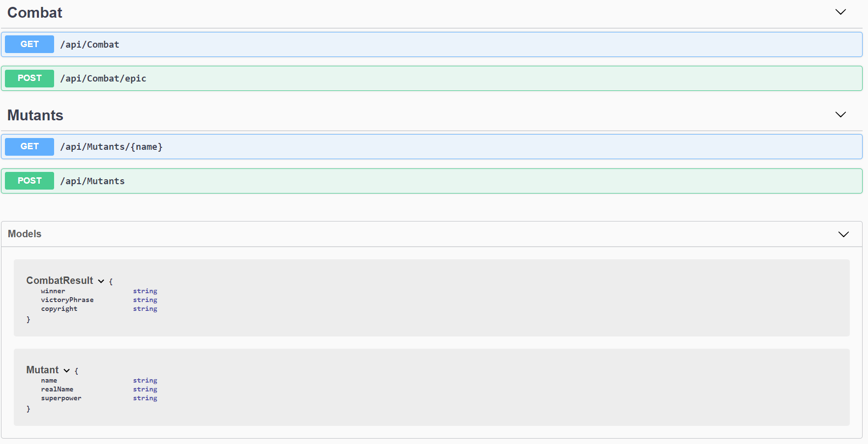

Slide 5
Создаем тестовый проект
<Project Sdk="Microsoft.NET.Sdk.Web"> <PropertyGroup><TargetFramework>netcoreapp2.2</TargetFramework</PropertyGroup>
<ItemGroup>
<PackageReference Include="Microsoft.AspNetCore.App"/>
<PackageReference Include="Microsoft.AspNetCore.Mvc.Testing" Version="2.2.0"/>
<PackageReference Include="Microsoft.NET.Test.Sdk" Version="15.9.0" />
<PackageReference Include="xunit" Version="2.4.0" />
<PackageReference Include="xunit.runner.visualstudio" Version="2.4.0" />
</ItemGroup>
</Project>

Slide 6
Создаем тестовый проект
<Project Sdk="Microsoft.NET.Sdk.Web"> <PropertyGroup><TargetFramework>netcoreapp2.2</TargetFramework</PropertyGroup>
<ItemGroup>
<PackageReference Include="Microsoft.AspNetCore.App"/>
<PackageReference Include="Microsoft.AspNetCore.Mvc.Testing" Version="2.2.0"/>
<PackageReference Include="Microsoft.NET.Test.Sdk" Version="15.9.0" />
<PackageReference Include="xunit" Version="2.4.0" />
<PackageReference Include="xunit.runner.visualstudio" Version="2.4.0" />
</ItemGroup>
</Project>

Slide 7
WebApplicationFactory
public class CombatFeature :
IClassFixture<WebApplicationFactory<Startup>>
{
private readonly WebApplicationFactory<Startup> factory;
public CombatFeature(WebApplicationFactory<Startup> factory)
{
this.factory = factory;
}
…

Slide 8
#1: Wolverine vs Magneto
[Fact]
public async Task Combat_MagnetoVsWolverine_MagnetoWins()
{
// arrange
var client = factory.CreateClient();
// act
var response = await client.
GetAsync("api/combat?attacker=Magneto&defender=Wolverine");
// assert
response.EnsureSuccessStatusCode();
var result = await response.Content.ReadAsAsync<CombatResult>();
Assert.Equal("Magneto", result.Winner);
}

Slide 9
#1: Wolverine vs Magneto
[Fact]
public async Task Combat_MagnetoVsWolverine_MagnetoWins()
{
// arrange
var client = factory.CreateClient();
// act
var response = await client.
GetAsync("api/combat?attacker=Magneto&defender=Wolverine");
// assert
response.EnsureSuccessStatusCode();
var result = await response.Content.ReadAsAsync<CombatResult>();
Assert.Equal("Magneto", result.Winner);
}

Slide 10
#1: Wolverine vs Magneto
[Fact]
public async Task Combat_MagnetoVsWolverine_MagnetoWins()
{
// arrange
var client = factory.CreateClient();
// act
var response = await client.
GetAsync("api/combat?attacker=Magneto&defender=Wolverine");
// assert
response.EnsureSuccessStatusCode();
var result = await response.Content.ReadAsAsync<CombatResult>();
Assert.Equal("Magneto", result.Winner);
}

Slide 11
#1: Wolverine vs Magneto
[Fact]
public async Task Combat_MagnetoVsWolverine_MagnetoWins()
{
// arrange
var client = factory.CreateClient();
// act
var response = await client.
GetAsync("api/combat?attacker=Magneto&defender=Wolverine");
// assert
response.EnsureSuccessStatusCode();
var result = await response.Content.ReadAsAsync<CombatResult>();
Assert.Equal("Magneto", result.Winner);
}

Slide 12
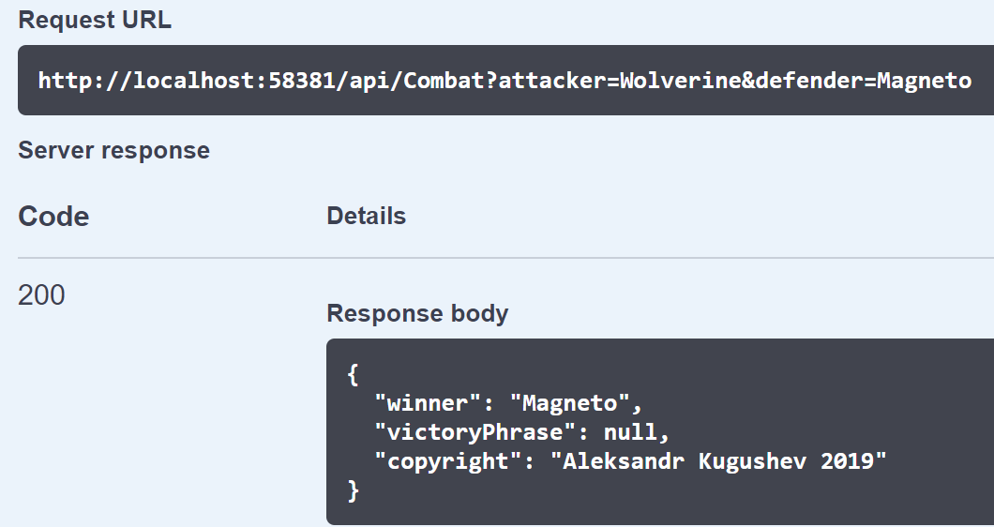

Slide 13
Copyright
appSettings.json
Copyright: Aleksandr Kugushev
appSettings.Development.json
CopyrightYear: 2019
Notes:
Разработчики захотят поменять год. Через год у нас отвалится тест

Slide 14
Наследник WebApplicationFactory
public class TestWebApplicationFactory : WebApplicationFactory<Startup> {
protected override IWebHostBuilder CreateWebHostBuilder() {
return WebHost.CreateDefaultBuilder().UseStartup<Startup>();
}
protected override void ConfigureWebHost(IWebHostBuilder builder){
var config = new Dictionary<string, string>{
["Domain:CopyrightYear"] = "42"
};
builder.ConfigureAppConfiguration(
b => b.AddInMemoryCollection(config));
base.ConfigureWebHost(builder);
}
}

