Slide 1
Immutability that doesn’t make you sick
Aleksandr Kugushev
Notes:
Источники мудрости в IT

Slide 2
The Codless Code. Case 15 Immutability
A novice was recently arrived from the Temple of Three Stones where only C was used. He was new to the ways of Java, and soon stumbled upon the immutability of Strings.
“I wish only to convert the contents of this field to mixed case!” he cried. “Yet this requires the construction of a StringBuffer and a new String subsequently, with many untouched characters copied twice between them! For what purpose were Strings designed thus?”
A learned sister heard, and advised him: “The brass coin passed from hand to hand may still be exchanged on the morrow; not so the egg.” The novice was enlightened.
Notes:
Послушник недавно прибыл из Храма Трёх Камней, где используется только язык C. Он был новичком в Java и вскоре наткнулся на неизменяемость строк. “Я хочу только поменять содержимое этого поля!” - воскликнул он. “Но для этого требуется создать объект StringBuffer и, впоследствии, новый объект String, дважды копируя множество нетронутых символов между ними! С какой целью были разработаны такие строки?” Учёная сестра услышала его и посоветовала: “Медную монету, передаваемую из рук в руки, всё ещё можно обменять на другой день, но только не яйцо”. И послушник просветился.

Slide 3
Plan
Advantages of using immutable entities and collections
Techniques to make entities immutable
How to make changes to immutable entity
Myths about immutable collections

Slide 4
Why?
Avoiding unexpected changes in huge code base
In memory cache
Multithreading
Snapshot semantic

Slide 5
Avoiding unexpected changes in huge code base
Result GetResult(Entity entity)
{
/* a lot of code */
var name = GetEntityName(entity);
/* a lot of code */
return LoadResult(name,
name == entity.Name);
}
public string GetEntityName(Entity entity)
{
string name = entity.Name;
/* a lot of code */
// Bugfix 666
entity.Name = $"Name: {entity.Name}";
/* a lot of code */
return name;
}

Slide 6
In memory cache
private readonly Dictionary<int, Entity> cache = new Dictionary<int, Entity>();
void DoSomething(int id)
{
/* a lot of code */
if (!cache.TryGetValue(id, out var entity))
entity = cache[id] = GetEntity(id);
/* a lot of code */
//Bugfix 1313
entity.Name = "Hello World!";
}
Entity GetEntity(int id) { /*---*/ }

Slide 7
Multithreading and snapshot semantic
Thread1
Thread2
public Entity Entity { get; private set; }
void DoSomething()
{
var entity = Entity;
Console.WriteLine(Entity.Name);
Console.WriteLine(entity.Name);
/* a lot of code */
Console.WriteLine(Entity.Name);
Console.WriteLine(entity.Name);
}
/*---*/
void UpdateEntityName(string name)
{
Entity.Name = name;
}

Slide 8
Immutable entities
Records
Constructor
Builder
Wrapper
Immutable interface

Slide 9
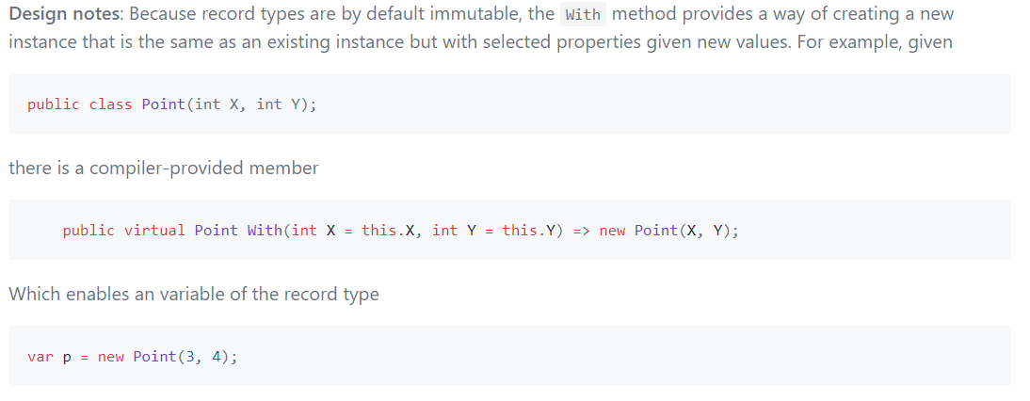
Records

Slide 10
Constructor
class Bicycle
{
public Bicycle(int id, string name)
{
Id = id;
Name = name;
}
public int Id { get; }
public string Name { get; }
}

Slide 11
The Codless Code. Case 15 Immutability
Soon the novice was defining all his classes to be immutable. Not one property could be modified: a new instance had to be created with the necessary changes. His constructors were sometimes astonishingly large and complex.
The Java master was told of this, and said: “Let the form of an egg be cast in brass, and given to the nun to breakfast upon.”
In this manner was the nun charged with correcting the novice.
Notes:
Вскоре послушник стал определять все классы неизменяемыми. Ни одно свойство нельзя было менять: только при создании нового экземпляра можно было делать необходимые изменения. Его конструкторы иногда были удивительно большими и сложными.Учитель Java узнал об этом и сказал: “Пусть яйцо отольют из меди подадут монахине на завтрак.”Таким образом была наказана монахиня за свой совет послушнику.

Slide 12
Constructor ☹
class Car
{
public Car(int id, string model, string modelFull, string mark, int certificate, int issuerId,
string issuePlace, DateTime issueDate, IReadOnlyList<IOwner> owners)
{
Id = id;
Model = model;
ModelFull = modelFull;
Mark = mark;
Certificate = certificate;
IssuerId = issuerId;
IssuePlace = issuePlace;
IssueDate = issueDate;
Owners = owners;
}
/*…*/
}
Notes:
- Проверка в compile time
- Много аргументов в конструкторе
- Сериализация
- Entity Framework
+ Simple
+ Automapper can

Slide 13
Constructor +/-
Advantages
Disadvantages
Simple
Well known
No compile time validation
Ugly if big
No serialization
No Entity Framework

Slide 14
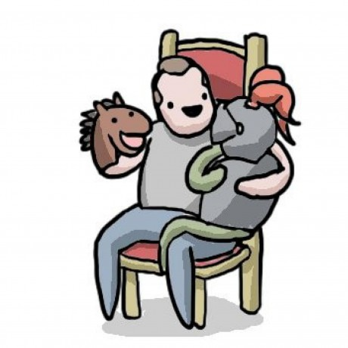
Builder
class Bicycle
{
public Bicycle(Builder builder)
{
Id = builder.Id;
Name = builder.Name;
}
public int Id { get; }
public string Name { get; }
public class Builder
{
public int Id { get; set; }
public string Name { get; set; }
}
}
Notes:
+ Popsticle immutability
+ POCO class

Slide 15
Builder ☹
class Car
{
public Car(Builder builder)
{
Id = builder.Id;
Model = builder.Model;
ModelFull = builder.ModelFull;
Mark = builder.Mark;
Certificate = builder.Certificate;
IssuerId = builder.IssuerId;
IssuePlace = builder.IssuePlace;
IssueDate = builder.IssueDate;
Owners = builder.Owners;
}
/*---*/
public int Id { get; }
public string Model { get; }
public string ModelFull { get; }
public string Mark { get; }
public int Certificate { get; }
public int IssuerId { get; }
public string IssuePlace { get; }
public DateTime IssueDate { get; }
public IReadOnlyList<IOwner> Owners { get; }
public class Builder
{
public int Id { get; set; }
public string Model { get; set; }
public string ModelFull { get; set; }
public string Mark { get; set; }
public int Certificate { get; set; }
public int IssuerId { get; set; }
public string IssuePlace { get; set; }
public DateTime IssueDate { get; set; }
public IReadOnlyList<IOwner> Owners { get; set; }
}
}
Notes:
- No compile time

Slide 16
Builder +/-
Advantages
Disadvantages
Still Simple
Well known
Constructor doesn’t change
Support serialization
Support Entity Framework, but…
No compile time validation
Ugly if big

Slide 17
Wrapper
class Wrapper<T>
{
public Wrapper(T entity)
public V Get<V>(Func<T, V> getter);
}

Slide 18
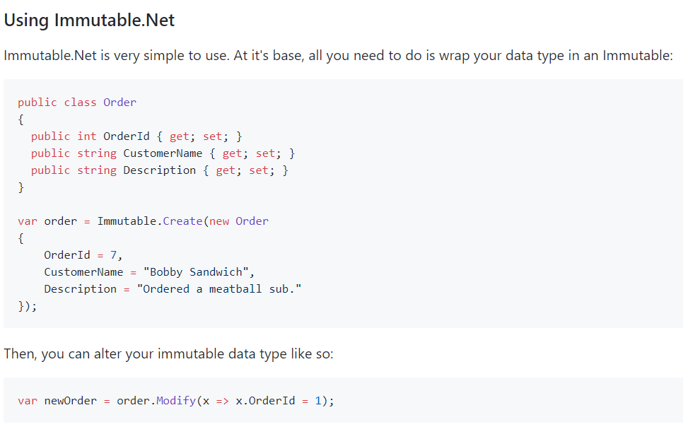
github.com/mattnischan/Immutable.Net

Slide 19
Wrapper: Example
class Credentials<T>
{
/*MUTABLE LEGACY*/
}
class Address
{
/*MUTABLE LEGACY*/
}
class BirthInformation
{
/*MUTABLE LEGACY*/
}
class Owner
{
public Owner(int id, Credentials<RealEntity> credentials, Address address, BirthInformation birthInformation)
{
Id = id;
Credentials = Immutable.Create(credentials);
BirthInformation = Immutable.Create(birthInformation);
Address = Immutable.Create(address);
}
public int Id { get; }
public Immutable<Credentials<RealEntity>> Credentials { get; }
public Immutable<Address> Address { get; }
public Immutable<BirthInformation> BirthInformation { get; }
}

Slide 20
Wrapper +/-
Advantages
Disadvantages
We can use mutable POCO classes!!!
Support serialization
Support Entity Framework
Require external dependency
It makes code a little bit more complicated

Slide 21
Immutable interface
Available only inside a creator
Available everywhere
class Bicycle : IBicycle
{
public int Id { get; set; }
public string Name { get; set; }
}
interface IBicycle
{
int Id { get; }
string Name { get; }
}

Slide 22
Immutable interface ☺
interface ICar
{
int Id { get; }
string Model { get; }
string ModelFull { get; }
string Mark { get; }
int Certificate { get; }
int IssuerId { get; }
string IssuePlace { get; }
DateTime IssueDate { get; }
IReadOnlyList<IOwner> Owners { get; }
}
class Car: ICar
{
public int Id { get; set; }
public string Model { get; set; }
public string ModelFull { get; set; }
public string Mark { get; set; }
public int Certificate { get; set; }
public int IssuerId { get; set; }
public string IssuePlace { get; set; }
public DateTime IssueDate { get; set; }
public IReadOnlyList<IOwner> Owners { get; set; }
}

Slide 23
Immutable interface +/-
Advantages
Disadvantages
Compile time validation
Performance
Mutable and immutable states of an entity
Support deserialization
Support Entity Framework
Specification via Expression<Predicate<Entity>>
Verbose
Vulnerable against cast
No methods*

Slide 24
The Codless Code. Case 96 Stateless
It is the duty of every monk to call upon master Kaimu at least once during their time at the temple. When the master opens his door the monk must bow and ask: “What is the great joy of stateless services?”
Without fail master Kaimu will reply: “Ten thousand guests fed by a single grain of rice.”
The monk must then ask: “And what is the great sorrow?”
Kaimu will reply: “The great sorrow of what?”
Notes:
Каждый монах должен позвать учителя Кайму как минимум раз за время пребывания в храме. Когда учитель откроет дверь, монах должен поклониться и спросить: “Какой большой плюс у сервисов без состояния?” Кайму наверняка ответит: “Десять тысяч гостей кормятся одним зерном риса”. Затем монах должен спросить: “А какой большой минус?” Кайму ответит: “Большой минус у чего?”

Slide 25
With pattern
class Bicycle
{
// …
public Bicycle WithName(string value)
{
return value == Name
? this
: new Bicycle(Id, value);
}
}

Slide 26
Anti-pattern “With builder”
public ICar With(Action<Car> builder)
{
var clone = (Car)MemberwiseClone();
builder(clone);
return clone;
}

Slide 27
Dangerous “With builder”
class Car : ICar
{
public Owner CurrentOwner { get; set; }
public IEntity With(Action<Car> builder)
{
var clone = (Car)MemberwiseClone();
builder(clone);
return clone;
}
}
class Owner : IOwner
{
public string Name { get; set; }
}
void Test_SellCar()
{
ICar car = new Car
{
CurrentOwner = new Owner
{
Name = "Aleksandr Kugushev"
}
};
ICar soldCar = car.With(e
=> e.CurrentOwner.Name = "Jon Skeet");
Assert.Equal(
"Aleksandr Kugushev",
car.CurrentOwner.Name);
}

Slide 28
Myth 1: Immutable collections are useless
class Car
{
// ...
public IReadOnlyList<IOwner> Owners { get; private set; }
public Car AddItems(IOwner owner)
{
return new Car
{
Owners = Owners.Append(owner).ToList()
};
}
}

Slide 29
Immutable collections
Instead of comparing immutable collections with a mutable collection we should consider it as an alternative to using mutable collections in an immutable way.

Slide 30
Myth 2: We should use Immutable collections everywhere
 | Mutable (amortized) | Mutable (worst case) | Immutable
Stack.Push | O(1) | O(n) | O(1)
Queue.Enqueue | O(1) | O(n) | O(1)
List.Add | O(1) | O(n) | O(log n)
HashSet.Add | O(1) | O(n) | O(log n)
SortedSet.Add | O(log n) | O(n) | O(log n)
Dictionary.Add | O(1) | O(n) | O(log n)
SortedDictionary.Add | O(log n) | O(n log n) | O(log n)

Slide 31
Benchmark: Append
Mean: 1,193.7 ns
Mean: 365.9 ns
[Benchmark]
object List_Add()
{
return BigList
.Append(42)
.ToList()
.AsReadOnly();
}
[Benchmark]
object ImmutableList_Add()
{
return BigImmutableList
.Add(42);
}

Slide 32
Benchmark: Select
Mean: 133,267.5 ns
Mean: 276,739.8 ns
[Benchmark]
object List_Select()
{
return BigList
.Select(i => i.ToString())
.ToList();
}
[Benchmark]
object ImmutableList_Select()
{
return BigImmutableList
.Select(i => i.ToString())
.ToImmutableList();
}

Slide 33
Benchmark: Where
Mean: 3,990.8 ns
Mean: 74,251.9 ns
[Benchmark]
object List_Where()
{
return BigList
.Where(i => i < 100)
.ToList();
}
[Benchmark]
object ImmutableList_Where()
{
return BigImmutableList
.Where(i => i < 100)
.ToImmutableList();
}

Slide 34
Benchmark: Dictionary Get
Mean: 20.47 ns
Mean: 109.25 ns
[Benchmark]
object Dictianary_Get()
{
return Big[42];
}
[Benchmark]
object ImmutablDictionary_Get()
{
return BigImmutable[42];
}

Slide 35
Benchmark: New Dictionary Set
Mean: 35,392.16 ns
Mean: 4,628.17 ns
[Benchmark]
object Dictianary_Set()
{
var newDict =
new Dictionary<int, string>(Big);
newDict[42] = "123";
newDict.Add(Count + 1, "new");
return newDict;
}
[Benchmark]
object ImmutableDictionary_Set()
{
var newDict = BigImmutable
.SetItem(42, "123");
return newDict
.Add(Count + 1, "new");
}

Slide 36
All benchmarks
Method | Count | Mean | Error | StdDev
List_Add | 1000 | 1,193.7 ns | 28.018 ns | 31.14 ns
ImmutableList_Add | 1000 | 365.9 ns | 7.324 ns | 11.18 ns
List_Select | 1000 | 133,267.5 ns | 3,220.017 ns | 3,445.381 ns
ImmutableList_Select | 1000 | 276,739.8 ns | 5,488.651 ns | 10,705.193 ns
List_Where | 1000 | 3,990.8 ns | 54.505 ns | 50.984 ns
ImmutableList_Where | 1000 | 74,251.9 ns | 896.101 ns | 838.214 ns
Dictianary_Get | 1000 | 20.47 ns | 0.3230 ns | 0.3021 ns
ImmutableDictionary_Get | 1000 | 109.25 ns | 1.9552 ns | 1.5265 ns
Dictianary_Set | 1000 | 35,392.16 ns | 714.6436 ns | 668.4780 ns
ImmutableDictionary_Set | 1000 | 4,628.17 ns | 32.1994 ns | 30.1194 ns

Slide 37
Useful presentations and articles
Jon Skeet — The changing state of immutability C#
Msdn blog:
Immutability in C# Part One
Immutability in C# Part Two
Functional C#: Immutability
Functional Programming In-Depth (12) Immutability, Anonymous Type, and Tuple

Slide 38
Conclusion
Notes:
Используйте все возможности с умом
Неизменяемость это не экстрим, а вполне реальный подход
Не бойтесь иммутабельности. Если ее приготовить правильно, от нее Вас точно не стошнит.

